Slide 2
?
Where in
the Word

Slide 3
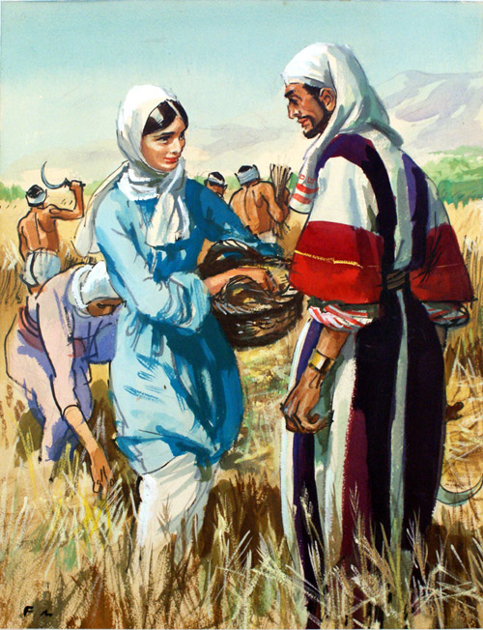
Here’s how it works
A. Ruth 1:16-17
B. Ruth 2:8-9
C. Ruth 3:7-8
D. Ruth 4:1-2
www.bookpalace.com

Slide 4
Ruth 2:8 Then said Boaz unto Ruth, Hearest thou not, my daughter? Go not to glean in another field, neither go from hence, but abide here fast by my maidens: ⁹ Let thine eyes be on the field that they do reap, and go thou after them: have I not charged the young men that they shall not touch thee? and when thou art athirst, go unto the vessels, and drink of that which the young men have drawn.
The
B
answer is
. . .

Slide 5
Old Testament
1
2
3
4
5
6
7
8
9
10
11
12
13
14
15
16
17
18
19
20
Gospels
1
2
3
4
5
6
7
8
9
10
11
12
13
14
15
16
17
18
19
20
Tie Breakers

Slide 6
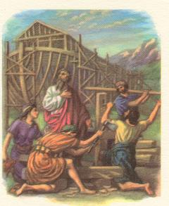
Old Testament #1
A. Genesis 2-3
B. Genesis 6-9
C. Genesis 10-11
D. Genesis 12-13
http://effatha.dk/bibelbilleder/en_vis.asp?mater=4

Slide 7
Genesis 6:14 Make thee an ark of gopher wood; rooms shalt thou make in the ark, and shalt pitch it within and without with pitch. ¹⁵ And this is the fashion which thou shalt make it of: The length of the ark shall be three hundred cubits, the breadth of it fifty cubits, and the height of it thirty cubits.
The
B
answer is
. . .

Slide 8
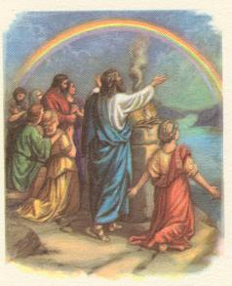
Old Testament #2
A. Genesis 6
B. Genesis 7
C. Genesis 8
D. Genesis 9
www.effatha.dk/bibelbilleder/en_vis.asp?mater=25

Slide 9
Genesis 9:13 I do set my bow in the cloud, and it shall be for a token of a covenant between me and the earth. … ¹⁶ And the bow shall be in the cloud; and I will look upon it, that I may remember the everlasting covenant between God and every living creature of all flesh that is upon the earth.
The
D
answer is
. . .

Slide 10
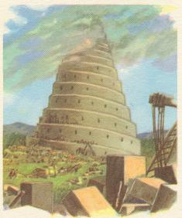
Old Testament #3
A. Genesis 10
B. Genesis 11
C. Genesis 12
D. Genesis 13
www.effata.dk/bibelbilleder/en_vis.asp?mater=25

Slide 11
Genesis 11:3 And they said one to another, Go to, let us make brick, and burn them throughly. And they had brick for stone, and slime had they for morter. ⁴ And they said, Go to, let us build us a city and a tower, whose top may reach unto heaven; and let us make us a name, lest we be scattered abroad upon the face of the whole earth.
The
B
answer is
. . .

Slide 12
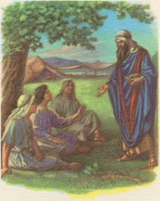
Old Testament #4
A. Genesis 18
B. Genesis 19
C. Genesis 21
D. Genesis 22
www.effata.dk/bibelbilleder/en_vis.asp?mater=25

Slide 13
Genesis 18:1 And the LORD appeared unto (Abraham) in the plains of Mamre: and he sat in the tent door in the heat of the day; ² And he lift up his eyes and looked, and, lo, three men stood by him: and when he saw them, he ran to meet them from the tent door, and bowed himself toward the ground …¹⁰ And (the LORD) said, I will certainly return unto thee according to the time of life; and, lo, Sarah thy wife shall have a son. And Sarah heard it in the tent door, which was behind him.
The
A
answer is
. . .

Slide 14
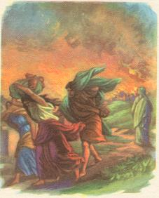
Old Testament #5
A. Genesis 18
B. Genesis 19
C. Genesis 21
D. Genesis 22
www.effata.dk/bibelbilleder/en_vis.asp?mater=25

Slide 15
Genesis 19:24 Then the LORD rained upon Sodom and upon Gomorrah brimstone and fire from the LORD out of heaven; ²⁵ And he overthrew those cities, and all the plain, and all the inhabitants of the cities, and that which grew upon the ground. ²⁶ But his wife looked back from behind him, and she became a pillar of salt.
The
B
answer is
. . .

Slide 16
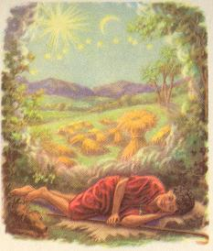
Old Testament #6
A. Genesis 24
B. Genesis 28
C. Genesis 37
D. Genesis 41
www.effata.dk/bibelbilleder/en_vis.asp?mater=25

Slide 17
Genesis 37:5 And Joseph dreamed a dream, and he told it his brethren: and they hated him yet the more. ⁶ And he said unto them, Hear, I pray you, this dream which I have dreamed: ⁷ For, behold, we were binding sheaves in the field, and, lo, my sheaf arose, and also stood upright; and, behold, your sheaves stood round about, and made obeisance to my sheaf. ⁸ And his brethren said to him, Shalt thou indeed reign over us? or shalt thou indeed have dominion over us? And they hated him yet the more for his dreams, and for his words.
The
C
answer is
. . .

Slide 18
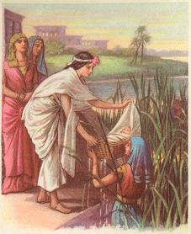
Old Testament #7
A. Exodus 1
B. Exodus 2
C. Exodus 3
D. Exodus 4
www.effata.dk/bibelbilleder/en_vis.asp?mater=25

Slide 19
Exodus 2:1 And there went a man of the house of Levi, and took to wife a daughter of Levi. ² And the woman conceived, and bare a son: and when she saw him that he was a goodly child, she hid him three months. ³ And when she could not longer hide him, she took for him an ark of bulrushes, and daubed it with slime and with pitch, and put the child therein; and she laid it in the flags by the river’s brink. ⁴ And his sister stood afar off, to wit what would be done to him.
The
B
answer is
. . .

Slide 20
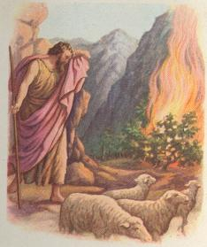
Old Testament #8
A. Exodus 3
B. Exodus 6
C. Exodus 9
D. Exodus 12
www.effata.dk/bibelbilleder/en_vis.asp?mater=25

Slide 21
Exodus 3:1 Now Moses kept the flock of Jethro his father in law, the priest of Midian: and he led the flock to the backside of the desert, and came to the mountain of God, even to Horeb. ² And the angel of the LORD appeared unto him in a flame of fire out of the midst of a bush: and he looked, and, behold, the bush burned with fire, and the bush was not consumed. ³ And Moses said, I will now turn aside, and see this great sight, why the bush is not burnt. ⁴ And when the LORD saw that he turned aside to see, God called unto him out of the midst of the bush …
The
A
answer is
. . .

Slide 22
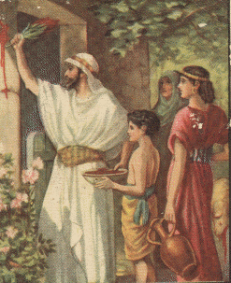
Old Testament #9
A. Exodus 10
B. Exodus 11
C. Exodus 12
D. Exodus 13
www.effatha.dk/bibelbilleder/en_vis.asp?mater=25

Slide 23
Exodus 12:5 Your lamb shall be without blemish, a male of the first year: ye shall take it out from the sheep, or from the goats: ⁶ And ye shall keep it up until the fourteenth day of the same month: and the whole assembly of the congregation of Israel shall kill it in the evening. ⁷ And they shall take of the blood, and strike it on the two side posts and on the upper door post of the houses, wherein they shall eat it.
The
C
answer is
. . .

Slide 24
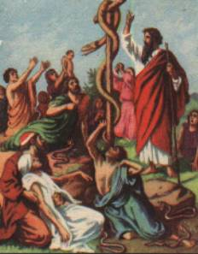
Old Testament #10
A. Exodus 17
B. Leviticus 16
C. Numbers 21
D. Deuteronomy 5
www.effata.dk/bibelbilleder/en_vis.asp?mater=25

Slide 25
Numbers 21:6 And the LORD sent fiery serpents among the people, and they bit the people; and much people of Israel died. ⁷ Therefore the people came to Moses, and said, We have sinned, for we have spoken against the LORD, and against thee; pray unto the LORD, that he take away the serpents from us. And Moses prayed for the people. ⁸ And the LORD said unto Moses, Make thee a fiery serpent, and set it upon a pole: and it shall come to pass, that every one that is bitten, when he looketh upon it, shall live. ⁹ And Moses made a serpent of brass, and put it upon a pole, and it came to pass, that if a serpent had bitten any man, when he beheld the serpent of brass, he lived.
The
C
answer is
. . .

Slide 26
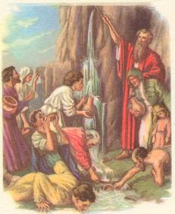
Old Testament #11
A. Exodus 17
B. Exodus 18
C. Exodus 19
D. Exodus 20
www.effata.dk/bibelbilleder/en_vis.asp?mater=25

Slide 27
Exodus 17:5 And the LORD said unto Moses, Go on before the people, and take with thee of the elders of Israel; and thy rod, wherewith thou smotest the river, take in thine hand, and go. ⁶ Behold, I will stand before thee there upon the rock in Horeb; and thou shalt smite the rock, and there shall come water out of it, that the people may drink. And Moses did so in the sight of the elders of Israel.
The
A
answer is
. . .

Slide 28
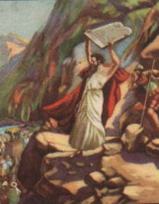
Old Testament #12
A. Exodus 19
B. Exodus 20
C. Exodus 24
D. Exodus 32
www.effata.dk/bibelbilleder/en_vis.asp?mater=25

Slide 29
Exodus 32:5 And Moses turned, and went down from the mount, and the two tables of the testimony were in his hand: the tables were written on both their sides; on the one side and on the other were they written. ¹⁶ And the tables were the work of God, and the writing was the writing of God, graven upon the tables. …¹⁹ And it came to pass, as soon as he came nigh unto the camp, that he saw the calf, and the dancing: and Moses’ anger waxed hot, and he cast the tables out of his hands, and brake them beneath the mount.
The
D
answer is
. . .

Slide 30
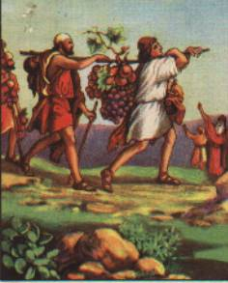
Old Testament #13
A. Numbers 13
B. Numbers 14
C. Joshua 2
D. Joshua 6
www.effata.dk/bibelbilleder/en_vis.asp?mater=25

Slide 31
Numbers 13:21 So they went up, and searched the land from the wilderness of Zin unto Rehob, as men come to Hamath. ²² And they ascended by the south, and came unto Hebron; where Ahiman, Sheshai, and Talmai, the children of Anak, were. (Now Hebron was built seven years before Zoan in Egypt.) ²³ And they came unto the brook of Eshcol, and cut down from thence a branch with one cluster of grapes, and they bare it between two upon a staff; and they brought of the pomegranates, and of the figs.
The
A
answer is
. . .

Slide 32
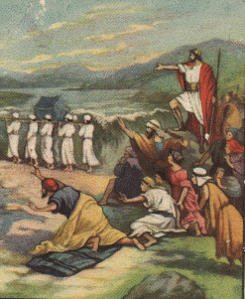
Old Testament #14
A. Exodus 13
B. Exodus 14
C. Joshua 1-2
D. Joshua 3-4
www.effata.dk/bibelbilleder/en_vis.asp?mater=25

Slide 33
Joshua 3:1 And Joshua rose early in the morning; and they removed from Shittim, and came to Jordan, he and all the children of Israel, and lodged there before they passed over. ² And it came to pass after three days, that the officers went through the host; ³ And they commanded the people, saying, When ye see the ark of the covenant of the LORD your God, and the priests the Levites bearing it, then ye shall remove from your place, and go after it.
The
D
answer is
. . .

Slide 34
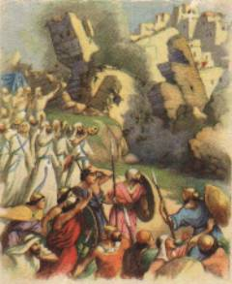
Old Testament #15
A. Joshua 2
B. Joshua 3
C. Joshua 6
D. Joshua 7
www.effata.dk/bibelbilleder/en_vis.asp?mater=25

Slide 35
Joshua 6:20 So the people shouted when the priests blew with the trumpets: and it came to pass, when the people heard the sound of the trumpet, and the people shouted with a great shout, that the wall fell down flat, so that the people went up into the city, every man straight before him, and they took the city.
The
C
answer is
. . .

Slide 36
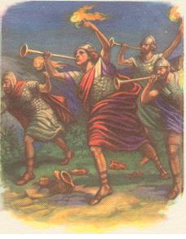
Old Testament #16
A. Joshua 6
B. Joshua 10
C. Judges 4-5
D. Judges 6-7
www.effata.dk/bibelbilleder/en_vis.asp?mater=25

Slide 37
Judges 7:19 So Gideon, and the hundred men that were with him, came unto the outside of the camp in the beginning of the middle watch; and they had but newly set the watch: and they blew the trumpets, and brake the pitchers that were in their hands. ²⁰ And the three companies blew the trumpets, and brake the pitchers, and held the lamps in their left hands, and the trumpets in their right hands to blow withal: and they cried, The sword of the LORD, and of Gideon.
The
D
answer is
. . .

Slide 38
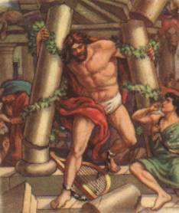
Old Testament #17
A. Judges 13
B. Judges 14
C. Judges 15
D. Judges 16
www.effata.dk/bibelbilleder/en_vis.asp?mater=25

Slide 39
Judges 16:28 And Samson called unto the LORD, and said, O Lord GOD, remember me, I pray thee, and strengthen me, I pray thee, only this once, O God, that I may be at once avenged of the Philistines for my two eyes. ²⁹ And Samson took hold of the two middle pillars upon which the house stood, and on which it was borne up, of the one with his right hand, and of the other with his left. ³⁰ And Samson said, Let me die with the Philistines. And he bowed himself with all his might; and the house fell upon the lords, and upon all the people that were therein.
The
D
answer is
. . .

Slide 40
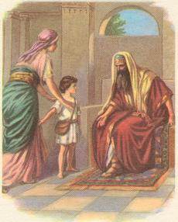
Old Testament #18
A. 1 Samuel 1
B. 1 Samuel 2
C. 1 Samuel 3
D. 1 Samuel 4
www.effata.dk/bibelbilleder/en_vis.asp?mater=25

Slide 41
1 Samuel 1:20 Wherefore it came to pass, when the time was come about after Hannah had conceived, that she bare a son, and called his name Samuel, saying, Because I have asked him of the LORD. … ²⁴ And when she had weaned him, she took him up with her, with three bullocks, and one ephah of flour, and a bottle of wine, and brought him unto the house of the LORD in Shiloh: and the child was young. ²⁵ And they slew a bullock, and brought the child to Eli.
The
A
answer is
. . .

Slide 42
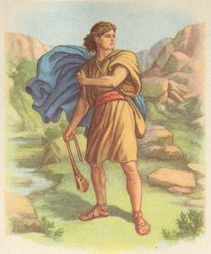
Old Testament #19
A. 1 Samuel 16
B. 1 Samuel 17
C. 1 Samuel 18
D. 1 Samuel 19
www.effata.dk/bibelbilleder/en_vis.asp?mater=25

Slide 43
1 Samuel 17:40 And he took his staff in his hand, and chose him five smooth stones out of the brook, and put them in a shepherd’s bag which he had, even in a scrip; and his sling was in his hand: and he drew near to the Philistine. ⁴¹ And the Philistine came on and drew near unto David … ⁴⁹ And David put his hand in his bag, and took thence a stone, and slang it, and smote the Philistine in his forehead, that the stone sunk into his forehead; and he fell upon his face to the earth.
The
B
answer is
. . .

Slide 44
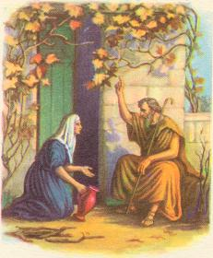
Old Testament #20
A. 1 Kings 17
B. 1 Kings 18
C. 2 Kings 4
D. 2 Kings 5
www.effata.dk/bibelbilleder/en_vis.asp?mater=25

Slide 45
1 Kings 17:8 And the word of the LORD came unto (Elijah), saying, ⁹ Arise, get thee to Zarephath, which belongeth to Zidon, and dwell there: behold, I have commanded a widow woman there to sustain thee. ¹⁰ So he arose and went to Zarephath. And when he came to the gate of the city, behold, the widow woman was there gathering of sticks: and he called to her, and said, Fetch me, I pray thee, a little water in a vessel, that I may drink.
The
A
answer is
. . .

Slide 46
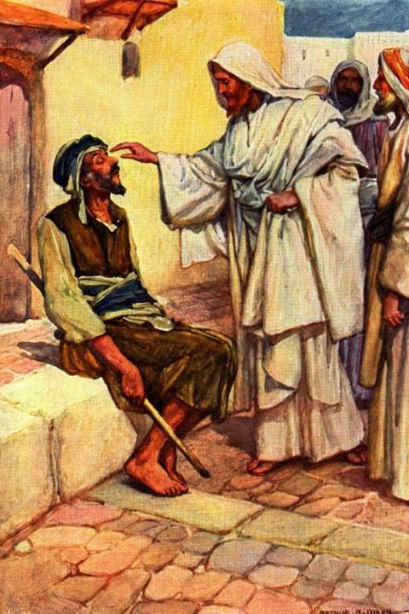
Gospels #1
A. Matthew 8:2-3
B. Mark 2:3
C. Mark 7:32
D. Luke 4:18
www.drsmdavis.com/content/ Jes_heals_man.jpg

Slide 47
Luke 4:18 The Spirit of the Lord is upon me, because he hath anointed me to preach the gospel to the poor; he hath sent me to heal the brokenhearted, to preach deliverance to the captives, and recovering of sight to the blind, to set at liberty them that are bruised …
The
D
answer is
. . .

Slide 48
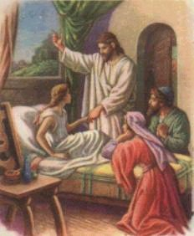
Gospels #2
A. Mark 5:22-23
B. Luke 7:11-15
C. John 5:8
D. John 11:43-44
www.effata.dk/bibelbilleder/en_vis.asp?mater=33

Slide 49
Mark 5:22 And, behold, there cometh one of the rulers of the synagogue, Jairus by name; and when he saw him, he fell at his feet, ²³ And besought him greatly, saying, My little daughter lieth at the point of death: I pray thee, come and lay thy hands on her, that she may be healed; and she shall live.
The
A
answer is
. . .

Slide 50
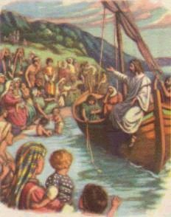
Gospels #3
A. Matthew 8:23-24
B. Matthew 13:2
C. Mark 1:19
D. John 21:3
www.effata.dk/bibelbilleder/en_vis.asp?mater=32

Slide 51
Matthew 13:1 The same day went Jesus out of the house, and sat by the sea side. ² And great multi-tudes were gathered together unto him, so that he went into a ship, and sat; and the whole multitude stood on the shore.
The
B
answer is
. . .

Slide 52
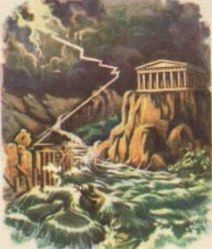
Gospels #4
A. Matthew 7:24-27
B. Matthew 13:3-9
C. Luke 10:30-37
D. Luke 18:9-14
www.effata.dk/bibelbilleder/en_vis.asp?mater=31

Slide 53
Matthew 7:24 Therefore whosoever heareth these sayings of mine, and doeth them, I will liken him unto a wise man, which built his house upon a rock: ²⁵ And the rain descended, and the floods came, and the winds blew, and beat upon that house; and it fell not: for it was founded upon a rock. ²⁶ And every one that heareth these sayings of mine, and doeth them not, shall be likened unto a foolish man, which built his house upon the sand: ²⁷ And the rain descended, and the floods came, and the winds blew, and beat upon that house; and it fell: and great was the fall of it.
The
A
answer is
. . .

Slide 54
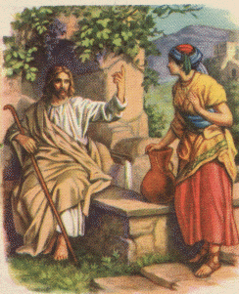
Gospels #5
A. Matthew 9:20
B. Mark 7:25-26
C. Luke 7:37-38
D. John 4:5-7
www.effata.dk/bibelbilleder/en_vis.asp?mater=34

Slide 55
John 4:5 Then cometh he to a city of Samaria, which is called Sychar, near to the parcel of ground that Jacob gave to his son Joseph. ⁶ Now Jacob’s well was there. Jesus therefore, being wearied with his journey, sat thus on the well: and it was about the sixth hour. ⁷ There cometh a woman of Samaria to draw water: Jesus saith unto her, Give me to drink.
The
D
answer is
. . .

Slide 56
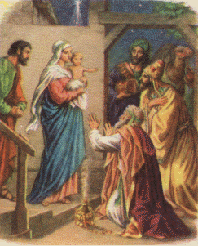
Gospels #6
A. Matthew 1:18
B. Matthew 2:1-2,11
C. Luke 2:15-16
D. Luke 2:25-32
www.effata.dk/bibelbilleder/en_vis.asp?mater=25

Slide 57
Matthew 2:1 Now when Jesus was born in Bethlehem of Judaea in the days of Herod the king, behold, there came wise men from the east to Jerusalem, ² Saying, Where is he that is born King of the Jews? for we have seen his star in the east, and are come to worship him … ¹¹ And when they were come into the house, they saw the young child with Mary his mother, and fell down, and worshipped him …
The
B
answer is
. . .

Slide 58
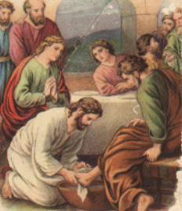
Gospels #7
A. Matthew 10:14
B. Mark 5:22
C. Luke 7:37-38
D. John 13:4-5
www.effata.dk/bibelbilleder/en_vis.asp?mater=51

Slide 59
John 13:4 He riseth from supper, and laid aside his garments; and took a towel, and girded himself. ⁵ After that he poureth water into a bason, and began to wash the disciples’ feet, and to wipe them with the towel wherewith he was girded.
The
D
answer is
. . .

Slide 60
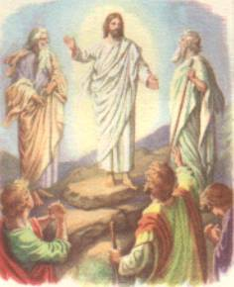
Gospels #8
A. Matthew 17:1-3
B. Mark 6:46
C. Luke 4:5
D. John 6:15
www.effata.dk/bibelbilleder/en_vis.asp?mater=44

Slide 61
Matthew 17:1 And after six days Jesus taketh Peter, James, and John his brother, and bringeth them up into an high mountain apart, ² And was transfigured before them: and his face did shine as the sun, and his raiment was white as the light. ³ And, behold, there appeared unto them Moses and Elias talking with him.
The
A
answer is
. . .

Slide 62
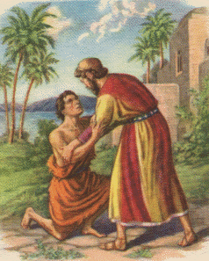
Gospels #9
A. Luke 10:30-37
B. Luke 15:3-7
C. Luke 15:11-32
D. Luke 16:19-31
www.effata.dk/bibelbilleder/en_vis.asp?mater=39

Slide 63
Luke 15:11 And he said, A certain man had two sons: ¹² And the younger of them said to his father, Father, give me the portion of goods that falleth to me. And he divided unto them his living. ¹³ And not many days after the younger son gathered all together, and took his journey into a far country, and there wasted his substance with riotous living. … ²⁰ And he arose, and came to his father. But when he was yet a great way off, his father saw him, and had compassion, and ran, and fell on his neck, and kissed him. … ³² It was meet that we should make merry, and be glad: for this thy brother was dead, and is alive again; and was lost, and is found.
The
C
answer is
. . .

Slide 64
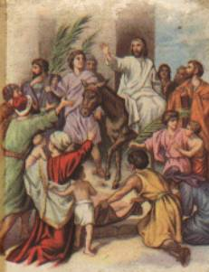
Gospels #10
A. Matthew 21:6-9
B. Mark 11:15
C. John 2:13-16
D. John 7:14-15
www.effata.dk/bibelbilleder/en_vis.asp?mater=50

Slide 65
Matthew 21:6 And the disciples went, and did as Jesus commanded them, ⁷ And brought the ass, and the colt, and put on them their clothes, and they set him thereon. ⁸ And a very great multitude spread their garments in the way; others cut down branches from the trees, and strawed them in the way. ⁹ And the multi-tudes that went before, and that followed, cried, saying, Hosanna to the Son of David: Blessed is he that cometh in the name of the Lord; Hosanna in the highest.
The
A
answer is
. . .

Slide 66
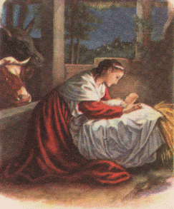
Gospels #11
A. Matthew 18:2-3
B. Mark 10:13
C. Luke 2:11-12
D. Luke 18:16
www.effata.dk/bibelbilleder/en_vis.asp?mater=23

Slide 67
Luke 2:11 For unto you is born this day in the city of David a Saviour, which is Christ the Lord. ¹² And this shall be a sign unto you; Ye shall find the babe wrap-ped in swaddling clothes, lying in a manger.
The
C
answer is
. . .

Slide 68
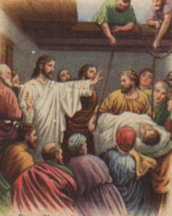
Gospels #12
A. Matthew 8:2-3
B. Mark 2:3-4
C. Mark 7:32
D. Luke 4:33-36
www.effata.dk/bibelbilleder/en_vis.asp?mater=35

Slide 69
Mark 2:3 And they come unto him, bringing one sick of the palsy, which was borne of four. ⁴ And when they could not come nigh unto him for the press, they uncovered the roof where he was: and when they had broken it up, they let down the bed wherein the sick of the palsy lay.
The
B
answer is
. . .

Slide 70
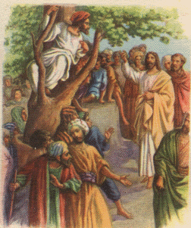
Gospels #13
A. Matthew 21:18-22
B. Mark 13:28-31
C. Luke 13:6-9
D. Luke 19:1-10
www.effata.dk/bibelbilleder/en_vis.asp?mater=46

Slide 71
Luke 19:1 And Jesus entered and passed through Jericho. ² And, behold, there was a man named Zacchaeus, which was the chief among the publicans, and he was rich. ³ And he sought to see Jesus who he was; and could not for the press, because he was little of stature. ⁴ And he ran be-fore, and climbed up into a sycomore tree to see him: for he was to pass that way.
The
D
answer is
. . .

Slide 72
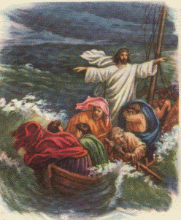
Gospels #14
A. Matthew 14:22- 25 ff*
B. Mark 4:37-39
C. Luke 5:4-6
D. John 21:3-6
* ff = “and following verses”
www.effata.dk/bibelbilleder/en_vis.asp?mater=36

Slide 73
Mark 4:37 And there arose a great storm of wind, and the waves beat into the ship, so that it was now full. ³⁸ And he was in the hinder part of the ship, asleep on a pillow: and they awake him, and say unto him, Master, carest thou not that we perish? ³⁹ And he arose, and rebuked the wind, and said unto the sea, Peace, be still. And the wind ceased, and there was a great calm.
The
B
answer is
. . .

Slide 74
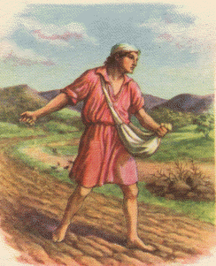
Gospels #15
A. Matthew 13:44
B. Mark 4:2-3 ff*
C. Luke 15:3-4 ff
D. Luke 16:1-2 ff * ff = “and following verses”
www.effata.dk/bibelbilleder/en_vis.asp?mater=42

Slide 75
Mark 4:2 And he taught them many things by parables, and said unto them in his doctrine, ³ Hearken; Behold, there went out a sower to sow …
The
B
answer is
. . .

Slide 76
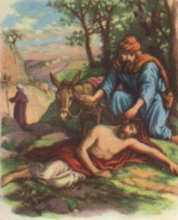
Gospels #16
A. Luke 10:30-34 ff*
B. Luke 17:11-19
C. John 4:4-7 ff
D. John 8:48
* ff = “and following verses”
www.effata.dk/bibelbilleder/en_vis.asp?mater=45

Slide 77
Luke 10:30 And Jesus answering said, A certain man went down from Jerusalem to Jericho, and fell among thieves, which stripped him of his raiment, and wounded him, and departed, leaving him half dead. ³¹ And by chance there came down a certain priest that way: and when he saw him, he passed by on the other side. ³² And likewise a Levite, when he was at the place, came and looked on him, and passed by on the other side. ³³ But a certain Samari-tan, as he journeyed, came where he was: and when he saw him, he had compassion on him …
The
A
answer is
. . .

Slide 78
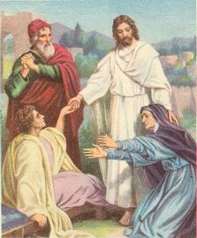
Gospels #17
A. Matthew 28:5-6
B. Mark 5:35-43
C. Luke 7:11-15
D. John 11:43-44
http://effata.dk/bibelbilleder/en_vis.asp?mater=110

Slide 79
Luke 7:11 And it came to pass the day after, that he went into a city called Nain; and many of his disciples went with him, and much people. ¹² Now when he came nigh to the gate of the city, behold, there was a dead man carried out, the only son of his mother, and she was a widow: and much people of the city was with her. ¹³ And when the Lord saw her, he had compassion on her, and said unto her, Weep not. ¹⁴ And he came and touched the bier: and they that bare him stood still. And he said, Young man, I say unto thee, Arise. ¹⁵ And he that was dead sat up, and began to speak. And he delivered him to his mother.
The
C
answer is
. . .

Slide 80
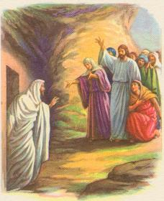
Gospels #18
A. Matthew 28:5-6
B. Mark 5:35-43
C. Luke 7:11-15
D. John 11:43-44
http://effata.dk/bibelbilleder/en_vis.asp?mater=114

Slide 81
John 11:43 And when he thus had spoken, (Jesus) cried with a loud voice, Lazarus, come forth. ⁴⁴ And he that was dead came forth, bound hand and foot with graveclothes: and his face was bound about with a napkin. Jesus saith unto them, Loose him, and let him go.
The
D
answer is
. . .

Slide 82
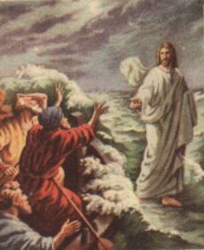
Gospels #19
A. Matthew 8:23-27
B. Matthew 14:28-31
C. Luke 5:1-11
D. Luke 9:10-17
http://effata.dk/bibelbilleder/en_vis.asp?mater=116

Slide 83
Matthew 14:28 And Peter answered him and said, Lord, if it be thou, bid me come unto thee on the water. ²⁹ And he said, Come. And when Peter was come down out of the ship, he walked on the water, to go to Jesus. ³⁰ But when he saw the wind boisterous, he was afraid; and begin-ning to sink, he cried, saying, Lord, save me. ³¹ And immediately Jesus stretched forth his hand, and caught him, and said unto him, O thou of little faith, wherefore didst thou doubt?
The
B
answer is
. . .

Slide 84
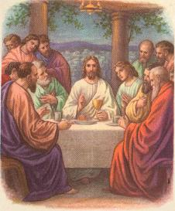
Gospels #20
A. Matthew 26:1-5
B. Mark 14:10-11
C. Luke 22:14-20
D. John 18:1-11
http://effata.dk/bibelbilleder/en_vis.asp?mater=122

Slide 85
Luke 22:14 And when the hour was come, he sat down, and the twelve apostles with him. ¹⁵ And he said unto them, With desire I have desired to eat this passover with you before I suffer: ¹⁶ For I say unto you, I will not any more eat thereof, until it be fulfilled in the kingdom of God. ¹⁷ And he took the cup, and gave thanks, and said, Take this, and divide it among yourselves: ¹⁸ For I say unto you, I will not drink of the fruit of the vine, until the kingdom of God shall come.
The
C
answer is
. . .

Slide 86
Tie Breaker #1
Where in the Word is this statement found?
Discuss it, but do not open your Bibles.
“Come, ye blessed of my Father, inherit the kingdom prepared for you from the founda-tion of the world”
A. Matthew 25:34
B. Mark 11:9
C. Luke 10:23
D. John 12:12-13

Slide 87
Matthew 25:34 Then shall the King say unto them on his right hand, Come, ye blessed of my Father, inherit the kingdom prepared for you from the foundation of the world: ³⁵ For I was an hungred, and ye gave me meat: I was thirsty, and ye gave me drink: I was a stranger, and ye took me in: ³⁶ Naked, and ye clothed me: I was sick, and ye visited me: I was in prison, and ye came unto me.
The
A
answer is
. . .

Slide 88
Tie Breaker #2
Where in the Word is this statement found?
Discuss it, but do not open your Bibles.
“Rest with us, when the Lord Jesus shall be revealed from heaven with his mighty angels, In flaming fire taking vengeance on them that know not God, and that obey not the gospel of our Lord Jesus Christ”
A. Matthew 11:28
B. Acts 2:26
C. 2 Corinthians 12:9
D. 2 Thessalonians 1:7-8

Slide 89
2 Thessalonians 1:6 It is a righteous thing with God to recompense tribu-lation to them that trouble you; ⁷ And to you who are troubled rest with us, when the Lord Jesus shall be revealed from heaven with his mighty angels, ⁸ In flaming fire taking vengeance on them that know not God, and that obey not the gospel of our Lord Jesus Christ:
The
D
answer is
. . .

Slide 90
Tie Breaker #3
Where in the Word is this statement found?
Discuss it, but do not open your Bibles.
“There is laid up for me a crown of righteous-ness, which the Lord, the righteous judge, shall give me at that day”
A. 1 Corinthians 9:25
B. 2 Timothy 4:8
C. 1 Peter 5:4
D. Revelation 2:10

Slide 91
2 Timothy 4:7 I have fought a good fight, I have finished my course, I have kept the faith: ⁸ Henceforth there is laid up for me a crown of righteousness, which the Lord, the righteous judge, shall give me at that day: and not to me only, but unto all them also that love his appearing.
The
B
answer is
. . .

Slide 92
Tie Breaker #4
Where in the Word is this statement found?
Discuss it, but do not open your Bibles.
“We ought to obey God rather than men”
A. Acts 5:29
B. Romans 5:19
C. Ephesians 6:1
D. Philippians 2:8

Slide 93
Acts 5:29 Then Peter and the other apostles answered and said, We ought to obey God rather than men.
The
A
answer is
. . .

Slide 94
?
Where in
the Word

