Slide 1
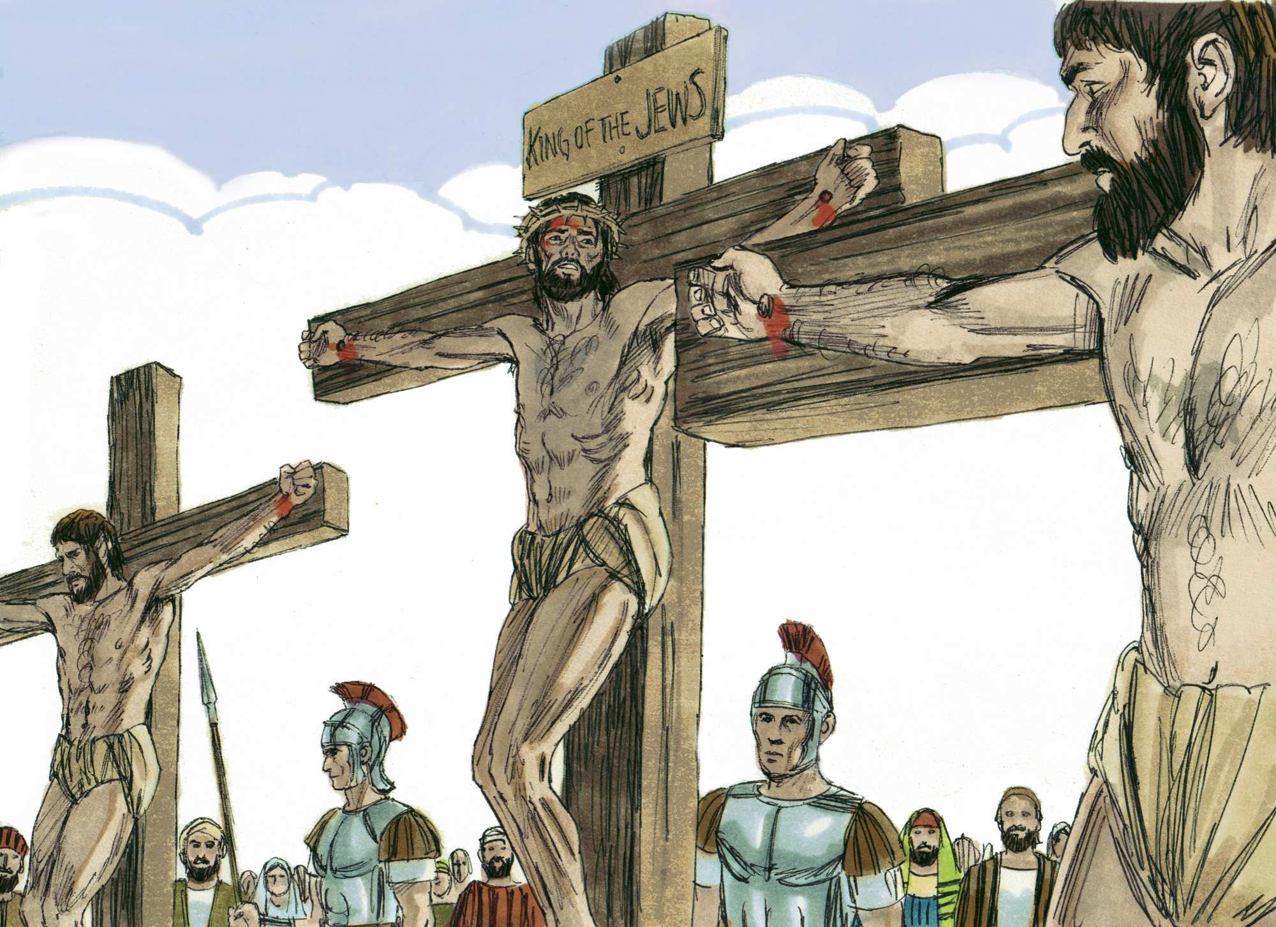
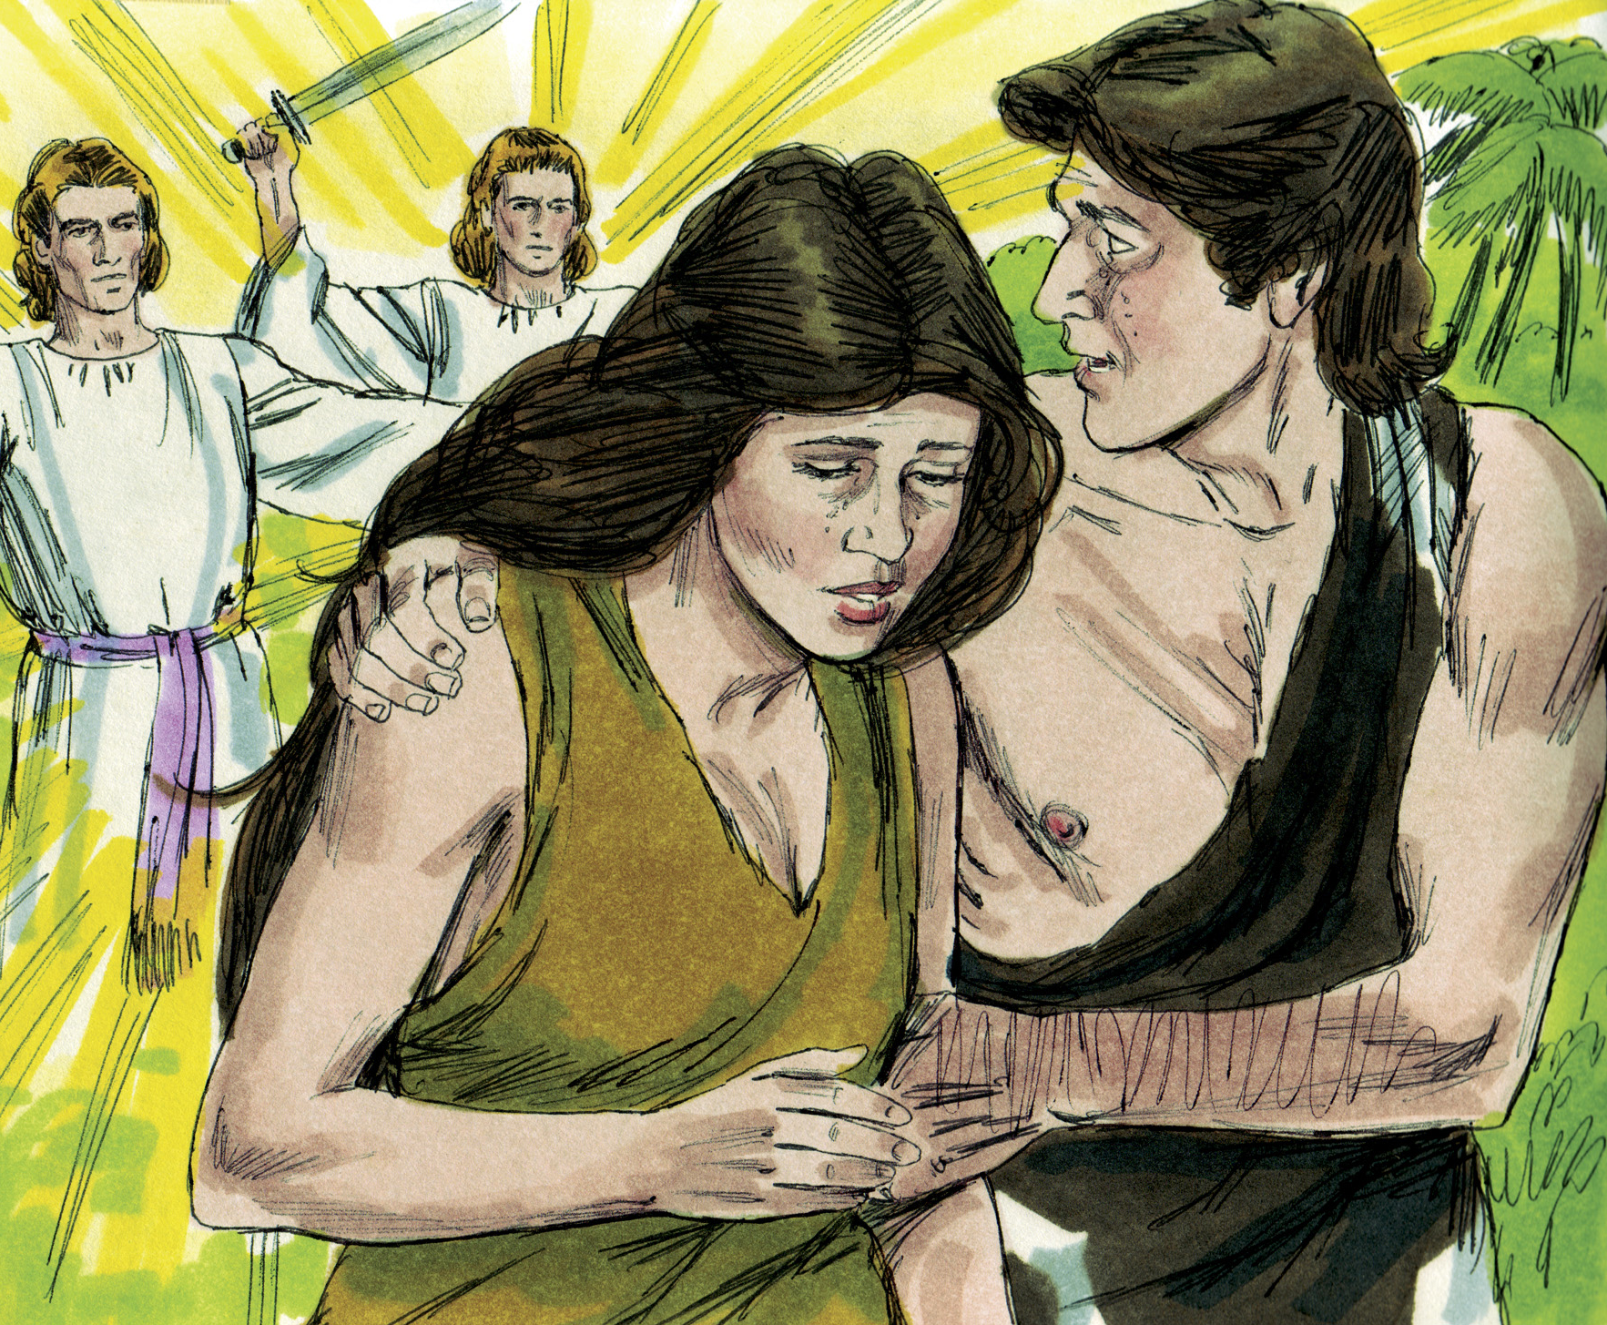
What’s the Bible Story?
Bible Illustrations From Sweet Publishing
Genesis & Gospels
Tap the screen to get started

Slide 2
What’s the Bible Story?
Genesis & Gospels
A Multiple-Choice Bible Game
This multiple-choice game is created in PowerPoint. A tap (screen-tap or mouse-click) is all that is needed to play. No PowerPoint skills are required. The next screen shows how it works.
The images for all Genesis Questions are from Unfolding Word, Sweet Publishing Co. Artist: Jim Padgett. They are available from Unfolding Word (https://www.unfoldingword.org/sweet-publishing).
The images for all Gospels Questions except #5, #8, #9, #11, #17, and #23 are from Unfolding Word, Sweet Publishing Co. Artist: Jim Padgett. They are available from Unfolding Word (https://www.unfoldingword.org/sweet-publishing).
Gospels #5 images from jw.org; #8, #11, and #23 images from theglobalgospel.org, Artist: Paula Nash Giltner; #9 images from sundayschoolsources.com; #17 from polination.files.wordpress.com.
Tap the screen to continue

Slide 3
Here’s how it works
(1) Tap any GENESIS or GOSPELS number on the Menu Board (next screen).
(1)
(2) Look at the picture and the three Story choices. What’s the right choice? Tap the screen to get the answer.
(2)
(2)
(3) Here’s the answer and Bible chapter. Every player/team can score on every question. Tap the screen to return to the Menu Board.
(2)
(3)
Tap the screen to go to the Menu Board and start playing

Slide 4
What’s the Bible Story?
GENESIS GOSPELS
1
2
3
4
5
1
2
3
4
5
6
7
8
9
10
6
7
8
9
10
11
12
13
14
15
11
12
13
14
15
16
17
18
19
20
16
17
18
19
20
21
22
23
24
25
21
22
23
24
25

Slide 5
What’s the Bible Story?
A. Creation
B. God’s promises
to Abram
Bible Illustrations From Sweet Publishing
C. Joseph’s
dreams

Slide 6
What’s the Bible Story?
A. Creation
Bible Illustrations From Sweet Publishing
GENESIS 1

Slide 7
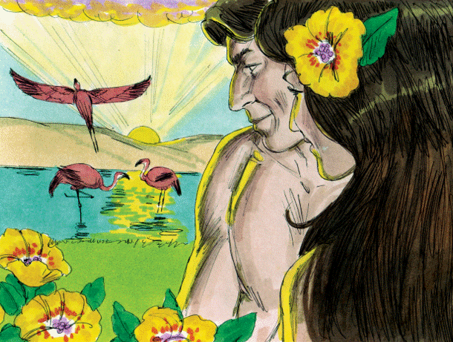
What’s the Bible Story?
A. Adam & Eve in the
Garden of Eden
B. Abraham & Sarah in
the Promised Land
C. Isaac & Rebekah in
the south country
Bible Illustrations From Sweet Publishing https://www.unfoldingword.org/sweet-publishing

Slide 8
What’s the Bible Story?
A. Adam & Eve in the
Garden of Eden
Bible Illustrations From Sweet Publishing https://www.unfoldingword.org/sweet-publishing
GENESIS 2 & 3

Slide 9
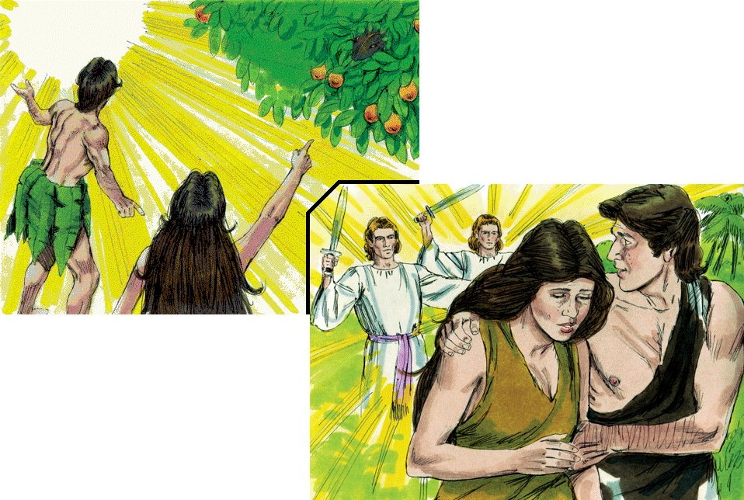
What’s the Bible Story?
A. Adam and Eve
and the serpent
all disobey God
B. The serpent
disobeys God
Bible Illustrations From Sweet Publishing
C. Adam and Eve
disobey God

Slide 10
What’s the Bible Story?
Bible Illustrations From Sweet Publishing
C. Adam and Eve
disobey God
GENESIS 3

Slide 11
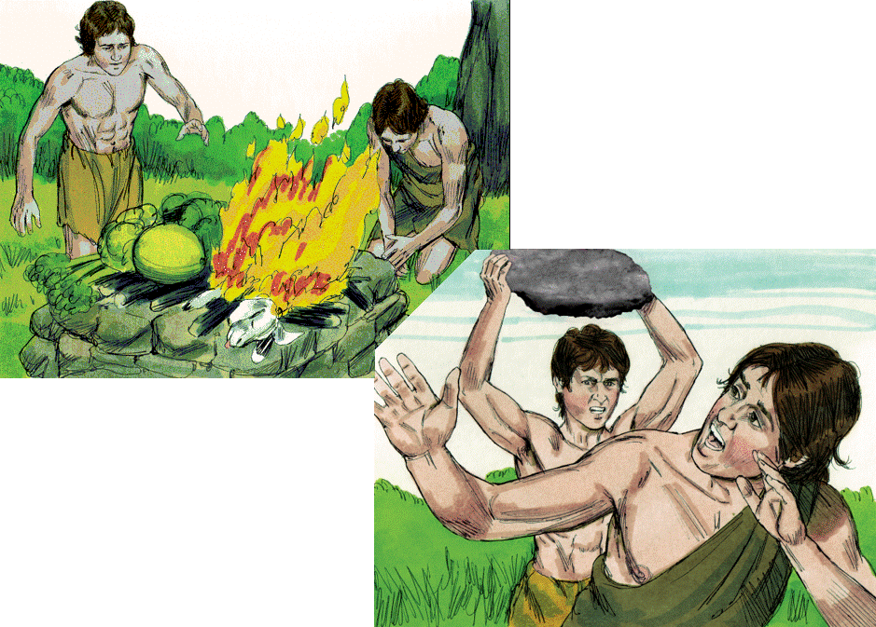
What’s the Bible Story?
A. Cain & Abel
B. Jacob & Esau
Bible Illustrations From Sweet Publishing
C. Joseph & Benjamin

Slide 12
What’s the Bible Story?
A. Cain & Abel
Bible Illustrations From Sweet Publishing
GENESIS 4

Slide 13
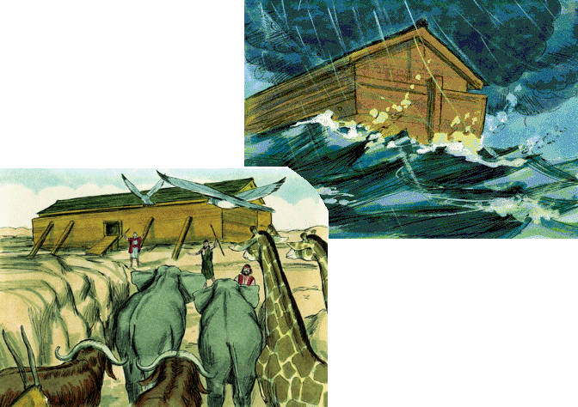
What’s the Bible Story?
A. Adam names the
animals
B. Noah and the
flood
Bible Illustrations From Sweet Publishing
C. Moses and the
plagues on Egypt

Slide 14
What’s the Bible Story?
B. Noah and the
flood
Bible Illustrations From Sweet Publishing
GENESIS 6 TO 9

Slide 15
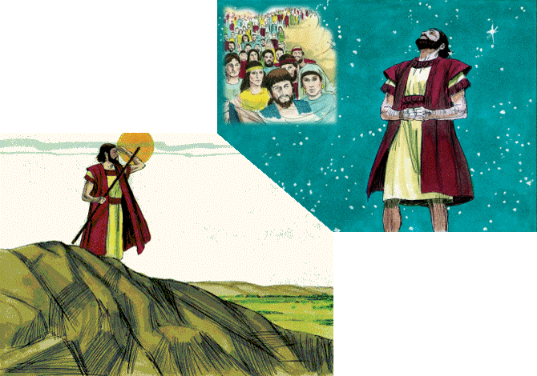
What’s the Bible Story?
A. God’s promises
to Abram
B. Moses leads Israel
out of Egypt
Bible Illustrations From Sweet Publishing
C. David prays to
God for Israel

Slide 16
What’s the Bible Story?
A. God’s promises
to Abram
Bible Illustrations From Sweet Publishing
GENESIS 12, 13 & 15

Slide 17
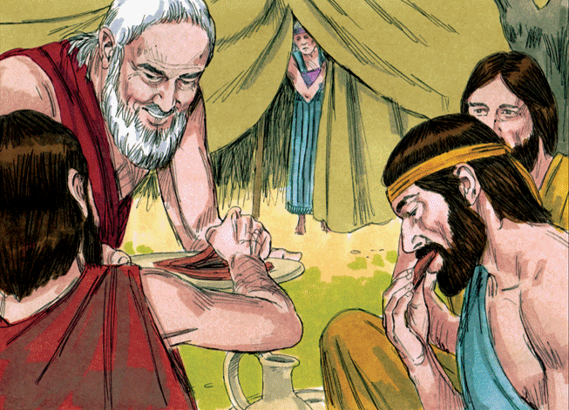
What’s the Bible Story?
A. Sharing food with
neighbors
B. Angles visit Abram.
Sarah will have a son
C. Angels visit Lot
at Sodom
Bible Illustrations From Sweet Publishing https://www.unfoldingword.org/sweet-publishing

Slide 18
What’s the Bible Story?
B. Angles visit Abram.
Sarah will have a son
Bible Illustrations From Sweet Publishing https://www.unfoldingword.org/sweet-publishing
GENESIS 18

Slide 19
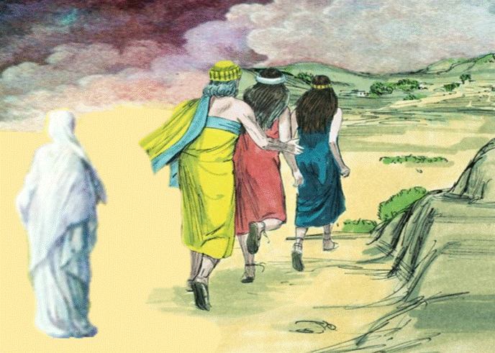
What’s the Bible Story?
A. People run to get
away from the flood
B. Abram leaves Ur
of the Chaldees
C. Sodom is destroyed.
Lot escapes with
his daughters
Bible Illustrations From Sweet Publishing https://www.unfoldingword.org/sweet-publishing

Slide 20
What’s the Bible Story?
C. Sodom is destroyed.
Lot escapes with
his daughters
Bible Illustrations From Sweet Publishing https://www.unfoldingword.org/sweet-publishing
GENESIS 19

Slide 21
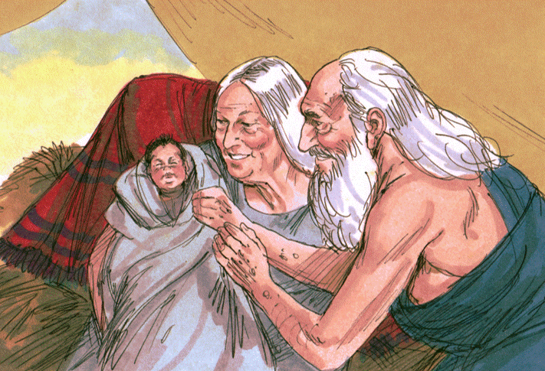
What’s the Bible Story?
A. The birth of Abram
B. The birth of Isaac
C. The birth of Moses
Bible Illustrations From Sweet Publishing https://www.unfoldingword.org/sweet-publishing

Slide 22
What’s the Bible Story?
B. The birth of Isaac
Bible Illustrations From Sweet Publishing https://www.unfoldingword.org/sweet-publishing
GENESIS 21

Slide 23
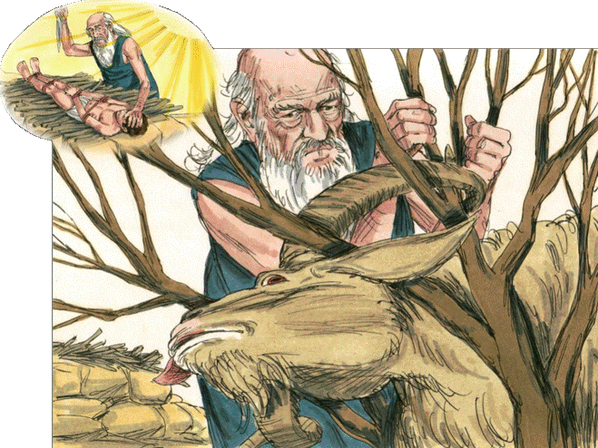
What’s the Bible Story?
A. Nimrod, the mighty
hunter
B. The sacrifice of
Isaac
C. Esau hunts food for
Isaac
Bible Illustrations From Sweet Publishing https://www.unfoldingword.org/sweet-publishing

Slide 24
What’s the Bible Story?
B. The sacrifice of
Isaac
Bible Illustrations From Sweet Publishing https://www.unfoldingword.org/sweet-publishing
GENESIS 22

Slide 25
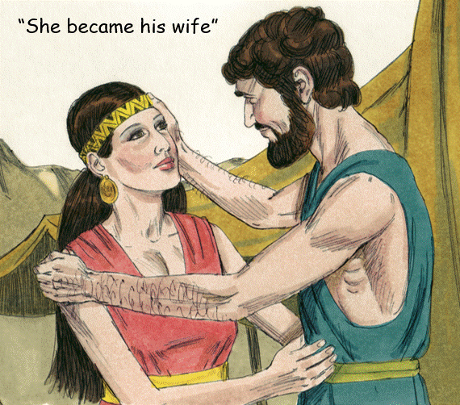
What’s the Bible Story?
A. Adam & Eve
B. Abraham & Sarah
C. Isaac & Rebekah
Bible Illustrations From Sweet Publishing https://www.unfoldingword.org/sweet-publishing

Slide 26
What’s the Bible Story?
C. Isaac & Rebekah
Bible Illustrations From Sweet Publishing https://www.unfoldingword.org/sweet-publishing
GENESIS 24

Slide 27
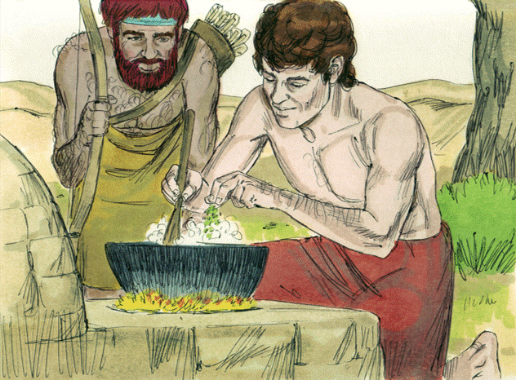
What’s the Bible Story?
A. Cain and Abel have
a meal together
B. Tired Esau sells his
birthright to Jacob
C. Jacob and Esau pre- pare food for Isaac
Bible Illustrations From Sweet Publishing https://www.unfoldingword.org/sweet-publishing

Slide 28
What’s the Bible Story?
B. Tired Esau sells his
birthright to Jacob
Bible Illustrations From Sweet Publishing https://www.unfoldingword.org/sweet-publishing
GENESIS 25

Slide 29
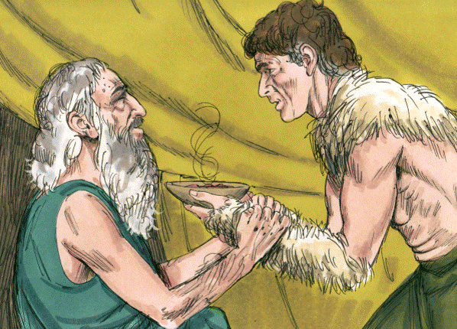
What’s the Bible Story?
A. Abraham gives food
to a visitor
B. Jacob tricks Isaac
to get his blessing
C. Esau tries to get a
blessing from Isaac
Bible Illustrations From Sweet Publishing https://www.unfoldingword.org/sweet-publishing

Slide 30
What’s the Bible Story?
B. Jacob tricks Isaac
to get his blessing
Bible Illustrations From Sweet Publishing https://www.unfoldingword.org/sweet-publishing
GENESIS 27

Slide 31
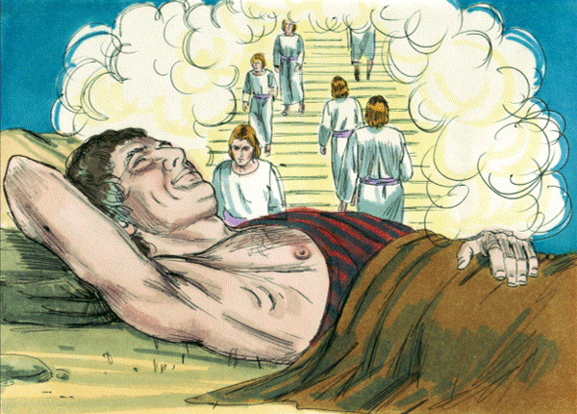
What’s the Bible Story?
A. Jacob’s dream
at Bethel
B. Joseph’s dream
at Hebron
C. Pharaoh’s dream
in Egypt
Bible Illustrations From Sweet Publishing https://www.unfoldingword.org/sweet-publishing

Slide 32
What’s the Bible Story?
A. Jacob’s dream
at Bethel
Bible Illustrations From Sweet Publishing https://www.unfoldingword.org/sweet-publishing
GENESIS 28

Slide 33
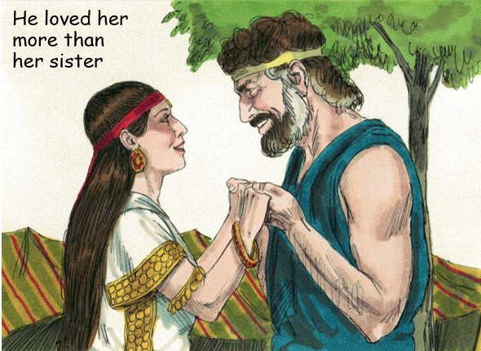
What’s the Bible Story?
“I will serve you
seven years for
your younger daughter”
A. Abraham & Sarah
B. Isaac & Rebekah
C. Jacob & Rachel
Bible Illustrations From Sweet Publishing https://www.unfoldingword.org/sweet-publishing

Slide 34
What’s the Bible Story?
“I will serve you
seven years for
your younger daughter”
C. Jacob & Rachel
Bible Illustrations From Sweet Publishing https://www.unfoldingword.org/sweet-publishing
GENESIS 29

Slide 35
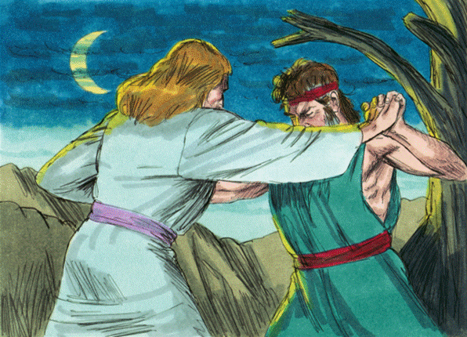
What’s the Bible Story?
A. Cain fights against
Abel
B. Jacob struggles
with Esau
C. Jacob wrestles with
an angel of God
Bible Illustrations From Sweet Publishing https://www.unfoldingword.org/sweet-publishing

Slide 36
What’s the Bible Story?
C. Jacob wrestles with
an angel of God
Bible Illustrations From Sweet Publishing https://www.unfoldingword.org/sweet-publishing
GENESIS 32

Slide 37
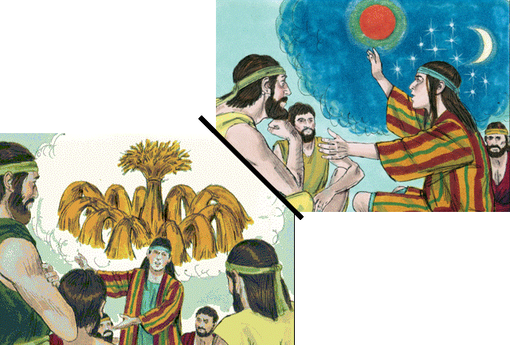
What’s the Bible Story?
A. Jacob’s dreams
at Bethel
B. Joseph’s dreams
at Hebron
Bible Illustrations From Sweet Publishing
C. Pharaoh’s dreams
in Egypt

Slide 38
What’s the Bible Story?
B. Joseph’s dreams
at Hebron
Bible Illustrations From Sweet Publishing
GENESIS 37

Slide 39
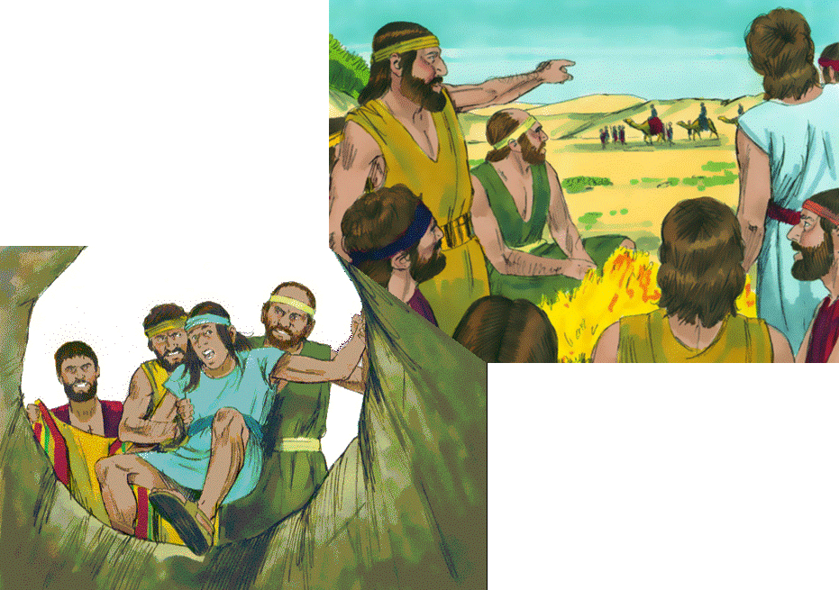
What’s the Bible Story?
A. Joseph is sold
into slavery
B. Jeremiah is thrown
into a pit
Bible Illustrations From Sweet Publishing
C. Daniel is put into
a lion’s den

Slide 40
What’s the Bible Story?
A. Joseph is sold
into slavery
Bible Illustrations From Sweet Publishing
GENESIS 37

Slide 41
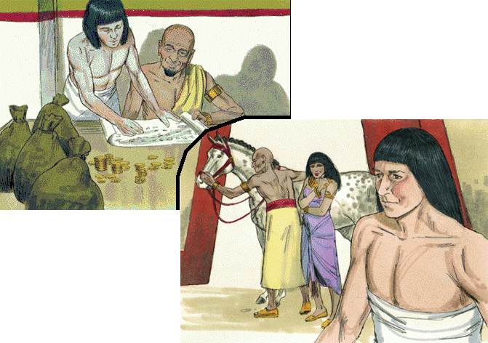
What’s the Bible Story?
A. Abram is rich in
silver and gold
B. Jacob makes
Laban a rich man
Bible Illustrations From Sweet Publishing
C. Joseph serves
Potiphar in Egypt

Slide 42
What’s the Bible Story?
Bible Illustrations From Sweet Publishing
C. Joseph serves
Potiphar in Egypt
GENESIS 39

Slide 43
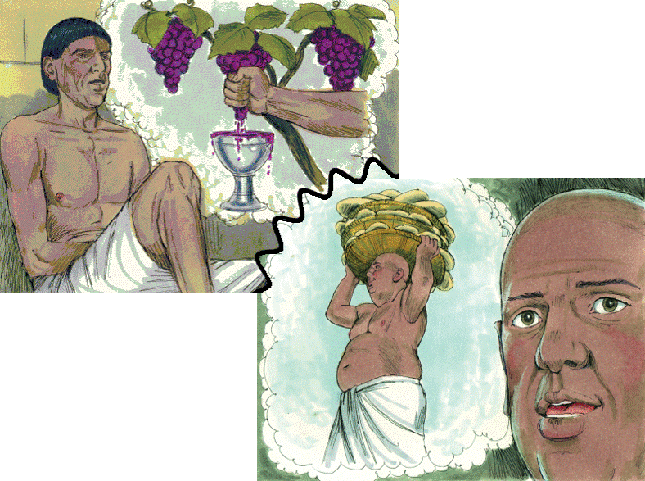
What’s the Bible Story?
Joseph interprets …
A. Jacob’s dreams
B. The Butler’s and
Baker’s dreams
Bible Illustrations From Sweet Publishing
C. Nebuchadnezzar’s
dreams

Slide 44
What’s the Bible Story?
Joseph interprets …
B. The Butler’s and
Baker’s dreams
Bible Illustrations From Sweet Publishing
GENESIS 40

Slide 45
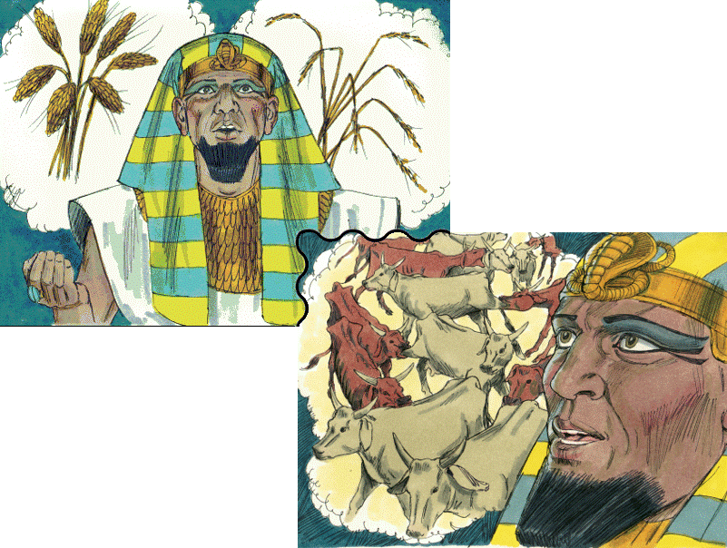
What’s the Bible Story?
Joseph interprets …
A. Pharaoh’s dreams
B. Nebuchadnezzar’s
dreams
Bible Illustrations From Sweet Publishing
C. A young man’s
visions

Slide 46
What’s the Bible Story?
Joseph interprets …
A. Pharaoh’s dreams
Bible Illustrations From Sweet Publishing
GENESIS 41

Slide 47
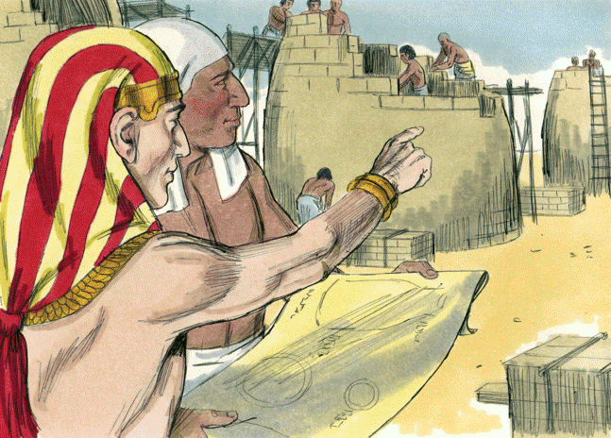
What’s the Bible Story?
A. Men build a
tower at Babel
B. The pyramids are
built in Egypt
C. Joseph is raised to
power in Egypt
Bible Illustrations From Sweet Publishing https://www.unfoldingword.org/sweet-publishing

Slide 48
What’s the Bible Story?
C. Joseph is raised to
power in Egypt
Bible Illustrations From Sweet Publishing https://www.unfoldingword.org/sweet-publishing
GENESIS 41

Slide 49
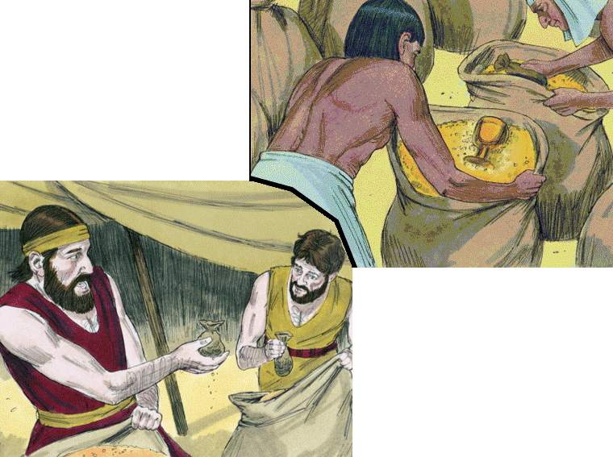
What’s the Bible Story?
A. The possessions of
Sodom are taken
B. Joseph’s brothers
buy food in Egypt
Bible Illustrations From Sweet Publishing
C. Achan hides things
stolen at Jericho

Slide 50
What’s the Bible Story?
B. Joseph’s brothers
buy food in Egypt
Bible Illustrations From Sweet Publishing
GENESIS 42 TO 45

Slide 51
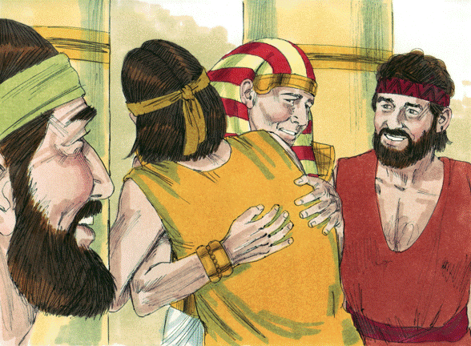
What’s the Bible Story?
A. Abram says
“Good-bye” to Lot
B. Esau and Jacob
make peace
C. Joseph is reunited
with his brothers
Bible Illustrations From Sweet Publishing https://www.unfoldingword.org/sweet-publishing

Slide 52
What’s the Bible Story?
C. Joseph is reunited
with his brothers
Bible Illustrations From Sweet Publishing https://www.unfoldingword.org/sweet-publishing
GENESIS 45

Slide 53
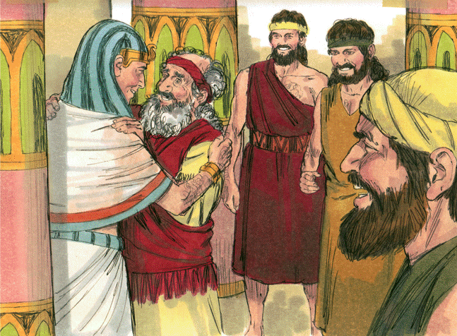
What’s the Bible Story?
A. Jacob goes to
Joseph in Egypt
B. Jacob returns to
Isaac in Canaan
C. Abram meets
Pharaoh
Bible Illustrations From Sweet Publishing https://www.unfoldingword.org/sweet-publishing

Slide 54
What’s the Bible Story?
A. Jacob goes to
Joseph in Egypt
Bible Illustrations From Sweet Publishing https://www.unfoldingword.org/sweet-publishing
GENESIS 46

Slide 56
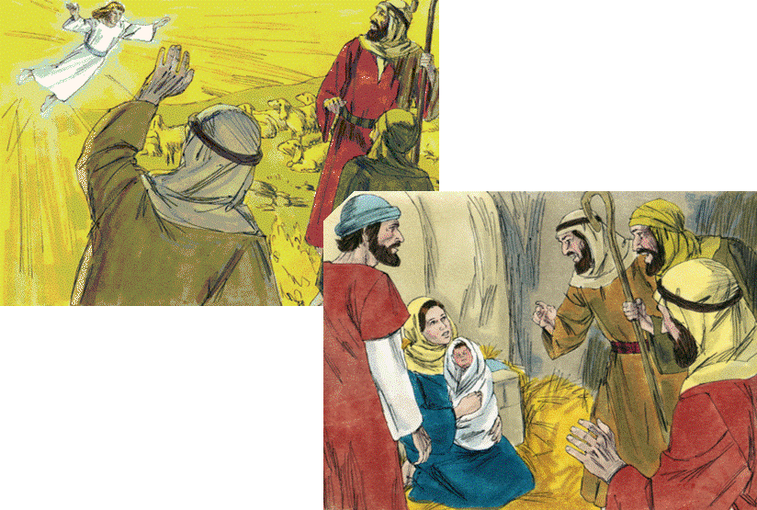
What’s the Bible Story?
A. Birth of Jesus.
Shepherds worship
B. Birth of Jesus.
Wise men worship
Bible Illustrations From Sweet Publishing
C. Birth of Jesus.
Wise men and
shepherds worship

Slide 57
What’s the Bible Story?
A. Birth of Jesus.
Shepherds worship
Bible Illustrations From Sweet Publishing
LUKE 2

Slide 58
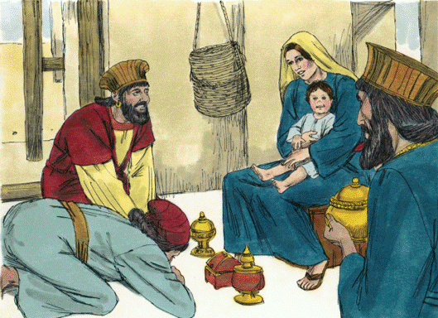
What’s the Bible Story?
A. The child Jesus.
Shepherds worship
B. The child Jesus.
Wise men worship
C. The child Jesus.
Wise men and
shepherds worship
Bible Illustrations From Sweet Publishing https://www.unfoldingword.org/sweet-publishing

Slide 59
What’s the Bible Story?
B. The child Jesus.
Wise men worship
Bible Illustrations From Sweet Publishing https://www.unfoldingword.org/sweet-publishing
MATTHEW 2

Slide 60
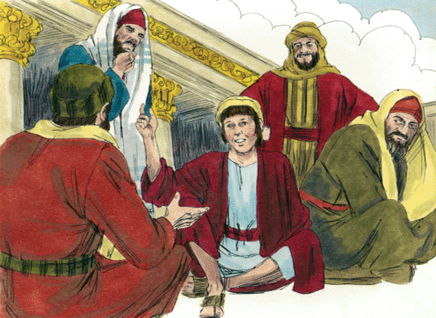
What’s the Bible Story?
A. The centurion’s
son
B. Reciting the Ten
Commandments
C. Twelve-year old
Jesus in the Temple
Bible Illustrations From Sweet Publishing https://www.unfoldingword.org/sweet-publishing

Slide 61
What’s the Bible Story?
C. Twelve-year old
Jesus in the Temple
Bible Illustrations From Sweet Publishing https://www.unfoldingword.org/sweet-publishing
LUKE 2

Slide 62
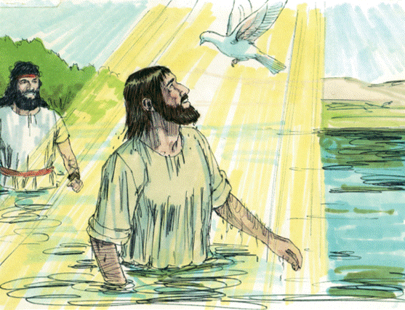
What’s the Bible Story?
A. Jesus is baptized
B. Saul of Tarsus is
baptized
C. Cornelius is
baptized
Bible Illustrations From Sweet Publishing https://www.unfoldingword.org/sweet-publishing

Slide 63
What’s the Bible Story?
A. Jesus is baptized
Bible Illustrations From Sweet Publishing https://www.unfoldingword.org/sweet-publishing
MATTHEW 3
MARK 1
LUKE 3

Slide 64
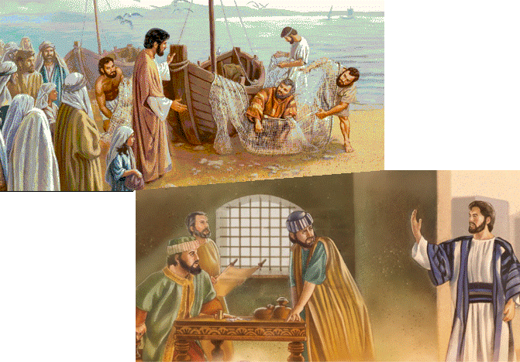
What’s the Bible Story?
A. Jesus teaches
people everywhere
B. Jesus calls disciples
to follow him
https://www.jw.org/
C. Jesus helps
friends in need

Slide 65
What’s the Bible Story?
B. Jesus calls disciples
to follow him
https://www.jw.org/
MATTHEW 4 & 9
MARK 1 & 2
LUKE 5

Slide 66
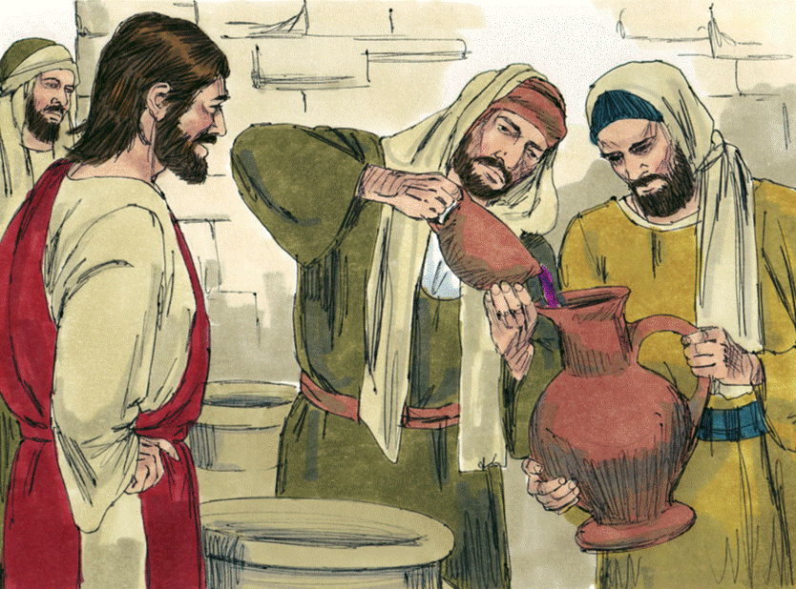
What’s the Bible Story?
A. Disciples prepare
“The Last Supper”
B. New wine is put
into new wineskins
C. Jesus turns water
to wine at Cana
Bible Illustrations From Sweet Publishing https://www.unfoldingword.org/sweet-publishing

Slide 67
What’s the Bible Story?
C. Jesus turns water
to wine at Cana
Bible Illustrations From Sweet Publishing https://www.unfoldingword.org/sweet-publishing
JOHN 2

Slide 68
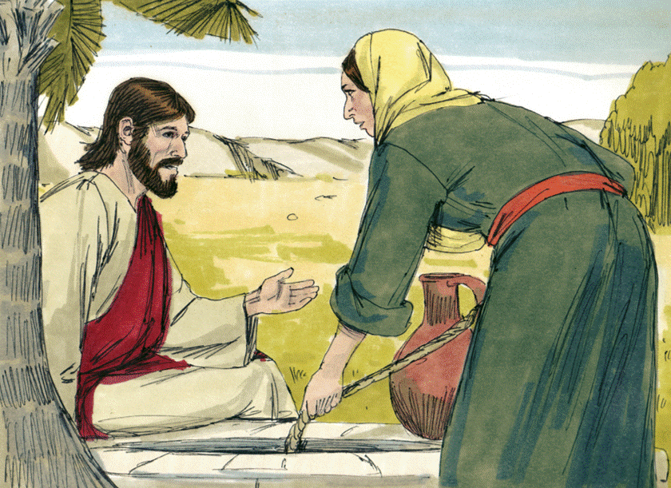
What’s the Bible Story?
A. Jacob meets
Rachel
B. Jesus teaches a
Samaritan woman
at Jacob’s well
C. A woman offers a drink to Jesus
Bible Illustrations From Sweet Publishing https://www.unfoldingword.org/sweet-publishing
Tap screen for the answer

Slide 69
What’s the Bible Story?
B. Jesus teaches a
Samaritan woman
at Jacob’s well
Bible Illustrations From Sweet Publishing https://www.unfoldingword.org/sweet-publishing
JOHN 4

Slide 70
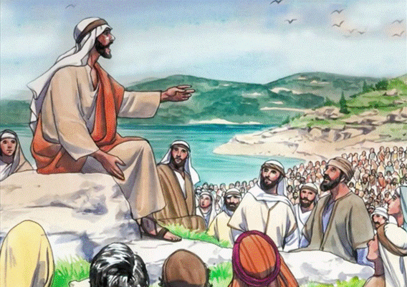
What’s the Bible Story?
A. The Sermon on
the Mount
B. Feeding the 5,000
C. Feeding the 4,000
Paula Nash Giltner, www.theglobalgospel.org
Tap screen for the answer

Slide 71
What’s the Bible Story?
A. The Sermon on
the Mount
Paula Nash Giltner, www.theglobalgospel.org
MATTHEW 5, 6 & 7

Slide 72
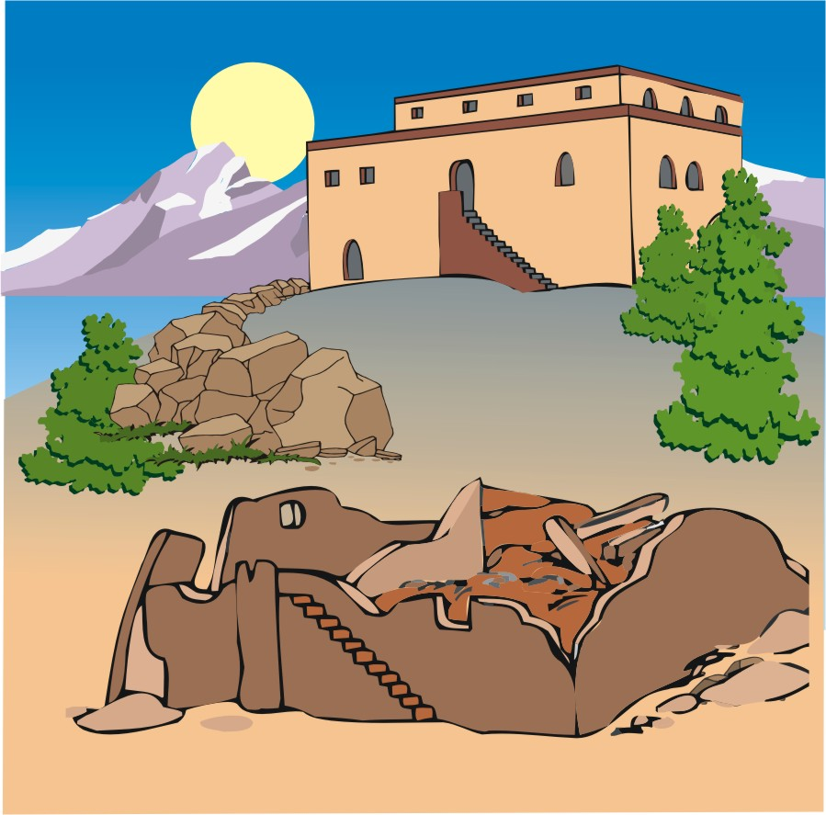
What’s the Bible Story?
A. The old man and
the young man
B. The rich man and
the poor man
C. The wise man and
the foolish man
Sunday School Sources

Slide 73
What’s the Bible Story?
C. The wise man and
the foolish man
Sunday School Sources
MATTHEW 7
LUKE 6

Slide 74
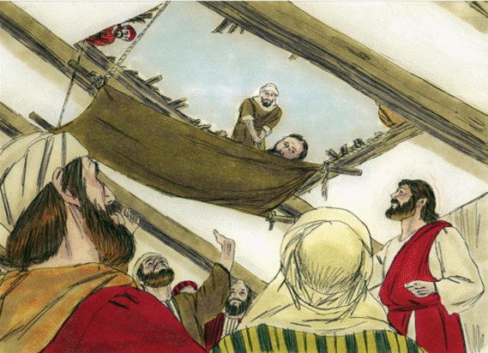
What’s the Bible Story?
A. Jesus helps an
injured friend
B. Jesus heals a
leper
C. Jesus heals a
paralyzed man
Bible Illustrations From Sweet Publishing https://www.unfoldingword.org/sweet-publishing

Slide 75
What’s the Bible Story?
C. Jesus heals a
paralyzed man
Bible Illustrations From Sweet Publishing https://www.unfoldingword.org/sweet-publishing
MATTHEW 9
MARK 2
LUKE 5

Slide 76
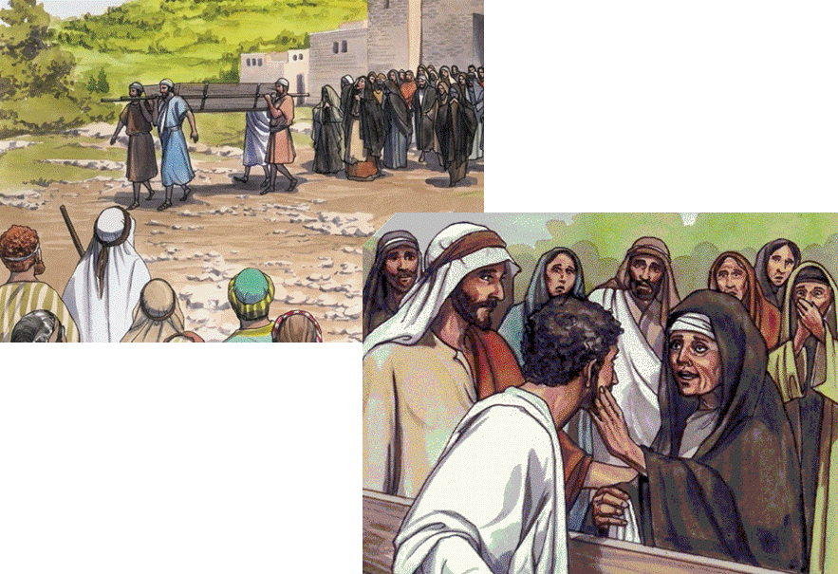
What’s the Bible Story?
A. Jesus raises a
widow’s son at Nain
B. Jesus raises Lazarus at Bethany
Paula Nash Giltner, www.theglobalgospel.org
C. Jesus heals a sick
man in Galilee

Slide 77
What’s the Bible Story?
A. Jesus raises a
widow’s son at Nain
Paula Nash Giltner, www.theglobalgospel.org
LUKE 7

Slide 78
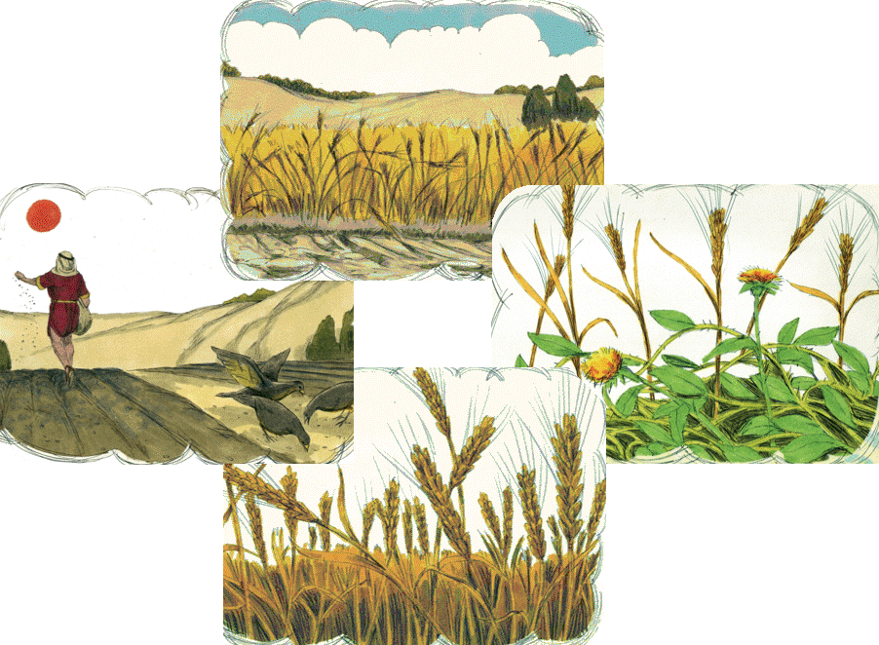
What’s the Bible Story?
A. Parable of workers
in the vineyard
B. Parable of the
sower
Bible Illustrations From Sweet Publishing
C. Parable of the
unforgiving servant

Slide 79
What’s the Bible Story?
B. Parable of the
sower
Bible Illustrations From Sweet Publishing
MATTHEW 13
MARK 4
LUKE 8

Slide 80
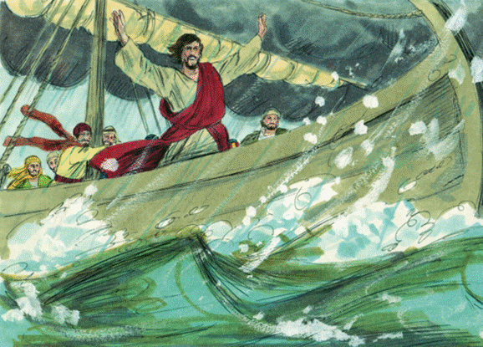
What’s the Bible Story?
A. Jesus calms a storm
on the Sea of Galilee
B. Jesus invites Peter
to walk on water
C. Jesus tells the
fishermen where
to find fish
Bible Illustrations From Sweet Publishing https://www.unfoldingword.org/sweet-publishing

Slide 81
What’s the Bible Story?
A. Jesus calms a storm
on the Sea of Galilee
Bible Illustrations From Sweet Publishing https://www.unfoldingword.org/sweet-publishing
MATTHEW 8
MARK 4
LUKE 8

Slide 82
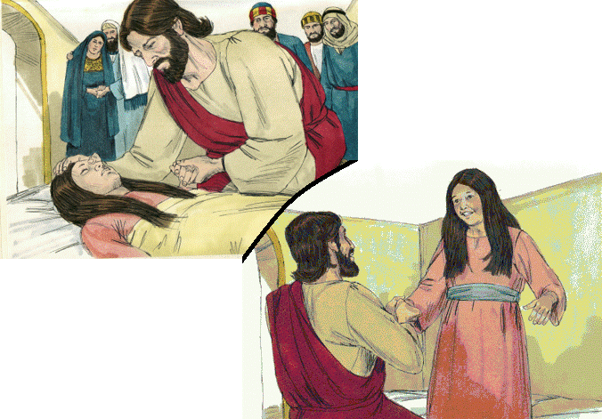
What’s the Bible Story?
A. Jesus cures a
sick girl’s fever
B. Jesus comforts
the dying
Bible Illustrations From Sweet Publishing
C. Jesus raises
Jairus’ daughter

Slide 83
What’s the Bible Story?
Bible Illustrations From Sweet Publishing
C. Jesus raises
Jairus’ daughter
MATTHEW 9
MARK 5
LUKE 8

Slide 84
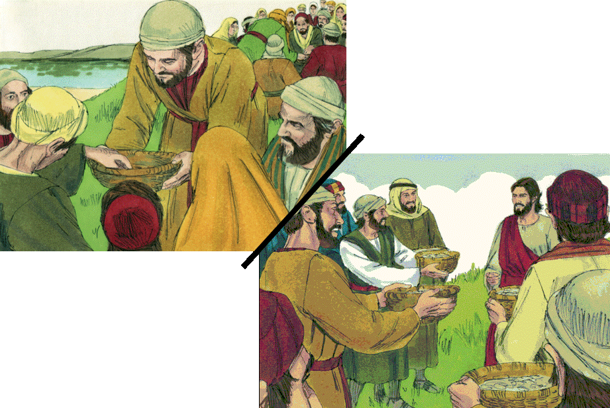
What’s the Bible Story?
A. Taking a collection
for the poor
B. Giving alms to the
poor
Bible Illustrations From Sweet Publishing
C. Feeding the 5,000
with five loaves
and two fish

Slide 85
What’s the Bible Story?
Bible Illustrations From Sweet Publishing
C. Feeding the 5,000
with five loaves
and two fish
MATTHEW 14
MARK 6
LUKE 9
JOHN 6

Slide 86
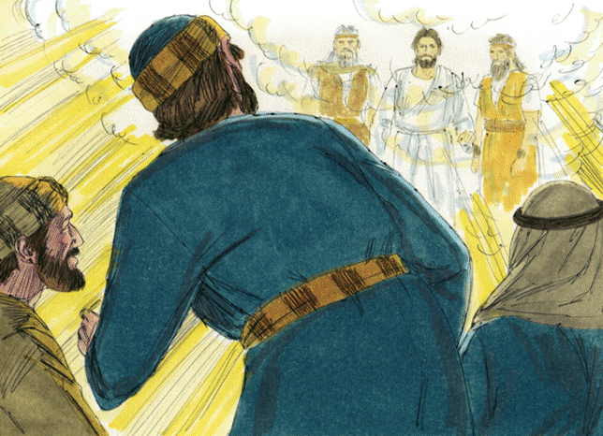
What’s the Bible Story?
A. The transfiguration
of Jesus
B. The ascension of
Jesus to heaven
C. The return of
Jesus from heaven
Bible Illustrations From Sweet Publishing https://www.unfoldingword.org/sweet-publishing

Slide 87
What’s the Bible Story?
A. The transfiguration
of Jesus
Bible Illustrations From Sweet Publishing https://www.unfoldingword.org/sweet-publishing
MATTHEW 17
MARK 9
LUKE 9

Slide 88
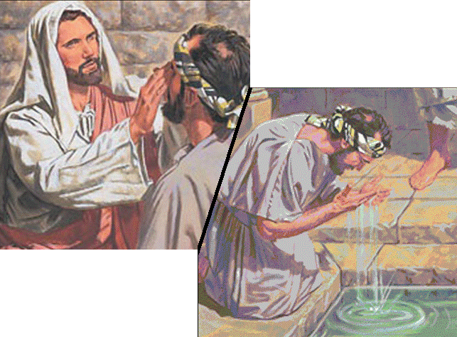
What’s the Bible Story?
A. Jesus heals blind
Bartimaeus at Jericho
B. Jesus heals a
man born blind
C. Jesus heals a
leper at Capernaum
https://polination.files.wordpress.com/

Slide 89
What’s the Bible Story?
B. Jesus heals a
man born blind
https://polination.files.wordpress.com/
JOHN 9

Slide 90
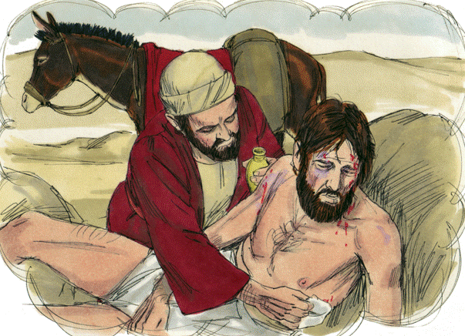
What’s the Bible Story?
A. Parable of the
good Samaritan
B. Parable of the
prodigal son
C. Parable of the
rich fool
Bible Illustrations From Sweet Publishing https://www.unfoldingword.org/sweet-publishing
Tap screen for the answer

Slide 91
What’s the Bible Story?
A. Parable of the
good Samaritan
Bible Illustrations From Sweet Publishing https://www.unfoldingword.org/sweet-publishing
LUKE 10

Slide 92
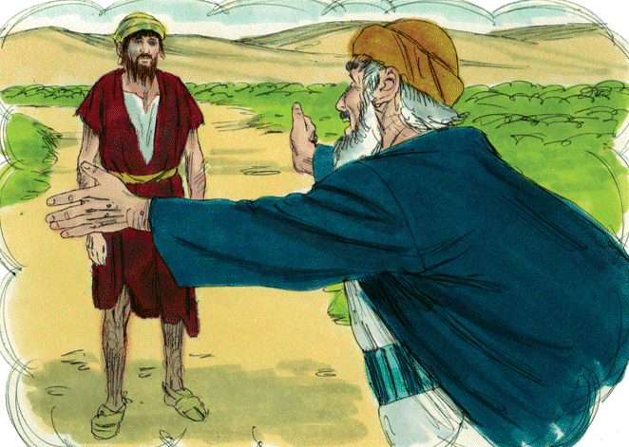
What’s the Bible Story?
A. Parable of the
good Samaritan
B. Parable of the
prodigal son
C. Parable of the
mote and the beam
(the speck and the log)
Bible Illustrations From Sweet Publishing https://www.unfoldingword.org/sweet-publishing

Slide 93
What’s the Bible Story?
B. Parable of the
prodigal son
Bible Illustrations From Sweet Publishing https://www.unfoldingword.org/sweet-publishing
LUKE 15

Slide 94
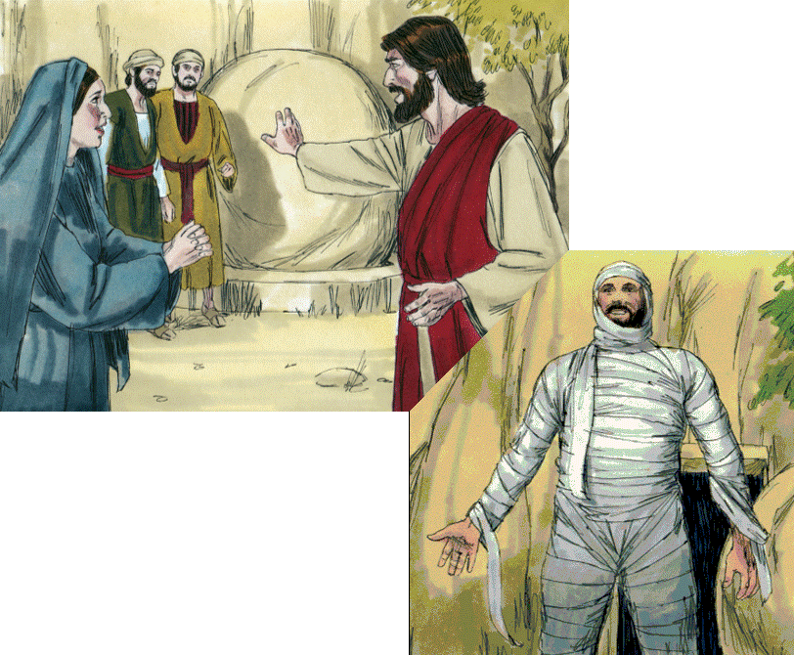
What’s the Bible Story?
A. Jesus foretells his
death and resurrection
B. Jesus raises a
widow’s son at Nain
Bible Illustrations From Sweet Publishing
C. Jesus raises Lazarus
from the dead

Slide 95
What’s the Bible Story?
Bible Illustrations From Sweet Publishing
C. Jesus raises Lazarus
from the dead
JOHN 11

Slide 96
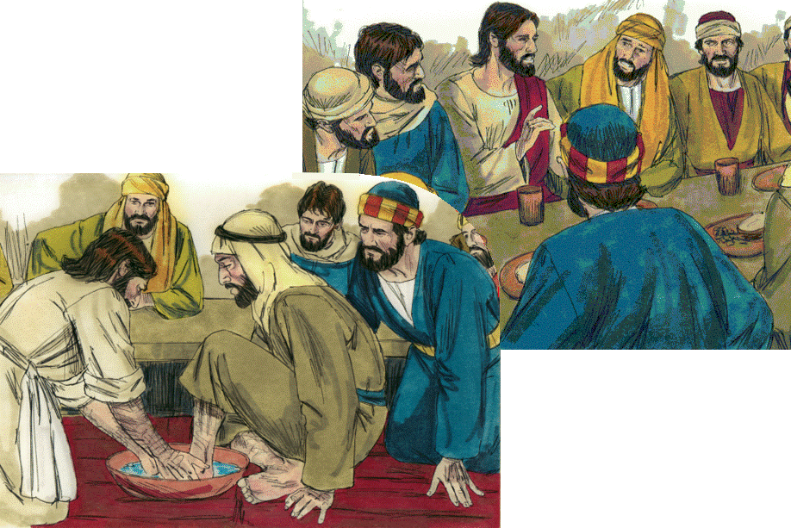
What’s the Bible Story?
A. “The Last Supper”
B. Jesus washes his
disciples’ feet
Bible Illustrations From Sweet Publishing
C. Both A and B

Slide 97
What’s the Bible Story?
A
B
Bible Illustrations From Sweet Publishing
C. Both A and B
MATTHEW 26
MARK 14
LUKE 22
JOHN 13

Slide 98
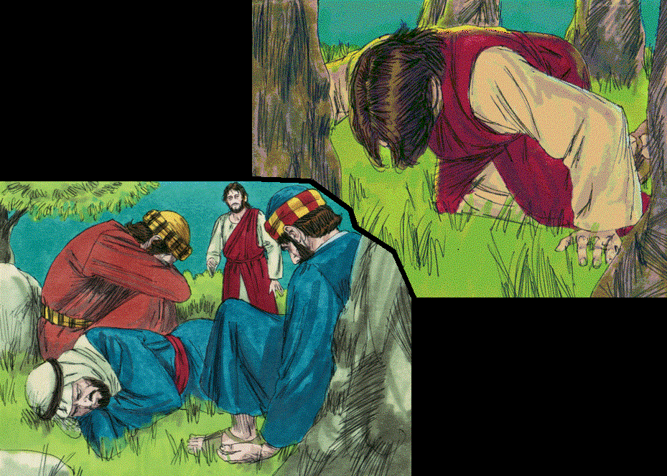
What’s the Bible Story?
A. Jesus chooses
12 apostles
B. Jesus prays in
Gethsemane
Bible Illustrations From Sweet Publishing
C. Jesus teaches
“The Lord’s Prayer”

Slide 99
What’s the Bible Story?
B. Jesus prays in
Gethsemane
Bible Illustrations From Sweet Publishing
Bible Illustrations From Sweet Publishing
MATTHEW 26
MARK 14
LUKE 22
Cp. JOHN 18

Slide 100
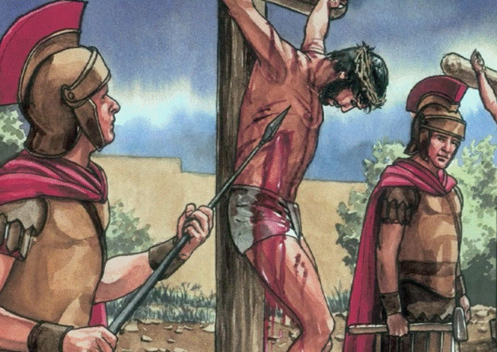
What’s the Bible Story?
A. “Take up your cross
and follow me”
B. The serpent lifted
up in the wilderness
C. The crucifixion
of Jesus
Paula Nash Giltner, www.theglobalgospel.org

Slide 101
What’s the Bible Story?
C. The crucifixion
of Jesus
Paula Nash Giltner, www.theglobalgospel.org
MATTHEW 27
MARK 15
LUKE 23
JOHN 19

Slide 102
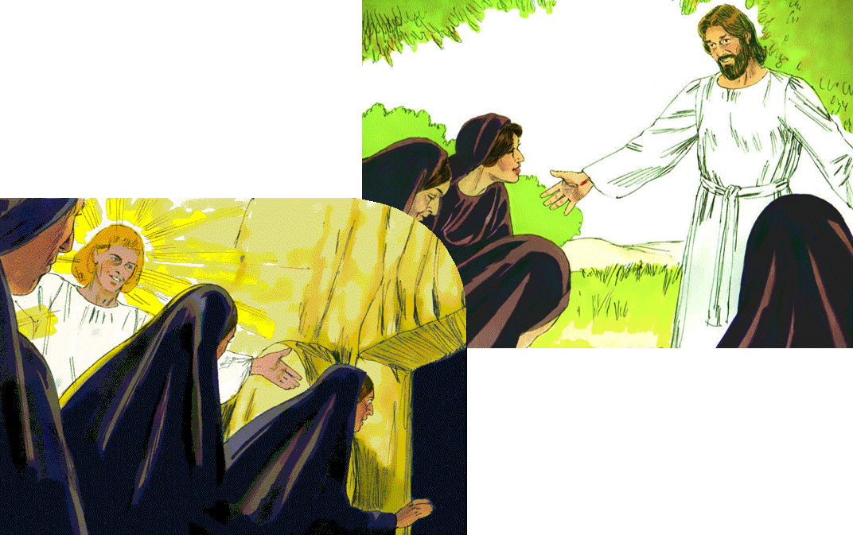
What’s the Bible Story?
A. The resurrection
of Jesus
B. The transfiguration
of Jesus
Bible Illustrations From Sweet Publishing
C. The ascension
of Jesus

Slide 103
What’s the Bible Story?
A. The resurrection
of Jesus
Bible Illustrations From Sweet Publishing
MATTHEW 28
MARK 16
LUKE 24
JOHN 20

Slide 104
What’s the Bible Story?
A. The transfiguration
of Jesus
B. The ascension of
Jesus to heaven
C. The return of
Jesus from heaven
Bible Illustrations From Sweet Publishing https://www.unfoldingword.org/sweet-publishing

Slide 105
What’s the Bible Story?
B. The ascension of
Jesus to heaven
Bible Illustrations From Sweet Publishing https://www.unfoldingword.org/sweet-publishing
LUKE 24 & ACTS 1

