Slide 1
Bible Book and Chapter Challenge!
Old Testament Events Set #4
How to Play

Slide 2
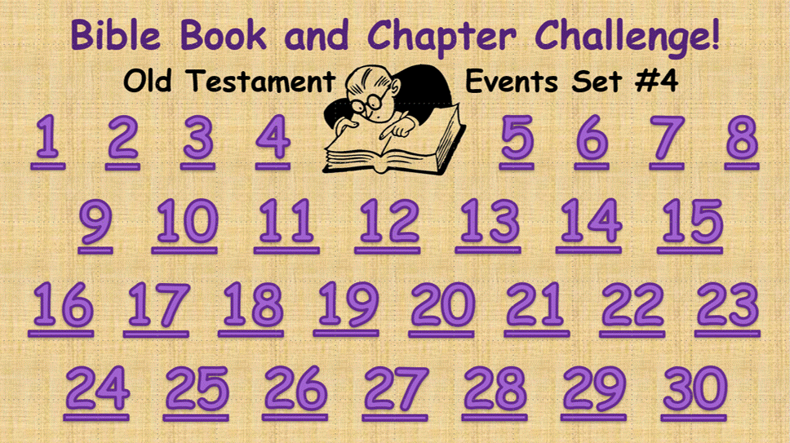
Download and Save
Download “Bible Book and Chapter Challenge!” from https://www.meridenchristadelphians.com/Bible-Games.html.
Save a copy on a device that supports PowerPoint.
Connect and Project
Connect the device to a TV or data projector.
Open “Bible Book and Chapter Challenge!” and display it for everyone to see.
Go to the game menu slide. There are 30 Old Testament Book and Chapter questions to choose from:

Slide 3
“Bible Book and Chapter Challenge!”
can be used as a whole-class activity or played as a team game.
To Play as a Team Game
Form small teams.
Provide each team with a pad of paper and a marker. Personal-sized dry-erase boards work, too.
Teams take turns calling for a question number from the menu slide:

Slide 4
Each number on the menu slide is an active hyperlink that takes you to a Bible Event slide. Where is the Event found in the Bible? Book and Chapter choices are provided to choose from.
Give the teams 10 or 15 seconds to huddle and write down their choices of Book and Chapter.
Then it’s “Answers up!” Each team holds up their answer choices.
Advance to the next slide to see the correct answers.

Slide 5
Answer slide:
Teams get:.
One point for the correct Book.
Two points for the correct Chapter.
All teams can score on every question.
.
Take a minute to talk about the pictures. What do the students know about this Bible Event?

Slide 6
When you are ready, click or tap the answer slide to return to the menu and choose another question.
(Question numbers change color after they have been used.)

Slide 7
Bible Book and Chapter Challenge!
Old Testament Events Set #4
1
2
3
4
5
6
7
8
9
10
11
12
13
14
15
16
17
18
19
20
21
22
23
24
25
26
27
28
29
30

Slide 8
Oops!
Click the emoji.
Then click the number again!

Slide 9
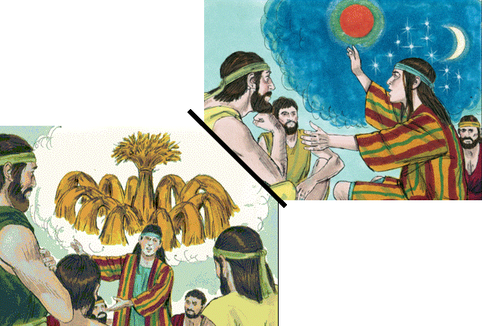
Old Testament Book
Joseph’s Dreams
Genesis
Exodus
Leviticus
Numbers
Deuteronomy
… and Chapter
28
48
37
Bible Illustrations From Sweet Publishing

Slide 10
Old Testament Book
Joseph’s Dreams
Genesis
1 point
… and Chapter
37
2 points
Bible Illustrations From Sweet Publishing

Slide 11
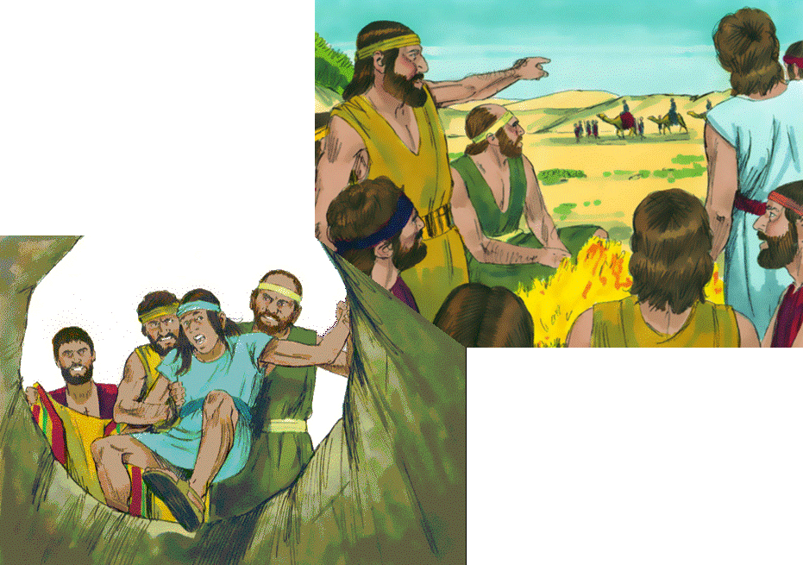
Joseph is Sold
by his Brothers
Old Testament Book
Genesis
Exodus
Leviticus
Numbers
Deuteronomy
… and Chapter
21
37
45
Bible Illustrations From Sweet Publishing

Slide 12
Joseph is Sold
by his Brothers
Old Testament Book
Genesis
1 point
… and Chapter
37
2 points
Bible Illustrations From Sweet Publishing

Slide 13
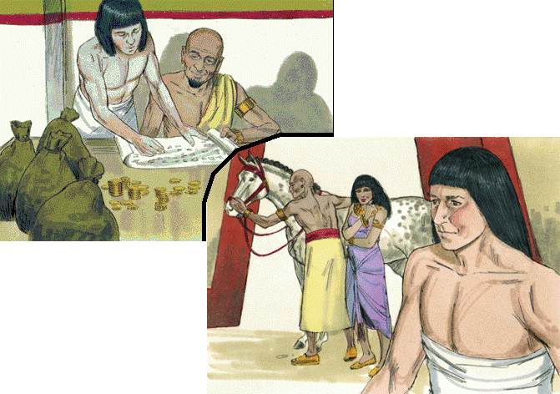
Joseph Serves Potiphar in Egypt
Old Testament Book
Genesis
Exodus
Leviticus
Numbers
Deuteronomy
… and Chapter
Bible Illustrations From Sweet Publishing
31
20
39

Slide 14
Joseph Serves Potiphar in Egypt
Old Testament Book
Genesis
1 point
… and Chapter
Bible Illustrations From Sweet Publishing
2 points
39

Slide 15
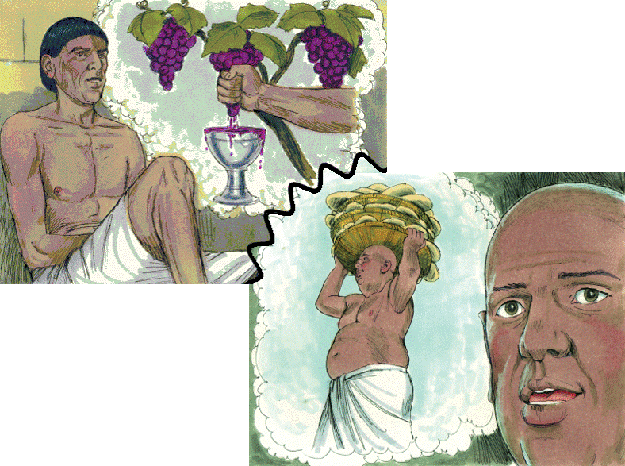
The Butler & The Baker
Old Testament Book
Genesis
Exodus
Leviticus
Numbers
Deuteronomy
Joseph
Interprets
their Dreams
… and Chapter
40
20
30
Bible Illustrations From Sweet Publishing https://www.unfoldingword.org/sweet-publishing

Slide 16
The Butler & The Baker
Old Testament Book
Genesis
1 point
Joseph
Interprets
their Dreams
… and Chapter
40
2 points
Bible Illustrations From Sweet Publishing https://www.unfoldingword.org/sweet-publishing

Slide 17
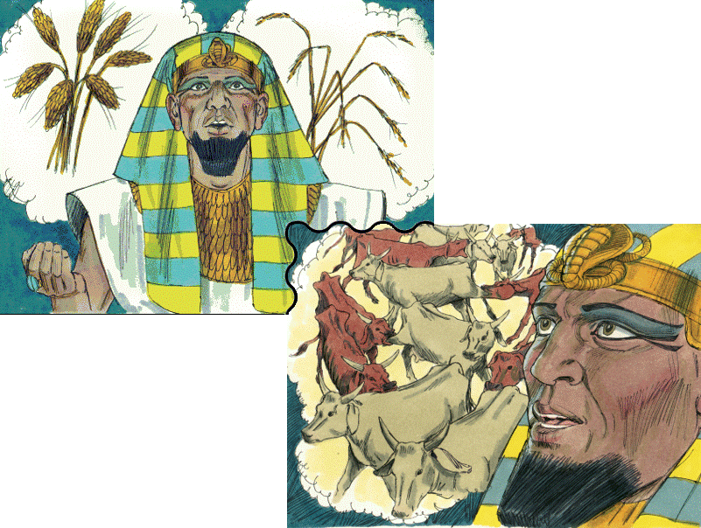
Pharaoh’s Dreams
Old Testament Book
Genesis
Exodus
Leviticus
Numbers
Deuteronomy
Bible Illustrations From Sweet Publishing
… and Chapter
28
41
15

Slide 18
Pharaoh’s Dreams
Old Testament Book
Genesis
1 point
Bible Illustrations From Sweet Publishing
… and Chapter
41
2 points

Slide 19
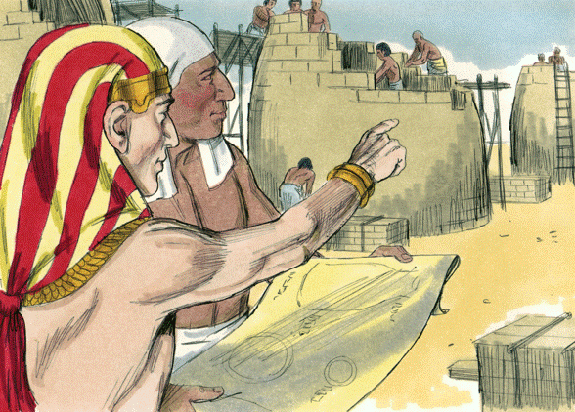
Joseph is Raised
to Power in Egypt
Old Testament Book
Genesis
Exodus
Leviticus
Numbers
Deuteronomy
… and Chapter
17
29
41
Bible Illustrations From Sweet Publishing https://www.unfoldingword.org/sweet-publishing

Slide 20
Joseph is Raised
to Power in Egypt
Old Testament Book
Genesis
1 point
… and Chapter
41
2 points
Bible Illustrations From Sweet Publishing https://www.unfoldingword.org/sweet-publishing

Slide 21
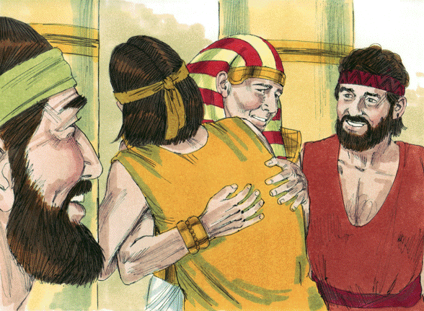
Joseph is Reunited With his Brothers
Old Testament Book
Genesis
Exodus
Leviticus
Numbers
Deuteronomy
… and Chapter
31
45
21
Bible Illustrations From Sweet Publishing https://www.unfoldingword.org/sweet-publishing

Slide 22
Joseph is Reunited With his Brothers
Old Testament Book
Genesis
1 point
… and Chapter
2 points
45
Bible Illustrations From Sweet Publishing https://www.unfoldingword.org/sweet-publishing

Slide 23
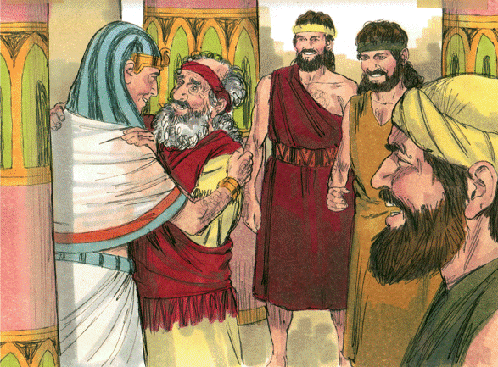
Jacob Goes to Joseph in Egypt
Old Testament Book
Genesis
Exodus
Leviticus
Numbers
Deuteronomy
… and Chapter
46
26
12
Bible Illustrations From Sweet Publishing https://www.unfoldingword.org/sweet-publishing

Slide 24
Jacob Goes to Joseph in Egypt
Old Testament Book
Genesis
1 point
… and Chapter
46
2 points
Bible Illustrations From Sweet Publishing https://www.unfoldingword.org/sweet-publishing

Slide 25
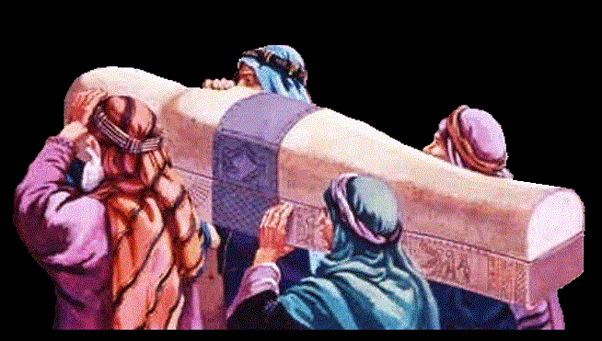
Old Testament Book
Joseph Dies
in Egypt
Genesis
Exodus
Leviticus
Numbers
Deuteronomy
… and Chapter
49
38
50
www.yeshua.wordpress.com/2016/07/16/the-exodus-from-egypt-and-the-red-sea-crossing-exodus-1231-1519/

Slide 26
Old Testament Book
Joseph Dies
in Egypt
Genesis
1 point
… and Chapter
2 points
50
www.yeshua.wordpress.com/2016/07/16/the-exodus-from-egypt-and-the-red-sea-crossing-exodus-1231-1519/

Slide 27
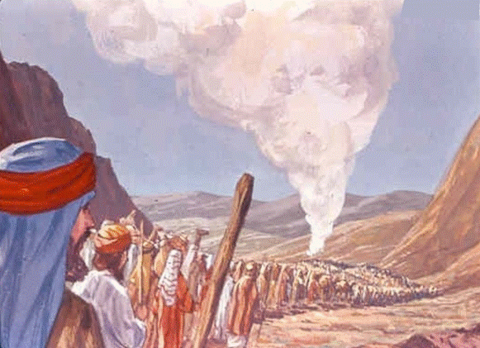
Israel Leaves
Mt. Sinai
Old Testament Book
Genesis
Exodus
Leviticus
Numbers
Deuteronomy
… and Chapter
10
40
1
St-Talka.org

Slide 28
Israel Leaves
Mt. Sinai
Old Testament Book
1 point
Numbers
… and Chapter
10
2 points
St-Talka.org

Slide 29
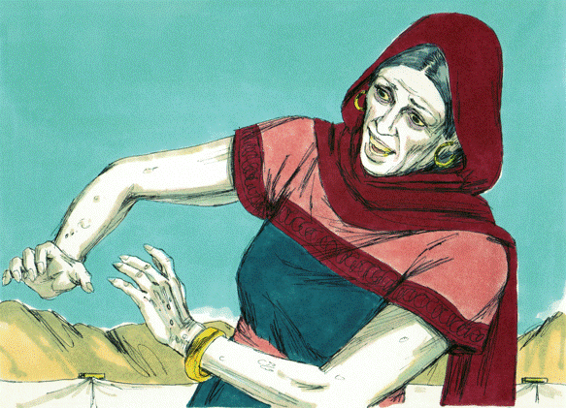
Miriam is Struck
with Leprosy
Old Testament Book
Genesis
Exodus
Leviticus
Numbers
Deuteronomy
… and Chapter
24
12
36
Bible Illustrations From Sweet Publishing https://www.unfoldingword.org/sweet-publishing

Slide 30
Miriam is Struck
with Leprosy
Old Testament Book
1 point
Numbers
… and Chapter
12
2 points
Bible Illustrations From Sweet Publishing https://www.unfoldingword.org/sweet-publishing

Slide 31
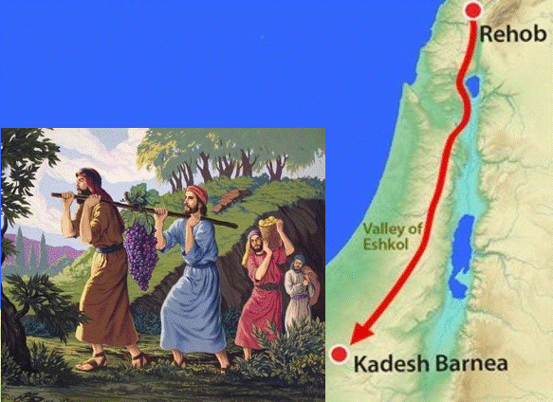
Twelve Spies
Search the Land
of Canaan
Old Testament Book
Genesis
Exodus
Leviticus
Numbers
Deuteronomy
… and Chapter
5
13
20
http://www.freebibleimages.org/illustrations/moses-spies/

Slide 32
Twelve Spies
Search the Land
of Canaan
Old Testament Book
1 point
Numbers
… and Chapter
13
2 points
http://www.freebibleimages.org/illustrations/moses-spies/

Slide 33
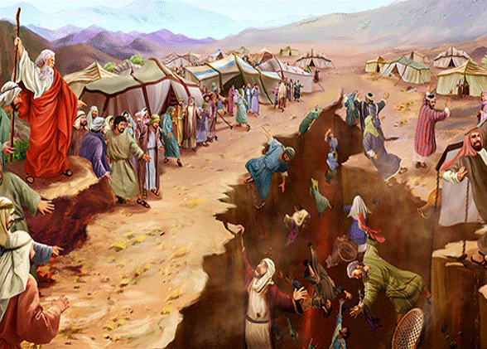
Old Testament Book
Korah’s Rebellion
Genesis
Exodus
Leviticus
Numbers
Deuteronomy
… and Chapter
25
2
16
https://toirahruv.com/wp-content/uploads/2017/06/Korahs-Rebellion.jpg

Slide 34
Old Testament Book
Korah’s Rebellion
1 point
Numbers
… and Chapter
16
2 points
https://toirahruv.com/wp-content/uploads/2017/06/Korahs-Rebellion.jpg

Slide 35
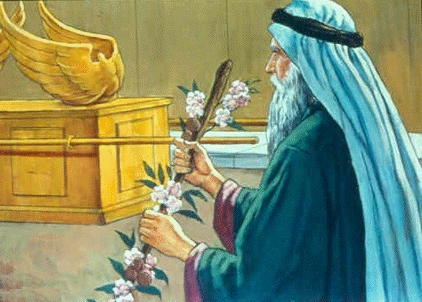
Aaron’s Staff Buds
& Bears Almonds
Old Testament Book
Genesis
Exodus
Leviticus
Numbers
Deuteronomy
… and Chapter
17
3
8
https://st-takla.org/Gallery/Bible/Illustrations/Bible-Slides/OT/Numbers/Bible-Slides-numbers-466.html

Slide 36
Aaron’s Staff Buds
& Bears Almonds
Old Testament Book
1 point
Numbers
… and Chapter
17
2 points
https://st-takla.org/Gallery/Bible/Illustrations/Bible-Slides/OT/Numbers/Bible-Slides-numbers-466.html

Slide 37
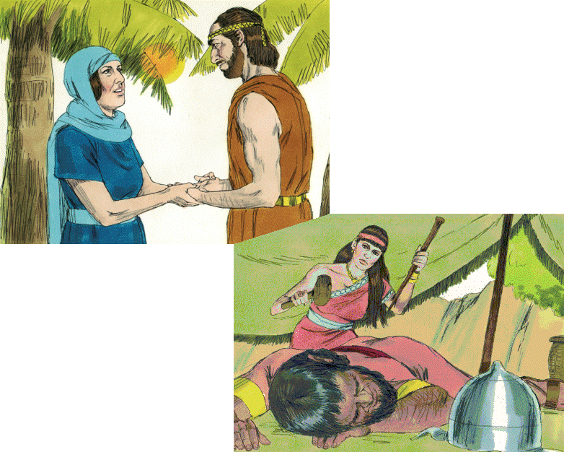
Old Testament Book
Joshua
Judges
Ruth
1 Samuel
2 Samuel
Deborah & Barak
Jael
& Sisera
… and Chapters
4-5
13-16
29-31
Bible Illustrations From Sweet Publishing https://www.unfoldingword.org/sweet-publishing

Slide 38
Old Testament Book
Judges
1 point
Deborah & Barak
Jael
& Sisera
… and Chapters
4-5
2 points
Bible Illustrations From Sweet Publishing https://www.unfoldingword.org/sweet-publishing

Slide 39
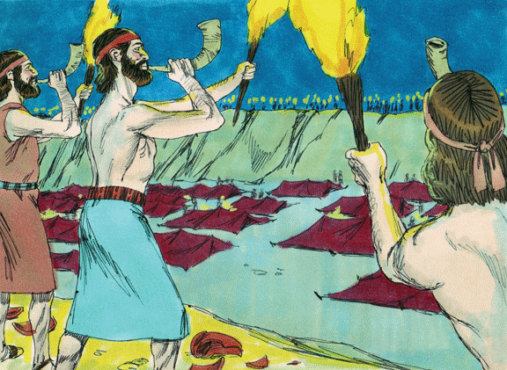
Gideon Defeats
the Midianites
Old Testament Book
Joshua
Judges
Ruth
1 Samuel
2 Samuel
… and Chapters
6-8
2-3
17-18
Bible Illustrations From Sweet Publishing https://www.unfoldingword.org/sweet-publishing

Slide 40
Gideon Defeats
the Midianites
Old Testament Book
Judges
1 point
… and Chapters
6-8
2 points
Bible Illustrations From Sweet Publishing https://www.unfoldingword.org/sweet-publishing

Slide 41
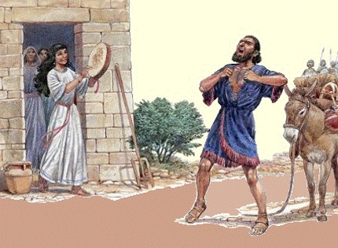
Jephthah and his Faithful Daughter
Old Testament Book
Joshua
Judges
Ruth
1 Samuel
2 Samuel
… and Chapter
11
4
21
http://www.biblestudywithrandy.com/2015/11/jephthahs-daughter-part-2-was-she-sacrificed/

Slide 42
Jephthah and his Faithful Daughter
Old Testament Book
Judges
1 point
… and Chapter
11
2 points
http://www.biblestudywithrandy.com/2015/11/jephthahs-daughter-part-2-was-she-sacrificed/

Slide 43
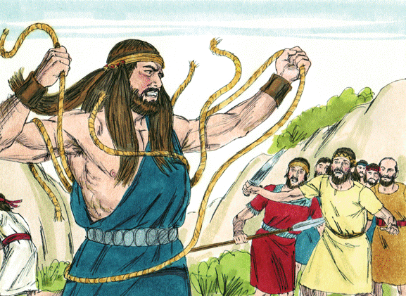
Samson, the Spirit-
Powered Nazarite
Old Testament Book
Joshua
Judges
Ruth
1 Samuel
2 Samuel
… and Chapters
2-3
13-16
6-8
Bible Illustrations From Sweet Publishing https://www.unfoldingword.org/sweet-publishing

Slide 44
Samson, the Spirit-
Powered Nazarite
Old Testament Book
Judges
1 point
… and Chapters
13-16
2 points
Bible Illustrations From Sweet Publishing https://www.unfoldingword.org/sweet-publishing

Slide 45
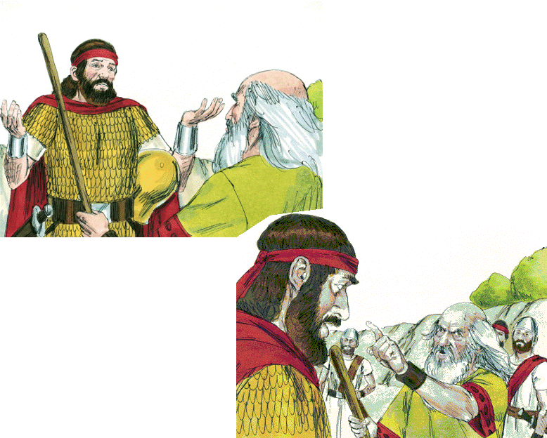
Old Testament Book
Saul Spares Agag
Joshua
Judges
Ruth
1 Samuel
2 Samuel
“To obey is better than sacrifice”
… and Chapter
6
15
24
Bible Illustrations From Sweet Publishing https://www.unfoldingword.org/sweet-publishing

Slide 46
Old Testament Book
Saul Spares Agag
1 Samuel
1 point
“To obey is better than sacrifice”
… and Chapter
15
2 points
Bible Illustrations From Sweet Publishing https://www.unfoldingword.org/sweet-publishing

Slide 47
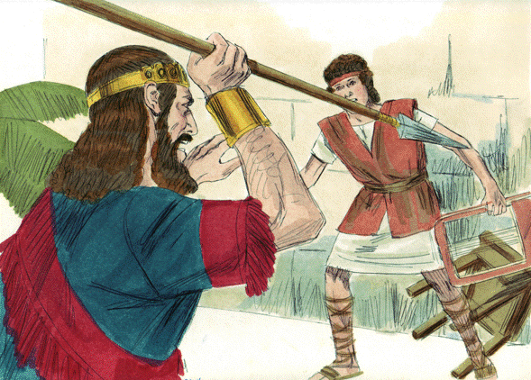
Saul Tries to
Kill David
Old Testament Book
Joshua
Judges
Ruth
1 Samuel
2 Samuel
… and Chapter
19
30
24
Bible Illustrations From Sweet Publishing https://www.unfoldingword.org/sweet-publishing

Slide 48
Saul Tries to
Kill David
Old Testament Book
1 Samuel
1 point
… and Chapter
19
2 points
Bible Illustrations From Sweet Publishing https://www.unfoldingword.org/sweet-publishing

Slide 49
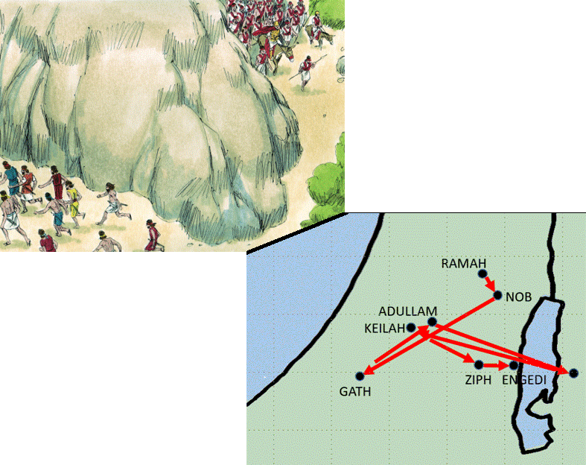
Old Testament Book
Joshua
Judges
Ruth
1 Samuel
2 Samuel
Bible Illustrations From Sweet Publishing
David
Flees
from Saul
… and Chapters
6-8
15-18
20-27

Slide 50
Old Testament Book
1 Samuel
1 point
Bible Illustrations From Sweet Publishing
David
Flees
from Saul
… and Chapters
2 points
20-27

Slide 51
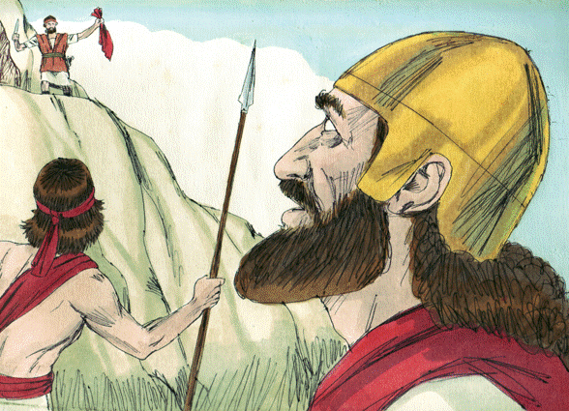
David Spares
Saul’s Life … Twice
Old Testament Book
Joshua
Judges
Ruth
1 Samuel
2 Samuel
… and Chapters
16 & 18
30 & 31
24 & 26
Bible Illustrations From Sweet Publishing https://www.unfoldingword.org/sweet-publishing

Slide 52
David Spares
Saul’s Life … Twice
Old Testament Book
1 Samuel
1 point
… and Chapters
24 & 26
2 points
Bible Illustrations From Sweet Publishing https://www.unfoldingword.org/sweet-publishing

Slide 53
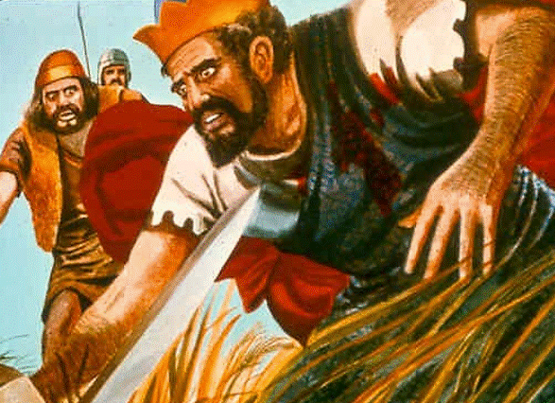
Old Testament Book
Saul Dies in Battle!
Joshua
Judges
Ruth
1 Samuel
2 Samuel
… and Chapter
26
17
31
St-Talka.org

Slide 54
Old Testament Book
Saul Dies in Battle!
1 Samuel
1 point
… and Chapter
2 points
31
St-Talka.org

Slide 55
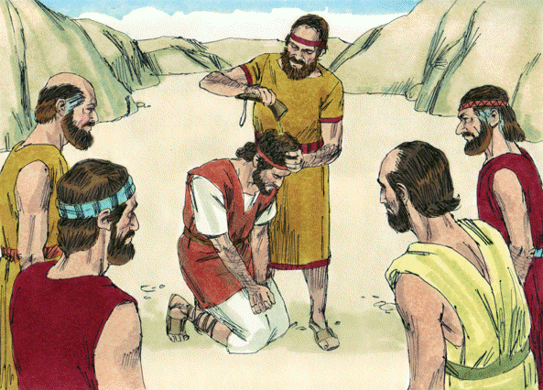
David Becomes King Over All Israel
Old Testament Book
Joshua
Judges
Ruth
1 Samuel
2 Samuel
… and Chapter
1
5
10
Bible Illustrations From Sweet Publishing https://www.unfoldingword.org/sweet-publishing

Slide 56
David Becomes King Over All Israel
Old Testament Book
1 point
2 Samuel
… and Chapter
2 points
5
Bible Illustrations From Sweet Publishing https://www.unfoldingword.org/sweet-publishing

Slide 57
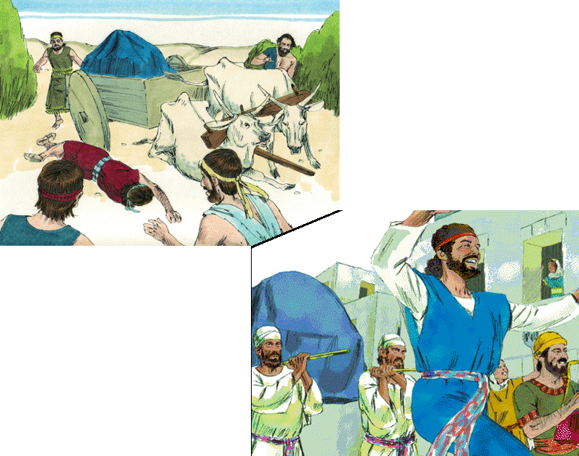
Old Testament Book
Joshua
Judges
Ruth
1 Samuel
2 Samuel
David Brings the Ark to Jerusalem
… and Chapter
2
16
6
Bible Illustrations From Sweet Publishing

Slide 58
Old Testament Book
1 point
2 Samuel
David Brings the Ark to Jerusalem
… and Chapter
6
2 points
Bible Illustrations From Sweet Publishing

Slide 59
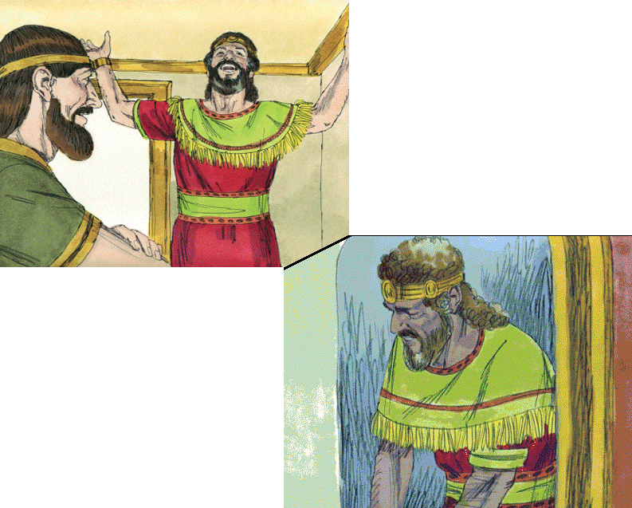
Old Testament Book
Joshua
Judges
Ruth
1 Samuel
2 Samuel
God’s Covenant with David
… and Chapter
23
7
16
Bible Illustrations From Sweet Publishing

Slide 60
Old Testament Book
1 point
2 Samuel
God’s Covenant with David
… and Chapter
7
2 points
Bible Illustrations From Sweet Publishing

Slide 61
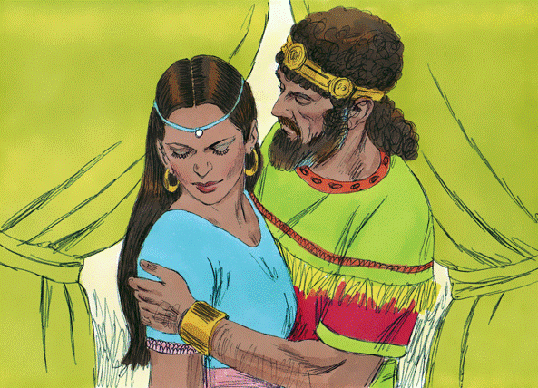
Old Testament Book
David & Bathsheba
Joshua
Judges
Ruth
1 Samuel
2 Samuel
… and Chapter
16
11
21
Bible Illustrations From Sweet Publishing https://www.unfoldingword.org/sweet-publishing

Slide 62
Old Testament Book
David & Bathsheba
1 point
2 Samuel
… and Chapter
11
2 points
Bible Illustrations From Sweet Publishing https://www.unfoldingword.org/sweet-publishing

Slide 63
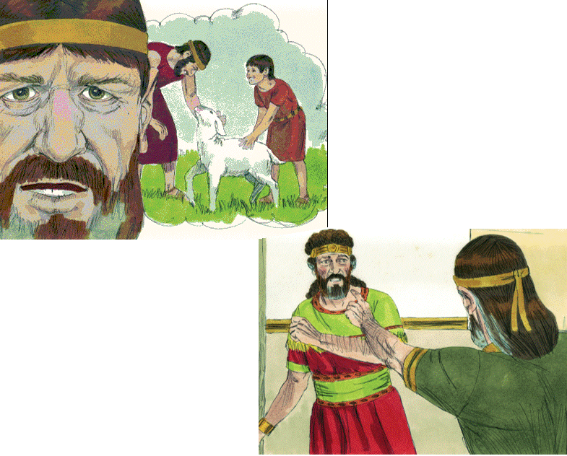
Old Testament Book
Joshua
Judges
Ruth
1 Samuel
2 Samuel
Nathan
to David: “You are the man!”
… and Chapter
5
12
20
Bible Illustrations From Sweet Publishing

Slide 64
Old Testament Book
1 point
2 Samuel
Nathan
to David: “You are the man!”
… and Chapter
12
2 points
Bible Illustrations From Sweet Publishing

Slide 65
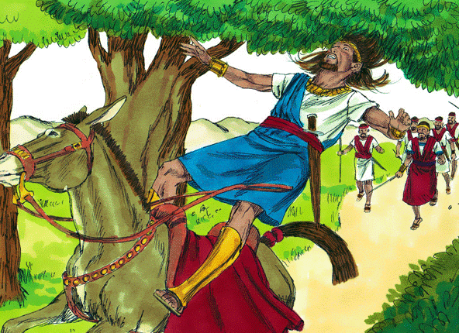
Old Testament Book
Absalom’s Rebellion
Joshua
Judges
Ruth
1 Samuel
2 Samuel
… and Chapters
15-18
7-9
23 & 25
Bible Illustrations From Sweet Publishing https://www.unfoldingword.org/sweet-publishing

Slide 66
Old Testament Book
Absalom’s Rebellion
1 point
2 Samuel
… and Chapters
15-18
2 points
Bible Illustrations From Sweet Publishing https://www.unfoldingword.org/sweet-publishing

Slide 67
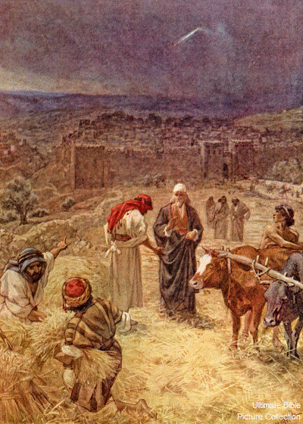
David Buys
Araunah’s
Threshing
Floor
Old Testament Book
Joshua
Judges
Ruth
1 Samuel
2 Samuel
… and Chapter
31
24
13
Ultimate Bible Picture Collection

Slide 68
David Buys
Araunah’s
Threshing
Floor
Old Testament Book
1 point
2 Samuel
… and Chapter
24
2 points
Ultimate Bible Picture Collection

