Slide 1


Bible Book and Chapter Challenge!
Great Passages in the New Testament Letters
Tap the screen and get started

Slide 2
Bible Book and Chapter Challenge!
Great Passages in the New Testament Letters
A Multiple-Choice Bible Game
This multiple-choice game is created in PowerPoint. A tap (screen-tap or mouse-click) is all that is needed to play. No PowerPoint skills are required. See “Here’s how it works” (next screen).
Clipart for Passages 3, 4, 11, 15, 21, and 27 is credited on each screen. The scroll clipart used with all other Passages is a VectorStock image. Bible text has been added.
Tap the screen to continue

Slide 3
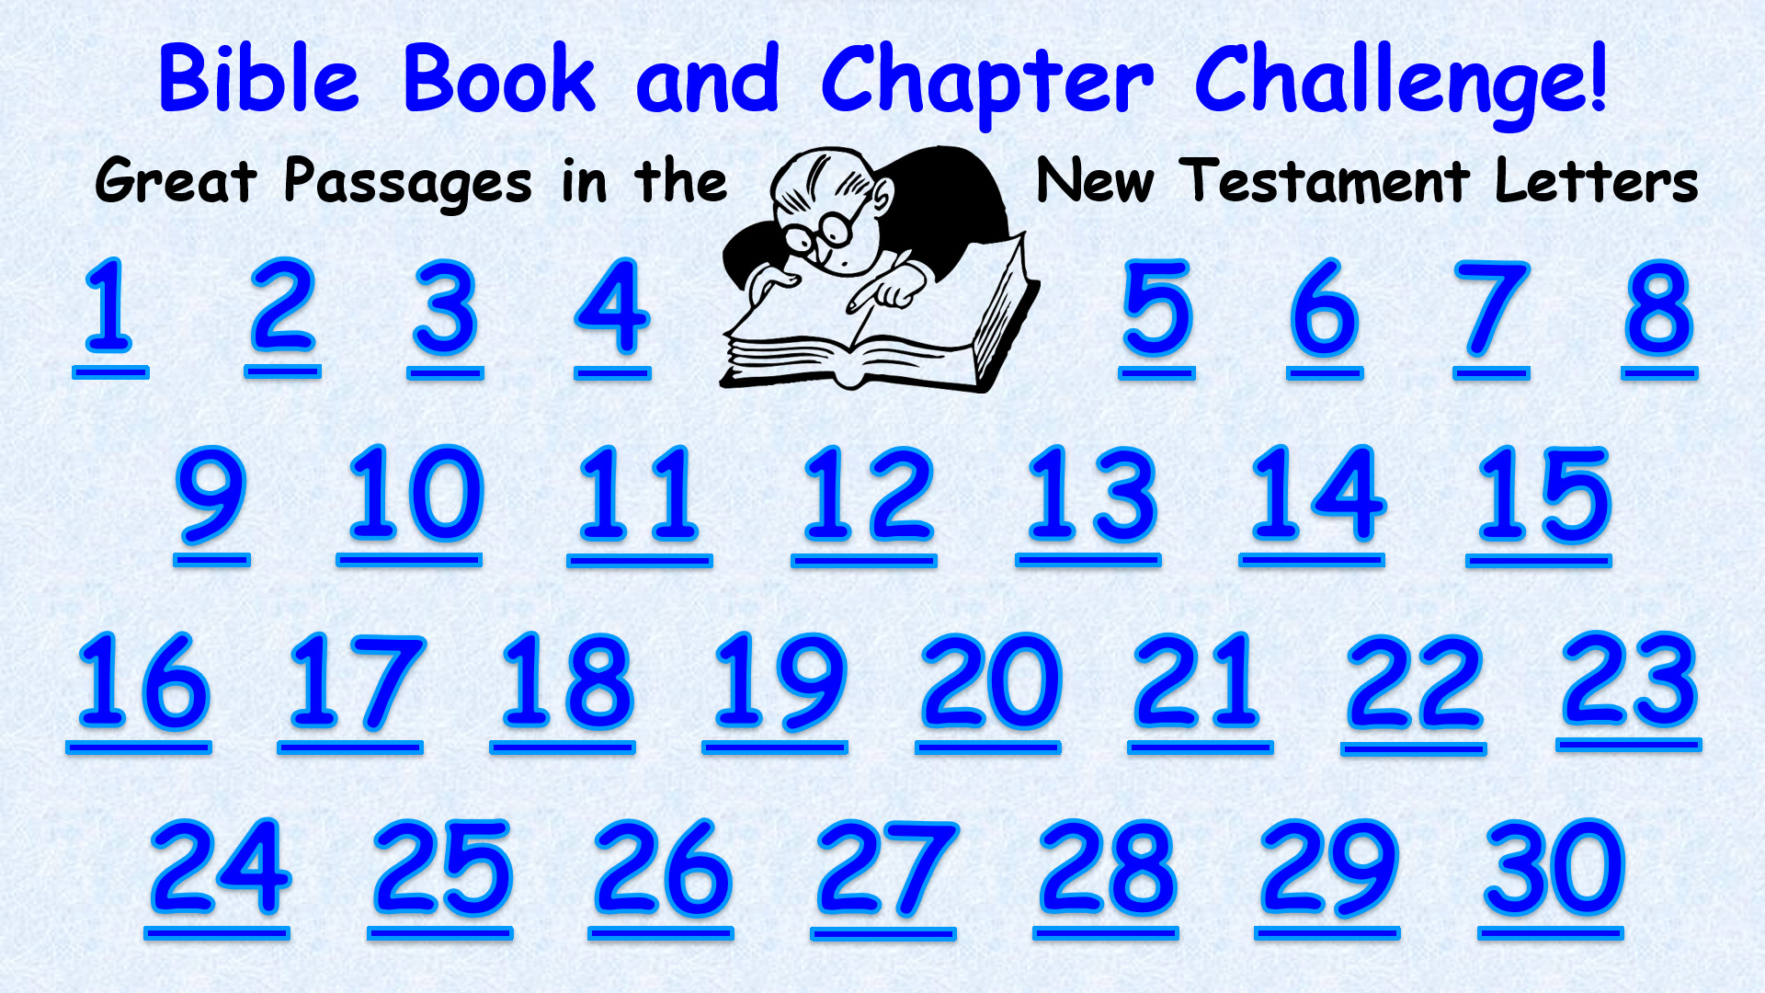
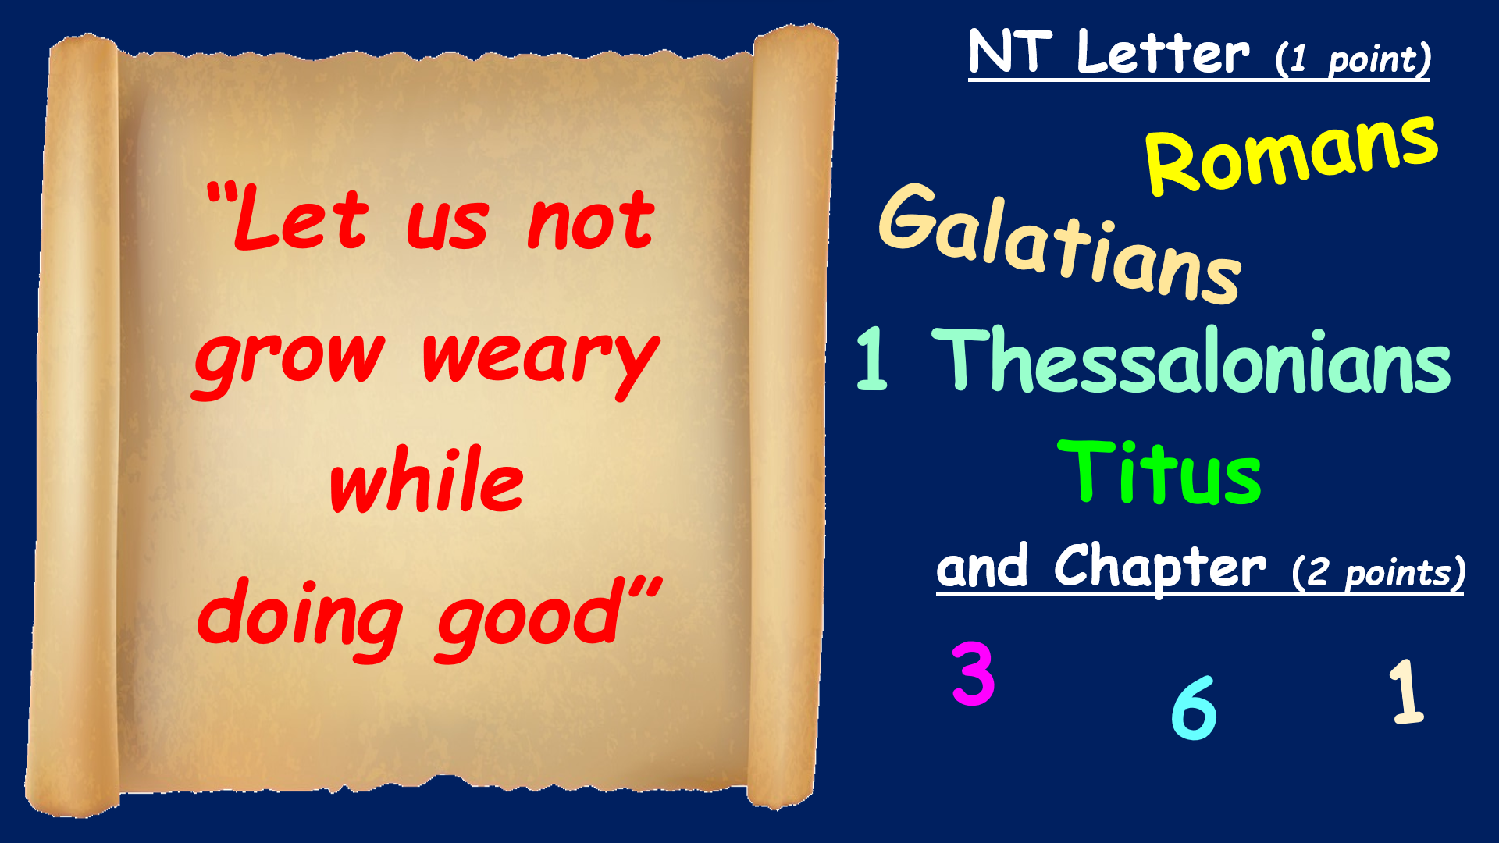
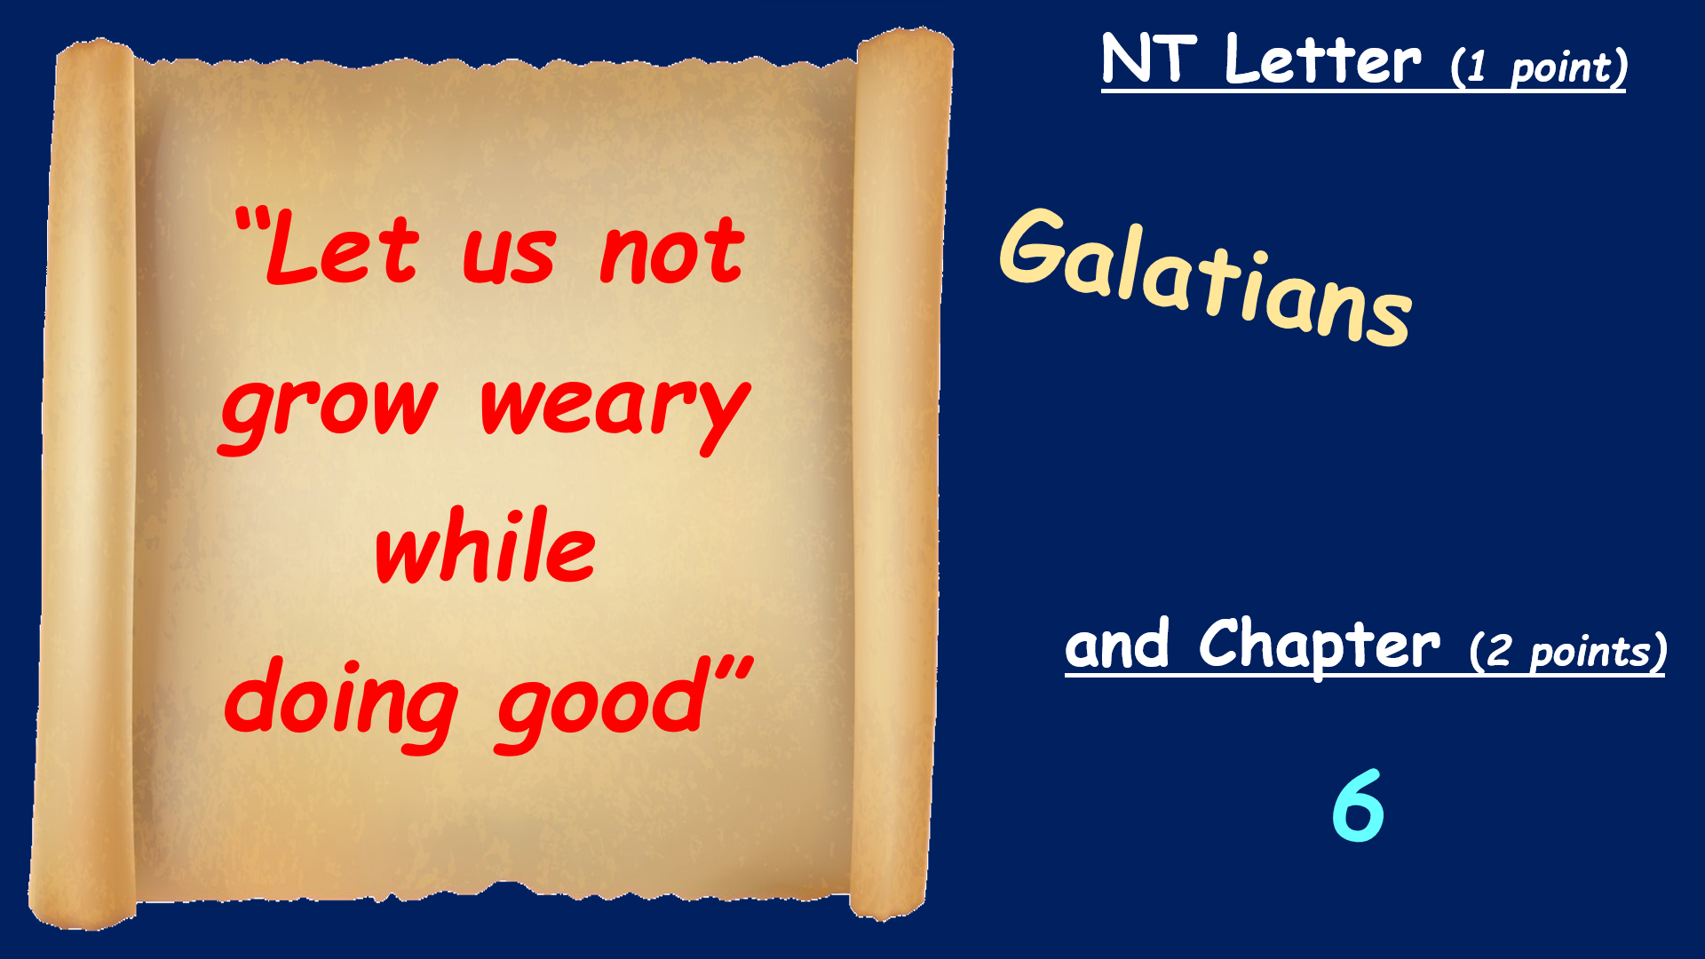
Here’s how it works
(1) Tap a Passage Number on the Menu Board (next screen).
(2) Read the Passage and study the Book and Chapter choices that
come up.
(3) It’s a multiple-choice game. Each Player or Team tries to choose
the correct Book and Chapter for the Passage.
(4) After making your choices, tap the screen to get the answers –
1 point for each correct Book and 2 points for each correct Chapter.
Everyone can score on every Passage.
(5) Tap the screen again and return to the Menu Board.
Tap the screen to go to the Menu Board and start playing

Slide 4
Bible Book and Chapter Challenge!
Great Passages in the New Testament Letters
1
2
3
4
5
6
7
8
9
10
11
12
13
14
15
16
17
18
19
20
21
22
23
24
25
26
27
28
29
30

Slide 5

The
Baptism
Chapter
NT Letter (1 point)
Romans
Galatians
Hebrews
James
and Chapter (2 points)
“Baptized into
Jesus Christ”
4
6
2
www.istockphoto.com/

Slide 6
The
Baptism
Chapter
NT Letter (1 point)
Romans
and Chapter (2 points)
“Baptized into
Jesus Christ”
6
www.istockphoto.com/

Slide 7

The Love Chapter
NT Letter (1 point)
1 Corinthians
Colossians
Philemon
Jude
and Chapter (2 points)
1
13
“Love is kind”
4
freepik.com

Slide 8
The Love Chapter
NT Letter (1 point)
1 Corinthians
and Chapter (2 points)
“Love is kind”
13
freepik.com

Slide 9

Fruit of the Spirit
NT Letter (1 point)
1 Corinthians
“Love,
joy,
peace
…”
Galatians
Ephesians
2 Thessalonians
and Chapter (2 points)
5
3
8
clipartkid.com

Slide 10
Fruit of the Spirit
NT Letter (1 point)
“Love,
joy,
peace
…”
Galatians
and Chapter (2 points)
5
clipartkid.com

Slide 11
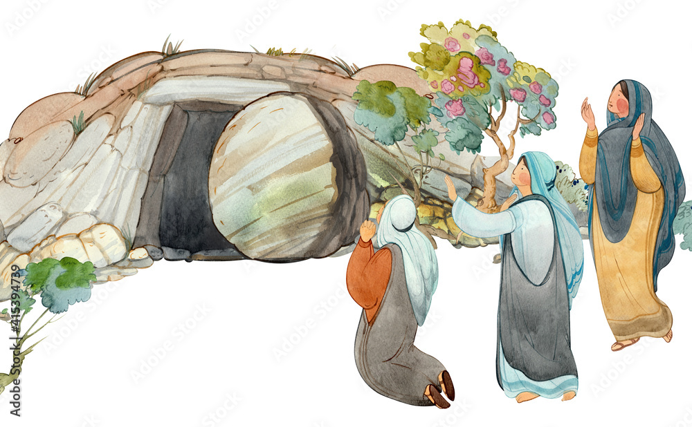
The Resurrection Chapter
NT Letter (1 point)
Romans
1 Corinthians
Ephesians
2 Thessalonians
and Chapter (2 points)
“Christ has risen
from the dead
and is the firstfruits
of those who sleep”
5
15
10
Adobe Stock

Slide 12
The Resurrection Chapter
NT Letter (1 point)
1 Corinthians
and Chapter (2 points)
“Christ has risen
from the dead
and is the firstfruits
of those who sleep”
15
Adobe Stock

Slide 13

The Faith Chapter
NT Letter (1 point)
Galatians
Philippians
Hebrews
1 John
and Chapter (2 points)
11
“Faith is the substance of things hoped for”
4
13
Free Clip Arts on Clipart Library

Slide 14
The Faith Chapter
NT Letter (1 point)
Hebrews
and Chapter (2 points)
11
“Faith is the substance of things hoped for”
Free Clip Arts on Clipart Library

Slide 15

The Armor of God
NT Letter (1 point)
Romans
2 Corinthians
Ephesians
Titus
and Chapter (2 points)
6
9
2
“Put on the whole
armor of God”
Adobe Stock

Slide 16
The Armor of God
NT Letter (1 point)
Ephesians
and Chapter (2 points)
6
“Put on the whole
armor of God”
Adobe Stock

Slide 17

NT Letter (1 point)
Romans
“All have sinned
and fall short
of the
glory of God”
Galatians
Colossians
1 Timothy
and Chapter (2 points)
3
8
6

Slide 18
NT Letter (1 point)
Romans
“All have sinned
and fall short
of the
glory of God”
and Chapter (2 points)
3

Slide 19
NT Letter (1 point)
Nothing
“shall be able
to separate us from
the love of God
which is in
Christ Jesus
our Lord”
Romans
1 Timothy
Titus
1 John
and Chapter (2 points)
8
3
1

Slide 20
NT Letter (1 point)
Nothing
“shall be able
to separate us from
the love of God
which is in
Christ Jesus
our Lord”
Romans
and Chapter (2 points)
8

Slide 21
NT Letter (1 point)
Romans
“Faith comes
by hearing,
and hearing
by the word
of God”
2 Timothy
Hebrews
James
and Chapter (2 points)
3
10
5

Slide 22
NT Letter (1 point)
Romans
“Faith comes
by hearing,
and hearing
by the word
of God”
and Chapter (2 points)
10

Slide 23
NT Letter (1 point)
Romans
“God has set
the members,
each one of them, in the body
just as
He pleased”
1 Corinthians
Galatians
Jude
and Chapter (2 points)
1
12
5

Slide 24
NT Letter (1 point)
“God has set
the members,
each one of them, in the body
just as
He pleased”
1 Corinthians
and Chapter (2 points)
12

Slide 25
NT Letter (1 point)
1 Corinthians
“For as in Adam
all die,
even so in Christ
all shall be
made alive”
Ephesians
Philippians
1 Thessalonians
and Chapter (2 points)
5
15
3

Slide 26
NT Letter (1 point)
1 Corinthians
“For as in Adam
all die,
even so in Christ
all shall be
made alive”
and Chapter (2 points)
15

Slide 27
NT Letter (1 point)
Romans
“God loves
a cheerful
giver”
2 Corinthians
Philippians
2 Peter
and Chapter (2 points)
9
4
2

Slide 28
NT Letter (1 point)
“God loves
a cheerful
giver”
2 Corinthians
and Chapter (2 points)
9

Slide 29
NT Letter (1 point)
Galatians
“Whatever
a man sows,
that
he will also reap”
1Timothy
Hebrews
2 Peter
and Chapter (2 points)
2
4
6

Slide 30
NT Letter (1 point)
Galatians
“Whatever
a man sows,
that
he will also reap”
and Chapter (2 points)
6

Slide 31
NT Letter (1 point)
Romans
“Set your mind
on things above,
not on things
on the earth”
Ephesians
Colossians
James
and Chapter (2 points)
6
3
2

Slide 32
NT Letter (1 point)
“Set your mind
on things above,
not on things
on the earth”
Colossians
and Chapter (2 points)
3

Slide 33
NT Letter (1 point)
Galatians
“Pray without ceasing,
in everything
give thanks”
1 Thessalonians
Hebrews
3 John
and Chapter (2 points)
5
9
2

Slide 34
NT Letter (1 point)
“Pray without ceasing,
in everything
give thanks”
1 Thessalonians
and Chapter (2 points)
5

Slide 35
NT Letter (1 point)
1 Corinthians
“Test all things;
hold fast
what is good”
Philippians
1 Thessalonians
1 Peter
and Chapter (2 points)
1
3
5

Slide 36
NT Letter (1 point)
“Test all things;
hold fast
what is good”
1 Thessalonians
and Chapter (2 points)
5

Slide 37
NT Letter (1 point)
Ephesians
"The love of money
is a root
of all kinds
of evil”
Colossians
1 Timothy
Titus
and Chapter (2 points)
3
6
2

Slide 38
NT Letter (1 point)
"The love of money
is a root
of all kinds
of evil”
1 Timothy
and Chapter (2 points)
6

Slide 39
NT Letter (1 point)
Romans
“All Scripture
is given
by inspiration
of God”
1 Corinthians
Colossians
2 Timothy
and Chapter (2 points)
3
9
5

Slide 40
NT Letter (1 point)
“All Scripture
is given
by inspiration
of God”
2 Timothy
and Chapter (2 points)
3

Slide 41
NT Letter (1 point)
Philippians
“Faith is
the substance of
things hoped for,
the evidence of
things not seen”
Colossians
Philemon
Hebrews
and Chapter (2 points)
1
11
4

Slide 42
NT Letter (1 point)
“Faith is
the substance of
things hoped for,
the evidence of
things not seen”
Hebrews
and Chapter (2 points)
11

Slide 43
NT Letter (1 point)
James
“Each one
is tempted
when he is
drawn away
by his own desires
and enticed”
1 Peter
1 John
Jude
and Chapter (2 points)
1
3
6

Slide 44
NT Letter (1 point)
James
“Each one
is tempted
when he is
drawn away
by his own desires
and enticed”
and Chapter (2 points)
1

Slide 45
NT Letter (1 point)
1 Thessalonians
“Faith
without works
is dead”
Hebrews
James
2 Peter
and Chapter (2 points)
2
4
6

Slide 46
NT Letter (1 point)
“Faith
without works
is dead”
James
and Chapter (2 points)
2

Slide 47
NT Letter (1 point)
Romans
“As he who
called you
is holy,
you also
be holy in
all your conduct”
Galatians
2 Thessalonians
1 Peter
and Chapter (2 points)
1
5
3

Slide 48
NT Letter (1 point)
“As he who
called you
is holy,
you also
be holy in
all your conduct”
1 Peter
and Chapter (2 points)
1

Slide 49
NT Letter (1 point)
Romans
Jesus
“was in all points tempted
as we are,
yet without sin”
Hebrews
2 Peter
Jude
and Chapter (2 points)
4
8
1

Slide 50
NT Letter (1 point)
Jesus
“was in all points tempted
as we are,
yet without sin”
Hebrews
and Chapter (2 points)
4

Slide 51
NT Letter (1 point)
Romans
“There is one God and one mediator between
God and men,
the man
Christ Jesus”
Hebrews
1 Timothy
1 Peter
and Chapter (2 points)
4
6
2

Slide 52
NT Letter (1 point)
“There is one God and one mediator between
God and men,
the man
Christ Jesus”
1 Timothy
and Chapter (2 points)
2

Slide 53
NT Letter (1 point)
Galatians
“Honor all people.
Love the brotherhood.
Fear God.
Honor the king.”
Philippians
2 Thessalonians
1 Peter
and Chapter (2 points)
2
6
4

Slide 54
NT Letter (1 point)
“Honor all people.
Love the brotherhood.
Fear God.
Honor the king.”
1 Peter
and Chapter (2 points)
2

Slide 55
NT Letter (1 point)
Colossians
“If we
confess our sins,
he is faithful
and just
to forgive us
our sins”
2 Peter
1 John
Jude
and Chapter (2 points)
1
3
5

Slide 56
NT Letter (1 point)
“If we
confess our sins,
he is faithful
and just
to forgive us
our sins”
1 John
and Chapter (2 points)
1

Slide 57
NT Letter (1 point)
Ephesians
“This is
the promise
that he has promised us—eternal life”
Philippians
2 Thessalonians
1 John
and Chapter (2 points)
2
8
4

Slide 58
NT Letter (1 point)
“This is
the promise
that he has promised us—eternal life”
1 John
and Chapter (2 points)
2

Slide 59
NT Letter (1 point)
Titus
“When
he is revealed,
we shall be like him, for we shall see him as he is”
Philemon
1 John
Jude
and Chapter (2 points)
3
1
5

Slide 60
NT Letter (1 point)
“When
he is revealed,
we shall be like him, for we shall see him as he is”
1 John
and Chapter (2 points)
3

Slide 61
NT Letter (1 point)
Galatians
“Be anxious for nothing … and
let your requests be made known
to God”
Philippians
Hebrews
James
and Chapter (2 points)
1
4
9

Slide 62
NT Letter (1 point)
“Be anxious for nothing … and
let your requests be made known
to God”
Philippians
and Chapter (2 points)
4

Slide 63
NT Letter (1 point)
Galatians
“By grace
you have been saved through faith
…
It is the gift
of God”
Ephesians
Philippians
Colossians
and Chapter (2 points)
1
2
6

Slide 64
NT Letter (1 point)
“By grace
you have been saved through faith
…
It is the gift
of God”
Ephesians
and Chapter (2 points)
2

