Slide 1
Bible Book and Chapter Challenge!
Old Testament Events Set #4
Tap the screen to get started

Slide 2
Bible Book and Chapter Challenge!
Old Testament Events Set #4
A Multiple-Choice Bible Game
This multiple-choice game is created in PowerPoint. A tap (screen-tap or mouse-click) is all that is needed to play. No PowerPoint skills are required. See “Here’s how it works” (next screen).
Images for all the Old Testament Events are credited on each screen.
Tap the screen to continue

Slide 3
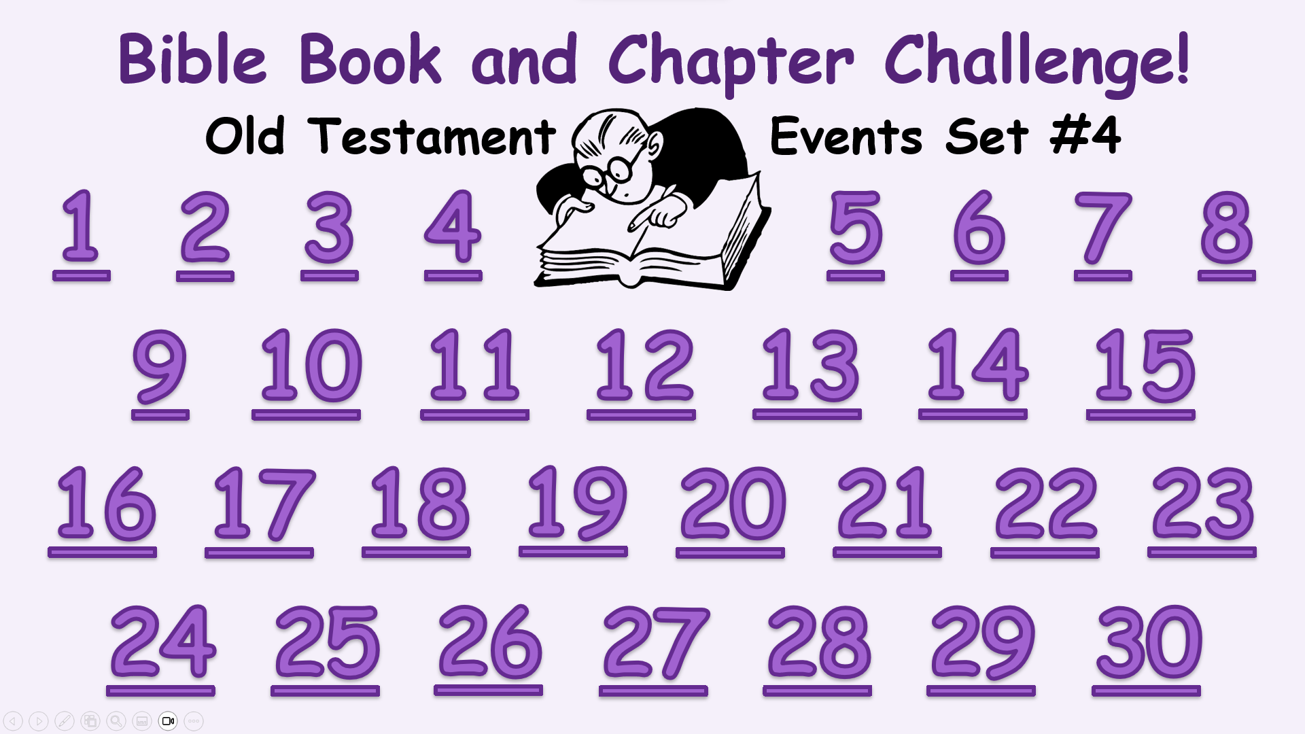
Here’s how it works
(1) Tap an Event Number on the Menu Board (next screen).
(2) Look at the Old Testament Event and the Book and Chapter
choices that come up.
(3) It’s a multiple-choice game. Each Player or Team tries to choose
the correct Book and Chapter for the Event.
(4) After making your choices, tap the screen to get the answers –
1 point for each correct Book and 2 points for each correct Chapter.
Everyone can score on every Event.
(5) Tap the screen again and return to the Menu Board.
Tap the screen to go to the Menu Board and start playing

Slide 4
Bible Book and Chapter Challenge!
Old Testament Events Set #4
1
2
3
4
5
6
7
8
9
10
11
12
13
14
15
16
17
18
19
20
21
22
23
24
25
26
27
28
29
30

Slide 5
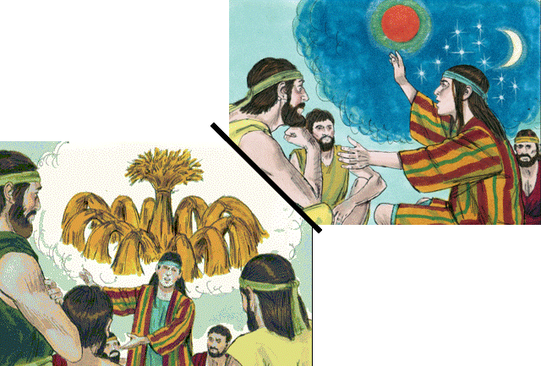
Old Testament Book
Joseph’s Dreams
Genesis
Exodus
Leviticus
Numbers
Deuteronomy
… and Chapter
28
48
37
Bible Illustrations From Sweet Publishing

Slide 6
Old Testament Book
Joseph’s Dreams
Genesis
1 point
… and Chapter
37
2 points
Bible Illustrations From Sweet Publishing

Slide 7
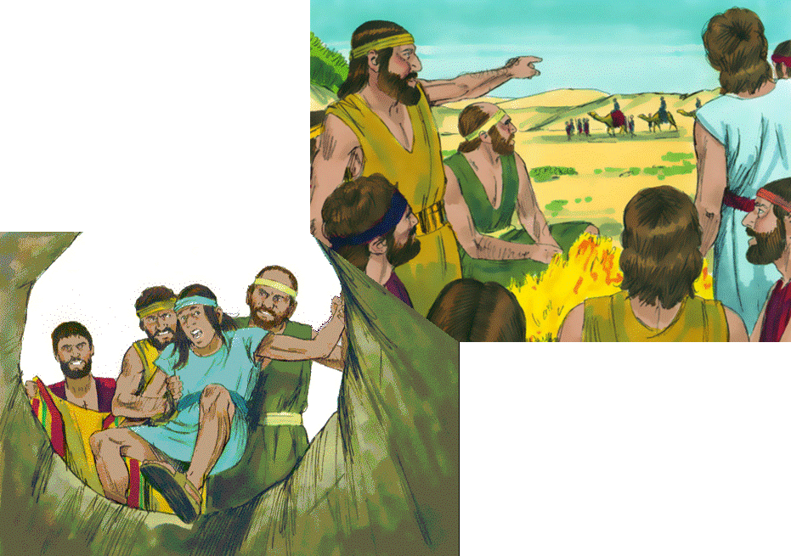
Joseph is Sold
by his Brothers
Old Testament Book
Genesis
Exodus
Leviticus
Numbers
Deuteronomy
… and Chapter
21
37
45
Bible Illustrations From Sweet Publishing

Slide 8
Joseph is Sold
by his Brothers
Old Testament Book
Genesis
1 point
… and Chapter
37
2 points
Bible Illustrations From Sweet Publishing

Slide 9
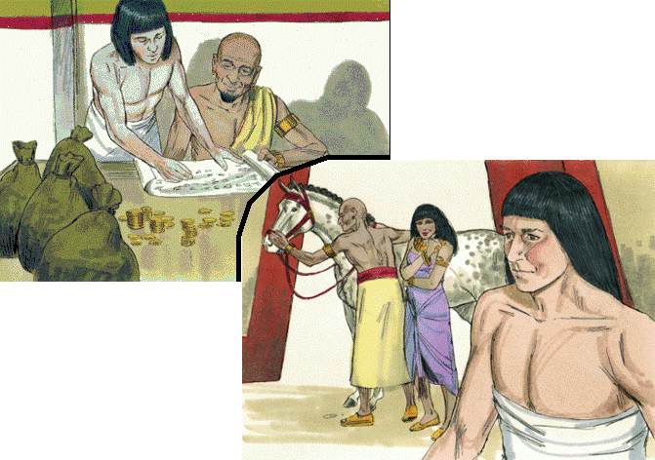
Joseph Serves Potiphar in Egypt
Old Testament Book
Genesis
Exodus
Leviticus
Numbers
Deuteronomy
… and Chapter
Bible Illustrations From Sweet Publishing
31
20
39

Slide 10
Joseph Serves Potiphar in Egypt
Old Testament Book
Genesis
1 point
… and Chapter
Bible Illustrations From Sweet Publishing
2 points
39

Slide 11
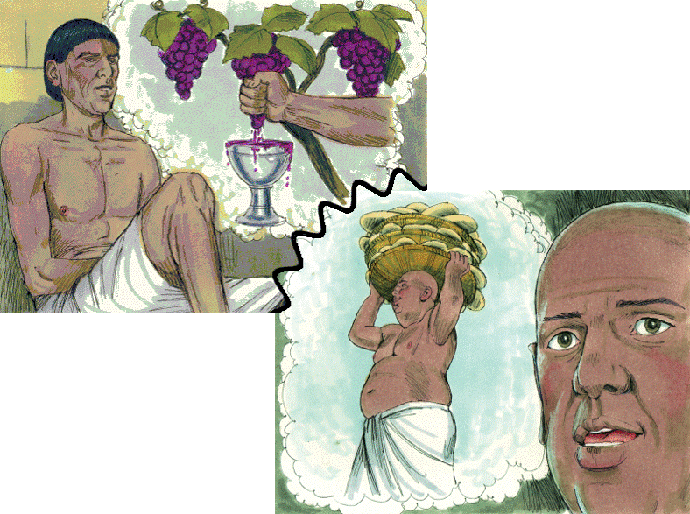
The Butler & The Baker
Old Testament Book
Genesis
Exodus
Leviticus
Numbers
Deuteronomy
Joseph
Interprets
their Dreams
… and Chapter
40
20
30
Bible Illustrations From Sweet Publishing https://www.unfoldingword.org/sweet-publishing

Slide 12
The Butler & The Baker
Old Testament Book
Genesis
1 point
Joseph
Interprets
their Dreams
… and Chapter
40
2 points
Bible Illustrations From Sweet Publishing https://www.unfoldingword.org/sweet-publishing

Slide 13
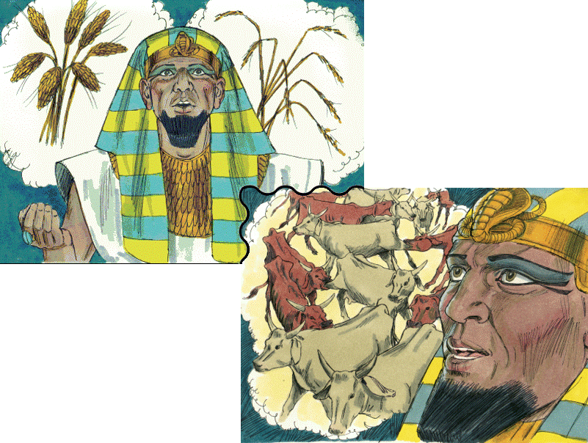
Pharaoh’s Dreams
Old Testament Book
Genesis
Exodus
Leviticus
Numbers
Deuteronomy
Bible Illustrations From Sweet Publishing
… and Chapter
28
41
15

Slide 14
Pharaoh’s Dreams
Old Testament Book
Genesis
1 point
Bible Illustrations From Sweet Publishing
… and Chapter
41
2 points

Slide 15
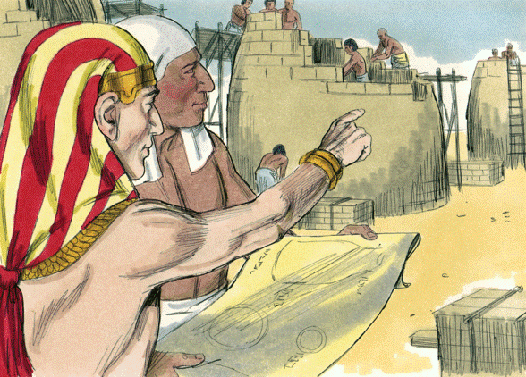
Joseph is Raised
to Power in Egypt
Old Testament Book
Genesis
Exodus
Leviticus
Numbers
Deuteronomy
… and Chapter
17
29
41
Bible Illustrations From Sweet Publishing https://www.unfoldingword.org/sweet-publishing

Slide 16
Joseph is Raised
to Power in Egypt
Old Testament Book
Genesis
1 point
… and Chapter
41
2 points
Bible Illustrations From Sweet Publishing https://www.unfoldingword.org/sweet-publishing

Slide 17
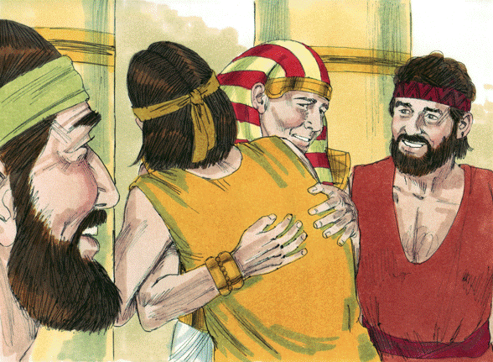
Joseph is Reunited With his Brothers
Old Testament Book
Genesis
Exodus
Leviticus
Numbers
Deuteronomy
… and Chapter
31
45
21
Bible Illustrations From Sweet Publishing https://www.unfoldingword.org/sweet-publishing

Slide 18
Joseph is Reunited With his Brothers
Old Testament Book
Genesis
1 point
… and Chapter
2 points
45
Bible Illustrations From Sweet Publishing https://www.unfoldingword.org/sweet-publishing

Slide 19
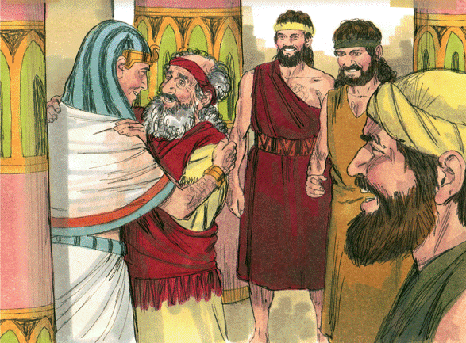
Jacob Goes to Joseph in Egypt
Old Testament Book
Genesis
Exodus
Leviticus
Numbers
Deuteronomy
… and Chapter
46
26
12
Bible Illustrations From Sweet Publishing https://www.unfoldingword.org/sweet-publishing

Slide 20
Jacob Goes to Joseph in Egypt
Old Testament Book
Genesis
1 point
… and Chapter
46
2 points
Bible Illustrations From Sweet Publishing https://www.unfoldingword.org/sweet-publishing

Slide 21
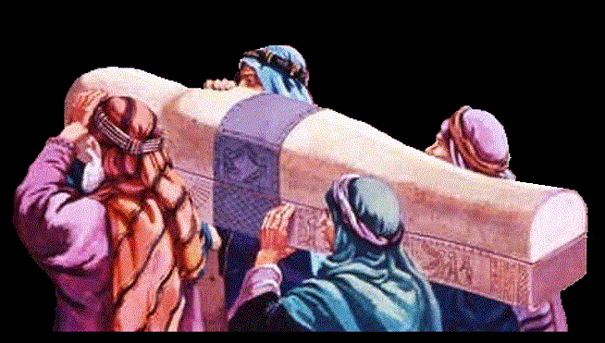
Old Testament Book
Joseph Dies
in Egypt
Genesis
Exodus
Leviticus
Numbers
Deuteronomy
… and Chapter
49
38
50
www.yeshua.wordpress.com/2016/07/16/the-exodus-from-egypt-and-the-red-sea-crossing-exodus-1231-1519/

Slide 22
Old Testament Book
Joseph Dies
in Egypt
Genesis
1 point
… and Chapter
2 points
50
www.yeshua.wordpress.com/2016/07/16/the-exodus-from-egypt-and-the-red-sea-crossing-exodus-1231-1519/

Slide 23
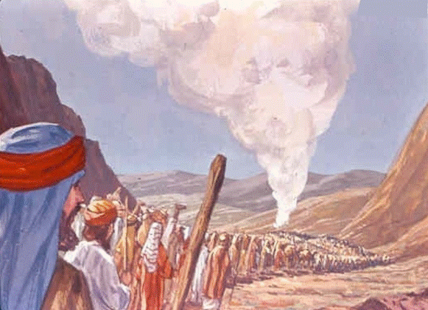
Israel Leaves
Mt. Sinai
Old Testament Book
Genesis
Exodus
Leviticus
Numbers
Deuteronomy
… and Chapter
10
40
1
St-Talka.org

Slide 24
Israel Leaves
Mt. Sinai
Old Testament Book
1 point
Numbers
… and Chapter
10
2 points
St-Talka.org

Slide 25
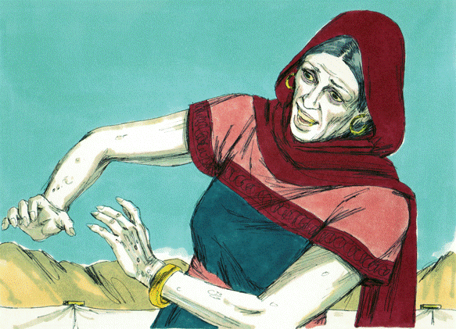
Miriam is Struck
with Leprosy
Old Testament Book
Genesis
Exodus
Leviticus
Numbers
Deuteronomy
… and Chapter
24
12
36
Bible Illustrations From Sweet Publishing https://www.unfoldingword.org/sweet-publishing

Slide 26
Miriam is Struck
with Leprosy
Old Testament Book
1 point
Numbers
… and Chapter
12
2 points
Bible Illustrations From Sweet Publishing https://www.unfoldingword.org/sweet-publishing

Slide 27
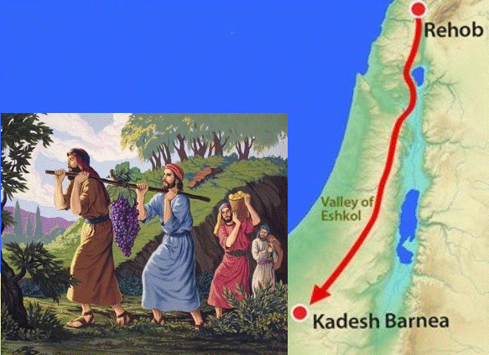
Twelve Spies
Search the Land
of Canaan
Old Testament Book
Genesis
Exodus
Leviticus
Numbers
Deuteronomy
… and Chapter
5
13
20
http://www.freebibleimages.org/illustrations/moses-spies/

Slide 28
Twelve Spies
Search the Land
of Canaan
Old Testament Book
1 point
Numbers
… and Chapter
13
2 points
http://www.freebibleimages.org/illustrations/moses-spies/

Slide 29
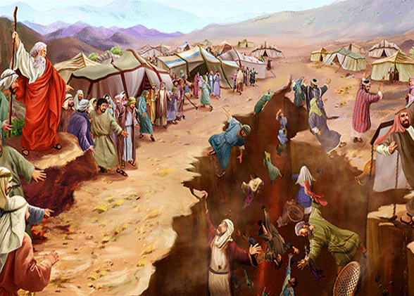
Old Testament Book
Korah’s Rebellion
Genesis
Exodus
Leviticus
Numbers
Deuteronomy
… and Chapter
25
2
16
https://toirahruv.com/wp-content/uploads/2017/06/Korahs-Rebellion.jpg

Slide 30
Old Testament Book
Korah’s Rebellion
1 point
Numbers
… and Chapter
16
2 points
https://toirahruv.com/wp-content/uploads/2017/06/Korahs-Rebellion.jpg

Slide 31
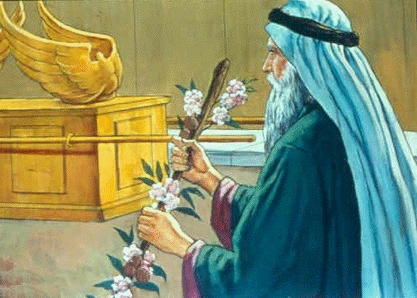
Aaron’s Staff Buds
& Bears Almonds
Old Testament Book
Genesis
Exodus
Leviticus
Numbers
Deuteronomy
… and Chapter
17
3
8
https://st-takla.org/Gallery/Bible/Illustrations/Bible-Slides/OT/Numbers/Bible-Slides-numbers-466.html

Slide 32
Aaron’s Staff Buds
& Bears Almonds
Old Testament Book
1 point
Numbers
… and Chapter
17
2 points
https://st-takla.org/Gallery/Bible/Illustrations/Bible-Slides/OT/Numbers/Bible-Slides-numbers-466.html

Slide 33
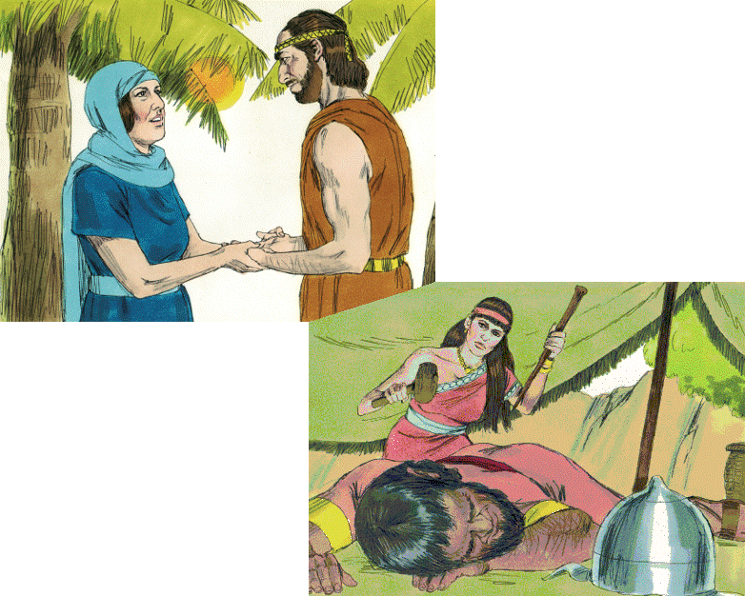
Old Testament Book
Joshua
Judges
Ruth
1 Samuel
2 Samuel
Deborah & Barak
Jael
& Sisera
… and Chapters
4-5
13-16
29-31
Bible Illustrations From Sweet Publishing https://www.unfoldingword.org/sweet-publishing

Slide 34
Old Testament Book
Judges
1 point
Deborah & Barak
Jael
& Sisera
… and Chapters
4-5
2 points
Bible Illustrations From Sweet Publishing https://www.unfoldingword.org/sweet-publishing

Slide 35
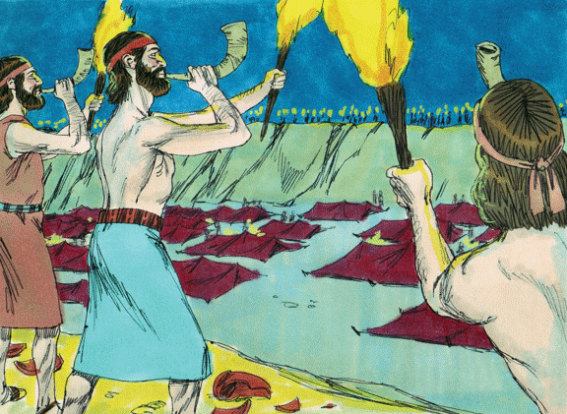
Gideon Defeats
the Midianites
Old Testament Book
Joshua
Judges
Ruth
1 Samuel
2 Samuel
… and Chapters
6-8
2-3
17-18
Bible Illustrations From Sweet Publishing https://www.unfoldingword.org/sweet-publishing

Slide 36
Gideon Defeats
the Midianites
Old Testament Book
Judges
1 point
… and Chapters
6-8
2 points
Bible Illustrations From Sweet Publishing https://www.unfoldingword.org/sweet-publishing

Slide 37
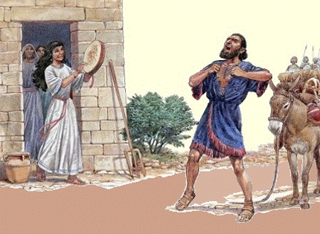
Jephthah and his Faithful Daughter
Old Testament Book
Joshua
Judges
Ruth
1 Samuel
2 Samuel
… and Chapter
11
4
21
http://www.biblestudywithrandy.com/2015/11/jephthahs-daughter-part-2-was-she-sacrificed/

Slide 38
Jephthah and his Faithful Daughter
Old Testament Book
Judges
1 point
… and Chapter
11
2 points
http://www.biblestudywithrandy.com/2015/11/jephthahs-daughter-part-2-was-she-sacrificed/

Slide 39
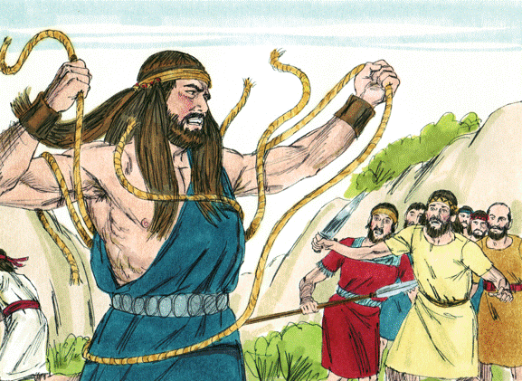
Samson, the Spirit-
Powered Nazarite
Old Testament Book
Joshua
Judges
Ruth
1 Samuel
2 Samuel
… and Chapters
2-3
13-16
6-8
Bible Illustrations From Sweet Publishing https://www.unfoldingword.org/sweet-publishing

Slide 40
Samson, the Spirit-
Powered Nazarite
Old Testament Book
Judges
1 point
… and Chapters
13-16
2 points
Bible Illustrations From Sweet Publishing https://www.unfoldingword.org/sweet-publishing

Slide 41
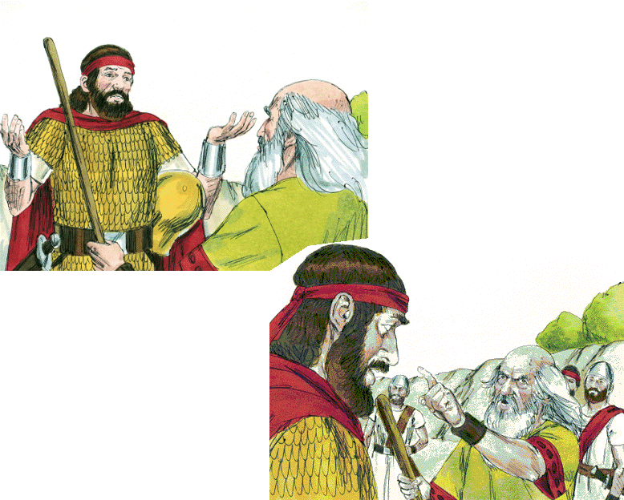
Old Testament Book
Saul Spares Agag
Joshua
Judges
Ruth
1 Samuel
2 Samuel
“To obey is better than sacrifice”
… and Chapter
6
15
24
Bible Illustrations From Sweet Publishing https://www.unfoldingword.org/sweet-publishing

Slide 42
Old Testament Book
Saul Spares Agag
1 Samuel
1 point
“To obey is better than sacrifice”
… and Chapter
15
2 points
Bible Illustrations From Sweet Publishing https://www.unfoldingword.org/sweet-publishing

Slide 43
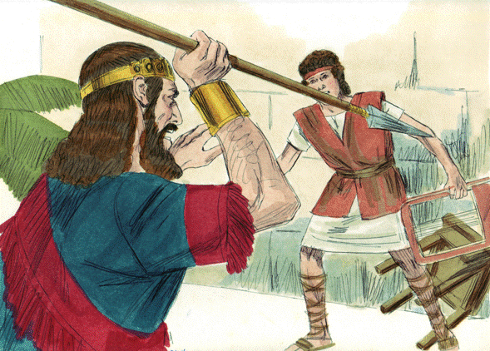
Saul Tries to
Kill David
Old Testament Book
Joshua
Judges
Ruth
1 Samuel
2 Samuel
… and Chapter
19
30
24
Bible Illustrations From Sweet Publishing https://www.unfoldingword.org/sweet-publishing

Slide 44
Saul Tries to
Kill David
Old Testament Book
1 Samuel
1 point
… and Chapter
19
2 points
Bible Illustrations From Sweet Publishing https://www.unfoldingword.org/sweet-publishing

Slide 45
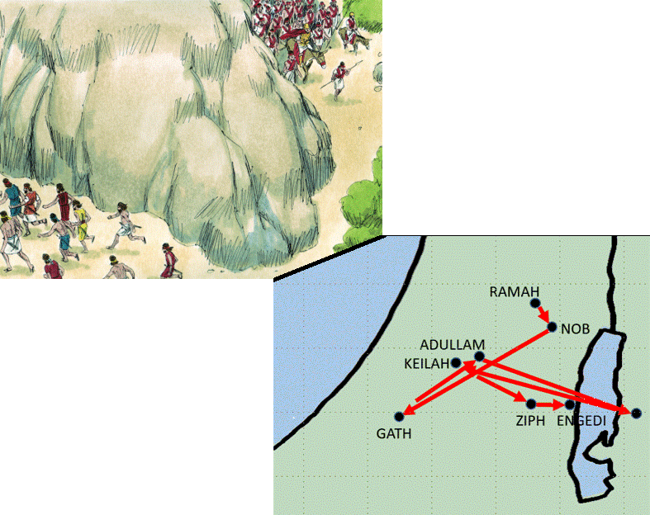
Old Testament Book
Joshua
Judges
Ruth
1 Samuel
2 Samuel
Bible Illustrations From Sweet Publishing
David
Flees
from Saul
… and Chapters
6-8
15-18
20-27

Slide 46
Old Testament Book
1 Samuel
1 point
Bible Illustrations From Sweet Publishing
David
Flees
from Saul
… and Chapters
2 points
20-27

Slide 47
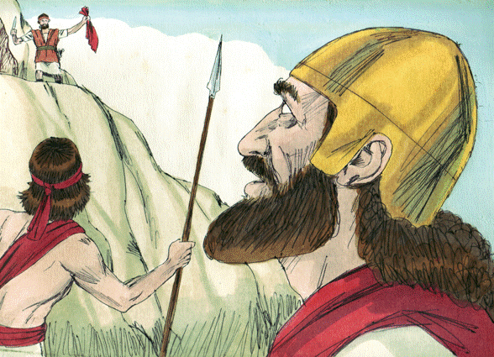
David Spares
Saul’s Life … Twice
Old Testament Book
Joshua
Judges
Ruth
1 Samuel
2 Samuel
… and Chapters
16 & 18
30 & 31
24 & 26
Bible Illustrations From Sweet Publishing https://www.unfoldingword.org/sweet-publishing

Slide 48
David Spares
Saul’s Life … Twice
Old Testament Book
1 Samuel
1 point
… and Chapters
24 & 26
2 points
Bible Illustrations From Sweet Publishing https://www.unfoldingword.org/sweet-publishing

Slide 49
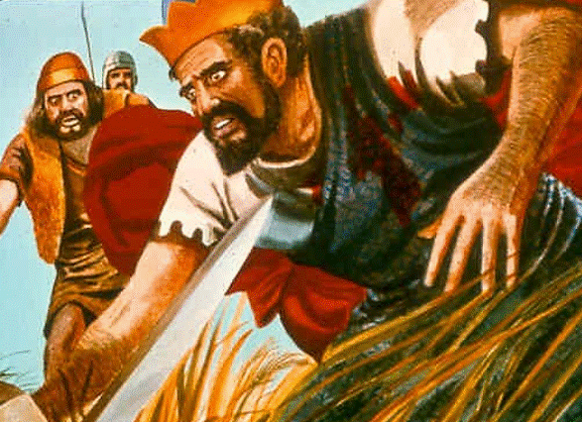
Old Testament Book
Saul Dies in Battle!
Joshua
Judges
Ruth
1 Samuel
2 Samuel
… and Chapter
26
17
31
St-Talka.org

Slide 50
Old Testament Book
Saul Dies in Battle!
1 Samuel
1 point
… and Chapter
2 points
31
St-Talka.org

Slide 51
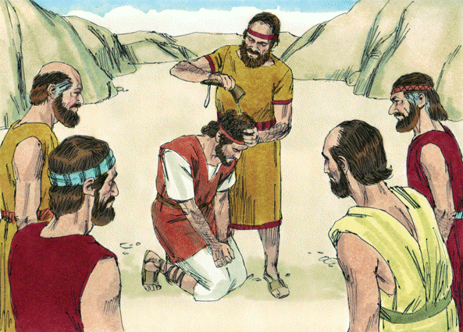
David Becomes King Over All Israel
Old Testament Book
Joshua
Judges
Ruth
1 Samuel
2 Samuel
… and Chapter
1
5
10
Bible Illustrations From Sweet Publishing https://www.unfoldingword.org/sweet-publishing

Slide 52
David Becomes King Over All Israel
Old Testament Book
1 point
2 Samuel
… and Chapter
2 points
5
Bible Illustrations From Sweet Publishing https://www.unfoldingword.org/sweet-publishing

Slide 53
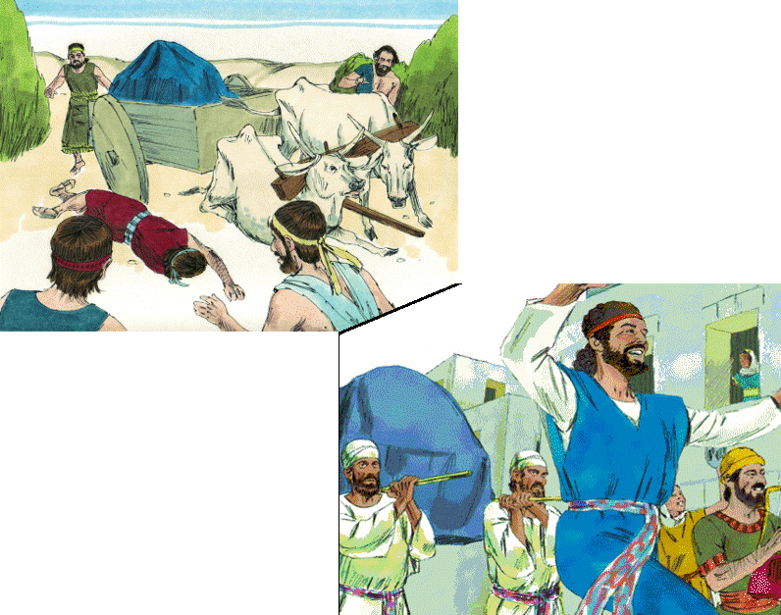
Old Testament Book
Joshua
Judges
Ruth
1 Samuel
2 Samuel
David Brings the Ark to Jerusalem
… and Chapter
2
16
6
Bible Illustrations From Sweet Publishing

Slide 54
Old Testament Book
1 point
2 Samuel
David Brings the Ark to Jerusalem
… and Chapter
6
2 points
Bible Illustrations From Sweet Publishing

Slide 55
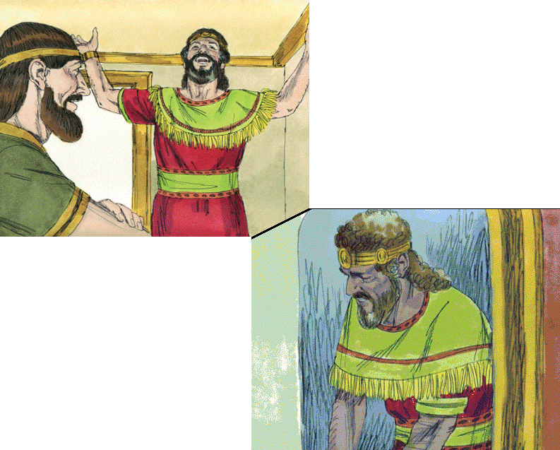
Old Testament Book
Joshua
Judges
Ruth
1 Samuel
2 Samuel
God’s Covenant with David
… and Chapter
23
7
16
Bible Illustrations From Sweet Publishing

Slide 56
Old Testament Book
1 point
2 Samuel
God’s Covenant with David
… and Chapter
7
2 points
Bible Illustrations From Sweet Publishing

Slide 57
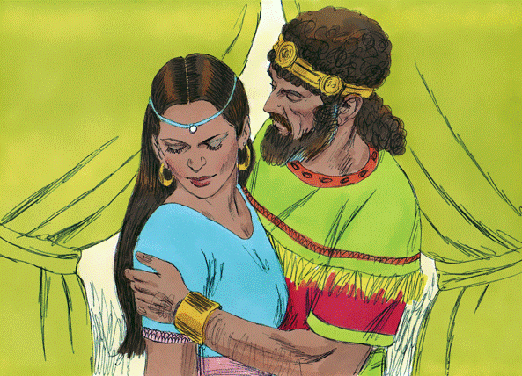
Old Testament Book
David & Bathsheba
Joshua
Judges
Ruth
1 Samuel
2 Samuel
… and Chapter
16
11
21
Bible Illustrations From Sweet Publishing https://www.unfoldingword.org/sweet-publishing

Slide 58
Old Testament Book
David & Bathsheba
1 point
2 Samuel
… and Chapter
11
2 points
Bible Illustrations From Sweet Publishing https://www.unfoldingword.org/sweet-publishing

Slide 59
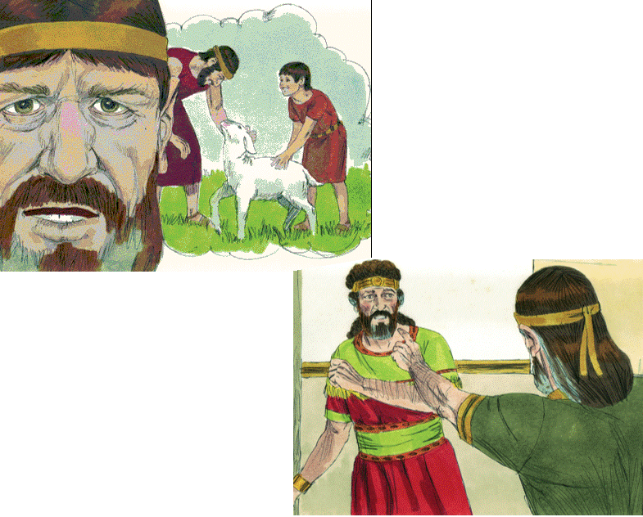
Old Testament Book
Joshua
Judges
Ruth
1 Samuel
2 Samuel
Nathan
to David: “You are the man!”
… and Chapter
5
12
20
Bible Illustrations From Sweet Publishing

Slide 60
Old Testament Book
1 point
2 Samuel
Nathan
to David: “You are the man!”
… and Chapter
12
2 points
Bible Illustrations From Sweet Publishing

Slide 61
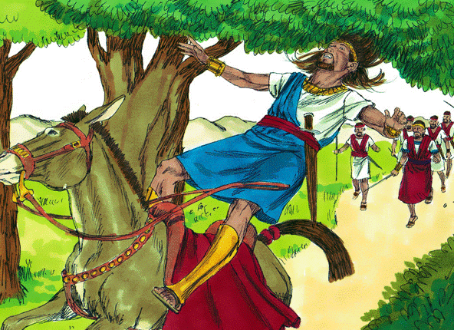
Old Testament Book
Absalom’s Rebellion
Joshua
Judges
Ruth
1 Samuel
2 Samuel
… and Chapters
15-18
7-9
23 & 25
Bible Illustrations From Sweet Publishing https://www.unfoldingword.org/sweet-publishing

Slide 62
Old Testament Book
Absalom’s Rebellion
1 point
2 Samuel
… and Chapters
15-18
2 points
Bible Illustrations From Sweet Publishing https://www.unfoldingword.org/sweet-publishing

Slide 63
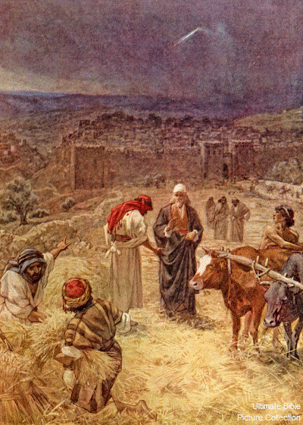
David Buys
Araunah’s
Threshing
Floor
Old Testament Book
Joshua
Judges
Ruth
1 Samuel
2 Samuel
… and Chapter
31
24
13
Ultimate Bible Picture Collection
Araunah - Wikipedia

Slide 64
David Buys
Araunah’s
Threshing
Floor
Old Testament Book
1 point
2 Samuel
… and Chapter
24
2 points
Ultimate Bible Picture Collection
Araunah - Wikipedia

