Slide 1
Bible Book and Chapter Challenge!
Old Testament Events Set #3
Tap the screen to get started

Slide 2
Bible Book and Chapter Challenge!
Old Testament Events Set #3
A Multiple-Choice Bible Game
This multiple-choice game is created in PowerPoint. A tap (screen-tap or mouse-click) is all that is needed to play. No PowerPoint skills are required. See “Here’s how it works” (next screen).
Images for all the Old Testament Events are credited on each screen.
Tap the screen to continue

Slide 3
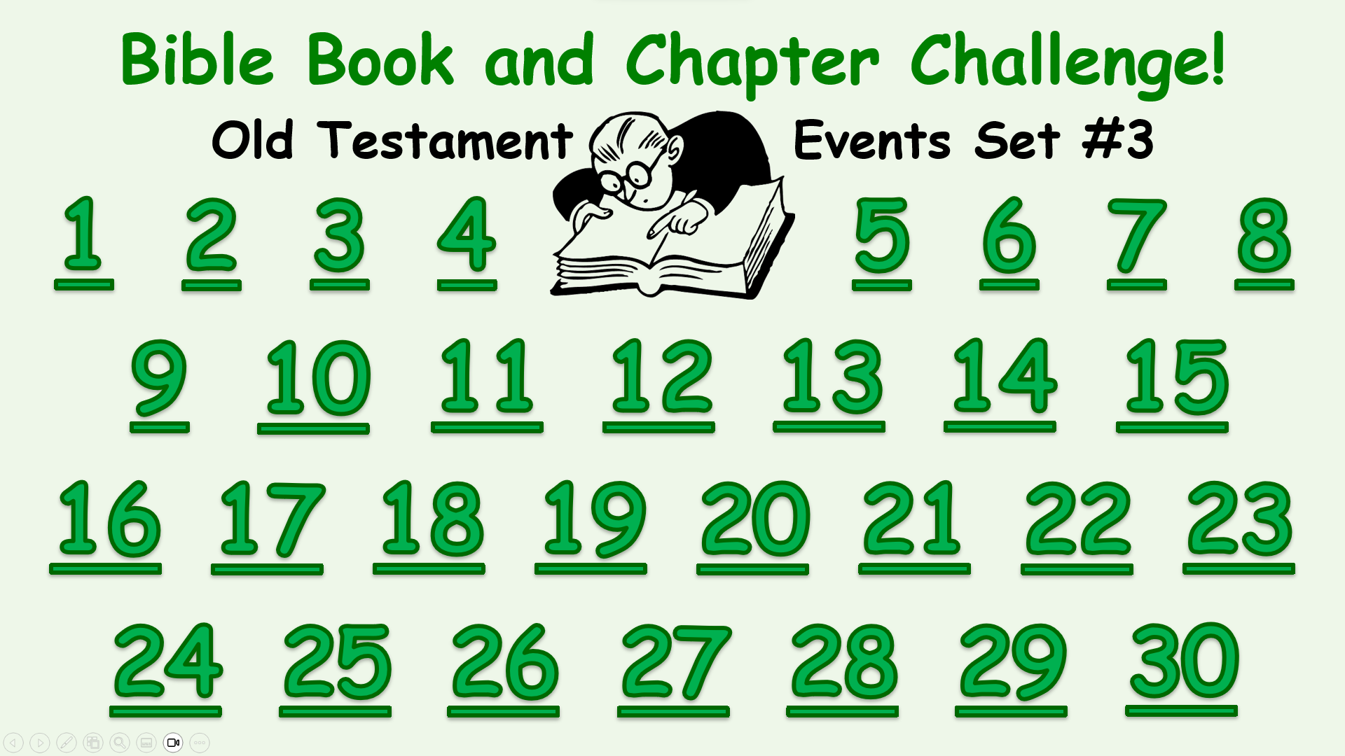
Here’s how it works
(1) Tap an Event Number on the Menu Board (next screen).
(2) Look at the Old Testament Event and the Book and Chapter
choices that come up.
(3) It’s a multiple-choice game. Each Player or Team tries to choose
the correct Book and Chapter for this Event.
(4) After making your choices, tap the screen to get the answers –
1 point for each correct Book and 2 points for each correct Chapter.
Everyone can score on every Event.
(5) Tap the screen again and return to the Menu Board.
Tap the screen to go to the Menu Board and start playing

Slide 4
Bible Book and Chapter Challenge!
Old Testament Events Set #3
1
2
3
4
5
6
7
8
9
10
11
12
13
14
15
16
17
18
19
20
21
22
23
24
25
26
27
28
29
30

Slide 5
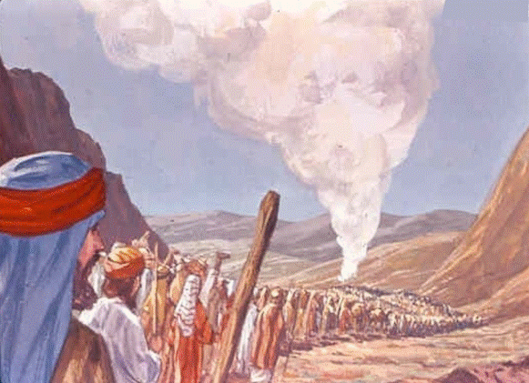
Israel Leaves
Mt. Sinai
Old Testament Book
Genesis
Exodus
Leviticus
Numbers
Deuteronomy
… and Chapter
10
40
1
St-Talka.org

Slide 6
Israel Leaves
Mt. Sinai
Old Testament Book
1 point
Numbers
… and Chapter
10
2 points
St-Talka.org

Slide 7
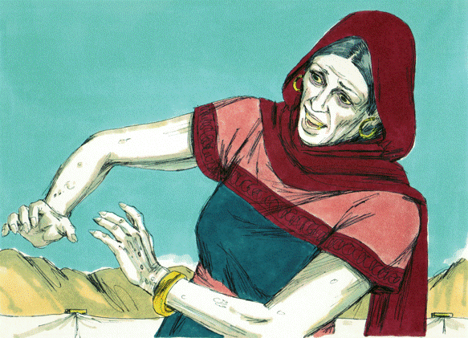
Miriam is Struck
with Leprosy
Old Testament Book
Genesis
Exodus
Leviticus
Numbers
Deuteronomy
… and Chapter
24
12
36
Bible Illustrations From Sweet Publishing https://www.unfoldingword.org/sweet-publishing

Slide 8
Miriam is Struck
with Leprosy
Old Testament Book
1 point
Numbers
… and Chapter
12
2 points
Bible Illustrations From Sweet Publishing https://www.unfoldingword.org/sweet-publishing

Slide 9
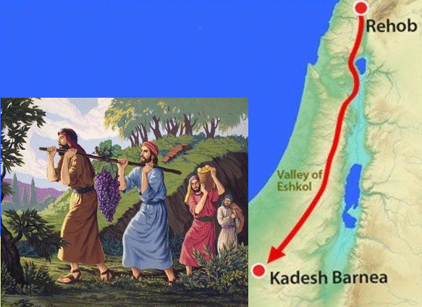
Twelve Spies
Search the Land
of Canaan
Old Testament Book
Genesis
Exodus
Leviticus
Numbers
Deuteronomy
… and Chapter
5
13
20
http://www.freebibleimages.org/illustrations/moses-spies/

Slide 10
Twelve Spies
Search the Land
of Canaan
Old Testament Book
1 point
Numbers
… and Chapter
13
2 points
http://www.freebibleimages.org/illustrations/moses-spies/

Slide 11
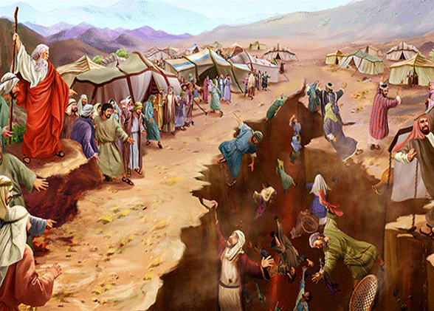
Old Testament Book
Korah’s Rebellion
Genesis
Exodus
Leviticus
Numbers
Deuteronomy
… and Chapter
25
2
16
https://toirahruv.com/wp-content/uploads/2017/06/Korahs-Rebellion.jpg

Slide 12
Old Testament Book
Korah’s Rebellion
1 point
Numbers
… and Chapter
16
2 points
https://toirahruv.com/wp-content/uploads/2017/06/Korahs-Rebellion.jpg

Slide 13
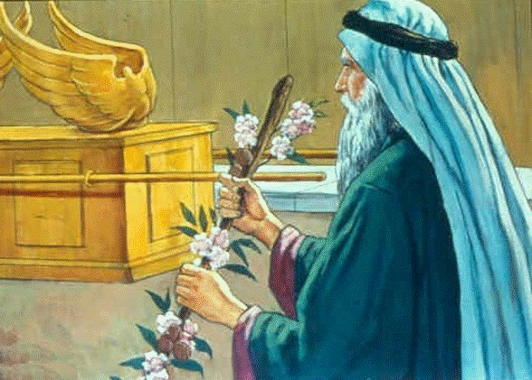
Aaron’s Staff Buds
& Bears Almonds
Old Testament Book
Genesis
Exodus
Leviticus
Numbers
Deuteronomy
… and Chapter
17
3
8
https://st-takla.org/Gallery/Bible/Illustrations/Bible-Slides/OT/Numbers/Bible-Slides-numbers-466.html

Slide 14
Aaron’s Staff Buds
& Bears Almonds
Old Testament Book
1 point
Numbers
… and Chapter
17
2 points
https://st-takla.org/Gallery/Bible/Illustrations/Bible-Slides/OT/Numbers/Bible-Slides-numbers-466.html

Slide 15
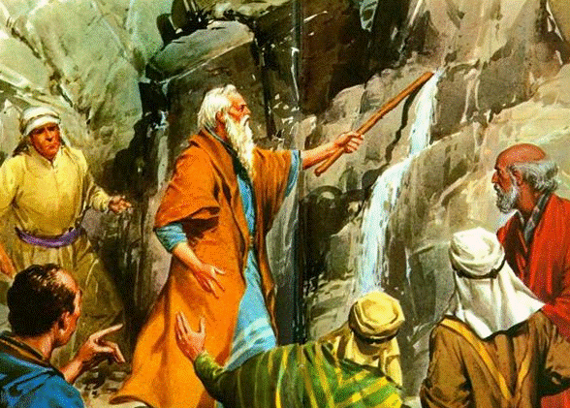
Moses Sins,
Striking the Rock
Old Testament Book
Genesis
Exodus
Leviticus
Numbers
Deuteronomy
… and Chapter
20
40
30
https://pastordesogamoso.podbean.com/e/si-es-posible-calmar-tu-sed-exodo-171-6/

Slide 16
Moses Sins,
Striking the Rock
Old Testament Book
1 point
Numbers
… and Chapter
20
2 points
https://pastordesogamoso.podbean.com/e/si-es-posible-calmar-tu-sed-exodo-171-6/

Slide 17
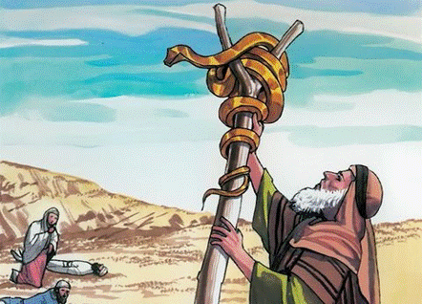
A Bronze Serpent
is Lifted Up
Old Testament Book
Genesis
Exodus
Leviticus
Numbers
Deuteronomy
… and Chapter
21
33
4
http://www.freebibleimages.org/illustrations/gnpi-017-nicodemus/

Slide 18
A Bronze Serpent
is Lifted Up
Old Testament Book
1 point
Numbers
… and Chapter
21
2 points
http://www.freebibleimages.org/illustrations/gnpi-017-nicodemus/

Slide 19
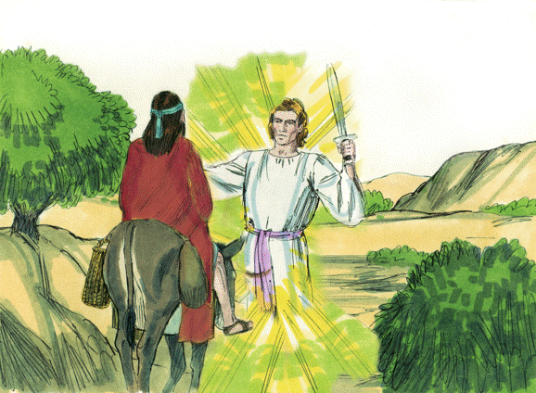
Balak Hires Balaam
to Curse Israel
Old Testament Book
Genesis
Exodus
Leviticus
Numbers
Deuteronomy
… and Chapters
4-5
22-24
15-16
Bible Illustrations From Sweet Publishing https://www.unfoldingword.org/sweet-publishing

Slide 20
Balak Hires Balaam
to Curse Israel
Old Testament Book
1 point
Numbers
… and Chapters
22-24
2 points
Bible Illustrations From Sweet Publishing https://www.unfoldingword.org/sweet-publishing

Slide 21
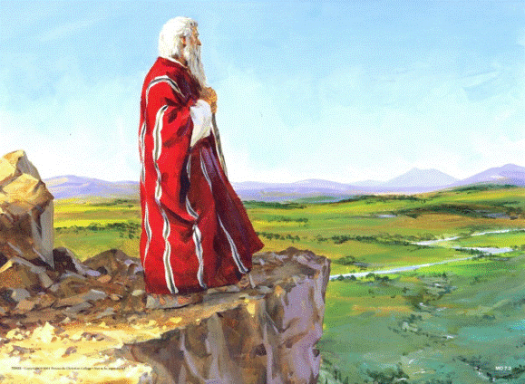
Moses Dies
on Mt. Nebo
Old Testament Book
Genesis
Exodus
Leviticus
Numbers
Deuteronomy
… and Chapter
40
27
34
http://phillipchan.org/eyes-off-our-destiny/

Slide 22
Moses Dies
on Mt. Nebo
Old Testament Book
1 point
Deuteronomy
… and Chapter
2 points
34
http://phillipchan.org/eyes-off-our-destiny/

Slide 23
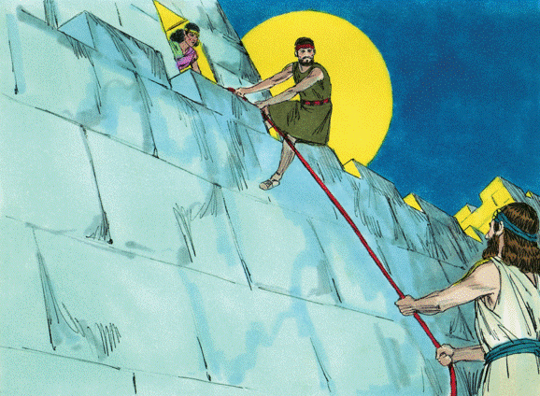
Rahab Hides Two
Hebrew Spies
Old Testament Book
Joshua
Judges
Ruth
1 Samuel
2 Samuel
… and Chapter
6
4
2
8
Bible Illustrations From Sweet Publishing https://www.unfoldingword.org/sweet-publishing

Slide 24
Rahab Hides Two
Hebrew Spies
Old Testament Book
Joshua
1 point
… and Chapter
2
2 points
Bible Illustrations From Sweet Publishing https://www.unfoldingword.org/sweet-publishing

Slide 25
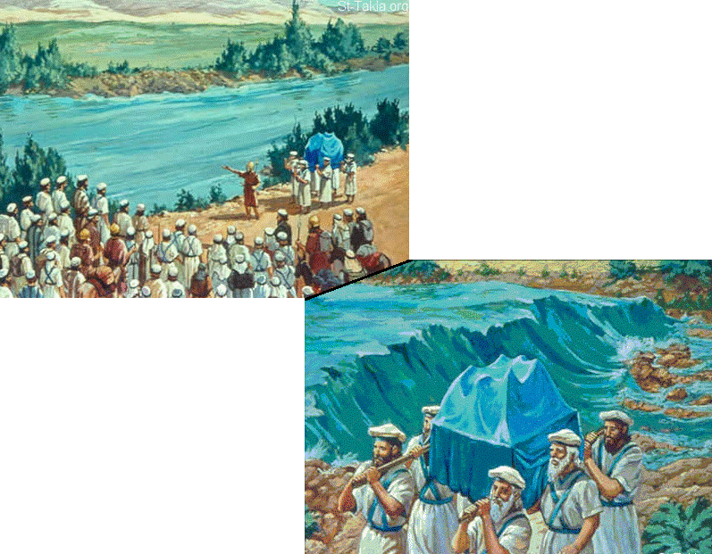
Old Testament Book
Joshua
Judges
Ruth
1 Samuel
2 Samuel
Israel
Crosses
The Jordan
… and Chapter
12
3
1
St-Talka.org

Slide 26
Old Testament Book
Joshua
1 point
Israel
Crosses
The Jordan
… and Chapter
3
2 points
St-Talka.org

Slide 27
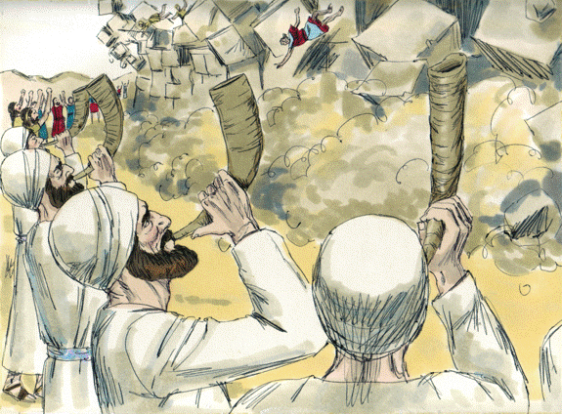
Old Testament Book
The Fall of Jericho
Joshua
Judges
Ruth
1 Samuel
2 Samuel
… and Chapter
6
20
13
Bible Illustrations From Sweet Publishing https://www.unfoldingword.org/sweet-publishing

Slide 28
Old Testament Book
The Fall of Jericho
Joshua
1 point
… and Chapter
6
2 points
Bible Illustrations From Sweet Publishing https://www.unfoldingword.org/sweet-publishing

Slide 29
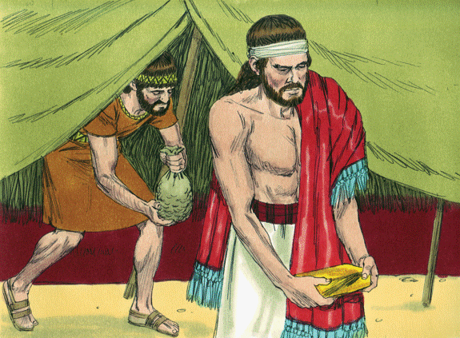
Old Testament Book
Achan’s Sin
Joshua
Judges
Ruth
1 Samuel
2 Samuel
… and Chapter
2
16
7
Bible Illustrations From Sweet Publishing https://www.unfoldingword.org/sweet-publishing

Slide 30
Old Testament Book
Achan’s Sin
Joshua
1 point
… and Chapter
7
2 points
Bible Illustrations From Sweet Publishing https://www.unfoldingword.org/sweet-publishing

Slide 31
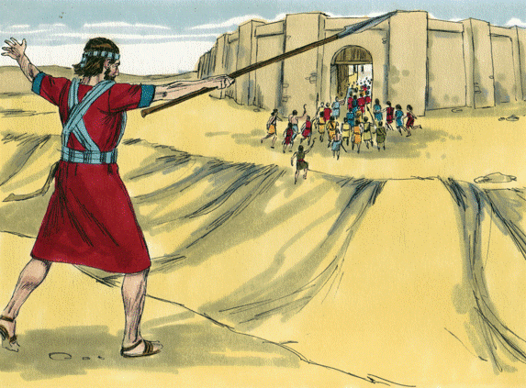
Old Testament Book
The Capture of Ai
Joshua
Judges
Ruth
1 Samuel
2 Samuel
… and Chapter
1
8
4
Bible Illustrations From Sweet Publishing https://www.unfoldingword.org/sweet-publishing

Slide 32
Old Testament Book
The Capture of Ai
Joshua
1 point
… and Chapter
8
2 points
Bible Illustrations From Sweet Publishing https://www.unfoldingword.org/sweet-publishing

Slide 33
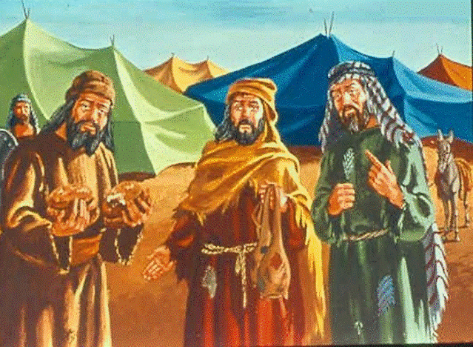
The Gibeonite
Deception
Old Testament Book
Joshua
Judges
Ruth
1 Samuel
2 Samuel
… and Chapter
16
9
32
St-Talka.org

Slide 34
The Gibeonite
Deception
Old Testament Book
Joshua
1 point
… and Chapter
9
2 points
St-Talka.org

Slide 35
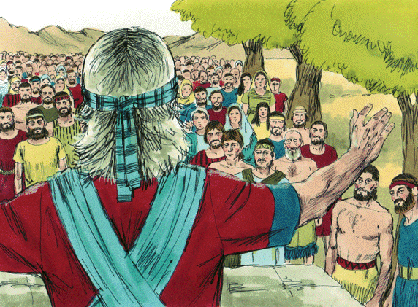
Old Testament Book
“As for me and
my house, we will serve the LORD”
Joshua
Judges
Ruth
1 Samuel
2 Samuel
… and Chapter
1
11
24
Bible Illustrations From Sweet Publishing https://www.unfoldingword.org/sweet-publishing

Slide 36
Old Testament Book
“As for me and
my house, we will serve the LORD”
Joshua
1 point
… and Chapter
2 points
24
Bible Illustrations From Sweet Publishing https://www.unfoldingword.org/sweet-publishing

Slide 37
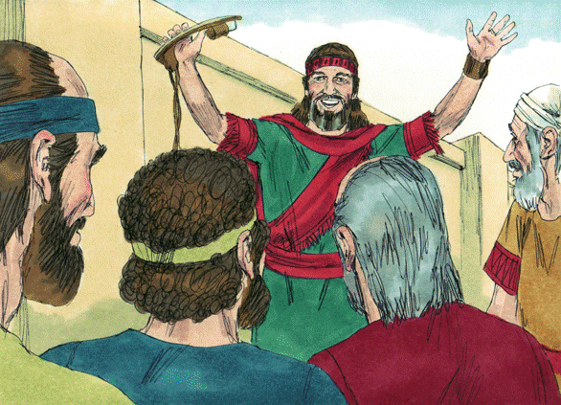
Boaz Becomes
a Redeemer
Old Testament Book
Joshua
Judges
Ruth
1 Samuel
2 Samuel
… and Chapter
1
4
2
3
Bible Illustrations From Sweet Publishing https://www.unfoldingword.org/sweet-publishing

Slide 38
Boaz Becomes
a Redeemer
Old Testament Book
Ruth
1 point
… and Chapter
4
2 points
Bible Illustrations From Sweet Publishing https://www.unfoldingword.org/sweet-publishing

Slide 39
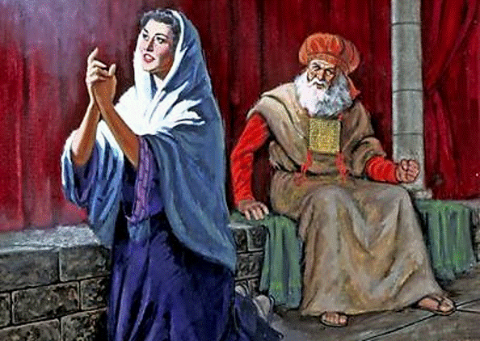
“My heart exults
in the LORD”
Old Testament Book
Joshua
Judges
Ruth
1 Samuel
2 Samuel
… and Chapter
2
16
9
https://asanefaith.com/hannahs-prayer-gods-answer-1-samuel-19-20-21-10/

Slide 40
“My heart exults
in the LORD”
Old Testament Book
1 Samuel
1 point
… and Chapter
2
2 points
https://asanefaith.com/hannahs-prayer-gods-answer-1-samuel-19-20-21-10/

Slide 41
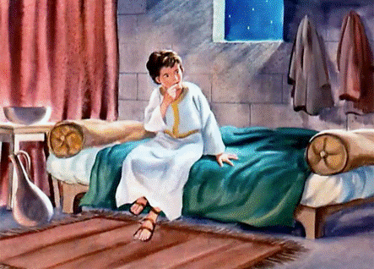
“Speak, LORD, for your servant hears”
Old Testament Book
Joshua
Judges
Ruth
1 Samuel
2 Samuel
… and Chapter
8
1
3
http://freebibleimages.org/illustrations/moody-samuel/

Slide 42
“Speak, LORD, for your servant hears”
Old Testament Book
1 Samuel
1 point
… and Chapter
2 points
3
http://freebibleimages.org/illustrations/moody-samuel/

Slide 43
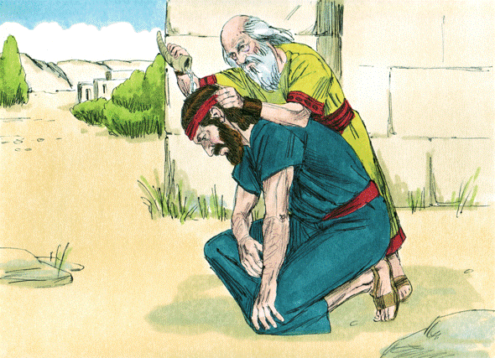
Saul is Anointed
King of Israel
Old Testament Book
Joshua
Judges
Ruth
1 Samuel
2 Samuel
… and Chapter
1
10
4
Bible Illustrations From Sweet Publishing https://www.unfoldingword.org/sweet-publishing

Slide 44
Saul is Anointed
King of Israel
Old Testament Book
1 Samuel
1 point
… and Chapter
10
2 points
Bible Illustrations From Sweet Publishing https://www.unfoldingword.org/sweet-publishing

Slide 45
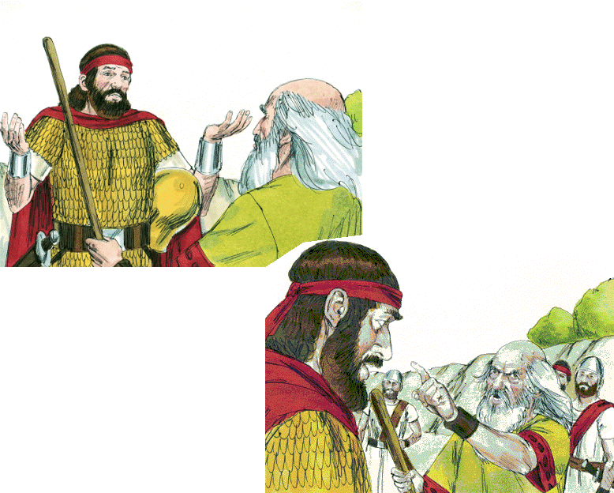
Old Testament Book
Saul Spares Agag
Joshua
Judges
Ruth
1 Samuel
2 Samuel
“To obey is better than sacrifice”
… and Chapter
6
15
24
Bible Illustrations From Sweet Publishing https://www.unfoldingword.org/sweet-publishing

Slide 46
Old Testament Book
Saul Spares Agag
1 Samuel
1 point
“To obey is better than sacrifice”
… and Chapter
15
2 points
Bible Illustrations From Sweet Publishing https://www.unfoldingword.org/sweet-publishing

Slide 47
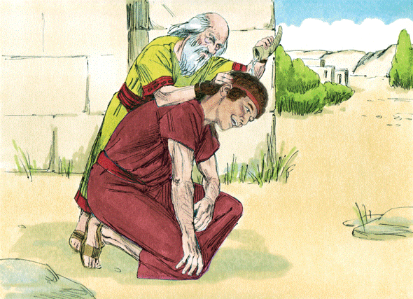
David is Chosen and
Anointed to be King
Old Testament Book
Joshua
Judges
Ruth
1 Samuel
2 Samuel
… and Chapter
16
10
1
Bible Illustrations From Sweet Publishing https://www.unfoldingword.org/sweet-publishing

Slide 48
David is Chosen and
Anointed to be King
Old Testament Book
1 Samuel
1 point
… and Chapter
16
2 points
Bible Illustrations From Sweet Publishing https://www.unfoldingword.org/sweet-publishing

Slide 49
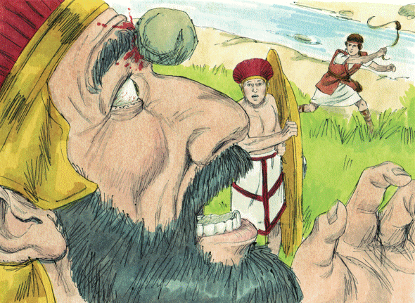
Old Testament Book
David Kills Goliath
Joshua
Judges
Ruth
1 Samuel
2 Samuel
… and Chapter
9
17
28
Bible Illustrations From Sweet Publishing https://www.unfoldingword.org/sweet-publishing

Slide 50
Old Testament Book
David Kills Goliath
1 Samuel
1 point
… and Chapter
17
2 points
Bible Illustrations From Sweet Publishing https://www.unfoldingword.org/sweet-publishing

Slide 51
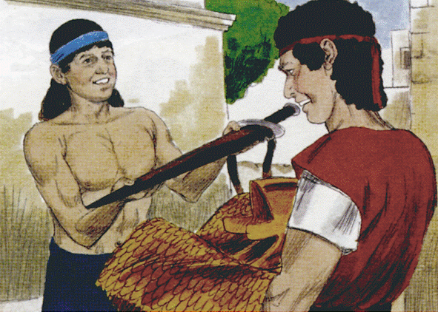
The Friendship of
David & Jonathan
Old Testament Book
Joshua
Judges
Ruth
1 Samuel
2 Samuel
… and Chapter
18
26
31
Bible Illustrations From Sweet Publishing https://www.unfoldingword.org/sweet-publishing

Slide 52
The Friendship of
David & Jonathan
Old Testament Book
1 Samuel
1 point
… and Chapter
18
2 points
Bible Illustrations From Sweet Publishing https://www.unfoldingword.org/sweet-publishing

Slide 53
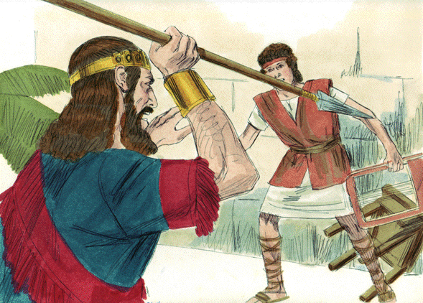
Saul Tries to
Kill David
Old Testament Book
Joshua
Judges
Ruth
1 Samuel
2 Samuel
… and Chapter
19
30
24
Bible Illustrations From Sweet Publishing https://www.unfoldingword.org/sweet-publishing

Slide 54
Saul Tries to
Kill David
Old Testament Book
1 Samuel
1 point
… and Chapter
19
2 points
Bible Illustrations From Sweet Publishing https://www.unfoldingword.org/sweet-publishing

Slide 55
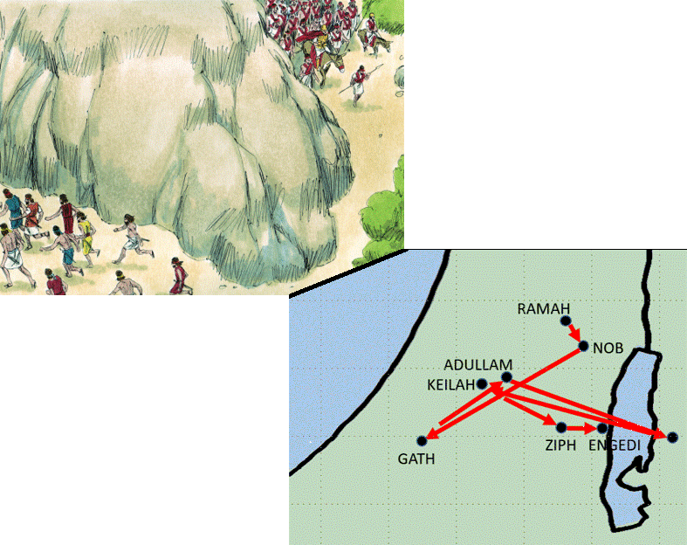
Old Testament Book
Joshua
Judges
Ruth
1 Samuel
2 Samuel
Bible Illustrations From Sweet Publishing
David
Flees
from Saul
… and Chapters
6-8
15-18
20-27

Slide 56
Old Testament Book
1 Samuel
1 point
Bible Illustrations From Sweet Publishing
David
Flees
from Saul
… and Chapters
2 points
20-27

Slide 57
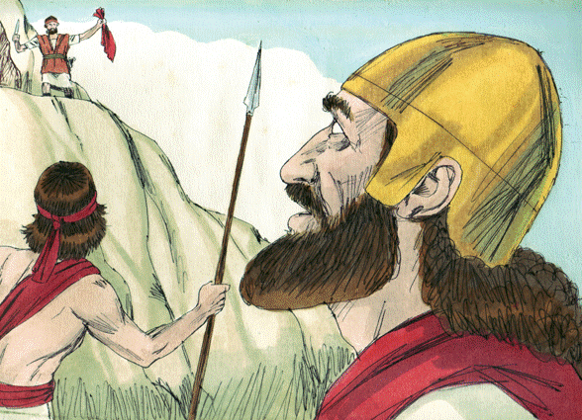
David Spares
Saul’s Life … Twice
Old Testament Book
Joshua
Judges
Ruth
1 Samuel
2 Samuel
… and Chapters
16 & 18
30 & 31
24 & 26
Bible Illustrations From Sweet Publishing https://www.unfoldingword.org/sweet-publishing

Slide 58
David Spares
Saul’s Life … Twice
Old Testament Book
1 Samuel
1 point
… and Chapters
24 & 26
2 points
Bible Illustrations From Sweet Publishing https://www.unfoldingword.org/sweet-publishing

Slide 59
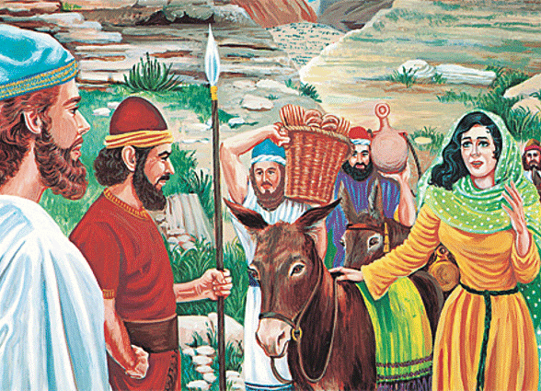
Old Testament Book
David & Abigail
Joshua
Judges
Ruth
1 Samuel
2 Samuel
… and Chapter
9
18
25
https://www.jw.org/en/publications/books/bible-stories/4/david-abigail/

Slide 60
Old Testament Book
David & Abigail
1 Samuel
1 point
… and Chapter
25
2 points
https://www.jw.org/en/publications/books/bible-stories/4/david-abigail/

Slide 61
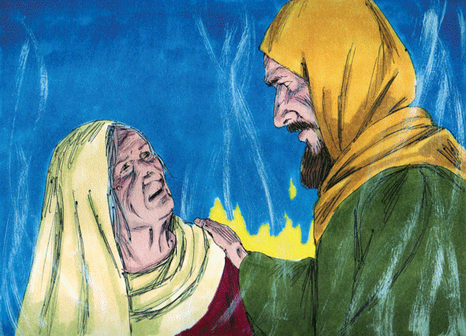
Saul asks a Witch
to “Divine” for Him
Old Testament Book
Joshua
Judges
Ruth
1 Samuel
2 Samuel
… and Chapter
23
34
28
Bible Illustrations From Sweet Publishing https://www.unfoldingword.org/sweet-publishing

Slide 62
Saul asks a Witch
to “Divine” for Him
Old Testament Book
1 Samuel
1 point
… and Chapter
28
2 points
Bible Illustrations From Sweet Publishing https://www.unfoldingword.org/sweet-publishing

Slide 63
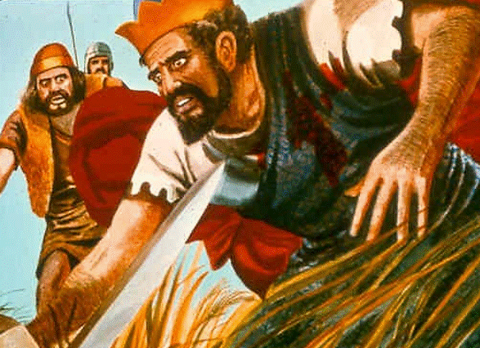
Old Testament Book
Saul Dies in Battle!
Joshua
Judges
Ruth
1 Samuel
2 Samuel
… and Chapter
26
17
31
St-Talka.org

Slide 64
Old Testament Book
Saul Dies in Battle!
1 Samuel
1 point
… and Chapter
2 points
31
St-Talka.org

