Slide 1

Bible Book and Chapter Challenge!
Old Testament Events Set #2
Tap the screen to get started

Slide 2
Bible Book and Chapter Challenge!
Old Testament Events Set #2
A Multiple-Choice Bible Game
This multiple-choice game is created in PowerPoint. A tap (screen-tap or mouse-click) is all that is needed to play. No PowerPoint skills are required. See “Here’s how it works” (next screen).
Images for all the Old Testament Events are credited on each screen.
Tap the screen to continue

Slide 3
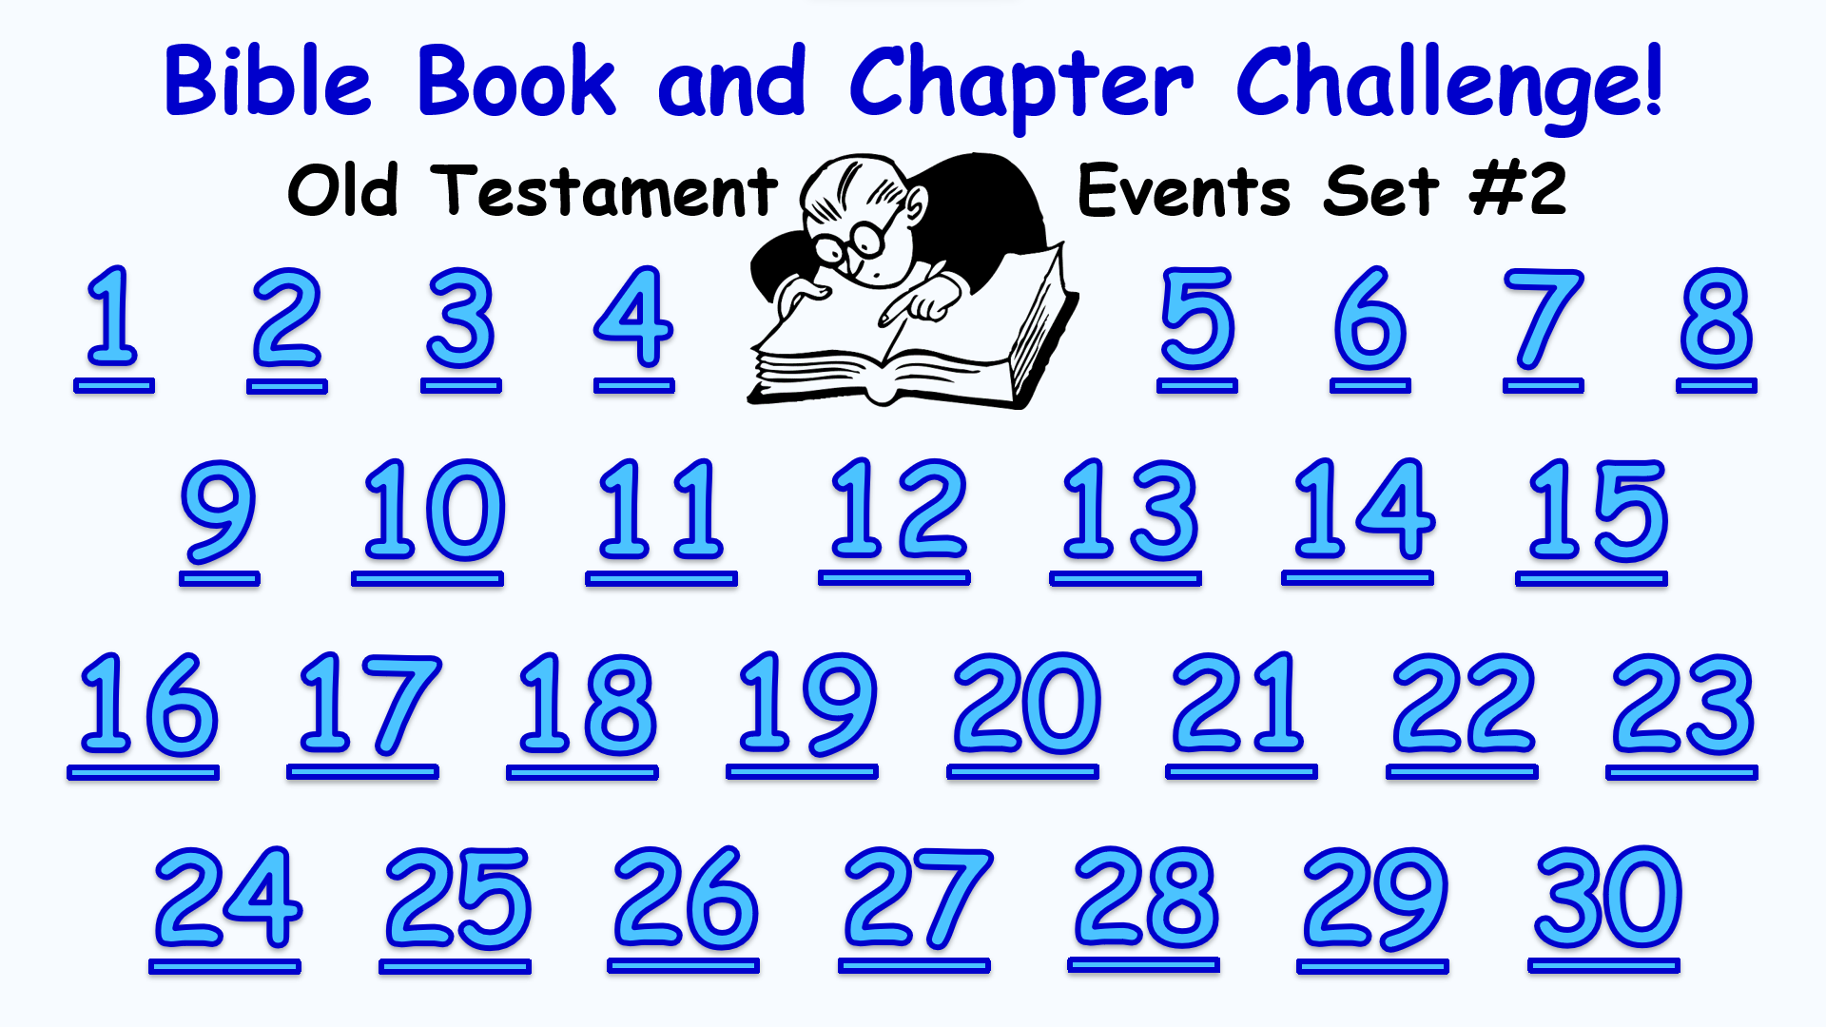
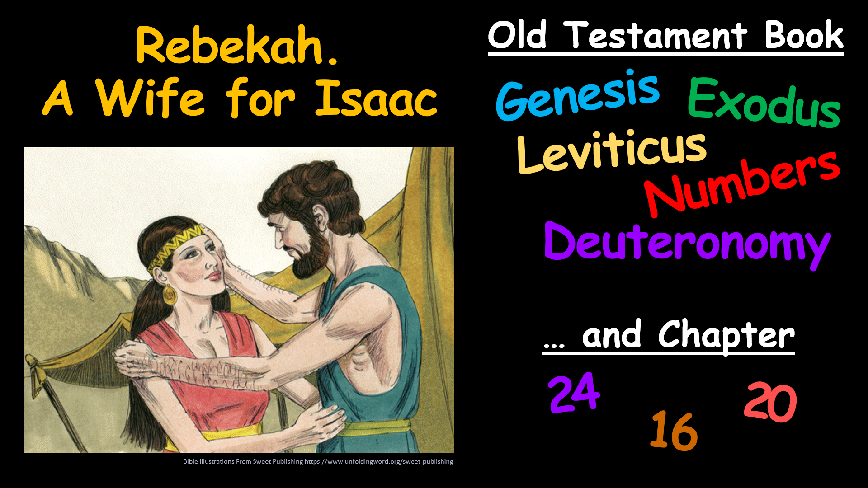
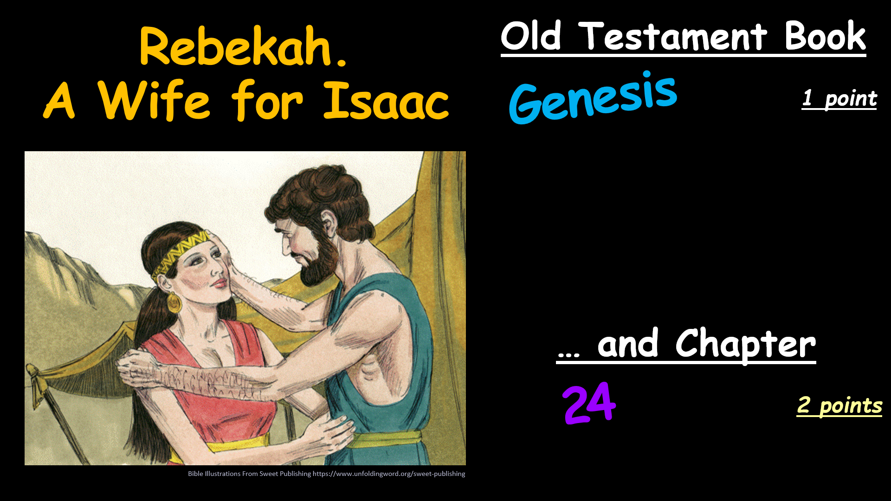
Here’s how it works
(1) Tap an Event Number on the Menu Board (next screen).
(2) Look at the Old Testament Event and the Book and Chapter
choices that come up.
(3) It’s a multiple-choice game. Each Player or Team tries to choose
the correct Book and Chapter for this Event.
(4) After making your choices, tap the screen to get the answers –
1 point for each correct Book and 2 points for each correct Chapter.
Everyone can score on every Event.
(5) Tap the screen again and return to the Menu Board.
Tap the screen to go to the Menu Board and start playing

Slide 4
Bible Book and Chapter Challenge!
Old Testament Events Set #2
1
2
3
4
5
6
7
8
9
10
11
12
13
14
15
16
17
18
19
20
21
22
23
24
25
26
27
28
29
30

Slide 5
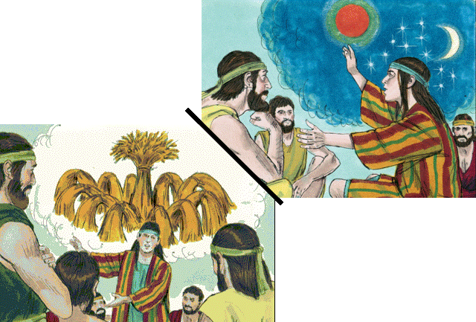
Old Testament Book
Joseph’s Dreams
Genesis
Exodus
Leviticus
Numbers
Deuteronomy
… and Chapter
28
48
37
Bible Illustrations From Sweet Publishing

Slide 6
Old Testament Book
Joseph’s Dreams
Genesis
1 point
… and Chapter
37
2 points
Bible Illustrations From Sweet Publishing

Slide 7
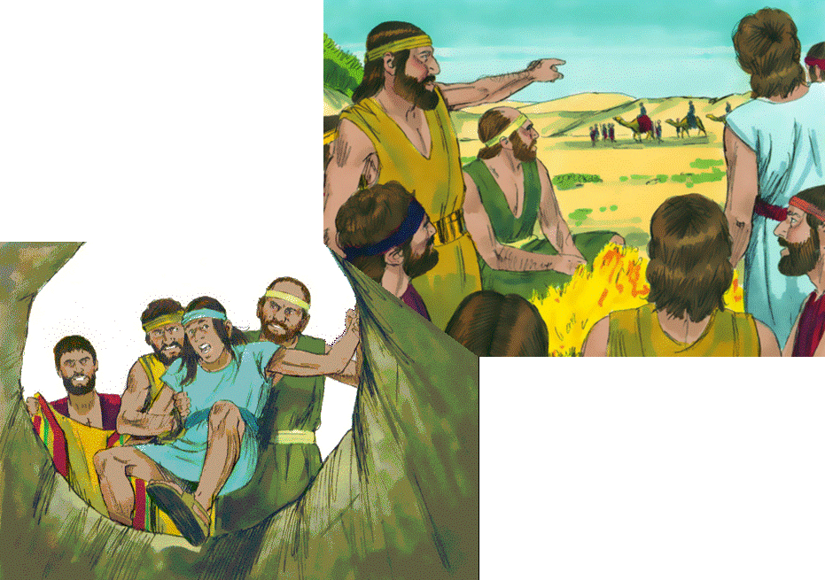
Joseph is Sold
by his Brothers
Old Testament Book
Genesis
Exodus
Leviticus
Numbers
Deuteronomy
… and Chapter
21
37
45
Bible Illustrations From Sweet Publishing

Slide 8
Joseph is Sold
by his Brothers
Old Testament Book
Genesis
1 point
… and Chapter
37
2 points
Bible Illustrations From Sweet Publishing

Slide 9
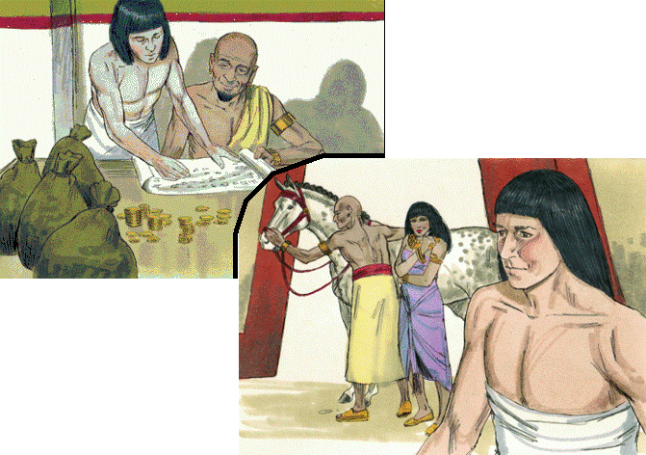
Joseph Serves Potiphar in Egypt
Old Testament Book
Genesis
Exodus
Leviticus
Numbers
Deuteronomy
… and Chapter
Bible Illustrations From Sweet Publishing
31
20
39

Slide 10
Joseph Serves Potiphar in Egypt
Old Testament Book
Genesis
1 point
… and Chapter
Bible Illustrations From Sweet Publishing
2 points
39

Slide 11
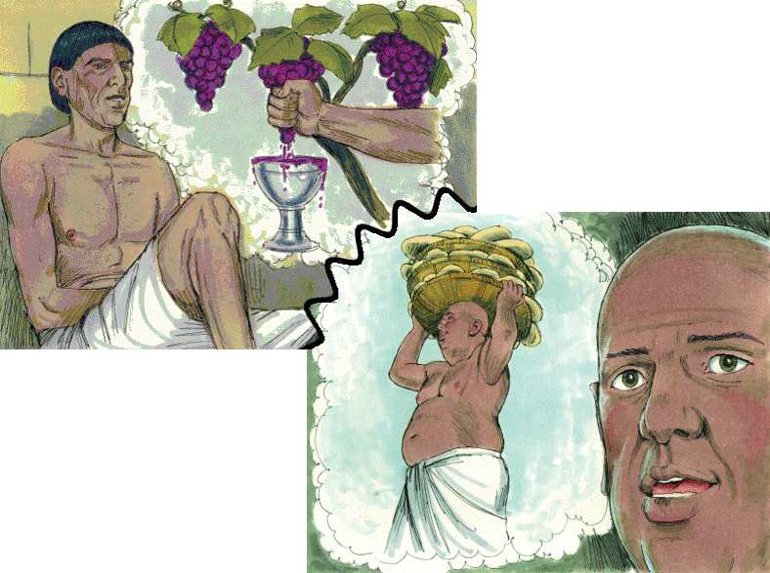
The Butler & The Baker
Old Testament Book
Genesis
Exodus
Leviticus
Numbers
Deuteronomy
Joseph
Interprets
their Dreams
… and Chapter
40
20
30
Bible Illustrations From Sweet Publishing https://www.unfoldingword.org/sweet-publishing

Slide 12
The Butler & The Baker
Old Testament Book
Genesis
1 point
Joseph
Interprets
their Dreams
… and Chapter
40
2 points
Bible Illustrations From Sweet Publishing https://www.unfoldingword.org/sweet-publishing

Slide 13
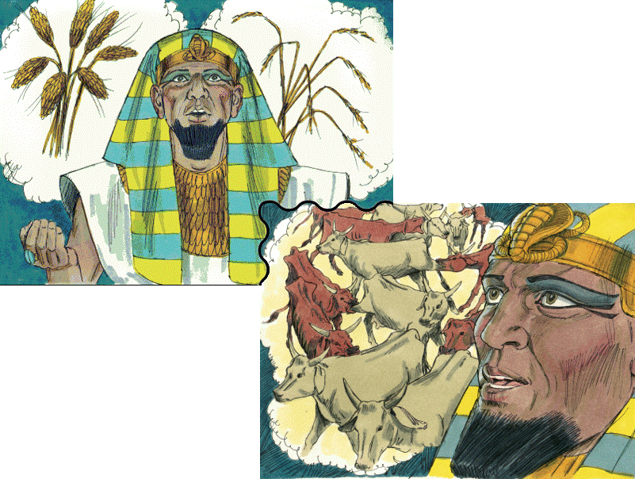
Pharaoh’s Dreams
Old Testament Book
Genesis
Exodus
Leviticus
Numbers
Deuteronomy
Bible Illustrations From Sweet Publishing
… and Chapter
28
41
15

Slide 14
Pharaoh’s Dreams
Old Testament Book
Genesis
1 point
Bible Illustrations From Sweet Publishing
… and Chapter
41
2 points

Slide 15
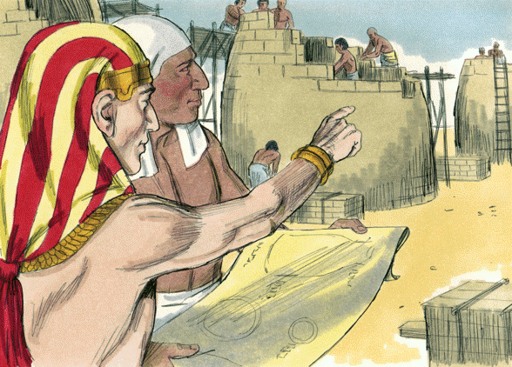
Joseph is Raised
to Power in Egypt
Old Testament Book
Genesis
Exodus
Leviticus
Numbers
Deuteronomy
… and Chapter
17
29
41
Bible Illustrations From Sweet Publishing https://www.unfoldingword.org/sweet-publishing

Slide 16
Joseph is Raised
to Power in Egypt
Old Testament Book
Genesis
1 point
… and Chapter
41
2 points
Bible Illustrations From Sweet Publishing https://www.unfoldingword.org/sweet-publishing

Slide 17
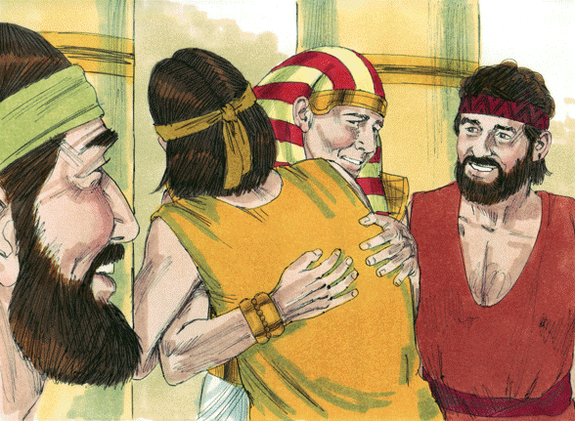
Joseph is Reunited With his Brothers
Old Testament Book
Genesis
Exodus
Leviticus
Numbers
Deuteronomy
… and Chapter
31
45
21
Bible Illustrations From Sweet Publishing https://www.unfoldingword.org/sweet-publishing

Slide 18
Joseph is Reunited With his Brothers
Old Testament Book
Genesis
1 point
… and Chapter
2 points
45
Bible Illustrations From Sweet Publishing https://www.unfoldingword.org/sweet-publishing

Slide 19
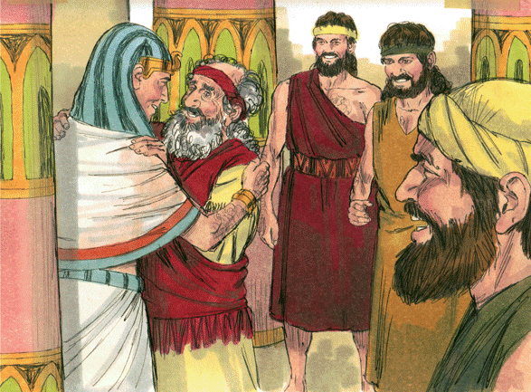
Jacob Goes to Joseph in Egypt
Old Testament Book
Genesis
Exodus
Leviticus
Numbers
Deuteronomy
… and Chapter
46
26
12
Bible Illustrations From Sweet Publishing https://www.unfoldingword.org/sweet-publishing

Slide 20
Jacob Goes to Joseph in Egypt
Old Testament Book
Genesis
1 point
… and Chapter
46
2 points
Bible Illustrations From Sweet Publishing https://www.unfoldingword.org/sweet-publishing

Slide 21
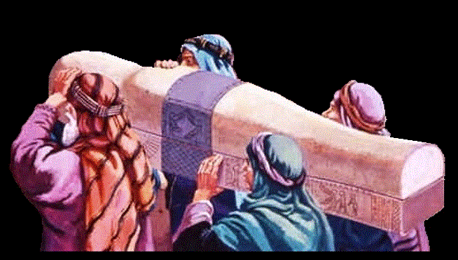
Old Testament Book
Joseph Dies
in Egypt
Genesis
Exodus
Leviticus
Numbers
Deuteronomy
… and Chapter
49
38
50
www.yeshua.wordpress.com/2016/07/16/the-exodus-from-egypt-and-the-red-sea-crossing-exodus-1231-1519/

Slide 22
Old Testament Book
Joseph Dies
in Egypt
Genesis
1 point
… and Chapter
2 points
50
www.yeshua.wordpress.com/2016/07/16/the-exodus-from-egypt-and-the-red-sea-crossing-exodus-1231-1519/

Slide 23
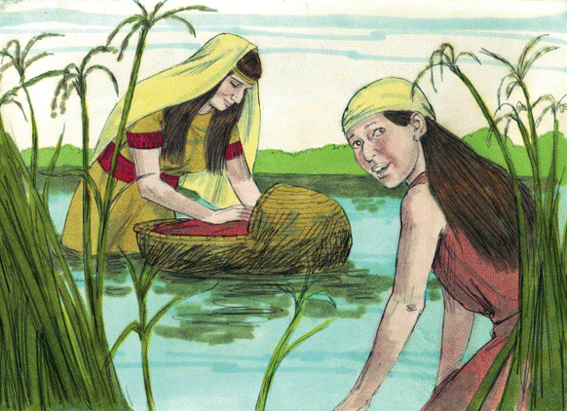
Old Testament Book
Birth of Moses
Genesis
Exodus
Leviticus
Numbers
Deuteronomy
… and Chapter
2
1
5
Bible Illustrations From Sweet Publishing https://www.unfoldingword.org/sweet-publishing

Slide 24
Old Testament Book
Birth of Moses
Exodus
1 point
… and Chapter
2
2 points
Bible Illustrations From Sweet Publishing https://www.unfoldingword.org/sweet-publishing

Slide 25
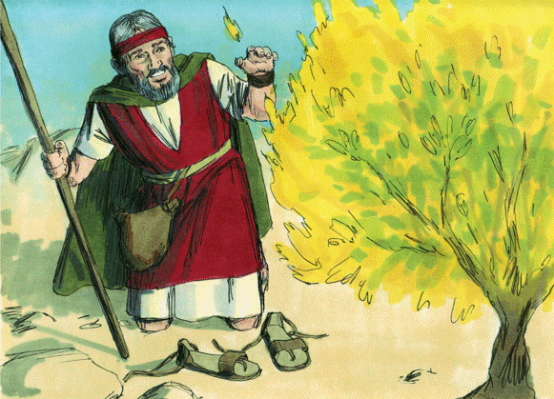
Moses at the
Burning Bush
Old Testament Book
Genesis
Exodus
Leviticus
Numbers
Deuteronomy
… and Chapter
8
3
11
Bible Illustrations From Sweet Publishing https://www.unfoldingword.org/sweet-publishing

Slide 26
Moses at the
Burning Bush
Old Testament Book
Exodus
1 point
… and Chapter
3
2 points
Bible Illustrations From Sweet Publishing https://www.unfoldingword.org/sweet-publishing

Slide 27
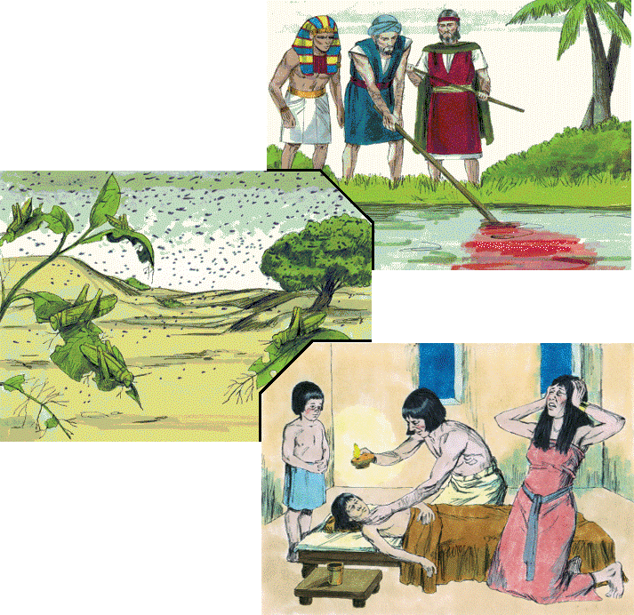
Ten
Plagues
Old Testament Book
Genesis
Exodus
Leviticus
Numbers
Bible Illustrations From Sweet Publishing
Deuteronomy
… and Chapters
Against Egypt
2-4
17-20
7-12

Slide 28
Ten
Plagues
Old Testament Book
Exodus
1 point
Bible Illustrations From Sweet Publishing
… and Chapters
Against Egypt
7-12
2 points

Slide 29
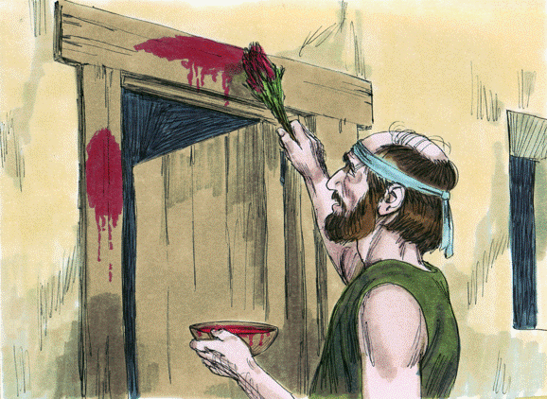
Old Testament Book
The Passover
Genesis
Exodus
Leviticus
Numbers
Deuteronomy
… and Chapter
24
12
19
Bible Illustrations From Sweet Publishing https://www.unfoldingword.org/sweet-publishing

Slide 30
Old Testament Book
The Passover
Exodus
1 point
… and Chapter
12
2 points
Bible Illustrations From Sweet Publishing https://www.unfoldingword.org/sweet-publishing

Slide 31
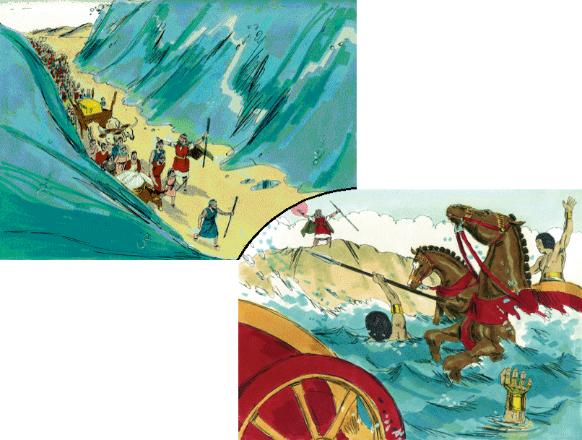
Old Testament Book
Genesis
Exodus
Leviticus
Numbers
Deuteronomy
Israel
Crosses the
Red Sea
… and Chapter
7
21
14
Bible Illustrations From Sweet Publishing https://www.unfoldingword.org/sweet-publishing

Slide 32
Old Testament Book
Exodus
1 point
Israel
Crosses the
Red Sea
… and Chapter
14
2 points
Bible Illustrations From Sweet Publishing https://www.unfoldingword.org/sweet-publishing

Slide 33
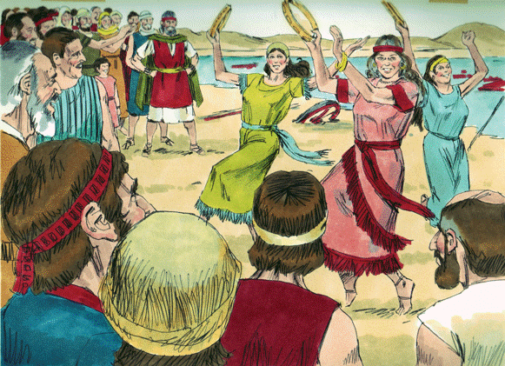
Song of Moses.
Miriam and
the Women Dance
Old Testament Book
Genesis
Exodus
Leviticus
Numbers
Deuteronomy
… and Chapter
24
32
15
Bible Illustrations From Sweet Publishing https://www.unfoldingword.org/sweet-publishing

Slide 34
Song of Moses.
Miriam and
the Women Dance
Old Testament Book
Exodus
1 point
… and Chapter
15
2 points
Bible Illustrations From Sweet Publishing https://www.unfoldingword.org/sweet-publishing

Slide 35
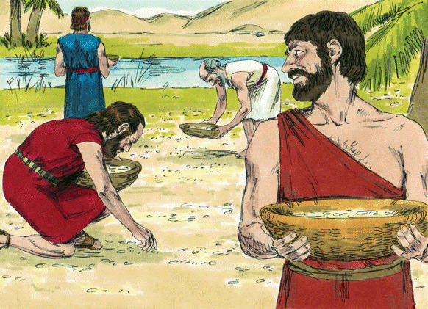
God Provides Manna
in the Wilderness
Old Testament Book
Genesis
Exodus
Leviticus
Numbers
Deuteronomy
… and Chapter
24
16
40
Bible Illustrations From Sweet Publishing https://www.unfoldingword.org/sweet-publishing

Slide 36
God Provides Manna
in the Wilderness
Old Testament Book
Exodus
1 point
… and Chapter
16
2 points
Bible Illustrations From Sweet Publishing https://www.unfoldingword.org/sweet-publishing

Slide 37
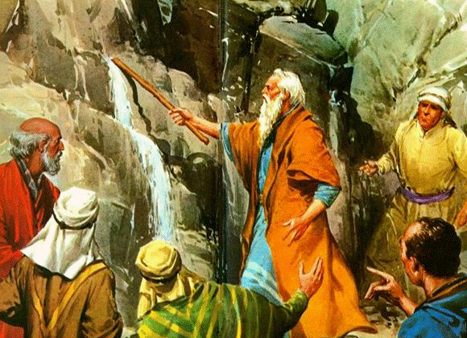
Water from the
Rock at Rephidim
Old Testament Book
Genesis
Exodus
Leviticus
Numbers
Deuteronomy
… and Chapter
13
17
20
www.biblestudentsdaily.com

Slide 38
Water from the
Rock at Rephidim
Old Testament Book
Exodus
1 point
… and Chapter
17
2 points
www.biblestudentsdaily.com

Slide 39
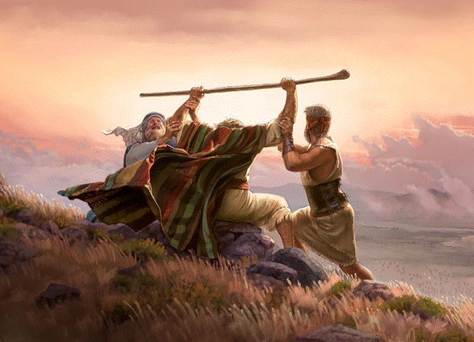
Amalek is Defeated
at Rephidim
Old Testament Book
Genesis
Exodus
Leviticus
Numbers
Deuteronomy
… and Chapter
17
32
27
https://zephyrseas.wordpress.com/2017/12/03/jehovah-nissi-the-lord-your-banner/

Slide 40
Amalek is Defeated
at Rephidim
Old Testament Book
Exodus
1 point
… and Chapter
17
2 points
https://zephyrseas.wordpress.com/2017/12/03/jehovah-nissi-the-lord-your-banner/

Slide 41
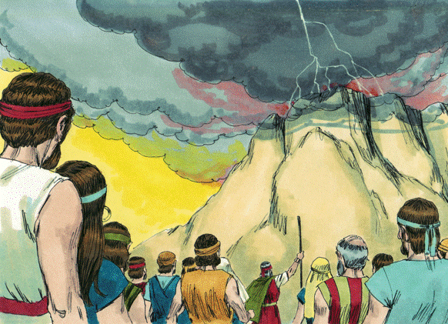
Israel Arrives
at Mt. Sinai
Old Testament Book
Genesis
Exodus
Leviticus
Numbers
Deuteronomy
… and Chapter
19
15
27
Bible Illustrations From Sweet Publishing https://www.unfoldingword.org/sweet-publishing

Slide 42
Israel Arrives
at Mt. Sinai
Old Testament Book
Exodus
1 point
… and Chapter
19
2 points
Bible Illustrations From Sweet Publishing https://www.unfoldingword.org/sweet-publishing

Slide 43
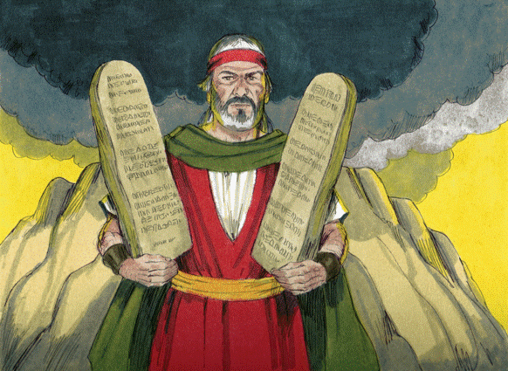
The Ten Commandments
Old Testament Book
Genesis
Exodus
Leviticus
Numbers
Deuteronomy
… and Chapter
5
35
20
Bible Illustrations From Sweet Publishing https://www.unfoldingword.org/sweet-publishing

Slide 44
The Ten Commandments
Old Testament Book
Exodus
An extra 3 points
if you got both!
1 point
Deuteronomy
… and Chapter
5
20
2 points
Bible Illustrations From Sweet Publishing https://www.unfoldingword.org/sweet-publishing

Slide 45
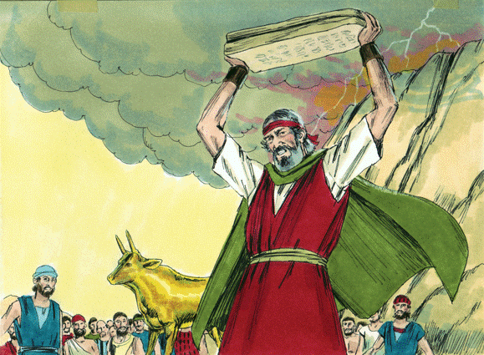
Israel Worships
a Golden Calf
Old Testament Book
Genesis
Exodus
Leviticus
Numbers
Deuteronomy
… and Chapter
32
27
19
Bible Illustrations From Sweet Publishing https://www.unfoldingword.org/sweet-publishing

Slide 46
Israel Worships
a Golden Calf
Old Testament Book
Exodus
1 point
… and Chapter
32
2 points
Bible Illustrations From Sweet Publishing https://www.unfoldingword.org/sweet-publishing

Slide 47
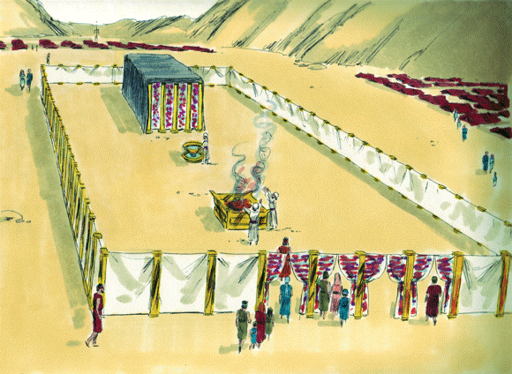
The Tabernacle
is set up at Sinai
Old Testament Book
Genesis
Exodus
Leviticus
Numbers
Deuteronomy
… and Chapter
21
40
30
Bible Illustrations From Sweet Publishing https://www.unfoldingword.org/sweet-publishing

Slide 48
The Tabernacle
is set up at Sinai
Old Testament Book
Exodus
1 point
… and Chapter
2 points
40
Bible Illustrations From Sweet Publishing https://www.unfoldingword.org/sweet-publishing

Slide 49
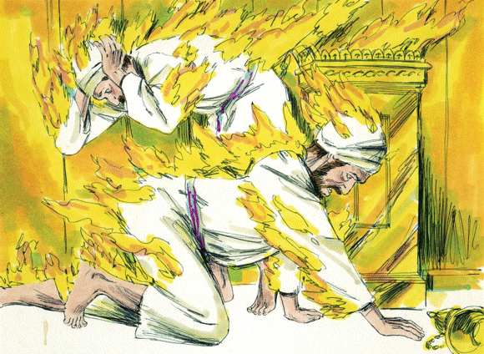
Nadab & Abihu
Offer Strange Fire
Old Testament Book
Genesis
Exodus
Leviticus
Numbers
Deuteronomy
… and Chapter
10
36
22
Bible Illustrations From Sweet Publishing https://www.unfoldingword.org/sweet-publishing

Slide 50
Nadab & Abihu
Offer Strange Fire
Old Testament Book
Leviticus
1 point
… and Chapter
10
2 points
Bible Illustrations From Sweet Publishing https://www.unfoldingword.org/sweet-publishing

Slide 51
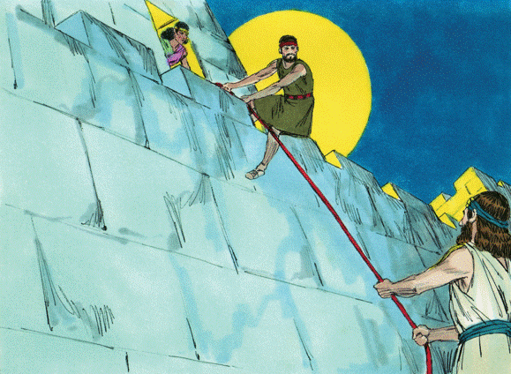
Rahab Hides Two
Hebrew Spies
Old Testament Book
Joshua
Judges
Ruth
1 Samuel
2 Samuel
… and Chapter
4
2
13
Bible Illustrations From Sweet Publishing https://www.unfoldingword.org/sweet-publishing

Slide 52
Rahab Hides Two
Hebrew Spies
Old Testament Book
Joshua
1 point
… and Chapter
2
2 points
Bible Illustrations From Sweet Publishing https://www.unfoldingword.org/sweet-publishing

Slide 53
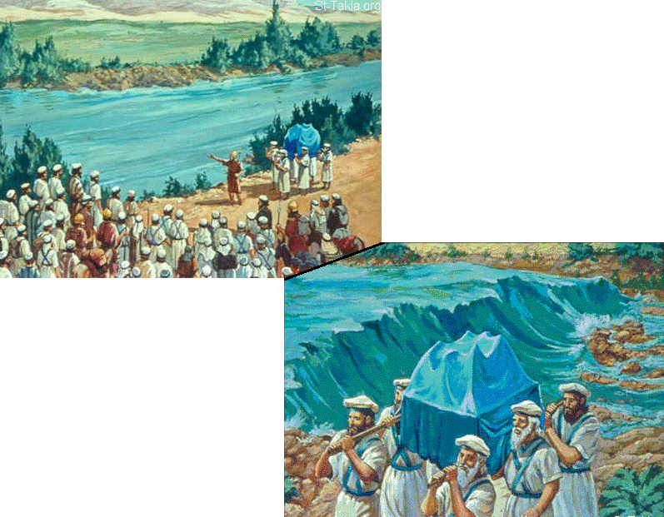
Old Testament Book
Joshua
Judges
Ruth
1 Samuel
2 Samuel
Israel
Crosses
The Jordan
… and Chapter
1
3
14
St-Talka.org

Slide 54
Old Testament Book
Joshua
1 point
Israel
Crosses
The Jordan
… and Chapter
3
2 points
St-Talka.org

Slide 55
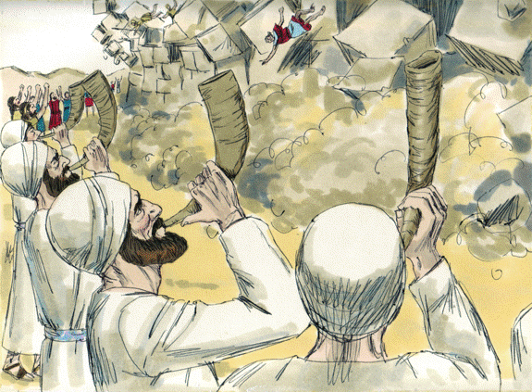
Old Testament Book
The Fall of Jericho
Joshua
Judges
Ruth
1 Samuel
2 Samuel
… and Chapter
6
8
14
Bible Illustrations From Sweet Publishing https://www.unfoldingword.org/sweet-publishing

Slide 56
Old Testament Book
The Fall of Jericho
Joshua
1 point
… and Chapter
6
2 points
Bible Illustrations From Sweet Publishing https://www.unfoldingword.org/sweet-publishing

Slide 57
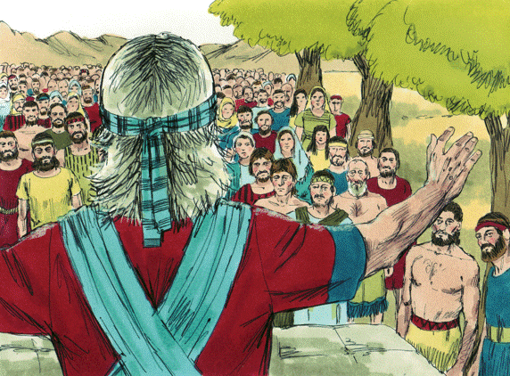
“As for me and my house, we will serve the LORD”
Old Testament Book
Joshua
Judges
Ruth
1 Samuel
2 Samuel
… and Chapter
24
31
11
Bible Illustrations From Sweet Publishing https://www.unfoldingword.org/sweet-publishing

Slide 58
“As for me and my house, we will serve the LORD”
Old Testament Book
Joshua
1 point
… and Chapter
24
2 points
Bible Illustrations From Sweet Publishing https://www.unfoldingword.org/sweet-publishing

Slide 59
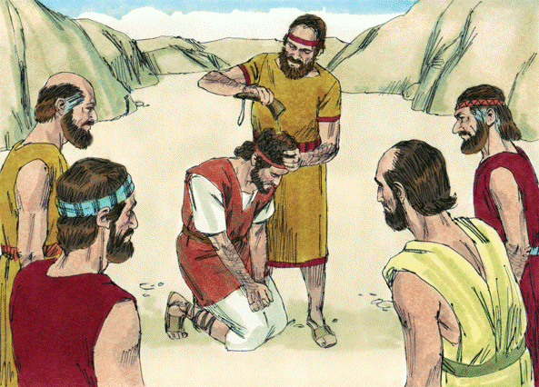
David Becomes King Over All Israel
Old Testament Book
Joshua
Judges
Ruth
1 Samuel
2 Samuel
… and Chapter
1
5
10
Bible Illustrations From Sweet Publishing https://www.unfoldingword.org/sweet-publishing

Slide 60
David Becomes King Over All Israel
Old Testament Book
1 point
2 Samuel
… and Chapter
2 points
5
Bible Illustrations From Sweet Publishing https://www.unfoldingword.org/sweet-publishing

Slide 61
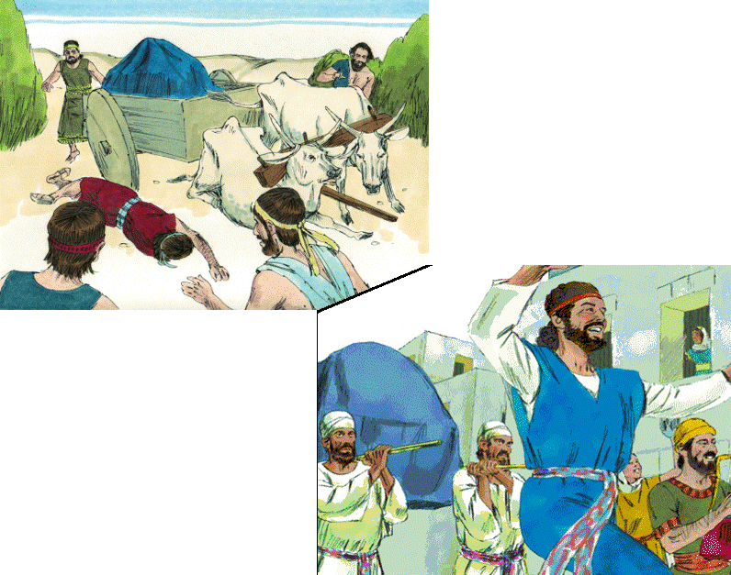
Old Testament Book
Joshua
Judges
Ruth
1 Samuel
2 Samuel
David Brings the Ark to Jerusalem
… and Chapter
2
16
6
Bible Illustrations From Sweet Publishing

Slide 62
Old Testament Book
1 point
2 Samuel
David Brings the Ark to Jerusalem
… and Chapter
6
2 points
Bible Illustrations From Sweet Publishing

Slide 63
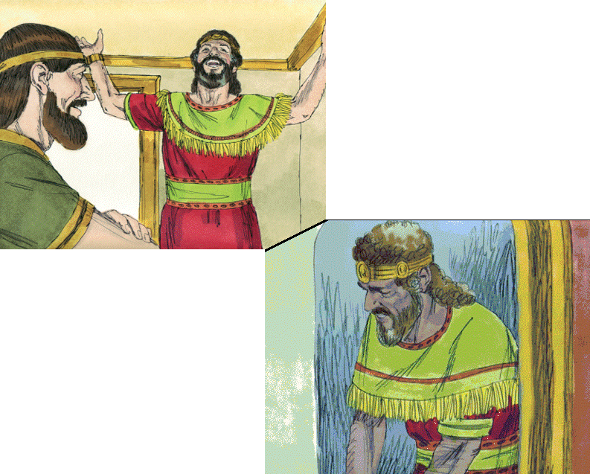
Old Testament Book
Joshua
Judges
Ruth
1 Samuel
2 Samuel
God’s Covenant with David
… and Chapter
23
7
16
Bible Illustrations From Sweet Publishing

Slide 64
Old Testament Book
1 point
2 Samuel
God’s Covenant with David
… and Chapter
7
2 points
Bible Illustrations From Sweet Publishing

