Slide 1
Bible Book and Chapter Challenge!
Old Testament Events Set #1
Tap the screen to get started

Slide 2
Bible Book and Chapter Challenge!
Old Testament Events Set #1
A Multiple-Choice Bible Game
This multiple-choice game is created in PowerPoint. A tap (screen-tap or mouse-click) is all that is needed to play. No PowerPoint skills are required. See “Here’s how it works” (next screen).
Images for all the Old Testament Events are credited on each screen.
Tap the screen to continue

Slide 3
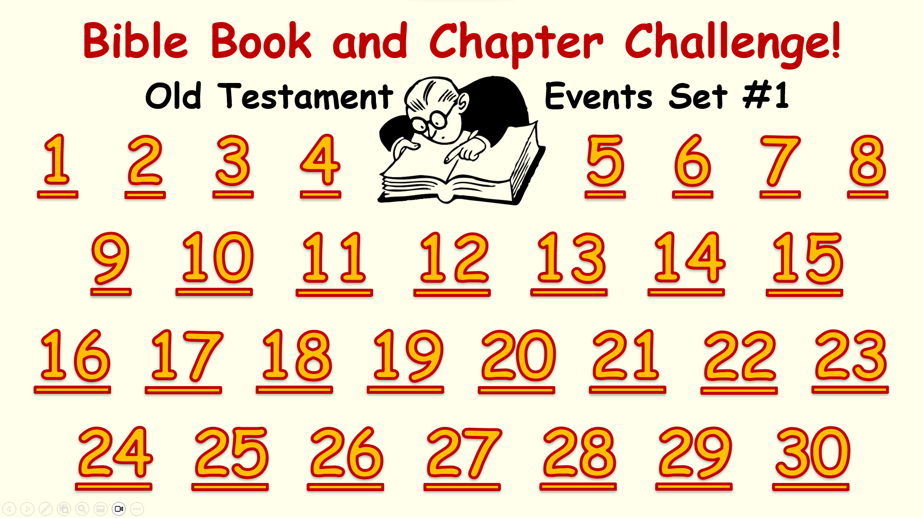
Here’s how it works
(1) Tap an Event Number on the Menu Board (next screen).
(2) Look at the Old Testament Event and the Book and Chapter
choices that come up.
(3) It’s a multiple-choice game. Each Player or Team tries to choose
the correct Book and Chapter for this Event.
(4) After making your choices, tap the screen to get the answers –
1 point for each correct Book and 2 points for each correct Chapter.
Everyone can score on every Event.
(5) Tap the screen again and return to the Menu Board.
Tap the screen to go to the Menu Board and start playing

Slide 4
Bible Book and Chapter Challenge!
Old Testament Events Set #1
1
2
3
4
5
6
7
8
9
10
11
12
13
14
15
16
17
18
19
20
21
22
23
24
25
26
27
28
29
30

Slide 5
God Creates the Heavens & Earth
Old Testament Book
Genesis
Exodus
Leviticus
Numbers
Deuteronomy
… and Chapters
Bible Illustrations From Sweet Publishing
1-2
11-12
20-21

Slide 6
God Creates the Heavens & Earth
Old Testament Book
Genesis
1 point
… and Chapters
Bible Illustrations From Sweet Publishing
1-2
2 points

Slide 7
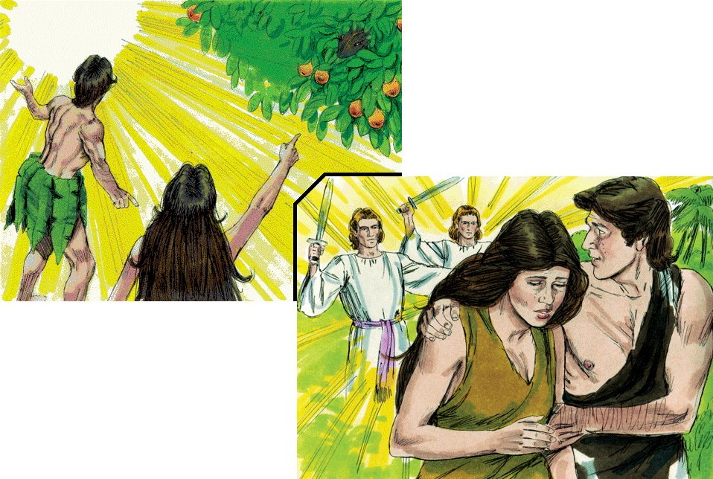
Sin & Death
Enter the World
Old Testament Book
Genesis
Exodus
Leviticus
Numbers
Deuteronomy
… and Chapter
3
27
15
Bible Illustrations From Sweet Publishing

Slide 8
Sin & Death
Enter the World
Old Testament Book
Genesis
1 point
… and Chapter
3
2 points
Bible Illustrations From Sweet Publishing

Slide 9
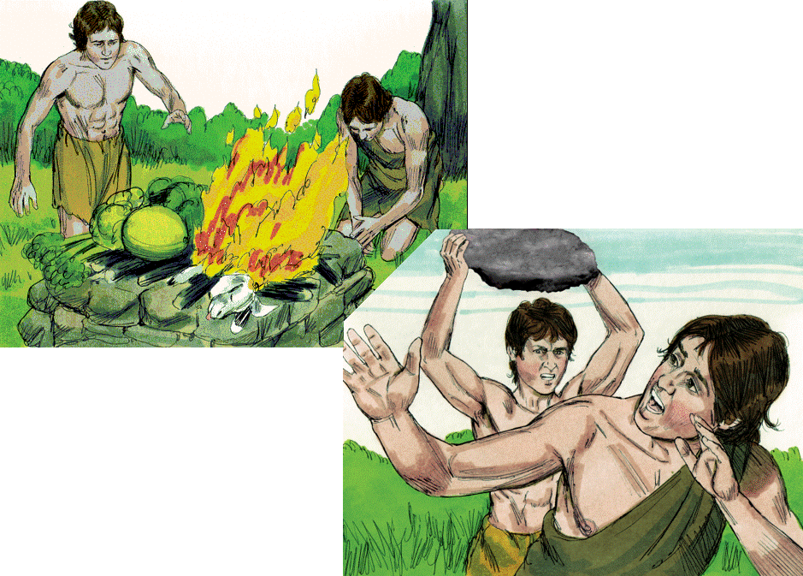
Old Testament Book
Cain & Abel
Genesis
Exodus
Leviticus
Numbers
Deuteronomy
… and Chapter
Bible Illustrations From Sweet Publishing
11
4
7

Slide 10
Old Testament Book
Cain & Abel
Genesis
1 point
… and Chapter
Bible Illustrations From Sweet Publishing
4
2 points

Slide 11
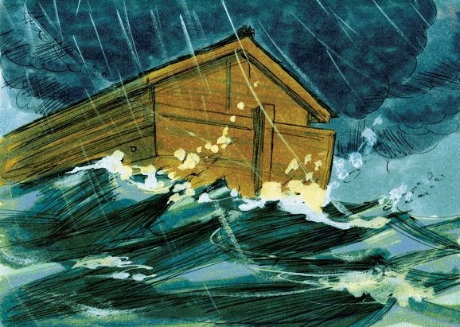
Noah. The Earth
Destroyed by Flood
Old Testament Book
Genesis
Exodus
Leviticus
Numbers
Deuteronomy
… and Chapters
12-14
6-9
2-3
Bible Illustrations From Sweet Publishing https://www.unfoldingword.org/sweet-publishing

Slide 12
Noah. The Earth
Destroyed by Flood
Old Testament Book
Genesis
1 point
… and Chapters
6-9
2 points
Bible Illustrations From Sweet Publishing https://www.unfoldingword.org/sweet-publishing

Slide 13
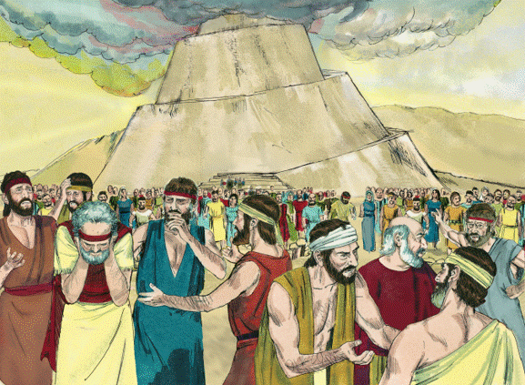
Old Testament Book
Babel
Genesis
Exodus
Leviticus
Numbers
Deuteronomy
… and Chapter
2
35
11
Bible Illustrations From Sweet Publishing https://www.unfoldingword.org/sweet-publishing

Slide 14
Old Testament Book
Babel
Genesis
1 point
… and Chapter
11
2 points
Bible Illustrations From Sweet Publishing https://www.unfoldingword.org/sweet-publishing

Slide 15
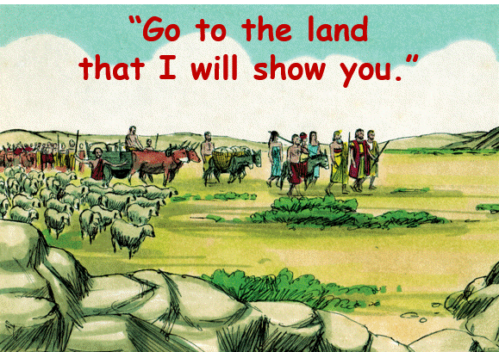
God’s Promises
to Abram
Old Testament Book
Genesis
Exodus
Leviticus
Numbers
Deuteronomy
… and Chapter
22
12
28
Bible Illustrations From Sweet Publishing https://www.unfoldingword.org/sweet-publishing

Slide 16
God’s Promises
to Abram
Old Testament Book
Genesis
1 point
… and Chapter
12
2 points
Bible Illustrations From Sweet Publishing https://www.unfoldingword.org/sweet-publishing

Slide 17
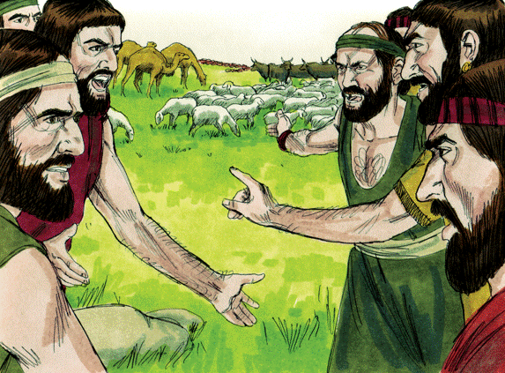
Strife! Lot &
Abram Separate
Old Testament Book
Genesis
Exodus
Leviticus
Numbers
Deuteronomy
… and Chapter
13
31
7
Bible Illustrations From Sweet Publishing https://www.unfoldingword.org/sweet-publishing

Slide 18
Strife! Lot &
Abram Separate
Old Testament Book
Genesis
1 point
… and Chapter
13
2 points
Bible Illustrations From Sweet Publishing https://www.unfoldingword.org/sweet-publishing

Slide 19
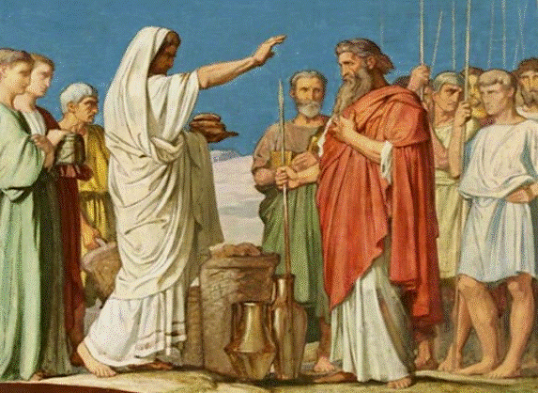
Melchizedek
Blesses Abram
Old Testament Book
Genesis
Exodus
Leviticus
Numbers
Deuteronomy
… and Chapter
32
8
14
Hippolyte Flandrin. Wikioo.org-The Encyclopedia of Find Arts

Slide 20
Melchizedek
Blesses Abram
Old Testament Book
Genesis
1 point
… and Chapter
2 points
14
Hippolyte Flandrin. Wikioo.org-The Encyclopedia of Find Arts

Slide 21
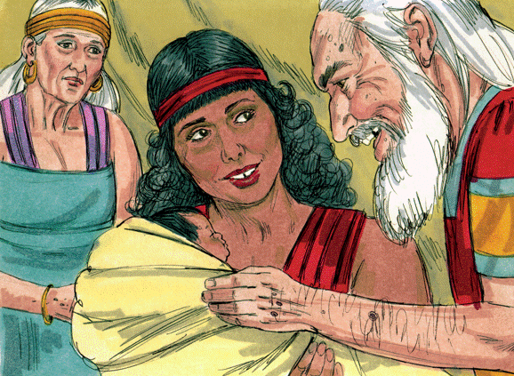
Hagar and the
Birth of Ishmael
Old Testament Book
Genesis
Exodus
Leviticus
Numbers
Deuteronomy
… and Chapter
35
25
16
Bible Illustrations From Sweet Publishing https://www.unfoldingword.org/sweet-publishing

Slide 22
Hagar and the
Birth of Ishmael
Old Testament Book
Genesis
1 point
… and Chapter
16
2 points
Bible Illustrations From Sweet Publishing https://www.unfoldingword.org/sweet-publishing

Slide 23
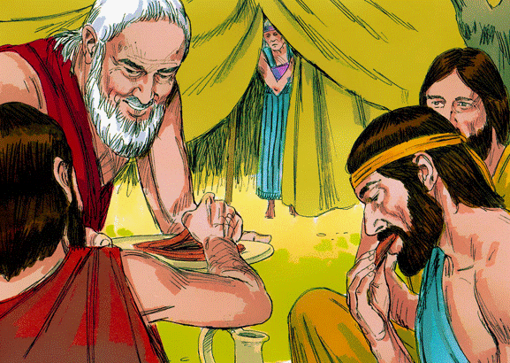
Angelic Visitors.
Sarah will have a Son
Old Testament Book
Genesis
Exodus
Leviticus
Numbers
Deuteronomy
… and Chapter
18
12
41
Bible Illustrations From Sweet Publishing https://www.unfoldingword.org/sweet-publishing

Slide 24
Angelic Visitors.
Sarah will have a Son
Old Testament Book
Genesis
1 point
… and Chapter
18
2 points
Bible Illustrations From Sweet Publishing https://www.unfoldingword.org/sweet-publishing

Slide 25
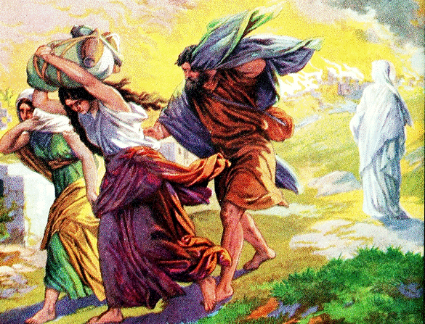
Destruction
of Sodom
Old Testament Book
Genesis
Exodus
Leviticus
Numbers
Deuteronomy
… and Chapter
43
19
34
https://free.messianicbible.com/news/archaeologists-find-site-sodom/

Slide 26
Destruction
of Sodom
Old Testament Book
Genesis
1 point
… and Chapter
19
2 points
https://free.messianicbible.com/news/archaeologists-find-site-sodom/

Slide 27
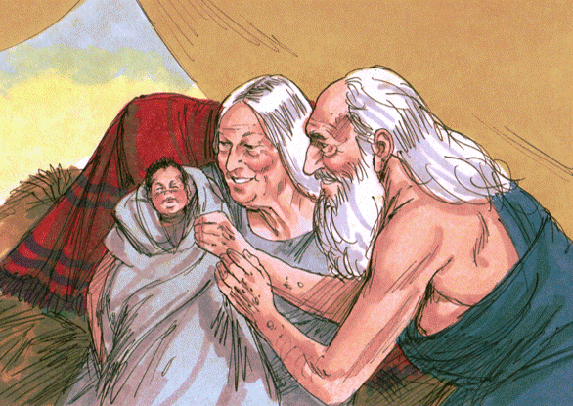
Old Testament Book
Birth of Isaac
Genesis
Exodus
Leviticus
Numbers
Deuteronomy
… and Chapter
21
35
13
Bible Illustrations From Sweet Publishing https://www.unfoldingword.org/sweet-publishing

Slide 28
Old Testament Book
Birth of Isaac
Genesis
1 point
… and Chapter
21
2 points
Bible Illustrations From Sweet Publishing https://www.unfoldingword.org/sweet-publishing

Slide 29
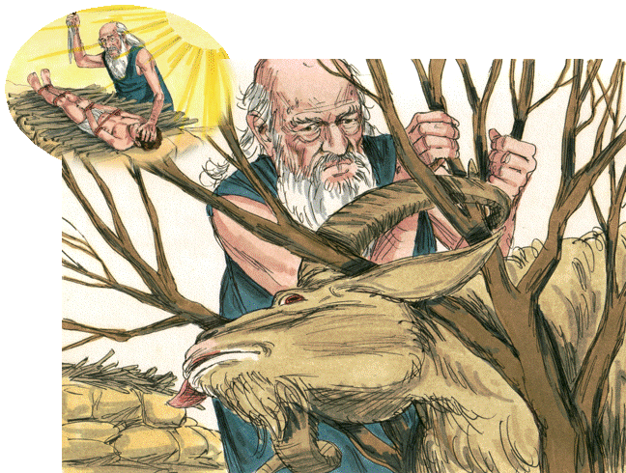
Old Testament Book
Sacrifice of Isaac
Genesis
Exodus
Leviticus
Numbers
Deuteronomy
… and Chapter
22
36
29
Bible Illustrations From Sweet Publishing https://www.unfoldingword.org/sweet-publishing

Slide 30
Old Testament Book
Sacrifice of Isaac
Genesis
1 point
… and Chapter
22
2 points
Bible Illustrations From Sweet Publishing https://www.unfoldingword.org/sweet-publishing

Slide 31
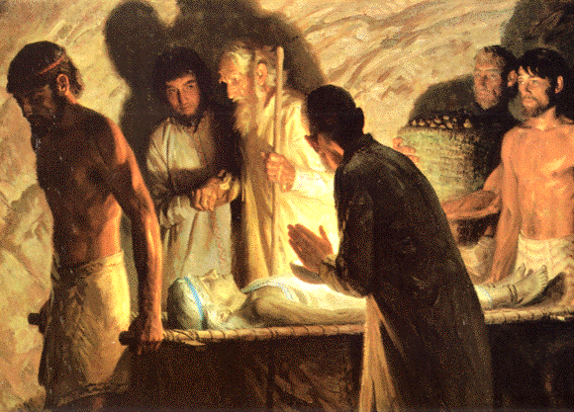
Death of Sarah.
Burial at Machpelah
Old Testament Book
Genesis
Exodus
Leviticus
Numbers
Deuteronomy
… and Chapter
11
23
34
Painting by Tom Lovell, Everyday Life in Bible Times, National Geographic, p.104.

Slide 32
Death of Sarah.
Burial at Machpelah
Old Testament Book
Genesis
1 point
… and Chapter
23
2 points
Painting by Tom Lovell, Everyday Life in Bible Times, National Geographic, p.104.

Slide 33
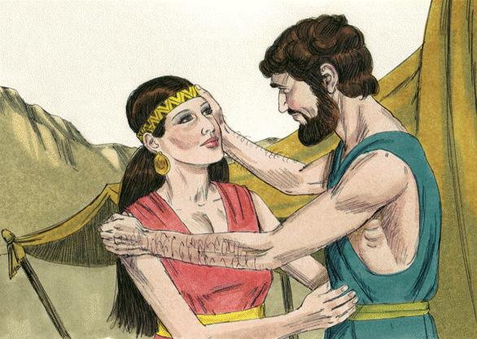
Rebekah.
A Wife for Isaac
Old Testament Book
Genesis
Exodus
Leviticus
Numbers
Deuteronomy
… and Chapter
24
20
16
Bible Illustrations From Sweet Publishing https://www.unfoldingword.org/sweet-publishing

Slide 34
Rebekah.
A Wife for Isaac
Old Testament Book
Genesis
1 point
… and Chapter
24
2 points
Bible Illustrations From Sweet Publishing https://www.unfoldingword.org/sweet-publishing

Slide 35
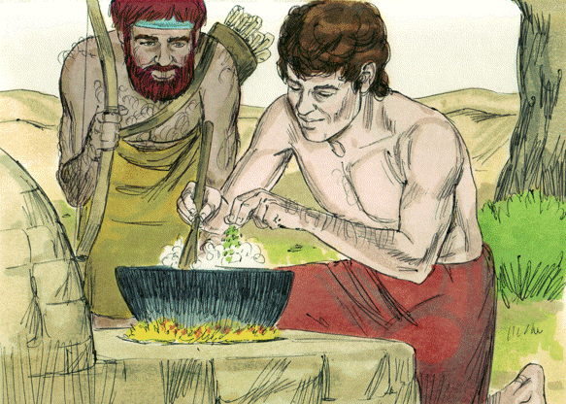
Esau & Jacob.
The Birthright
Old Testament Book
Genesis
Exodus
Leviticus
Numbers
Deuteronomy
… and Chapter
16
30
25
Bible Illustrations From Sweet Publishing https://www.unfoldingword.org/sweet-publishing

Slide 36
Esau & Jacob.
The Birthright
Old Testament Book
Genesis
1 point
… and Chapter
25
2 points
Bible Illustrations From Sweet Publishing https://www.unfoldingword.org/sweet-publishing

Slide 37
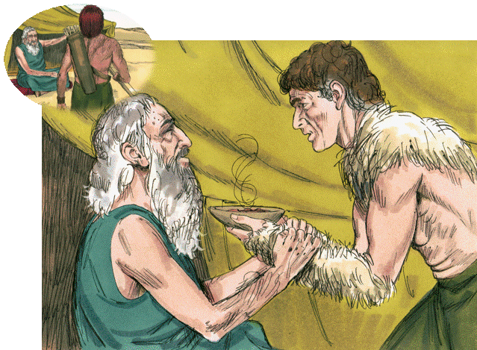
Isaac & Jacob.
The Blessing
Old Testament Book
Genesis
Exodus
Leviticus
Numbers
Deuteronomy
… and Chapter
27
17
25
Bible Illustrations From Sweet Publishing https://www.unfoldingword.org/sweet-publishing

Slide 38
Isaac & Jacob.
The Blessing
Old Testament Book
Genesis
1 point
… and Chapter
27
2 points
Bible Illustrations From Sweet Publishing https://www.unfoldingword.org/sweet-publishing

Slide 39
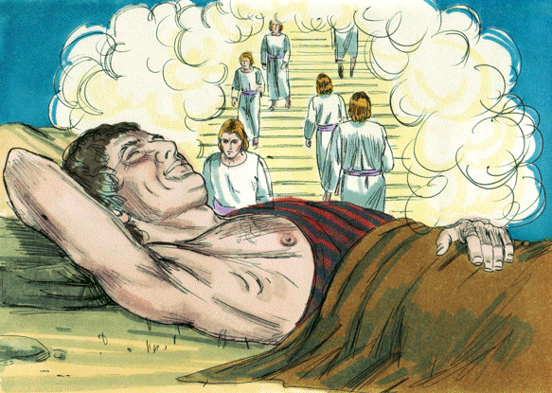
Jacob’s Dream
at Bethel
Old Testament Book
Genesis
Exodus
Leviticus
Numbers
Deuteronomy
… and Chapter
15
22
28
Bible Illustrations From Sweet Publishing https://www.unfoldingword.org/sweet-publishing

Slide 40
Jacob’s Dream
at Bethel
Old Testament Book
Genesis
1 point
… and Chapter
2 points
28
Bible Illustrations From Sweet Publishing https://www.unfoldingword.org/sweet-publishing

Slide 41
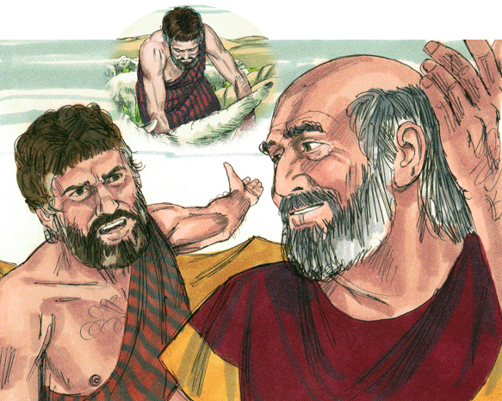
Jacob Serves
Laban
Old Testament Book
Genesis
Exodus
Leviticus
Numbers
Deuteronomy
… and Chapters
21-23
29-31
13-15
Bible Illustrations From Sweet Publishing https://www.unfoldingword.org/sweet-publishing

Slide 42
Jacob Serves
Laban
Old Testament Book
Genesis
1 point
… and Chapters
29-31
2 points
Bible Illustrations From Sweet Publishing https://www.unfoldingword.org/sweet-publishing

Slide 43
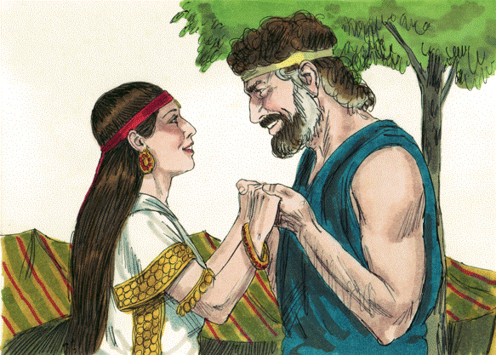
Old Testament Book
Jacob & Rachel
Genesis
Exodus
Leviticus
Numbers
Deuteronomy
… and Chapters
21
ff
29
ff
13
ff
Bible Illustrations From Sweet Publishing https://www.unfoldingword.org/sweet-publishing

Slide 44
Old Testament Book
Jacob & Rachel
Genesis
1 point
… and Chapters
29
ff
2 points
Bible Illustrations From Sweet Publishing https://www.unfoldingword.org/sweet-publishing

Slide 45
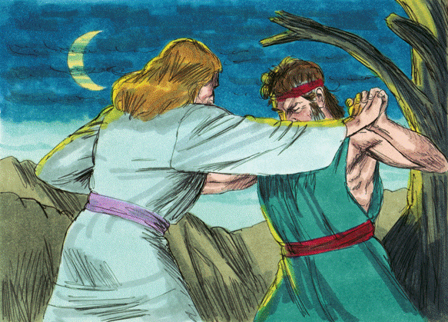
Wrestling Jacob
is Named Israel
Old Testament Book
Genesis
Exodus
Leviticus
Numbers
Deuteronomy
… and Chapter
16
32
23
Bible Illustrations From Sweet Publishing https://www.unfoldingword.org/sweet-publishing

Slide 46
Wrestling Jacob
is Named Israel
Old Testament Book
Genesis
1 point
… and Chapter
32
2 points
Bible Illustrations From Sweet Publishing https://www.unfoldingword.org/sweet-publishing

Slide 47
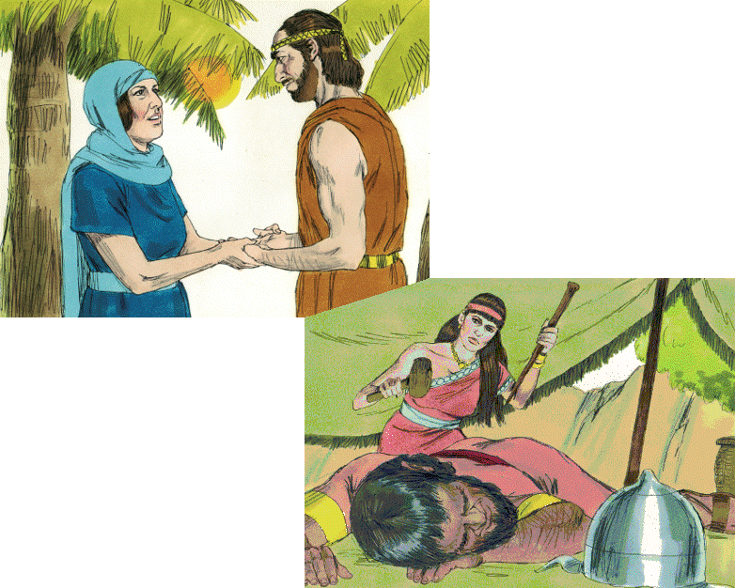
Old Testament Book
Joshua
Judges
Ruth
1 Samuel
2 Samuel
Deborah & Barak
Jael
& Sisera
… and Chapters
4-5
13-16
29-31
Bible Illustrations From Sweet Publishing https://www.unfoldingword.org/sweet-publishing

Slide 48
Old Testament Book
Judges
1 point
Deborah & Barak
Jael
& Sisera
… and Chapters
4-5
2 points
Bible Illustrations From Sweet Publishing https://www.unfoldingword.org/sweet-publishing

Slide 49
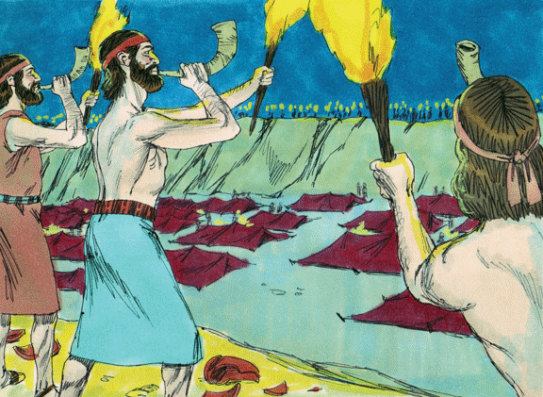
Gideon Defeats
the Midianites
Old Testament Book
Joshua
Judges
Ruth
1 Samuel
2 Samuel
… and Chapters
6-8
2-3
17-18
Bible Illustrations From Sweet Publishing https://www.unfoldingword.org/sweet-publishing

Slide 50
Gideon Defeats
the Midianites
Old Testament Book
Judges
1 point
… and Chapters
6-8
2 points
Bible Illustrations From Sweet Publishing https://www.unfoldingword.org/sweet-publishing

Slide 51
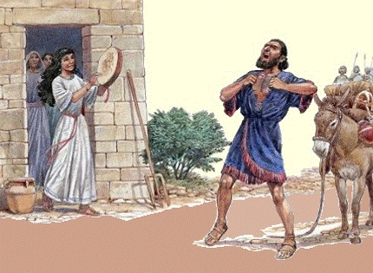
Jephthah and his Faithful Daughter
Old Testament Book
Joshua
Judges
Ruth
1 Samuel
2 Samuel
… and Chapter
11
4
21
http://www.biblestudywithrandy.com/2015/11/jephthahs-daughter-part-2-was-she-sacrificed/

Slide 52
Jephthah and his Faithful Daughter
Old Testament Book
Judges
1 point
… and Chapter
11
2 points
http://www.biblestudywithrandy.com/2015/11/jephthahs-daughter-part-2-was-she-sacrificed/

Slide 53
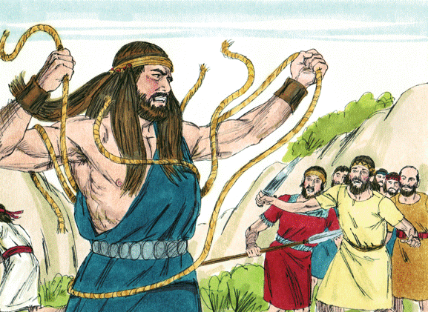
Samson, the Spirit-
Powered Nazarite
Old Testament Book
Joshua
Judges
Ruth
1 Samuel
2 Samuel
… and Chapters
2-3
13-16
6-8
Bible Illustrations From Sweet Publishing https://www.unfoldingword.org/sweet-publishing

Slide 54
Samson, the Spirit-
Powered Nazarite
Old Testament Book
Judges
1 point
… and Chapters
13-16
2 points
Bible Illustrations From Sweet Publishing https://www.unfoldingword.org/sweet-publishing

Slide 55
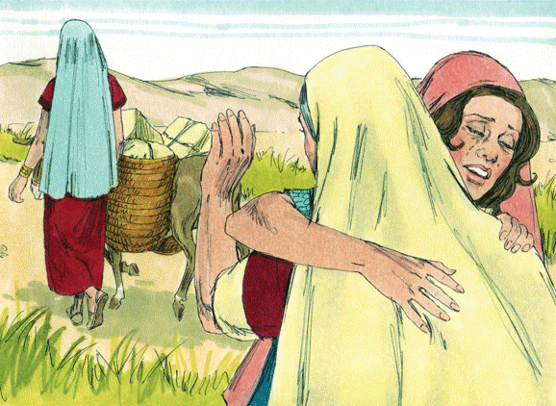
“Do not urge me
to leave you”
Old Testament Book
Joshua
Judges
Ruth
1 Samuel
2 Samuel
… and Chapter
3
2
1
4
Bible Illustrations From Sweet Publishing https://www.unfoldingword.org/sweet-publishing

Slide 56
“Do not urge me
to leave you”
Old Testament Book
Ruth
1 point
… and Chapter
1
2 points
Bible Illustrations From Sweet Publishing https://www.unfoldingword.org/sweet-publishing

Slide 57
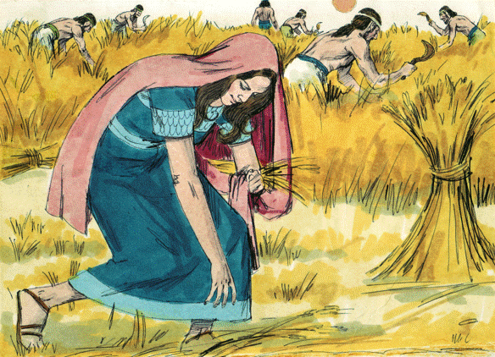
“Do not go to glean in another field”
Old Testament Book
Joshua
Judges
Ruth
1 Samuel
2 Samuel
… and Chapter
1
4
2
3
Bible Illustrations From Sweet Publishing https://www.unfoldingword.org/sweet-publishing

Slide 58
“Do not go to glean in another field”
Old Testament Book
Ruth
1 point
… and Chapter
2
2 points
Bible Illustrations From Sweet Publishing https://www.unfoldingword.org/sweet-publishing

Slide 59
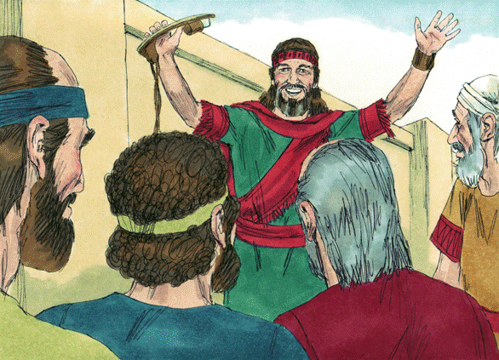
Boaz Becomes
a Redeemer
Old Testament Book
Joshua
Judges
Ruth
1 Samuel
2 Samuel
… and Chapter
1
4
2
3
Bible Illustrations From Sweet Publishing https://www.unfoldingword.org/sweet-publishing

Slide 60
Boaz Becomes
a Redeemer
Old Testament Book
Ruth
1 point
… and Chapter
4
2 points
Bible Illustrations From Sweet Publishing https://www.unfoldingword.org/sweet-publishing

Slide 61
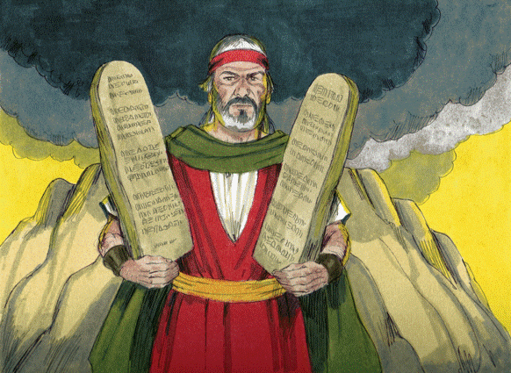
The Ten Commandments
Old Testament Book
Genesis
Exodus
Leviticus
Numbers
Deuteronomy
… and Chapter
5
40
20
Bible Illustrations From Sweet Publishing https://www.unfoldingword.org/sweet-publishing

Slide 62
The Ten Commandments
Old Testament Book
Exodus
An extra 3 points
if you got both!
1 point
Deuteronomy
… and Chapter
5
2 points
20
Bible Illustrations From Sweet Publishing https://www.unfoldingword.org/sweet-publishing

Slide 63
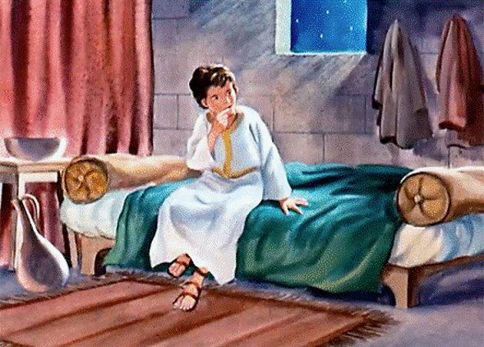
“Speak, LORD, for your servant hears”
Old Testament Book
Joshua
Judges
Ruth
1 Samuel
2 Samuel
… and Chapter
9
3
25
http://freebibleimages.org/illustrations/moody-samuel/

Slide 64
“Speak, LORD, for your servant hears”
Old Testament Book
1 Samuel
1 point
… and Chapter
3
2 points
http://freebibleimages.org/illustrations/moody-samuel/

