Slide 1
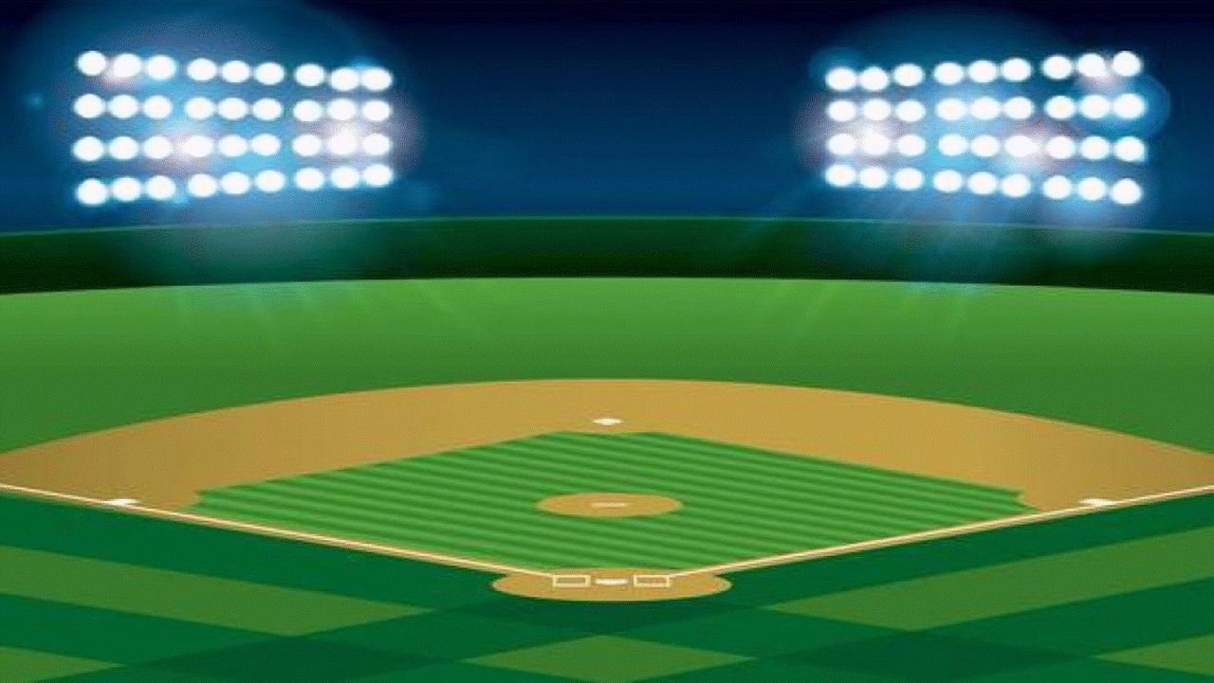

BIBLE BASEBALL
MATTHEW
Tap the screen to get started
http://www.thelockinmovie.com/tag/clip-art-of-baseball-field/

Slide 2
BIBLE BASEBALL
MATTHEW
Bible Baseball is created in PowerPoint. A tap (screen-tap or mouse-click) is all that is needed to play. No PowerPoint skills are required.
See the next screen for “Here’s how it works.”
Tap the screen to continue

Slide 3
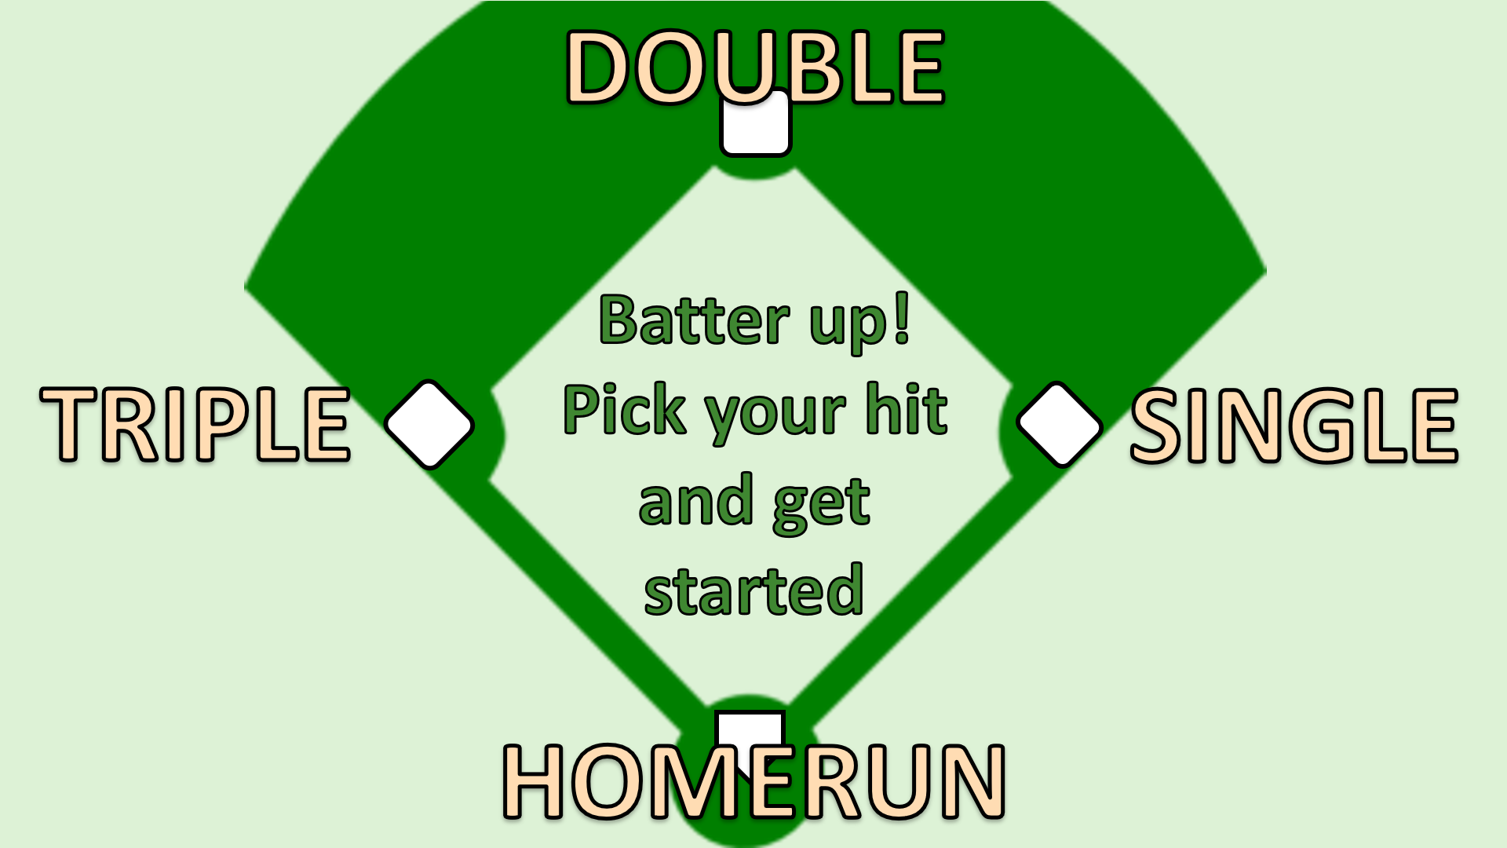
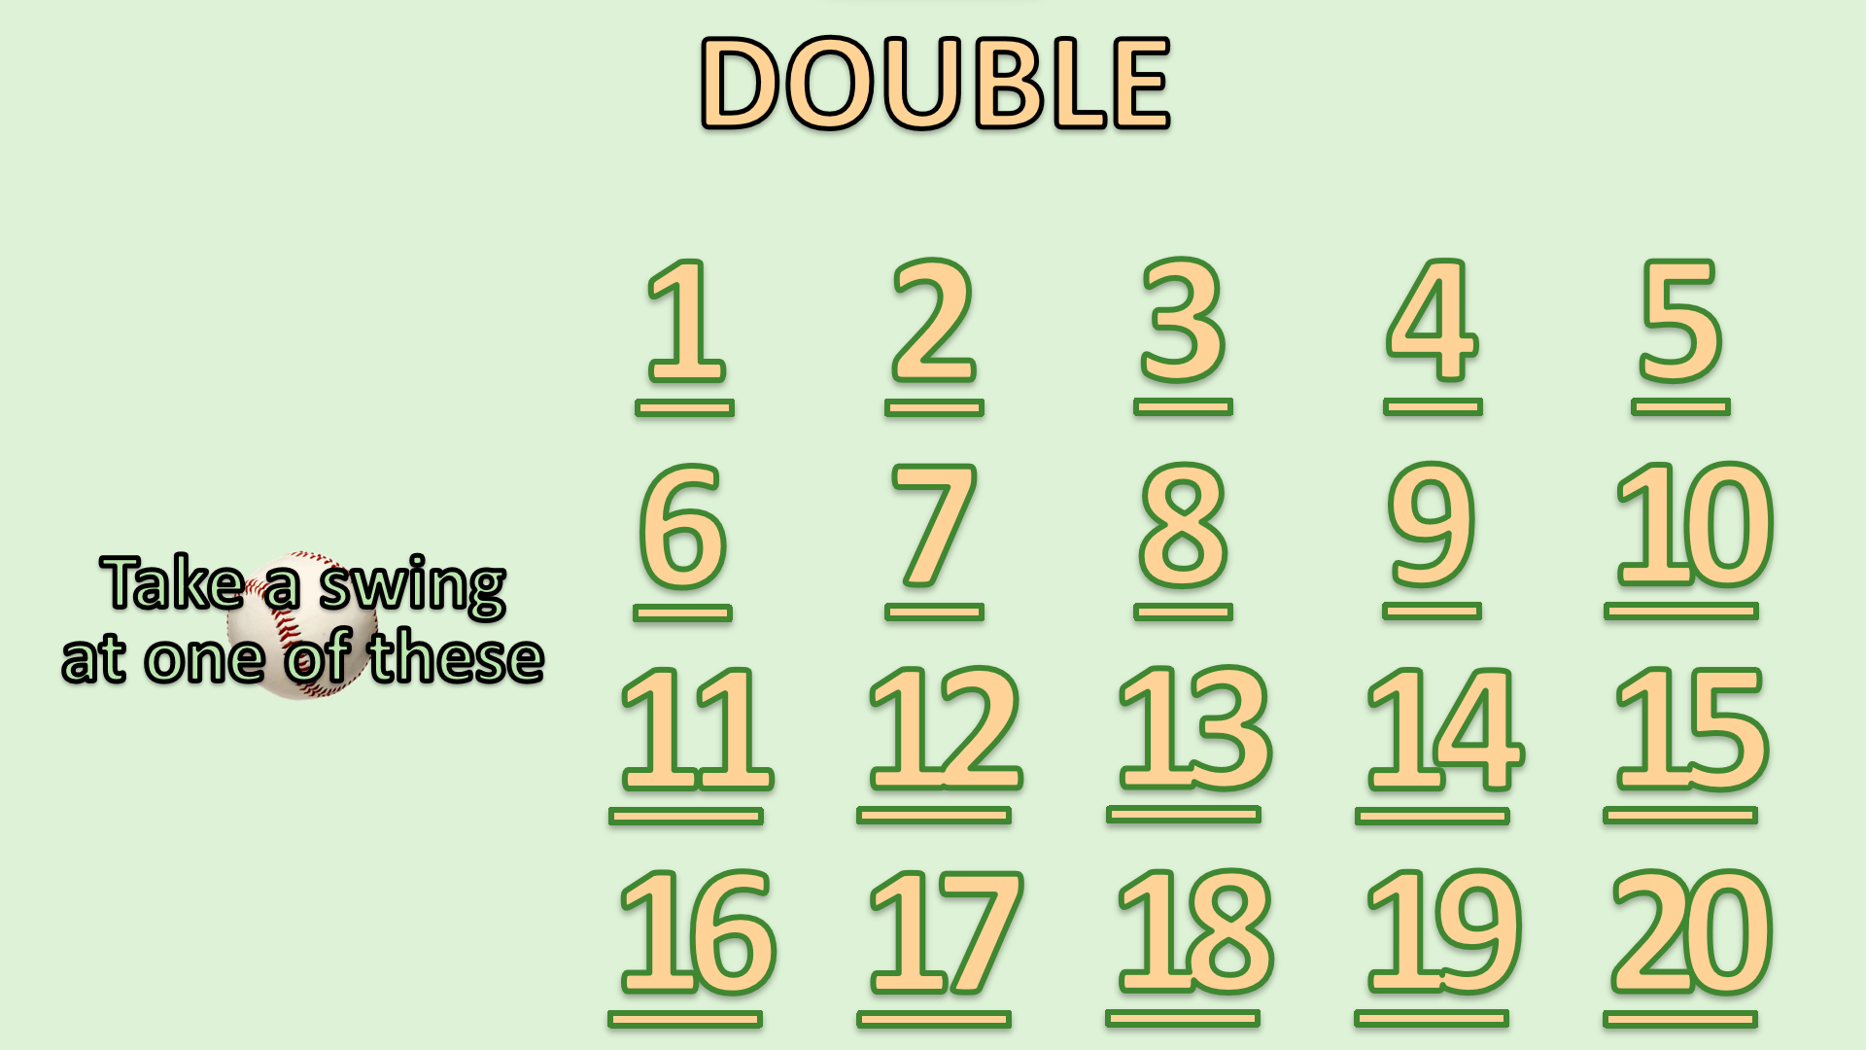

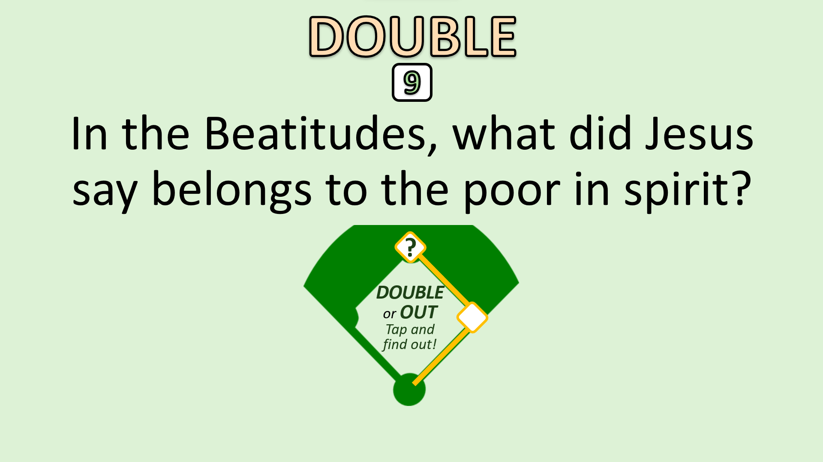
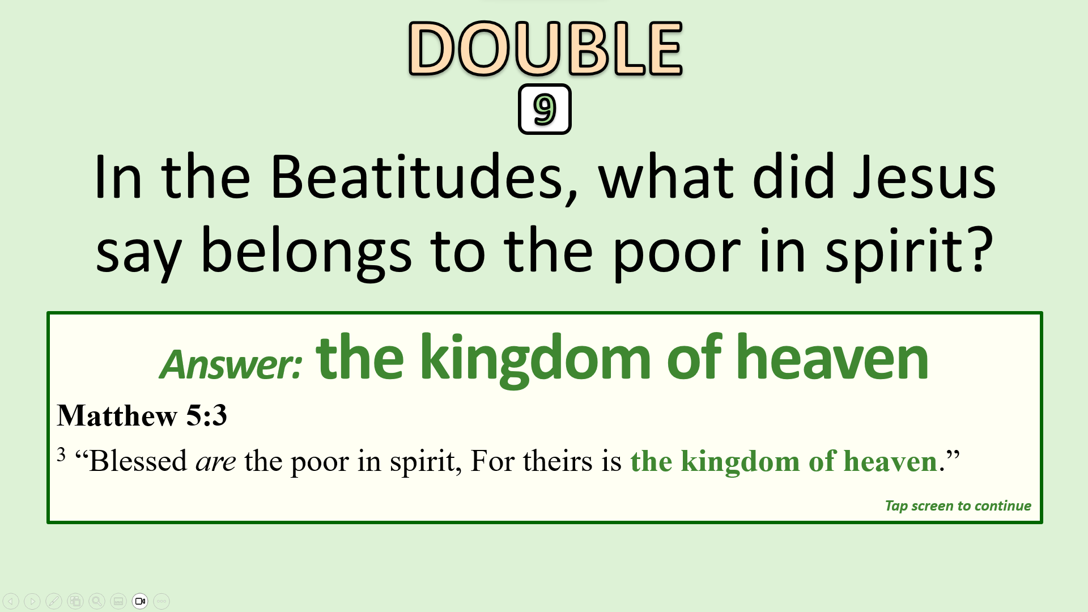
Here’s how it works
Everybody knows how to play Baseball! Be as formal as you want (form teams and keep score) or informal (just try it). You can learn a lot about MATTHEW’S GOSPEL either way.
SINGLE, DOUBLE, TRIPLE,
Batter up! What kind of hit do you want to swing for? or
HOMERUN
? Just tap the word. Of course, Homeruns are harder to hit than Singles!
DOUBLE
For example, want a ? Tap it to jump to the Double Screen. 20 “Double Questions” await your hitting skills. Tap any one of them (e.g., ).
9
Here’s your question. Answer it for a Double. Miss it and “You’re out!” Tap the middle of the Diamond to see how you’ve done.
The answer comes up. Did you hit it or not? Keep following the on-screen instructions (more taps). How you score the game is up to you.
Tap the screen and step to plate!

Slide 4

DOUBLE
Batter up!
Pick your hit
and get started
TRIPLE
SINGLE
HOMERUN

Slide 5


Take a swing
at one of these
1
2
3
4
5
6
7
8
9
10
SINGLE
11
12
13
14
15
16
17
18
19
20
No more singles left?
Tap here …

Slide 6
DOUBLE
1
2
3
4
5
6
7
8
9
10
Take a swing
at one of these
11
12
13
14
15
16
17
18
19
20
No more doubles left?
Tap here …

Slide 7
Take a swing
at one of these
1
2
3
4
5
6
7
8
9
10
TRIPLE
11
12
13
14
15
16
17
18
19
20
No more triples left?
Tap here …

Slide 8
1
2
3
4
5
6
7
8
9
10
Take a swing
at one of these
11
12
13
14
15
16
17
18
19
20
HOMERUN
No more homers left?
Tap here …

Slide 9
Where was Jesus born?
SINGLE
1
SINGLE
or OUT
Tap and
find out!
?

Slide 10
Where was Jesus born?
Answer: Bethlehem
Matthew 2:1-2
¹ Now after Jesus was born in Bethlehem of Judea in the days of Herod the king, behold, wise men from the east came to Jerusalem, ² saying, “Where is he who has been born king of the Jews?”
SINGLE
1
Tap screen to continue

Slide 11
DOUBLE
Next batter!
Pick a hit
TRIPLE
HOMERUN

Slide 12
In what city did
Jesus grow up?
SINGLE
2
SINGLE
or OUT
Tap and
find out!
?

Slide 13
In what city did
Jesus grow up?
Answer: Nazareth
Matthew 2:23
²³ And he went and lived in a city called Nazareth, so that what was spoken by the prophets might be fulfilled, that he would be called a Nazarene.
SINGLE
2
Tap screen to continue

Slide 14
DOUBLE
Next batter!
Pick a hit
TRIPLE
HOMERUN

Slide 15
Who prepared the way for Jesus to begin his ministry?
SINGLE
3
SINGLE
or OUT
Tap and
find out!
?

Slide 16
Who prepared the way for Jesus to begin his ministry?
Answer: John the Baptist
Matthew 3:1-2
¹ In those days John the Baptist came preaching in the wilderness of Judea, ² “Repent, for the kingdom of heaven is at hand.”
SINGLE
3
Tap screen to continue

Slide 17
DOUBLE
Next batter!
Pick a hit
TRIPLE
HOMERUN

Slide 18
Where was Jesus baptized?
SINGLE
4
SINGLE
or OUT
Tap and
find out!
?

Slide 19
Where was Jesus baptized?
Answer: the Jordan
Matthew 3:13
¹³ Then Jesus came from Galilee to the Jordan to John, to be baptized by him.
SINGLE
4
Tap screen to continue

Slide 20
DOUBLE
Next batter!
Pick a hit
TRIPLE
HOMERUN

Slide 21
How many temptations did Jesus suffer in the wilderness?
SINGLE
5
SINGLE
or OUT
Tap and
find out!
?

Slide 22
How many temptations did Jesus suffer in the wilderness?
Answer: three
Matthew 4:3, 6, 9
³ And the tempter came and said to him, “If you are the Son of God, command these stones to become loaves of bread.”
⁶ “If you are the Son of God, throw yourself down (from the pinnacle of the temple), for it is written, ‘“He will command his angels concerning you.”’
⁹ And he said to him, “All these (kingdoms) I will give you, if you will fall down and worship me.”
SINGLE
5
Tap screen to continue

Slide 23
DOUBLE
Next batter!
Pick a hit
TRIPLE
HOMERUN

Slide 24
What did Peter and Andrew do before they became disciples of Jesus?
SINGLE
6
SINGLE
or OUT
Tap and
find out!
?

Slide 25
What did Peter and Andrew do before they became disciples of Jesus?
Answer: fishermen
Matthew 4:18
¹⁸ While walking by the Sea of Galilee, he saw two brothers, Simon (who is called Peter) and Andrew his brother, casting a net into the sea, for they were fishermen.
SINGLE
6
Tap screen to continue

Slide 26
DOUBLE
Next batter!
Pick a hit
TRIPLE
HOMERUN

Slide 27
Complete the quote: “Let your _____ shine before others, so they may see your good works.”
SINGLE
7
SINGLE
or OUT
Tap and
find out!
?

Slide 28
Complete the quote: “Let your _____ shine before others, so they may see your good works.”
Answer: light
Matthew 5:16
¹⁶ “In the same way, let your light shine before others, so that they may see your good works and give glory to your Father who is in heaven.”
SINGLE
7
Tap screen to continue

Slide 29
DOUBLE
Next batter!
Pick a hit
TRIPLE
HOMERUN

Slide 30
Complete the quote: “Your kingdom come, Your will be done _____, as it is in heaven”
SINGLE
8
SINGLE
or OUT
Tap and
find out!
?

Slide 31
Complete the quote: “Your kingdom come, Your will be done _____, as it is in heaven”
Answer: on earth
Matthew 6:9-10
⁹ “Pray then like this: ‘Our Father in heaven, hallowed be your name. ¹⁰ Your kingdom come, your will be done, on earth as it is in heaven.’”
SINGLE
8
Tap screen to continue

Slide 32
DOUBLE
Next batter!
Pick a hit
TRIPLE
HOMERUN

Slide 33
“The rain fell, the floods came, and the winds blew, but the house built on this did not fall.”
SINGLE
9
SINGLE
or OUT
Tap and
find out!
?

Slide 34
“The rain fell, the floods came, and the winds blew, but the house built on this did not fall.”
Answer: the rock
Matthew 7:24-25
²⁴ “Everyone then who hears these words of mine and does them will be like a wise man who built his house on the rock. ²⁵ And the rain fell, and the floods came, and the winds blew and beat on that house, but it did not fall, because it had been founded on the rock.”
SINGLE
9
Tap screen to continue

Slide 35
DOUBLE
Next batter!
Pick a hit
TRIPLE
HOMERUN

Slide 36
How many apostles
did Jesus choose?
SINGLE
10
SINGLE
or OUT
Tap and
find out!
?

Slide 37
How many apostles
did Jesus choose?
Answer: 12
Matthew 10:1, 5
¹ And he called to him his twelve disciples and gave them authority over unclean spirits, to cast them out, and to heal every disease and every affliction. … ⁵ These twelve Jesus sent out.
SINGLE
10
Tap screen to continue

Slide 38
DOUBLE
Next batter!
Pick a hit
TRIPLE
HOMERUN

Slide 39
What apostle betrayed Jesus?
SINGLE
11
SINGLE
or OUT
Tap and
find out!
?

Slide 40
What apostle betrayed Jesus?
Answer: Judas Iscariot
Matthew 10:2-4
² The names of the twelve apostles are these: first, Simon, who is called Peter, and Andrew his brother; James the son of Zebedee, and John his brother; ³ Philip and Bartholomew; Thomas and Matthew the tax collector; James the son of Alphaeus, and Thaddaeus; ⁴ Simon the Zealot, and Judas Iscariot, who betrayed him.
SINGLE
11
Tap screen to continue

Slide 41
DOUBLE
Next batter!
Pick a hit
TRIPLE
HOMERUN

Slide 42
How many people did Jesus feed with five loaves and two fish?
SINGLE
12
SINGLE
or OUT
Tap and
find out!
?

Slide 43
How many people did Jesus feed with five loaves and two fish?
Answer: 5,000
(“besides women and children”)
Matthew 14:17-21
¹⁷ They said to him, “We have only five loaves here and two fish.” … ²¹ And those who ate were about five thousand men, besides women and children.
SINGLE
12
Tap screen to continue

Slide 44
DOUBLE
Next batter!
Pick a hit
TRIPLE
HOMERUN

Slide 45
Who walked on water to go to Jesus?
SINGLE
13
SINGLE
or OUT
Tap and
find out!
?

Slide 46
Who walked on water to go to Jesus?
Answer: Peter
Matthew 14:28-29
²⁸ And Peter answered him, “Lord, if it is you, command me to come to you on the water.” ²⁹ He said, “Come.” So Peter got out of the boat and walked on the water and came to Jesus.
SINGLE
13
Tap screen to continue

Slide 47
DOUBLE
Next batter!
Pick a hit
TRIPLE
HOMERUN

Slide 48
What did the face of Jesus shine like during his transfiguration?
SINGLE
14
SINGLE
or OUT
Tap and
find out!
?

Slide 49
What did the face of Jesus shine like during his transfiguration?
Answer: the sun
Matthew 17:1-2
¹ And after six days Jesus took with him Peter and James, and John his brother, and led them up a high mountain by themselves. ² And he was transfigured before them, and his face shone like the sun, and his clothes became white as light.
SINGLE
14
14
Tap screen to continue

Slide 50
DOUBLE
Next batter!
Pick a hit
TRIPLE
HOMERUN

Slide 51
At what city was Jesus tried, beaten and crucified?
SINGLE
15
SINGLE
or OUT
Tap and
find out!
?

Slide 52
At what city was Jesus tried, beaten and crucified?
Answer: Jerusalem
Matthew 20:17-18
¹⁷ And as Jesus was going up to Jerusalem, he took the twelve disciples aside, and on the way he said to them, ¹⁸ “See, we are going up to Jerusalem. And the Son of Man will be delivered over to the chief priests and scribes, and they will condemn him to death.”
SINGLE
15
Tap screen to continue

Slide 53
DOUBLE
Next batter!
Pick a hit
TRIPLE
HOMERUN

Slide 54
Who is coming again in power and great glory?
SINGLE
16
SINGLE
or OUT
Tap and
find out!
?

Slide 55
Who is coming again in power and great glory?
Answer: Jesus;
the Son of Man
Matthew 24:30
³⁰ “Then will appear in heaven the sign of the Son of Man, and then all the tribes of the earth will mourn, and they will see the Son of Man coming on the clouds of heaven with power and great glory.”
SINGLE
16
Tap screen to continue

Slide 56
DOUBLE
Next batter!
Pick a hit
TRIPLE
HOMERUN

Slide 57
What will the righteous be given at the Judgment Seat of Christ?
SINGLE
17
SINGLE
or OUT
Tap and
find out!
?

Slide 58
What will the righteous be given at the Judgment Seat of Christ?
Answer: the kingdom; eternal life
Matthew 25:34-40, 46
³⁴ “Then the King will say to those on his right, ‘Come, you who are blessed by my Father, inherit the kingdom prepared for you from the foundation of the world.’ … ⁴⁶ And … the righteous (will go) into eternal life.”
SINGLE
17
Tap screen to continue

Slide 59
DOUBLE
Next batter!
Pick a hit
TRIPLE
HOMERUN

Slide 60
How many times did Peter deny Jesus?
SINGLE
18
SINGLE
or OUT
Tap and
find out!
?

Slide 61
How many times did Peter deny Jesus?
Answer: three
Matthew 26:33-34
³⁴ Jesus said to him, “Truly, I tell you, this very night, before the rooster crows, you will deny me three times.” ³⁵ Peter said to him, “Even if I must die with you, I will not deny you!”
SINGLE
18
Tap screen to continue

Slide 62
DOUBLE
Next batter!
Pick a hit
TRIPLE
HOMERUN

Slide 63
What did Pilate’s soldiers place on the head of Jesus?
SINGLE
19
SINGLE
or OUT
Tap and
find out!
?

Slide 64
What did Pilate’s soldiers place on the head of Jesus?
Answer: a crown of thorns
Matthew 27:28-29
²⁸ And they stripped him and put a scarlet robe on him, ²⁹ and twisting together a crown of thorns, they put it on his head and put a reed in his right hand. And kneeling before him, they mocked him, saying, “Hail, King of the Jews!”
SINGLE
19
Tap screen to continue

Slide 65
DOUBLE
Next batter!
Pick a hit
TRIPLE
HOMERUN

Slide 66
On what day of the week did Jesus rise from the dead?
SINGLE
20
SINGLE
or OUT
Tap and
find out!
?

Slide 67
On what day of the week did Jesus rise from the dead?
Answer: the first
Matthew 26:1-6
¹ Now after the Sabbath, toward the dawn of the first day of the week, Mary Magdalene and the other Mary went to see the tomb. … ⁵ (And) the angel said to the women, “Do not be afraid, for I know that you seek Jesus who was crucified. ⁶ He is not here, for he has risen, as he said. Come, see the place where he lay.”
SINGLE
20
Tap screen to continue

Slide 68
DOUBLE
Next batter!
Pick a hit
TRIPLE
HOMERUN

Slide 69
DOUBLE
1
Who was king in Judea
when Jesus was born?
?
DOUBLE
or OUT
Tap and
find out!

Slide 70
DOUBLE
1
Who was king in Judea
when Jesus was born?
Answer: Herod; Herod the Great
Matthew 2:1
¹ Now after Jesus was born in Bethlehem of Judea in the days of Herod the king, behold, wise men from the east came to Jerusalem …
Tap screen to continue

Slide 71
Next batter!
Pick a hit
TRIPLE
HOMERUN

Slide 72
DOUBLE
2
Complete the Beatitude: “Blessed are the meek: for they shall inherit _____.”
?
DOUBLE
or OUT
Tap and
find out!

Slide 73
DOUBLE
2
Complete the Beatitude: “Blessed are the meek: for they shall inherit _____.”
Answer: the earth
Matthew 5:5
⁵ “Blessed are the meek, for they shall inherit the earth.”
Tap screen to continue

Slide 74
DOUBLE
Next batter!
Pick a hit
TRIPLE
SINGLE
HOMERUN

Slide 75
DOUBLE
3
Complete the quote: “Love your _____, and pray for those who persecute you.”
?
DOUBLE
or OUT
Tap and
find out!

Slide 76
DOUBLE
3
Complete the quote: “Love your _____, and pray for those who persecute you.”
Answer: enemies
Matthew 5:44-45
⁴⁴ “But I say to you, Love your enemies and pray for those who persecute you, ⁴⁵ so that you may be sons of your Father who is in heaven. For he makes his sun rise on the evil and on the good, and sends rain on the just and on the unjust.”
Tap screen to continue

Slide 77
DOUBLE
Next batter!
Pick a hit
TRIPLE
HOMERUN

Slide 78
DOUBLE
4
Complete the quote: “Be wise as serpents and innocent as _____.”
?
DOUBLE
or OUT
Tap and
find out!

Slide 79
DOUBLE
4
Complete the quote: “Be wise as serpents and innocent as _____.”
Answer: doves
Matthew 10:16
¹⁶ “Behold, I am sending you out as sheep in the midst of wolves, so be wise as serpents and innocent as doves.”
Tap screen to continue

Slide 80
DOUBLE
Next batter!
Pick a hit
TRIPLE
SINGLE
HOMERUN

Slide 81
DOUBLE
5
What must a disciple take up
in order to follow Jesus?
?
DOUBLE
or OUT
Tap and
find out!

Slide 82
DOUBLE
5
What must a disciple take up
in order to follow Jesus?
Answer: his cross
Matthew 10:38-39
^{38 “}And whoever does not take his cross and follow me is not worthy of me. ³⁹ Whoever finds his life will lose it, and whoever loses his life for my sake will find it.”
Tap screen to continue

Slide 83
DOUBLE
Next batter!
Pick a hit
TRIPLE
SINGLE
HOMERUN

Slide 84
DOUBLE
6
What did the Pharisees break
by their traditions?
?
DOUBLE
or OUT
Tap and
find out!

Slide 85
DOUBLE
6
What did the Pharisees break
by their traditions?
Answer: the commandment of God;
the word of God
Matthew 15:1-6
¹ Then Pharisees and scribes came to Jesus from Jerusalem and said, ² “Why do your disciples break the tradition of the elders?” … ³ He answered them, “And why do you break the commandment of God for the sake of your tradition? … ⁶ … So for the sake of your tradition you have made void the word of God.”
Tap screen to continue

Slide 86
Next batter!
Pick a hit
TRIPLE
HOMERUN

Slide 87
DOUBLE
7
Complete the quote: “This people honors me with their lips, but their _____ is far from me.”
?
DOUBLE
or OUT
Tap and
find out!

Slide 88
DOUBLE
7
Complete the quote: “This people honors me with their lips, but their _____ is far from me.”
Answer: heart
Matthew 15:8-9
^{8 “}This people honors me with their lips, but their heart is far from me; ⁹ in vain do they worship me, teaching as doctrines the commandments of men.”
Tap screen to continue

Slide 89
DOUBLE
Next batter!
Pick a hit
TRIPLE
HOMERUN

Slide 90
DOUBLE
8
Where do the things come from that defile a man?
?
DOUBLE
or OUT
Tap and
find out!

Slide 91
DOUBLE
8
Where do the things come from that defile a man?
Answer: the heart
Matthew 15:18-20
¹⁸ “But what comes out of the mouth proceeds from the heart, and this defiles a person. ¹⁹ For out of the heart come evil thoughts, murder, adultery, sexual immorality, theft, false witness, slander. ²⁰ These are what defile a person.”
Tap screen to continue

Slide 92
DOUBLE
Next batter!
Pick a hit
TRIPLE
SINGLE
HOMERUN

Slide 93
DOUBLE
9
Who did Peter say that Jesus was?
?
DOUBLE
or OUT
Tap and
find out!

Slide 94
DOUBLE
9
Who did Peter say that Jesus was?
Answer: the Christ;
the Son of the living God
Matthew 16:15-16
¹⁵ He said to them, “But who do you say that I am?” ¹⁶ Simon Peter replied, “You are the Christ, the Son of the living God.”
Tap screen to continue

Slide 95
DOUBLE
Next batter!
Pick a hit
TRIPLE
HOMERUN

Slide 96
DOUBLE
10
What did Jesus say would happen to him after he suffered and died?
?
DOUBLE
or OUT
Tap and
find out!

Slide 97
DOUBLE
10
What did Jesus say would happen to him after he suffered and died?
Answer: be raised
Matthew 16:21
²¹ From that time Jesus began to show his disciples that he must go to Jerusalem and suffer many things from the elders and chief priests and scribes, and be killed, and on the third day be raised.
Tap screen to continue

Slide 98
DOUBLE
Next batter!
Pick a hit
TRIPLE
SINGLE
HOMERUN

Slide 99
DOUBLE
11
When Peter rebuked Jesus,
what did Jesus call him?
?
DOUBLE
or OUT
Tap and
find out!

Slide 100
DOUBLE
11
When Peter rebuked Jesus,
what did Jesus call him?
Answer: Satan
Matthew 16:22-23
²² And Peter took him aside and began to rebuke him, saying, “Far be it from you, Lord! This shall never happen to you.” ²³ But he turned and said to Peter, “Get behind me, Satan! You are a hindrance to me. For you are not setting your mind on the things of God, but on the things of man.”
Tap screen to continue

Slide 101
Next batter!
Pick a hit
TRIPLE
HOMERUN

Slide 102
DOUBLE
12
What did the Son of man give
as a ransom for many?
?
DOUBLE
or OUT
Tap and
find out!

Slide 103
DOUBLE
12
What did the Son of man give
as a ransom for many?
Answer: his life
Matthew 20:26-28
²⁶ “… But whoever would be great among you must be your servant, ²⁷ and whoever would be first among you must be your slave, ²⁸ even as the Son of Man came not to be served but to serve, and to give his life as a ransom for many.”
Tap screen to continue

Slide 104
DOUBLE
Next batter!
Pick a hit
TRIPLE
SINGLE
HOMERUN

Slide 105
DOUBLE
13
Who do we become like
in the resurrection?
?
DOUBLE
or OUT
Tap and
find out!

Slide 106
DOUBLE
13
Who do we become like
in the resurrection?
Answer: angels
(also Jesus – 1 John 3:1-2)
Matthew 22:30
^{30 “}For in the resurrection they neither marry nor are given in marriage, but are like angels in heaven.”
Tap screen to continue

Slide 107
Next batter!
Pick a hit
TRIPLE
HOMERUN

Slide 108
DOUBLE
14
What is this commandment called? “You shall love the Lord your God with all your heart and with all your soul and with all your mind.”
?
DOUBLE
or OUT
Tap and
find out!

Slide 109
DOUBLE
14
What is this commandment called? “You shall love the Lord your God with all your heart and with all your soul and with all your mind.”
Answer: great; first
Matthew 22:37-38
³⁶ “Teacher, which is the great commandment in the Law?” ³⁷ And he said to him, “You shall love the Lord your God with all your heart and with all your soul and with all your mind. ³⁸ This is the great and first commandment.”
Tap screen to continue

Slide 110
DOUBLE
Next batter!
Pick a hit
TRIPLE
SINGLE
HOMERUN

Slide 111
DOUBLE
15
What does Jesus tell us to do because
we don’t know when he will come again?
?
DOUBLE
or OUT
Tap and
find out!

Slide 112
DOUBLE
15
What does Jesus tell us to do because
we don’t know when he will come again?
Answer: stay awake; be ready
(also watch – Mt.25:13; pray – Lk.21:36)
Matthew 24:42-44
⁴² “Therefore, stay awake, for you do not know on what day your Lord is coming. ⁴³ But know this, that if the master of the house had known in what part of the night the thief was coming, he would have stayed awake and would not have let his house be broken into. ⁴⁴ Therefore you also must be ready, for the Son of Man is coming at an hour you do not expect.”
Tap screen to continue

Slide 113
DOUBLE
Next batter!
Pick a hit
TRIPLE
SINGLE
HOMERUN

Slide 114
DOUBLE
16
Complete the words of Jesus: “Watch and pray, that you may not enter not into _____.”
?
DOUBLE
or OUT
Tap and
find out!

Slide 115
DOUBLE
16
Complete the words of Jesus: “Watch and pray, that you may not enter not into _____.”
Answer: temptation
Matthew 26:41
^{41 “}Watch and pray that you may not enter into temptation. The spirit indeed is willing, but the flesh is weak.”
Tap screen to continue

Slide 116
DOUBLE
Next batter!
Pick a hit
TRIPLE
HOMERUN

Slide 117
DOUBLE
17
During his trial, who asked Jesus, “Are you the King of the Jews?”
?
DOUBLE
or OUT
Tap and
find out!

Slide 118
DOUBLE
17
During his trial, who asked Jesus, “Are you the King of the Jews?”
Answer: the governor; (Pilate)
Matthew 27:11
¹¹ Now Jesus stood before the governor, and the governor asked him, “Are you the King of the Jews?” Jesus said, “You have said so.”
Tap screen to continue

Slide 119
DOUBLE
Next batter!
Pick a hit
TRIPLE
SINGLE
HOMERUN

Slide 120
DOUBLE
18
What notorious prisoner did Pilate release during the trial of Jesus?
?
DOUBLE
or OUT
Tap and
find out!

Slide 121
DOUBLE
18
What notorious prisoner did Pilate release during the trial of Jesus?
Answer: Barabbas
Matthew 27:20-21
²⁰ Now the chief priests and the elders persuaded the crowd to ask for Barabbas and destroy Jesus. ²¹ The governor again said to them, “Which of the two do you want me to release for you?” And they said, “Barabbas.”
Tap screen to continue

Slide 122
DOUBLE
Next batter!
Pick a hit
TRIPLE
HOMERUN

Slide 123
DOUBLE
19
What was the place called
where was Jesus crucified?
?
DOUBLE
or OUT
Tap and
find out!

Slide 124
DOUBLE
19
What was the place called
where was Jesus crucified?
Answer: Golgotha (Calvary – Lk.23:33);
Place of a Skull
Matthew 27:33-35
³³ And when they came to a place called Golgotha (which means Place of a Skull) … ³⁵ And when they had crucified him, they divided his garments among them by casting lots.
Tap screen to continue

Slide 125
DOUBLE
Next batter!
Pick a hit
TRIPLE
HOMERUN

Slide 126
DOUBLE
20
How was the tomb of Jesus opened when he rose from the dead?
?
DOUBLE
or OUT
Tap and
find out!

Slide 127
DOUBLE
20
How was the tomb of Jesus opened when he rose from the dead?
Answer: great earthquake;
an angel … rolled back the stone
Matthew 28:2
² And behold, there was a great earthquake, for an angel of the Lord descended from heaven and came and rolled back the stone and sat on it.
Tap screen to continue

Slide 128
Next batter!
Pick a hit
TRIPLE
HOMERUN

Slide 129
What does the name “Jesus” mean?
TRIPLE
1
TRIPLE
or OUT
Tap and
find out!
?

Slide 130
What does the name “Jesus” mean?
Answer: Savior
Matthew 1:21
^{21 “}She will bear a son, and you shall call his name Jesus, for he will save his people from their sins.”
TRIPLE
1
Tap screen to continue

Slide 131
DOUBLE
Next batter!
Pick a hit
TRIPLE
SINGLE
HOMERUN

Slide 132
What does “Christ” mean?
TRIPLE
2
TRIPLE
or OUT
Tap and
find out!
?

Slide 133
What does “Christ” mean?
Answer: Anointed
G5547 Χριστός Christos khris-tos’
AV New Testament – Christ 569; 569
Christ = “anointed”
TRIPLE
2
Tap screen to continue

Slide 134
DOUBLE
Next batter!
Pick a hit
TRIPLE
SINGLE
HOMERUN

Slide 135
What does “Messiah” mean?
TRIPLE
3
TRIPLE
or OUT
Tap and
find out!
?

Slide 136
What does “Messiah” mean?
Answer: Anointed
H4899 משׁיח mashiyach maw-shee’-akh
AV Old Testament – anointed 37, Messiah 2; 39
1) anointed, anointed one
TRIPLE
3
Tap screen to continue

Slide 137
DOUBLE
Next batter!
Pick a hit
TRIPLE
SINGLE
HOMERUN

Slide 138
What does “Immanuel” mean?
TRIPLE
4
TRIPLE
or OUT
Tap and
find out!
?

Slide 139
What does “Immanuel” mean?
Answer: God with us
Matthew 1:23
²³ “Behold, the virgin shall conceive and bear a son, and they shall call his name Immanuel” (which means, God with us).
TRIPLE
4
Tap screen to continue

Slide 140
DOUBLE
Next batter!
Pick a hit
TRIPLE
SINGLE
HOMERUN

Slide 141
Jesus said that his baptism was necessary to fulfill all _____.
TRIPLE
5
TRIPLE
or OUT
Tap and
find out!
?

Slide 142
Jesus said that his baptism was necessary to fulfill all _____.
TRIPLE
Answer: righteousness
Matthew 3:14-15
¹⁴ John would have prevented him, saying, “I need to be baptized by you, and do you come to me?” ¹⁵ But Jesus answered him, “Let it be so now, for thus it is fitting for us to fulfill all righteousness.”
5
Tap screen to continue

Slide 143
DOUBLE
Next batter!
Pick a hit
TRIPLE
SINGLE
HOMERUN

Slide 144
Complete the quote: “Where your _____ is, there your heart will be also.”
TRIPLE
6
TRIPLE
or OUT
Tap and
find out!
?

Slide 145
Complete the quote: “Where your _____ is, there your heart will be also.”
TRIPLE
Answer: treasure
Matthew 6:19-21
¹⁹ “Do not lay up for yourselves treasures on earth, where moth and rust destroy and where thieves break in and steal, ²⁰ but lay up for yourselves treasures in heaven, where neither moth nor rust destroys and where thieves do not break in and steal. ²¹ For where your treasure is, there your heart will be also.”
6
Tap screen to continue

Slide 146
DOUBLE
Next batter!
Pick a hit
TRIPLE
SINGLE
HOMERUN

Slide 147
Complete the quote: “You cannot serve God and _____.”
TRIPLE
7
TRIPLE
or OUT
Tap and
find out!
?

Slide 148
Complete the quote: “You cannot serve God and _____.”
TRIPLE
Answer: money
(AV – mammon)
Matthew 6:24
²⁴ “No one can serve two masters, for either he will hate the one and love the other, or he will be devoted to the one and despise the other. You cannot serve God and money.”
7
Tap screen to continue

Slide 149
DOUBLE
Next batter!
Pick a hit
TRIPLE
SINGLE
HOMERUN

Slide 150
Complete the quote: “Seek first the kingdom of God and his _____.”
TRIPLE
8
TRIPLE
or OUT
Tap and
find out!
?

Slide 151
Complete the quote: “Seek first the kingdom of God and his _____.”
TRIPLE
Answer: righteousness
Matthew 6:31-33
³¹ “Therefore do not be anxious, saying, ‘What shall we eat?’ or ‘What shall we drink?’ or ‘What shall we wear?’ ³² For … your heavenly Father knows that you need them all. ³³ But seek first the kingdom of God and his righteousness, and all these things will be added to you.”
8
Tap screen to continue

Slide 152
DOUBLE
Next batter!
Pick a hit
TRIPLE
SINGLE
HOMERUN

Slide 153
What Old Testament prophet said, “He took our illnesses and bore our diseases?”
TRIPLE
9
TRIPLE
or OUT
Tap and
find out!
?

Slide 154
What Old Testament prophet said, “He took our illnesses and bore our diseases?”
TRIPLE
9
Answer: Isaiah
Matthew 8:16-17 x-ref → Isaiah 53:4
¹⁶ That evening they brought to him many who were oppressed by demons, and he cast out the spirits with a word and healed all who were sick. ¹⁷ This was to fulfill what was spoken by the prophet Isaiah: “He took our illnesses and bore our diseases.”
Tap screen to continue

Slide 155
DOUBLE
Next batter!
Pick a hit
TRIPLE
SINGLE
HOMERUN

Slide 156
Complete the quote:
“I desire mercy, and not _____.”
TRIPLE
10
TRIPLE
or OUT
Tap and
find out!
?

Slide 157
Complete the quote:
“I desire mercy, and not _____.”
TRIPLE
Answer: sacrifice
Matthew 9:13 (also Matthew 12:7)
¹³ “Go and learn what this means, ‘I desire mercy, and not sacrifice.’”
10
Tap screen to continue

Slide 158
DOUBLE
Next batter!
Pick a hit
TRIPLE
SINGLE
HOMERUN

Slide 159
Who does Jesus identify as his brothers and sisters and mother?
TRIPLE
11
TRIPLE
or OUT
Tap and
find out!
?

Slide 160
Who does Jesus identify as his brothers and sisters and mother?
TRIPLE
11
Answer: his disciples
Matthew 12:49-50
⁴⁹ And stretching out his hand toward his disciples, he said, “Here are my mother and my brothers! ⁵⁰ For whoever does the will of my Father in heaven is my brother and sister and mother.”
Tap screen to continue

Slide 161
DOUBLE
Next batter!
Pick a hit
TRIPLE
SINGLE
HOMERUN

Slide 162
What does Jesus call the teaching of the Pharisees and Sadducees?
TRIPLE
12
TRIPLE
or OUT
Tap and
find out!
?

Slide 163
What does Jesus call the teaching of the Pharisees and Sadducees?
TRIPLE
Answer: leaven
Matthew 16:11-12
¹¹ “How is it that you fail to understand that I did not speak about bread? Beware of the leaven of the Pharisees and Sadducees.” ¹² Then they understood that he did not tell them to beware of the leaven of bread, but of the teaching of the Pharisees and Sadducees.
12
Tap screen to continue

Slide 164
DOUBLE
Next batter!
Pick a hit
TRIPLE
SINGLE
HOMERUN

Slide 165
What was the transfiguration of Jesus
a preview of?
TRIPLE
13
TRIPLE
or OUT
Tap and
find out!
?

Slide 166
What was the transfiguration of Jesus
a preview of?
Answer: Jesus coming in his kingdom
Matthew 16:28-17:2
²⁸ “Truly, I say to you, there are some standing here who will not taste death until they see the Son of Man coming in his kingdom.” ^{17:1} And after six days Jesus took with him Peter and James, and John his brother, and led them up a high mountain by themselves. ² And he was transfigured before them …
TRIPLE
13
Tap screen to continue

Slide 167
DOUBLE
Next batter!
Pick a hit
TRIPLE
SINGLE
HOMERUN

Slide 168
Who appeared and talked with Jesus during the transfiguration?
TRIPLE
14
TRIPLE
or OUT
Tap and
find out!
?

Slide 169
Who appeared and talked with Jesus during the transfiguration?
TRIPLE
Answer: Moses and Elijah
Matthew 17:3
³ And behold, there appeared to them Moses and Elijah, talking with him.
14
Tap screen to continue

Slide 170
DOUBLE
Next batter!
Pick a hit
TRIPLE
SINGLE
HOMERUN

Slide 171
When the Son of man sits on the throne of his glory, what will the apostles do?
TRIPLE
15
TRIPLE
or OUT
Tap and
find out!
?

Slide 172
When the Son of man sits on the throne of his glory, what will the apostles do?
TRIPLE
Answer: judge the twelve tribes of Israel
Matthew 19:28
²⁸ Jesus said to them, “Truly, I say to you, in the new world, when the Son of Man will sit on his glorious throne, you who have followed me will also sit on twelve thrones, judging the twelve tribes of Israel.”
15
Tap screen to continue

Slide 173
DOUBLE
Next batter!
Pick a hit
TRIPLE
SINGLE
HOMERUN

Slide 174
What commandment is like the great and first commandment?
TRIPLE
16
TRIPLE
or OUT
Tap and
find out!
?

Slide 175
What commandment is like the great and first commandment?
TRIPLE
Answer: You shall love your neighbor as yourself
Matthew 22:37-39
³⁷ … “You shall love the Lord your God with all your heart and with all your soul and with all your mind. ³⁸ This is the great and first commandment. ³⁹ And a second is like it: You shall love your neighbor as yourself.”
16
Tap screen to continue

Slide 176
DOUBLE
Next batter!
Pick a hit
TRIPLE
SINGLE
HOMERUN

Slide 177
What will false christs and false prophets do that deceives people?
TRIPLE
17
TRIPLE
or OUT
Tap and
find out!
?

Slide 178
What will false christs and false prophets do that deceives people?
TRIPLE
Answer: great signs and wonders
Matthew 24:24-25
²⁴ “For false christs and false prophets will arise and perform great signs and wonders, so as to lead astray, if possible, even the elect. ²⁵ See, I have told you beforehand.”
17
Tap screen to continue

Slide 179
DOUBLE
Next batter!
Pick a hit
TRIPLE
SINGLE
HOMERUN

Slide 180
What was the blood of Jesus shed for?
TRIPLE
18
TRIPLE
or OUT
Tap and
find out!
?

Slide 181
What was the blood of Jesus shed for?
Answer: the forgiveness of sins
Matthew 26:27-28
²⁷ And he took a cup, and when he had given thanks he gave it to them, saying, “Drink of it, all of you, ²⁸ for this is my blood of the covenant, which is poured out for many for the forgiveness of sins.”
TRIPLE
18
Tap screen to continue

Slide 182
DOUBLE
Next batter!
Pick a hit
TRIPLE
SINGLE
HOMERUN

Slide 183
Who would have come to the rescue of Jesus in Gethsemane, if he had asked for them?
TRIPLE
19
TRIPLE
or OUT
Tap and
find out!
?

Slide 184
Who would have come to the rescue of Jesus in Gethsemane, if he had asked for them?
Answer: more than twelve legions of angels
Matthew 26:52-54
⁵² Then Jesus said to him, “Put your sword back into its place. For all who take the sword will perish by the sword. ⁵³ Do you think that I cannot appeal to my Father, and he will at once send me more than twelve legions of angels? ⁵⁴ But how then should the Scriptures be fulfilled, that it must be so?”
TRIPLE
19
Tap screen to continue

Slide 185
DOUBLE
Next batter!
Pick a hit
TRIPLE
SINGLE
HOMERUN

Slide 186
What story did the chief priests make up to explain the resurrection of Jesus?
TRIPLE
20
TRIPLE
or OUT
Tap and
find out!
?

Slide 187
What story did the chief priests make up to explain the resurrection of Jesus?
TRIPLE
Answer: his disciples stole his body
Matthew 28:12-13
¹² And when they had assembled with the elders and taken counsel, they gave a sufficient sum of money to the soldiers ¹³ and said, “Tell people, ‘His disciples came by night and stole him away while we were asleep.’”
20
Tap screen to continue

Slide 188
DOUBLE
Next batter!
Pick a hit
TRIPLE
SINGLE
HOMERUN

Slide 189
What Old Testament prophet foretold the birthplace of Jesus?
HOMERUN
or OUT
Tap and
find out!
?
1
HOMERUN

Slide 190
What Old Testament prophet foretold the birthplace of Jesus?
Answer: Micah
Matthew 2:6 x-ref → Micah 5:2
⁴ (Herod) … inquired of them where the Christ was to be born. ⁵ They told him, “In Bethlehem of Judea, for so it is written by the prophet: ⁶ ‘And you, O Bethlehem, in the land of Judah, are by no means least among the rulers of Judah; for from you shall come a ruler who will shepherd my people Israel.’”
Tap screen to continue
1
HOMERUN

Slide 191
DOUBLE
Next batter!
Pick a hit
TRIPLE
SINGLE
HOMERUN

Slide 192
What Old Testament prophet spoke of
“The voice of one crying in the wilderness:
Prepare the way of the Lord; make his paths straight?”
HOMERUN
or OUT
Tap and
find out!
?
2
HOMERUN

Slide 193
What Old Testament prophet spoke of
“The voice of one crying in the wilderness:
Prepare the way of the Lord; make his paths straight?”
Answer: Isaiah
Matthew 3:1-3 x-ref → Isaiah 40:3
¹ In those days John the Baptist came preaching in the wilderness of Judea, ² “Repent, for the kingdom of heaven is at hand.” ³ For this is he who was spoken of by the prophet Isaiah when he said, “The voice of one crying in the wilderness: ‘Prepare the way of the Lord; make his paths straight.’”
Tap screen to continue
2
HOMERUN

Slide 194
DOUBLE
Next batter!
Pick a hit
TRIPLE
SINGLE
HOMERUN

Slide 195
What Old Testament book does this quote come from? “Man shall not live by bread alone, but by every word that comes from the mouth of God.”
HOMERUN
or OUT
Tap and
find out!
?
3
HOMERUN

Slide 196
What Old Testament book does this quote come from? “Man shall not live by bread alone, but by every word that comes from the mouth of God.”
Answer: Deuteronomy
Matthew 4:3-4 x-ref → Deuteronomy 8:3
³ And the tempter came and said to him, “If you are the Son of God, command these stones to become loaves of bread.” ⁴ But he answered, “It is written, ‘Man shall not live by bread alone, but by every word that comes from the mouth of God.’”
Tap screen to continue
3
HOMERUN

Slide 197
DOUBLE
Next batter!
Pick a hit
TRIPLE
SINGLE
HOMERUN

Slide 198
What Old Testament book does this quote come from? “He will command his angels concerning you: and on their hands they will bear you up.”
HOMERUN
or OUT
Tap and
find out!
?
4
HOMERUN

Slide 199
What Old Testament book does this quote come from? “He will command his angels concerning you: and on their hands they will bear you up.”
Answer: Psalms
Matthew 4:5-6 x-ref → Psalm 91:11-12
⁵ Then the devil took him to the holy city and set him on the pinnacle of the temple ⁶ and said to him, “If you are the Son of God, throw yourself down, for it is written, ‘He will command his angels concerning you,’ and ‘On their hands they will bear you up, lest you strike your foot against a stone.’”
Tap screen to continue
4
HOMERUN

Slide 200
DOUBLE
Next batter!
Pick a hit
TRIPLE
SINGLE
HOMERUN

Slide 201
What Old Testament book does this quote come from? “You shall worship the Lord your God,
and him only shall you serve.”
HOMERUN
or OUT
Tap and
find out!
?
5
HOMERUN

Slide 202
What Old Testament book does this quote come from? “You shall worship the Lord your God,
and him only shall you serve.”
Answer: Deuteronomy
Matthew 4:8-10 x-ref → Deuteronomy 6:13
⁸ Again, the devil took him to a very high mountain and showed him all the kingdoms of the world and their glory. ⁹ And he said to him, “All these I will give you, if you will fall down and worship me.” ¹⁰ Then Jesus said to him, “Be gone, Satan! For it is written, ‘You shall worship the Lord your God and him only shall you serve.’”
Tap screen to continue
5
HOMERUN

Slide 203
DOUBLE
Next batter!
Pick a hit
TRIPLE
SINGLE
HOMERUN

Slide 204
What two Tribes of Israel had their inheritance, “By the way of the sea, beyond the Jordan,
(in) Galilee of the Gentiles?”
HOMERUN
or OUT
Tap and
find out!
?
6
HOMERUN

Slide 205
What two Tribes of Israel had their inheritance, “By the way of the sea, beyond the Jordan,
(in) Galilee of the Gentiles?”
Answer: Zebulun and Naphtali
Matthew 4:15-16 citing Isaiah 9:1-2
¹⁵ The land of Zebulun and the land of Naphtali, the way of the sea, beyond the Jordan, Galilee of the Gentiles — ¹⁶ the people dwelling in darkness have seen a great light, and for those dwelling in the region and shadow of death, on them a light has dawned.
Tap screen to continue
6
HOMERUN

Slide 206
DOUBLE
Next batter!
Pick a hit
TRIPLE
SINGLE
HOMERUN

Slide 207
What Old Testament prophet said,
“I desire mercy, and not sacrifice?”
HOMERUN
or OUT
Tap and
find out!
?
7
HOMERUN

Slide 208
What Old Testament prophet said,
“I desire mercy, and not sacrifice?”
Answer: Hosea
Hosea 6:6 cited in Matthew 9:13 and Matthew 12:7
⁶ “For I desire steadfast love and not sacrifice, the knowledge of God rather than burnt offerings.”
Tap screen to continue
7
HOMERUN

Slide 209
DOUBLE
Next batter!
Pick a hit
TRIPLE
SINGLE
HOMERUN

Slide 210
What Old Testament prophet said,
“A person’s enemies will be those
of his own household?”
HOMERUN
or OUT
Tap and
find out!
?
8
HOMERUN

Slide 211
What Old Testament prophet said,
“A person’s enemies will be those
of his own household?”
Answer: Micah
Matthew 10:35-36 x-ref → Micah 7:6
³⁵ “For I have come to set a man against his father, and a daughter against her mother, and a daughter-in-law against her mother-in-law. ³⁶ And a person’s enemies will be those of his own household.”
Tap screen to continue
8
HOMERUN

Slide 212
DOUBLE
Next batter!
Pick a hit
TRIPLE
SINGLE
HOMERUN

Slide 213
Complete the quote:
“In his name the _____ will hope.”
HOMERUN
or OUT
Tap and
find out!
?
9
HOMERUN

Slide 214
Complete the quote:
“In his name the _____ will hope.”
Answer: Gentiles
Matthew 12:19-21 citing Isaiah 42:4 LXX
¹⁹ “He will not quarrel or cry aloud, nor will anyone hear his voice in the streets; ²⁰ a bruised reed he will not break, and a smoldering wick he will not quench, until he brings justice to victory; ²¹ and in his name the Gentiles will hope.”
Tap screen to continue
9
HOMERUN

Slide 215
DOUBLE
Next batter!
Pick a hit
TRIPLE
SINGLE
HOMERUN

Slide 216
What Old Testament prophet said, “You will indeed hear but never understand?”
HOMERUN
or OUT
Tap and
find out!
?
10
HOMERUN

Slide 217
What Old Testament prophet said, “You will indeed hear but never understand?”
Answer: Isaiah
Matthew 13:13-14 x-ref → Isaiah 6:9-10
¹³ “This is why I speak to them in parables, because seeing they do not see, and hearing they do not hear, nor do they understand. ¹⁴ Indeed, in their case the prophecy of Isaiah is fulfilled that says: ‘You will indeed hear but never understand, and you will indeed see but never perceive’”
Tap screen to continue
10
HOMERUN

Slide 218
DOUBLE
Next batter!
Pick a hit
TRIPLE
SINGLE
HOMERUN

Slide 219
What do thorns represent
in the parable of “The Sower”?
HOMERUN
or OUT
Tap and
find out!
?
11
HOMERUN

Slide 220
What do thorns represent
in the parable of “The Sower”?
Answer: cares of the world; deceitfulness of riches
Matthew 13:22
^{22 “}As for what was sown among thorns, this is the one who hears the word, but the cares of the world and the deceitfulness of riches choke the word, and it proves unfruitful.”
Tap screen to continue
11
HOMERUN

Slide 221
DOUBLE
Next batter!
Pick a hit
TRIPLE
SINGLE
HOMERUN

Slide 222
Name two of the four brothers of Jesus.
HOMERUN
or OUT
Tap and
find out!
?
12
HOMERUN

Slide 223
Name two of the four brothers of Jesus.
Answer: James, Joseph (Joses),
Simon, Judas
Matthew 13:55
^{55 “}Is not this the carpenter’s son? Is not his mother called Mary? And are not his brothers James and Joseph and Simon and Judas?”
Tap screen to continue
12
HOMERUN

Slide 224
DOUBLE
Next batter!
Pick a hit
TRIPLE
SINGLE
HOMERUN

Slide 225
A woman with “an issue of blood” touched the fringe of Jesus’s garment and was made well. Who else touched the fringe of his garment to be healed?
HOMERUN
or OUT
Tap and
find out!
?
13
HOMERUN

Slide 226
A woman with “an issue of blood” touched the fringe of Jesus’s garment and was made well. Who else touched the fringe of his garment to be healed?
Answer: the sick at Gennesaret
Matthew 14:34-36
³⁴ And when they had crossed over, they came to land at Gennesaret. ³⁵ And when the men of that place recognized him, they sent around to all that region and brought to him all who were sick ³⁶ and implored him that they might only touch the fringe of his garment. And as many as touched it were made well.
Tap screen to continue
13
HOMERUN

Slide 227
DOUBLE
Next batter!
Pick a hit
TRIPLE
SINGLE
HOMERUN

Slide 228
What Old Testament prophet said, “Behold, your King is coming to you, humble, and mounted on a donkey?”
HOMERUN
or OUT
Tap and
find out!
?
14
HOMERUN

Slide 229
What Old Testament prophet said, “Behold, your King is coming to you, humble, and mounted on a donkey?”
Answer: Zechariah
Matthew 21:4-5 x-ref → Zechariah 9:9
⁴ This took place to fulfill what was spoken by the prophet, saying, ⁵ “Say to the daughter of Zion, ‘Behold, your king is coming to you, humble, and mounted on a donkey, on a colt, the foal of a beast of burden.’”
Tap screen to continue
14
HOMERUN

Slide 230
DOUBLE
Next batter!
Pick a hit
TRIPLE
SINGLE
HOMERUN

Slide 231
What Psalm does this quote come from? “The Lord said to my Lord, Sit at my right hand, until I put your enemies under your feet?”
HOMERUN
or OUT
Tap and
find out!
?
15
HOMERUN

Slide 232
What Psalm does this quote come from? “The Lord said to my Lord, Sit at my right hand, until I put your enemies under your feet?”
Answer: Psalm 110 (of David)
Matthew 22:43-45 x-ref → Psalm 110:1
⁴³ He said to them, “How is it then that David, in the Spirit, calls him Lord, saying, ⁴⁴ ‘The Lord said to my Lord, “Sit at my right hand, until I put your enemies under your feet”’? ⁴⁵ If then David calls him Lord, how is he his son?”
Tap screen to continue
15
HOMERUN

Slide 233
DOUBLE
Next batter!
Pick a hit
TRIPLE
SINGLE
HOMERUN

Slide 234
What three things make up
the weighty matters of the law?
HOMERUN
or OUT
Tap and
find out!
?
16
HOMERUN

Slide 235
What three things make up
the weighty matters of the law?
Answer: justice (judgment), mercy, faithfulness (faith)
Matthew 23:23
²³ “Woe to you, scribes and Pharisees, hypocrites! For you tithe mint and dill and cumin, and have neglected the weightier matters of the law: justice and mercy and faithfulness. These you ought to have done, without neglecting the others.”
Tap screen to continue
16
HOMERUN

Slide 236
DOUBLE
Next batter!
Pick a hit
TRIPLE
SINGLE
HOMERUN

Slide 237
Complete the words of Jesus: “You will not see me again, until you say, _____.” (11 words!)
HOMERUN
or OUT
Tap and
find out!
?
17
HOMERUN

Slide 238
Complete the words of Jesus: “You will not see me again, until you say, _____.” (11 words!)
Answer: Blessed is he who comes in the name of the Lord
Matthew 23:39
^{39 “}For I tell you, you will not see me again, until you say, ‘Blessed is he who comes in the name of the Lord.’”
Tap screen to continue
17
HOMERUN

Slide 239
DOUBLE
Next batter!
Pick a hit
TRIPLE
SINGLE
HOMERUN

Slide 240
Where was Jesus taken right after
he was arrested in Gethsemane?
HOMERUN
or OUT
Tap and
find out!
?
18
HOMERUN

Slide 241
Where was Jesus taken right after
he was arrested in Gethsemane?
Answer: Caiaphas; the high priest;
the high priest’s palace
Matthew 26:57
⁵⁷ Then those who had seized Jesus led him to Caiaphas the high priest, where the scribes and the elders had gathered.
Tap screen to continue
18
HOMERUN

Slide 242
DOUBLE
Next batter!
Pick a hit
TRIPLE
SINGLE
HOMERUN

Slide 243
Who did the soldiers force to carry the cross of Jesus?
HOMERUN
or OUT
Tap and
find out!
?
19
HOMERUN

Slide 244
Who did the soldiers force to carry the cross of Jesus?
Answer: Simon of Cyrene
Matthew 27:32
³² As they went out, they found a man of Cyrene, Simon by name. They compelled this man to carry his cross.
Tap screen to continue
19
HOMERUN

Slide 245
DOUBLE
Next batter!
Pick a hit
TRIPLE
SINGLE
HOMERUN

Slide 246
Who went to Pilate and asked for
the body of Jesus?
HOMERUN
or OUT
Tap and
find out!
?
20
HOMERUN

Slide 247
Who went to Pilate and asked for
the body of Jesus?
Answer: Joseph of Arimathea
Matthew 27:57-58
⁵⁷ When it was evening, there came a rich man from Arimathea, named Joseph, who also was a disciple of Jesus. ⁵⁸ He went to Pilate and asked for the body of Jesus. Then Pilate ordered it to be given to him.
Tap screen to continue
20
HOMERUN

Slide 248
DOUBLE
Next batter!
Pick a hit
TRIPLE
SINGLE
HOMERUN

Slide 249
DOUBLE
Try a different
one!
TRIPLE
SINGLE
HOMERUN

