Slide 1


Bible Wise!
Favorite
Verses
With Wild Card Questions
Tap the screen to get started

Slide 2

Bible Wise!
Favorite Verses
With Wild Card Questions
Bible Wise is a Jeopardy-like Bible game created in PowerPoint. A tap (screen-tap or mouse-click) is all that is needed to play. No PowerPoint skills are required. See the next two screens for “Here’s how it works” and the Scoring Rules.
Tap the screen to continue

Slide 3
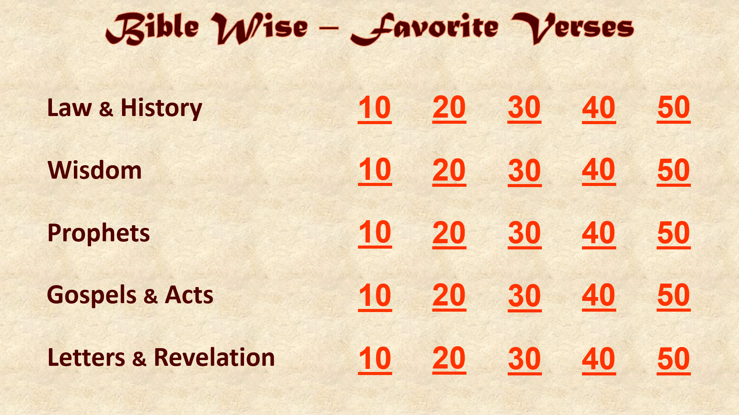
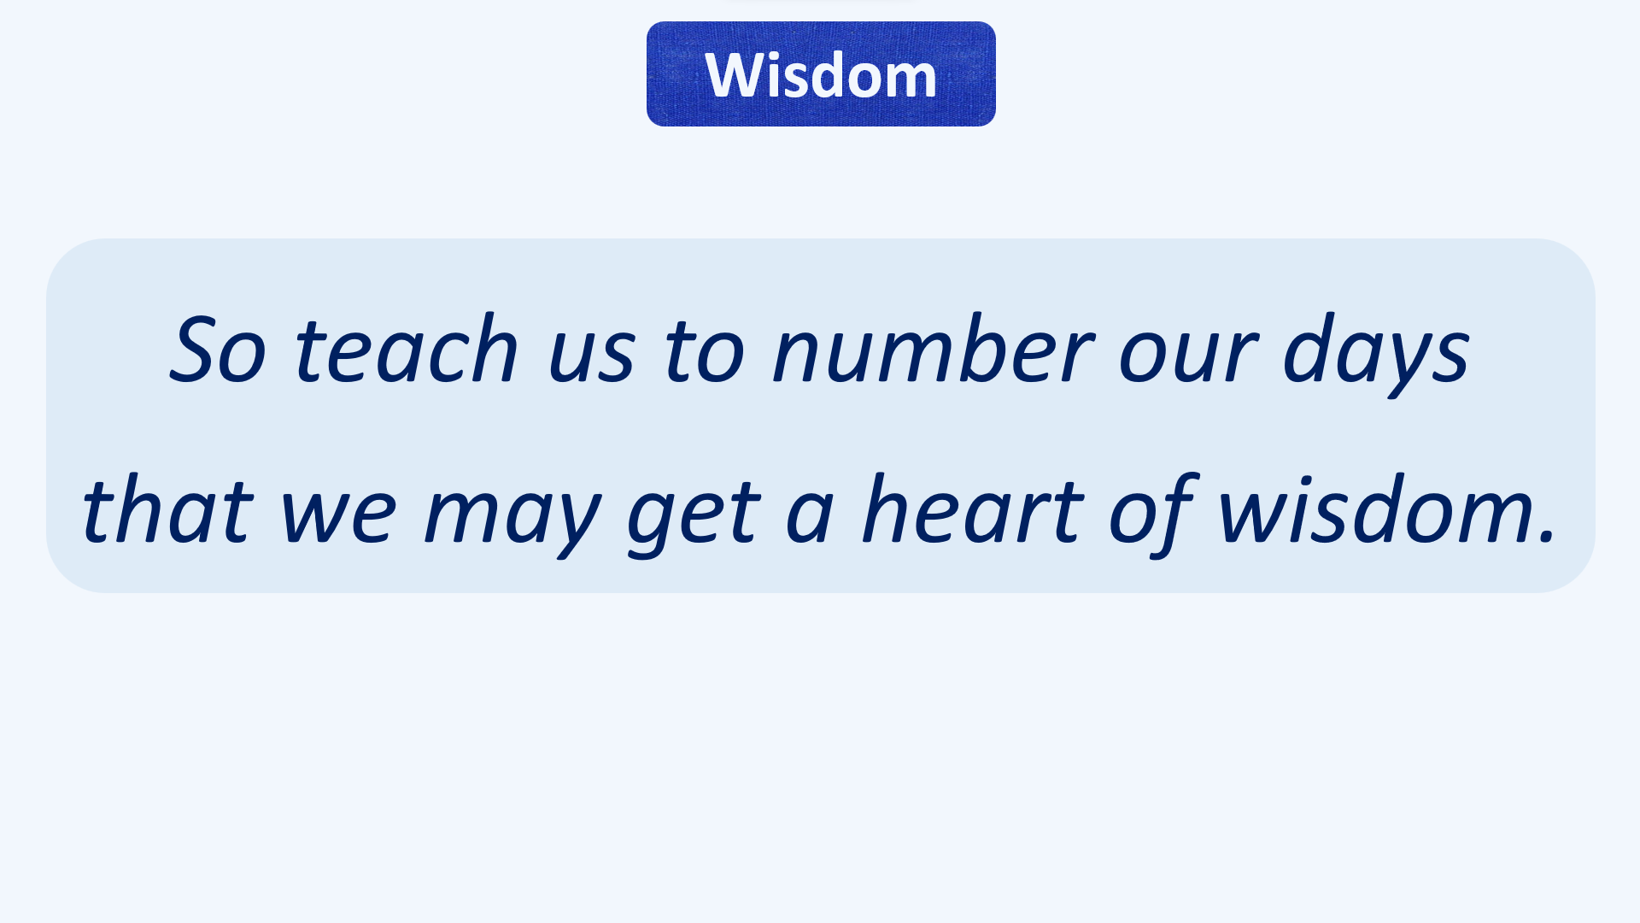
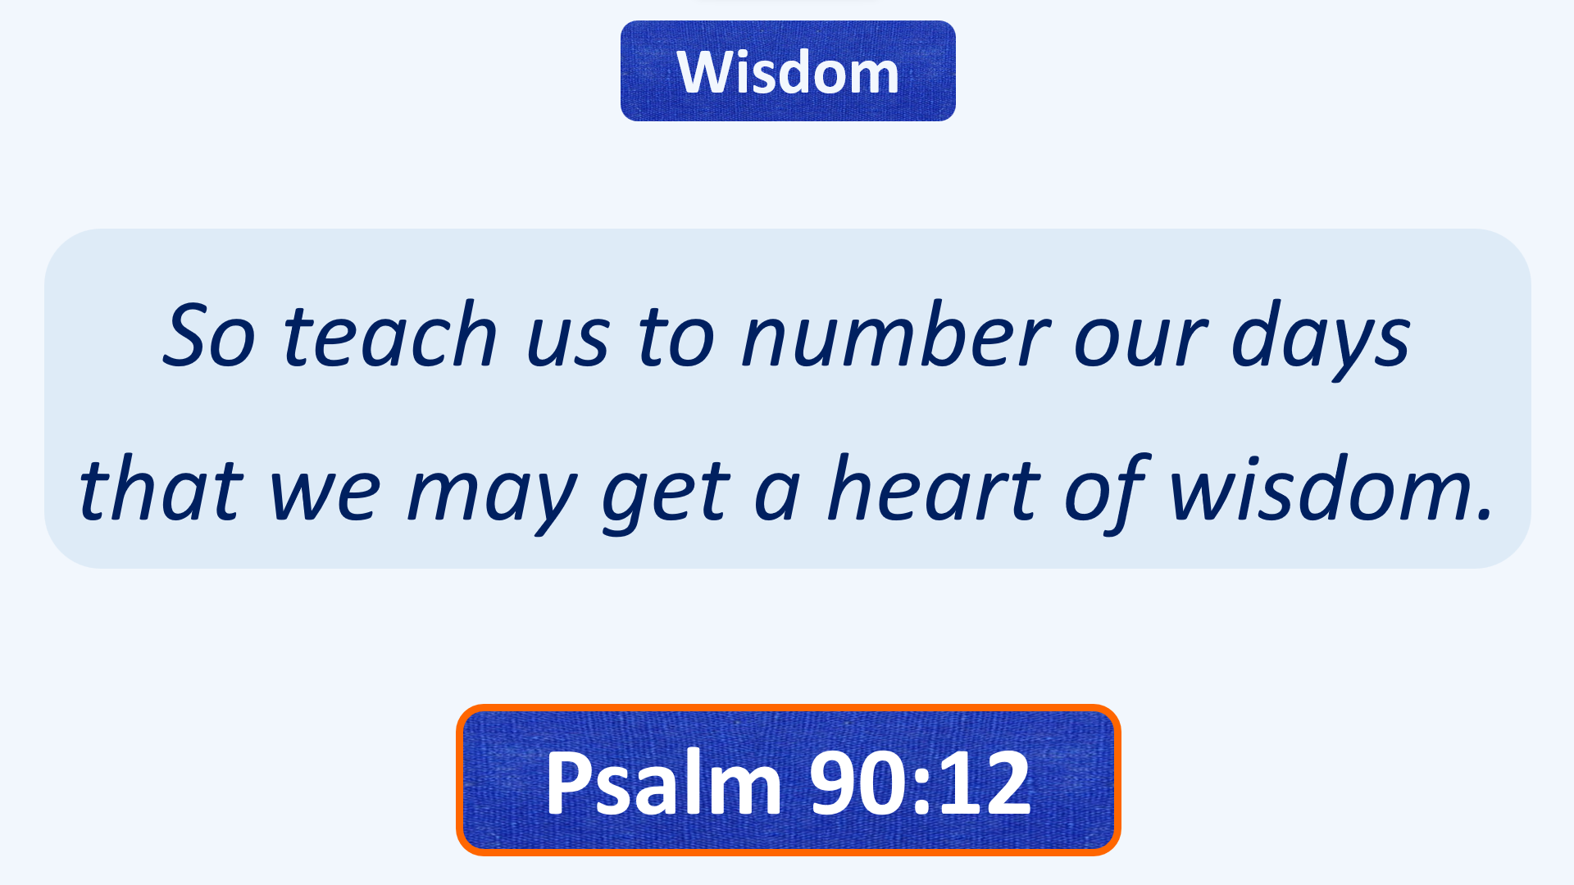

Here’s how it works
(1) Player chooses a Category (Law & History, etc.) and a Point Value (10, 20, etc.). Tap this choice on the Menu Board.
(2) Read the Bible Passage that comes up. Player tries to determine the Book that the Passage is found in. (Chapter and Verse are optional for extra points or none at all! See Scoring Rules on the next screen.) Set a time limit. After Player answers, tap the screen.
(3) The correct answer comes up. Complete Scoring Rules are on the next screen.
(4) A few random questions are Wild Card questions. Player can set the Point Value for these questions as described in the Scoring Rules (see next screen).
Tap the screen to continue

Slide 4
Scoring Rules
REGULAR QUESTIONS:
☺ Read the passage and name the Book = 1x score (E.g., a 10-point question gets 10 points) ☺
☺ Optional: name the Book and Chapter = 2x score (E.g., a 10-point question gets 20 points) ☺
☺ Optional: name the Book, Chapter, and Verse = 4x score (E.g., a 10-point question gets 40 points) ☺
(If there is more than one Verse in the passage, name at least one of the Verses for a 4x score)
☹ Miss any part (Book, Chapter, or Verse) = 0 score! ☹
WILD CARD QUESTIONS:
When these occur, Player decides the Point Value of the question beforehand, up to the Player’s present score
(E.g., Player has 115 points. Player can wager up to 115 points before seeing the question)
☺ Win = Just name the Book. Add the wagered points to Player’s score! ☺
☹ Lose = Miss the Book name. Deduct the wagered points from Player’s score! ☹
OR
Player can decide beforehand to treat this as a REGULAR QUESTION with 2x and 4x options as above
ANSWERS MAY BE CHALLENGED!
All Challenges are to be scored as REGULAR QUESTIONS with 2x and 4x options as above
Tap the screen to go to the Menu Board and start playing

Slide 5
Bible Wise – Favorite Verses
Law & History
10
20
30
40
50
Wisdom
10
20
30
40
50
Prophets
10
20
30
40
50
Gospels & Acts
10
20
30
40
50
Letters & Revelation
10
20
30
40
50

Slide 6

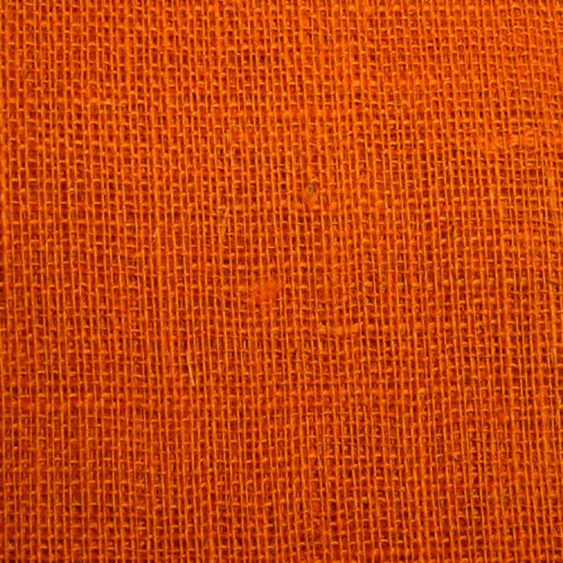
Law & History
But as for me and my house,
we will serve the LORD.

Slide 7
Law & History
But as for me and my house,
we will serve the LORD.
Joshua 24:15

Slide 8
Law & History
You shall love your neighbor
as yourself.

Slide 9
Law & History
You shall love your neighbor
as yourself.
Leviticus 19:18

Slide 10
Law & History
Hear, O Israel:
The LORD our God, the LORD is one!
You shall love the LORD your God
with all your heart,
with all your soul,
and with all your strength.

Slide 11
Law & History
Hear, O Israel:
The LORD our God, the LORD is one!
You shall love the LORD your God
with all your heart,
with all your soul,
and with all your strength.
Deuteronomy 6:4-5

Slide 12
Law & History
The LORD bless you and keep you;
the LORD make his face shine upon you,
and be gracious to you;
the LORD lift up his countenance upon you, and give you peace.

Slide 13
Law & History
The LORD bless you and keep you;
the LORD make his face shine upon you,
and be gracious to you;
the LORD lift up his countenance upon you, and give you peace.
Numbers 6:24-26

Slide 14


Win!
Lose!
☺
☹
Wild
Card!
JUST NAME THE BOOK TO WIN ………………………………………………… OR LOSE!
How many points do you want to wager on this question? Point limit = your present score.
You may also treat this as a REGULAR QUESTION with 2x and 4x options.

Slide 15
Law & History
Has the LORD as great delight
in burnt offerings and sacrifices,
as in obeying the voice of the LORD?
Behold, to obey is better than sacrifice,
and to heed than the fat of rams.

Slide 16
Law & History
Has the LORD as great delight
in burnt offerings and sacrifices,
as in obeying the voice of the LORD?
Behold, to obey is better than sacrifice,
and to heed than the fat of rams.
1 Samuel 15:22

Slide 17


Wisdom
The LORD is my shepherd;
I shall not want.

Slide 18
Wisdom
The LORD is my shepherd;
I shall not want.
Psalm 23:1

Slide 19
Wisdom
To everything there is a season,
a time for every purpose
under heaven.

Slide 20
Wisdom
To everything there is a season,
a time for every purpose
under heaven.
Ecclesiastes 3:1

Slide 21
Win!
Lose!
☺
☹
Wild
Card!
JUST NAME THE BOOK TO WIN ………………………………………………… OR LOSE!
How many points do you want to wager on this question? Point limit = your present score.
You may also treat this as a REGULAR QUESTION with 2x and 4x options.

Slide 22
Wisdom
Wisdom
Let the words of my mouth
and the meditation of my heart
be acceptable in your sight,
O LORD,
my strength and my redeemer.

Slide 23
Wisdom
Wisdom
Let the words of my mouth
and the meditation of my heart
be acceptable in your sight,
O LORD,
my strength and my redeemer.
Psalm 19:14

Slide 24
Wisdom
In all your ways
acknowledge him,
and he shall direct your paths.

Slide 25
Wisdom
In all your ways
acknowledge him,
and he shall direct your paths.
Proverbs 3:6

Slide 26
Wisdom
Let us hear the conclusion
of the whole matter:
fear God and keep his commandments,
for this is man’s all.

Slide 27
Wisdom
Let us hear the conclusion
of the whole matter:
fear God and keep his commandments,
for this is man’s all.
Ecclesiastes 12:13

Slide 28


Prophets
He shall judge between the nations,
and rebuke many people;
they shall beat their swords into plowshares,
and their spears into pruning hooks;
nation shall not lift up sword against nation,
neither shall they learn war anymore.

Slide 29
Prophets
He shall judge between the nations,
and rebuke many people;
they shall beat their swords into plowshares,
and their spears into pruning hooks;
nation shall not lift up sword against nation,
neither shall they learn war anymore.
Isaiah 2:4 or Micah 4:3

Slide 30
Prophets
And the ransomed of the LORD shall return,
and come to Zion with singing,
with everlasting joy on their heads.
They shall obtain joy and gladness,
and sorrow and sighing shall flee away.

Slide 31
Prophets
And the ransomed of the LORD shall return,
and come to Zion with singing,
with everlasting joy on their heads.
They shall obtain joy and gladness,
and sorrow and sighing shall flee away.
Isaiah 35:10 or Isaiah 51:11

Slide 32
Prophets
Through the LORD’S mercies
we are not consumed,
because his compassions fail not.
They are new every morning;
great is your faithfulness.

Slide 33
Prophets
Through the LORD’S mercies
we are not consumed,
because his compassions fail not.
They are new every morning;
great is your faithfulness.
Lamentations 3:22-23

Slide 34
Prophets
He has shown you, O man, what is good;
and what does the LORD require of you
but to do justly,
to love mercy,
and to walk humbly with your God?

Slide 35
Prophets
He has shown you, O man, what is good;
and what does the LORD require of you
but to do justly,
to love mercy,
and to walk humbly with your God?
Micah 6:8

Slide 36
Prophets
Then those who feared the LORD
spoke to one another,
and the LORD listened and heard them;
so a book of remembrance was written before him
for those who fear the LORD
and who meditate on his name.

Slide 37
Prophets
Then those who feared the LORD
spoke to one another,
and the LORD listened and heard them;
so a book of remembrance was written before him
for those who fear the LORD
and who meditate on his name.
Malachi 3:16

Slide 38
Win!
Lose!
☺
☹
Wild
Card!
JUST NAME THE BOOK TO WIN ………………………………………………… OR LOSE!
How many points do you want to wager on this question? Point limit = your present score.
You may also treat this as a REGULAR QUESTION with 2x and 4x options.

Slide 39


Gospels & Acts
In this manner, therefore, pray:
our Father in heaven,
hallowed be your name.
Your kingdom come.
Your will be done on earth as it is in heaven.

Slide 40
Gospels & Acts
In this manner, therefore, pray:
our Father in heaven,
hallowed be your name.
Your kingdom come.
Your will be done on earth as it is in heaven.
Matthew 6:9-10

Slide 41
Gospels & Acts
Let your light so shine before men,
that they may see your good works
and glorify your Father in heaven.

Slide 42
Gospels & Acts
Let your light so shine before men,
that they may see your good works
and glorify your Father in heaven.
Matthew 5:16

Slide 43
Gospels & Acts
Then Jesus spoke to them again, saying,
“I am the light of the world.
He who follows me shall not walk in darkness,
but have the light of life.”

Slide 44
Gospels & Acts
Then Jesus spoke to them again, saying,
“I am the light of the world.
He who follows me shall not walk in darkness,
but have the light of life.”
John 8:12

Slide 45
Gospels & Acts
And he said to them,
“Go into all the world
and preach the gospel to every creature.
He who believes
and is baptized will be saved;
but he who does not believe will be condemned.”

Slide 46
Gospels & Acts
And he said to them,
“Go into all the world
and preach the gospel to every creature.
He who believes
and is baptized will be saved;
but he who does not believe will be condemned.”
Mark 16:15-16

Slide 47
Gospels & Acts
Men of Galilee,
why do you stand gazing up into heaven?
This same Jesus,
who was taken up from you into heaven,
will so come in like manner
as you saw him go into heaven.

Slide 48
Gospels & Acts
Men of Galilee,
why do you stand gazing up into heaven?
This same Jesus,
who was taken up from you into heaven,
will so come in like manner
as you saw him go into heaven.
Acts 1:11

Slide 49


Letters & Revelation
And now abide
faith, hope, love,
these three;
but the greatest of these is love.

Slide 50

Letters & Revelation
And now abide
faith, hope, love,
these three;
but the greatest of these is love.
1 Corinthians 13:13

Slide 51
Letters & Revelation
He who testifies to these things says,
“Surely I am coming quickly.”
Amen.
Even so, come, Lord Jesus!

Slide 52
Letters & Revelation
He who testifies to these things says,
“Surely I am coming quickly.”
Amen.
Even so, come, Lord Jesus!
Revelation 22:20

Slide 53
Letters & Revelation
But the fruit of the Spirit is
love, joy, peace, longsuffering,
kindness, goodness, faithfulness,
gentleness, self-control.
Against such there is no law.

Slide 54
Letters & Revelation
But the fruit of the Spirit is
love, joy, peace, longsuffering,
kindness, goodness, faithfulness,
gentleness, self-control.
Against such there is no law.
Galatians 5:22-23

Slide 55
Win!
Lose!
☺
☹
Wild
Card!
JUST NAME THE BOOK TO WIN ………………………………………………… OR LOSE!
How many points do you want to wager on this question? Point limit = your present score.
You may also treat this as a REGULAR QUESTION with 2x and 4x options.

Slide 56
Letters & Revelation
Put on the whole armor of God,
that you may be able to stand
against the wiles of the devil.

Slide 57
Letters & Revelation
Put on the whole armor of God,
that you may be able to stand
against the wiles of the devil.
Ephesians 6:11

Slide 58
Letters & Revelation
For I consider that
the sufferings of this present time
are not worthy to be compared
with the glory which shall be revealed in us.

Slide 59
Letters & Revelation
For I consider that
the sufferings of this present time
are not worthy to be compared
with the glory which shall be revealed in us.
Romans 8:18

