Slide 1
Bible Wise!
The Word
of God
With Wild Card Questions
Tap the screen to get started

Slide 2
Bible Wise!
The Word of God
With Wild Card Questions
Bible Wise is a Jeopardy-like Bible game created in PowerPoint. A tap (screen-tap or mouse-click) is all that is needed to play. No PowerPoint skills are required. See the next two screens for “Here’s how it works” and the Scoring Rules.
Tap the screen to continue

Slide 3
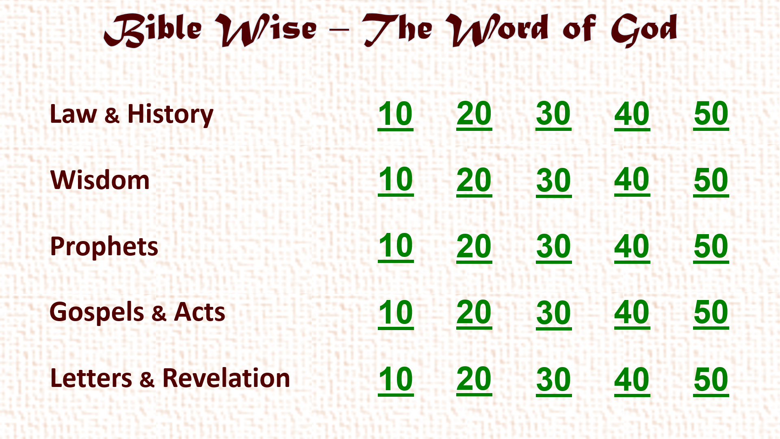
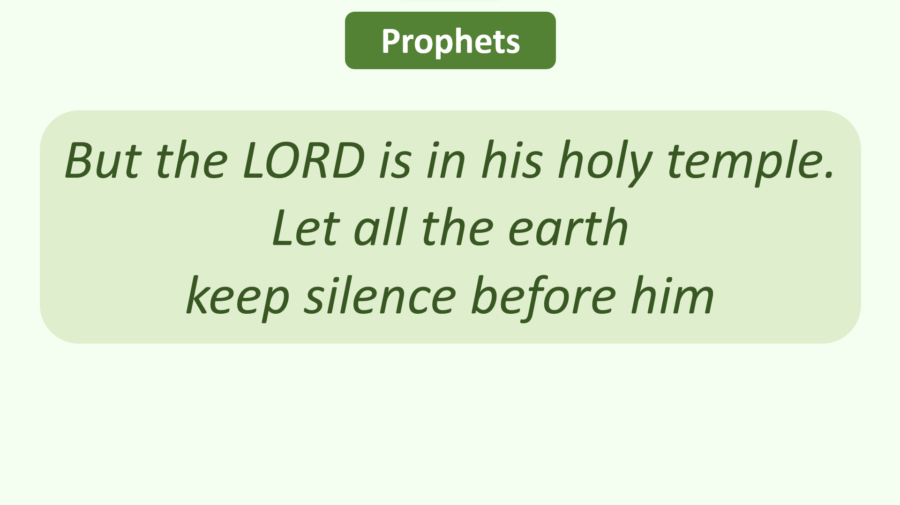
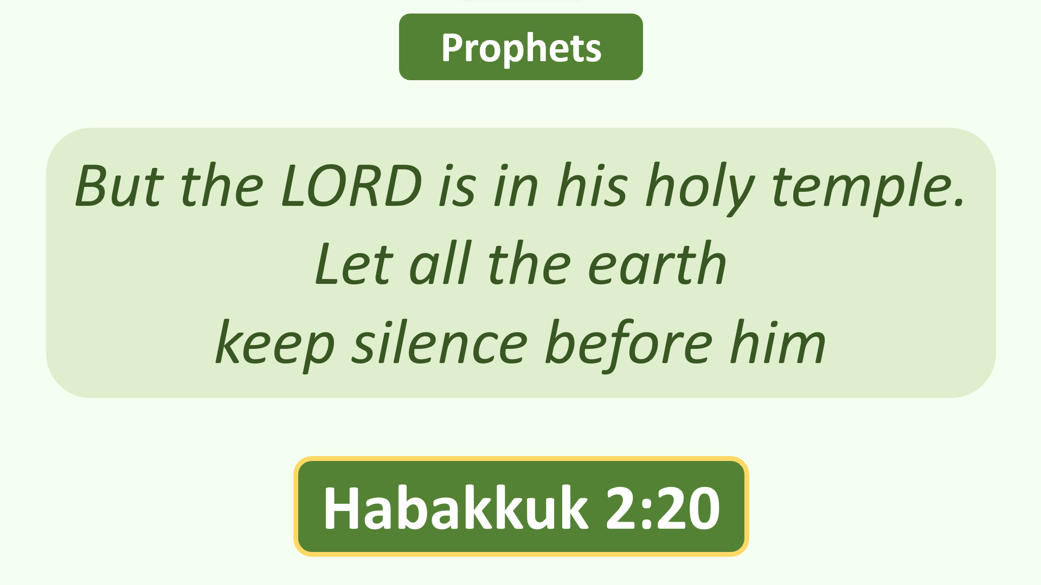
Here’s how it works
(1) Player chooses a Category (Law & History, etc.) and a Point Value (10, 20, etc.). Tap this choice on the Menu Board.
(2) Read the Bible Passage that comes up. Player tries to determine the Book that the Passage is found in. (Chapter and Verse are optional for extra points or none at all! See Scoring Rules on the next screen.) Set a time limit. After Player answers, tap the screen.
(3) The correct answer comes up. Complete Scoring Rules are on the next screen.
(4) A few random questions are Wild Card questions. Player can set the Point Value for these questions as described in the Scoring Rules (next screen).
Tap the screen to continue

Slide 4
Scoring Rules
REGULAR QUESTIONS:
☺ Read the passage and name the Book = 1x score (E.g., a 10-point question gets 10 points) ☺
☺ Optional: name the Book and Chapter = 2x score (E.g., a 10-point question gets 20 points) ☺
☺ Optional: name the Book, Chapter, and Verse = 4x score (E.g., a 10-point question gets 40 points) ☺
(If there is more than one Verse in the passage, name at least one of the Verses for a 4x score)
☹ Miss any part (Book, Chapter, or Verse) = 0 score! ☹
WILD CARD QUESTIONS:
When these occur, Player decides the Point Value of the question beforehand, up to the Player’s present score
(E.g., Player has 115 points. Player can wager up to 115 points before seeing the question)
☺ Win = Just name the Book. Add the wagered points to Player’s score! ☺
☹ Lose = Miss the Book name. Deduct the wagered points from Player’s score! ☹
OR
Player can decide beforehand to treat this as a REGULAR QUESTION with 2x and 4x options as above
ANSWERS MAY BE CHALLENGED!
All Challenges are to be scored as REGULAR QUESTIONS with 2x and 4x options as above
Tap the screen to go to the Menu Board and start playing

Slide 5
Bible Wise – The Word of God
Law & History
10
20
30
40
50
Wisdom
10
20
30
40
50
Prophets
10
20
30
40
50
Gospels & Acts
10
20
30
40
50
Letters & Revelation
10
20
30
40
50

Slide 6
Law & History
Man shall not live by bread alone;
but man lives by every word
that proceeds from
the mouth of the LORD.

Slide 7
Law & History
Man shall not live by bread alone;
but man lives by every word
that proceeds from
the mouth of the LORD.
Deuteronomy 8:3

Slide 8
Law & History
You shall not add to the word
which I command you,
nor take from it,
that you may keep the commandments
of the LORD your God which I command you.

Slide 9
Law & History
You shall not add to the word
which I command you,
nor take from it,
that you may keep the commandments
of the LORD your God which I command you.
Deuteronomy 4:2

Slide 10
Law & History
The Spirit of the LORD
spoke by me,
and his word was on my tongue.

Slide 11
Law & History
The Spirit of the LORD
spoke by me,
and his word was on my tongue.
2 Samuel 23:2

Slide 12
Law & History
As for God, his way is perfect;
the word of the LORD is proven;
he is a shield to all who trust in him.

Slide 13
Law & History
As for God, his way is perfect;
the word of the LORD is proven;
he is a shield to all who trust in him.
2 Samuel 22:31
(also Wisdom – Psalm 18:30)

Slide 14
Law & History
Yet for many years
you had patience with them,
and testified against them
by your Spirit in your prophets.

Slide 15
Law & History
Yet for many years
you had patience with them,
and testified against them
by your Spirit in your prophets.
Nehemiah 9:30

Slide 16
Win!
Lose!
☺
☹
Wild
Card!
JUST NAME THE BOOK TO WIN ………………………………………………… OR LOSE!
How many points do you want to wager on this question? Point limit = your present score.
You may also treat this as a REGULAR QUESTION with 2x and 4x options.

Slide 17
Wisdom
Wisdom
Your word is
a lamp to my feet
and a light to my path.

Slide 18
Wisdom
Wisdom
Your word is
a lamp to my feet
and a light to my path.
Psalm 119:105

Slide 19
Wisdom
By the word of the LORD
the heavens were made,
and all the host of them
by the breath of his mouth.

Slide 20
Wisdom
By the word of the LORD
the heavens were made,
and all the host of them
by the breath of his mouth.
Psalm 33:6

Slide 21
Wisdom
Bless the LORD,
you his angels,
who excel in strength,
who do his word,
heeding the voice of his word.

Slide 22
Wisdom
Bless the LORD,
you his angels,
who excel in strength,
who do his word,
heeding the voice of his word.
Psalm 103:20

Slide 23
Wisdom
I wait for the LORD,
my soul waits,
and in his word I do hope.

Slide 24
Wisdom
I wait for the LORD,
my soul waits,
and in his word I do hope.
Psalm 130:5

Slide 25
Wisdom
He who heeds the word wisely
will find good,
and whoever trusts in the LORD,
happy is he.

Slide 26
Wisdom
He who heeds the word wisely
will find good,
and whoever trusts in the LORD,
happy is he.
Proverbs 16:20

Slide 27
Prophets
Many people shall come and say,
“Come, and let us go up to the mountain of the LORD,
to the house of the God of Jacob;
he will teach us his ways, and we shall walk in his paths.”
For out of Zion shall go forth the law,
and the word of the LORD from Jerusalem.

Slide 28
Prophets
Many people shall come and say,
“Come, and let us go up to the mountain of the LORD,
to the house of the God of Jacob;
he will teach us his ways, and we shall walk in his paths.”
For out of Zion shall go forth the law,
and the word of the LORD from Jerusalem.
Isaiah 2:3 or Micah 4:2

Slide 29
Prophets
The grass withers,
the flower fades,
but the word of our God
stands forever.

Slide 30
Prophets
The grass withers,
the flower fades,
but the word of our God
stands forever.
Isaiah 40:8

Slide 31
Prophets
“For all those things my hand has made,
and all those things exist,” says the LORD.
“But on this one will I look:
on him who is poor and of a contrite spirit,
and who trembles at my word.”

Slide 32
Prophets
“For all those things my hand has made,
and all those things exist,” says the LORD.
“But on this one will I look:
on him who is poor and of a contrite spirit,
and who trembles at my word.”
Isaiah 66:2

Slide 33
Prophets
Surely the Lord GOD
does nothing,
unless he reveals his secret
to his servants the prophets.

Slide 34
Prophets
Surely the Lord GOD
does nothing,
unless he reveals his secret
to his servants the prophets.
Amos 3:7

Slide 35
Win!
Lose!
☺
☹
Wild
Card!
JUST NAME THE BOOK TO WIN ………………………………………………… OR LOSE!
How many points do you want to wager on this question? Point limit = your present score.
You may also treat this as a REGULAR QUESTION with 2x and 4x options.

Slide 36
Prophets
“For I am the LORD.
I speak,
and the word which I speak will come to pass;
…
I will say the word and perform it,”
says the Lord GOD.

Slide 37
Prophets
“For I am the LORD.
I speak,
and the word which I speak will come to pass;
…
I will say the word and perform it,”
says the Lord GOD.
Ezekiel 12:25

Slide 38
Gospels & Acts
But he answered and said,
“It is written,
‘Man shall not live by bread alone,
but by every word that proceeds
from the mouth of God.’”

Slide 39
Gospels & Acts
But he answered and said,
“It is written,
‘Man shall not live by bread alone,
but by every word that proceeds
from the mouth of God.’”
Matthew 4:4 or Luke 4:4

Slide 40
Gospels & Acts
And the word became flesh
and dwelt among us,
and we beheld his glory,
the glory as of the only begotten of the Father,
full of grace and truth.

Slide 41
Gospels & Acts
And the word became flesh
and dwelt among us,
and we beheld his glory,
the glory as of the only begotten of the Father,
full of grace and truth.
John 1:14

Slide 42
Win!
Lose!
☺
☹
Wild
Card!
JUST NAME THE BOOK TO WIN ………………………………………………… OR LOSE!
How many points do you want to wager on this question? Point limit = your present score.
You may also treat this as a REGULAR QUESTION with 2x and 4x options.

Slide 43
Gospels & Acts
You search the Scriptures,
for in them you think you have
eternal life;
and these are they which testify of me.

Slide 44
Gospels & Acts
You search the Scriptures,
for in them you think you have
eternal life;
and these are they which testify of me.
John 5:39

Slide 45
Gospels & Acts
He who sent me is true;
and I speak to the world
those things
which I heard from him.

Slide 46
Gospels & Acts
He who sent me is true;
and I speak to the world
those things
which I heard from him.
John 8:26

Slide 47
Gospels & Acts
And when they had prayed,
the place where they were assembled together
was shaken;
and they were all filled with the Holy Spirit,
and they spoke the word of God with boldness.

Slide 48
Gospels & Acts
And when they had prayed,
the place where they were assembled together
was shaken;
and they were all filled with the Holy Spirit,
and they spoke the word of God with boldness.
Acts 4:31

Slide 49
Letters & Revelation
All Scripture is given by inspiration of God,
and is profitable for doctrine,
for reproof,
for correction,
for instruction in righteousness.

Slide 50
Letters & Revelation
All Scripture is given by inspiration of God,
and is profitable for doctrine,
for reproof,
for correction,
for instruction in righteousness.
2 Timothy 3:16

Slide 51
Letters & Revelation
For prophecy never came
by the will of man,
but holy men of God spoke
as they were moved by the Holy Spirit.

Slide 52
Letters & Revelation
For prophecy never came
by the will of man,
but holy men of God spoke
as they were moved by the Holy Spirit.
2 Peter 1:21

Slide 53
Letters & Revelation
So then
faith comes by hearing,
and hearing
by the word of God.

Slide 54
Letters & Revelation
So then
faith comes by hearing,
and hearing
by the word of God.
Romans 10:17

Slide 55
Letters & Revelation
For whatever things were written before
were written for our learning,
that we
through the patience and comfort
of the Scriptures
might have hope.

Slide 56
Letters & Revelation
For whatever things were written before
were written for our learning,
that we
through the patience and comfort
of the Scriptures
might have hope.
Romans 15:4

Slide 57
Letters & Revelation
And take the helmet of salvation,
and the sword of the Spirit,
which is the word of God.

Slide 58
Letters & Revelation
And take the helmet of salvation,
and the sword of the Spirit,
which is the word of God.
Ephesians 6:17

