Slide 1
Bible Wise!
The Way
of Life
With Wild Card Questions
Tap the screen to get started

Slide 2
Bible Wise!
The Way of Life
With Wild Card Questions
Bible Wise is a Jeopardy-like Bible game created in PowerPoint. A tap (screen-tap or mouse-click) is all that is needed to play. No PowerPoint skills are required. See the next two screens for “Here’s how it works” and the Scoring Rules.
Tap the screen to continue

Slide 3
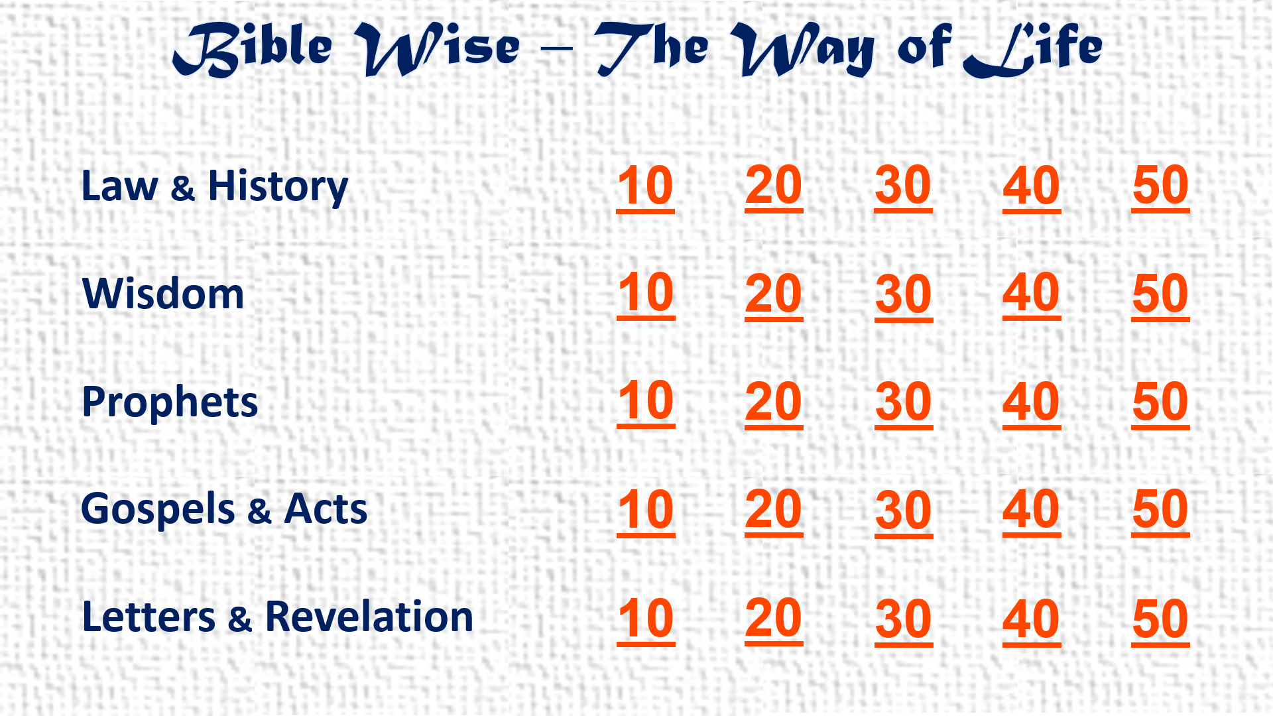
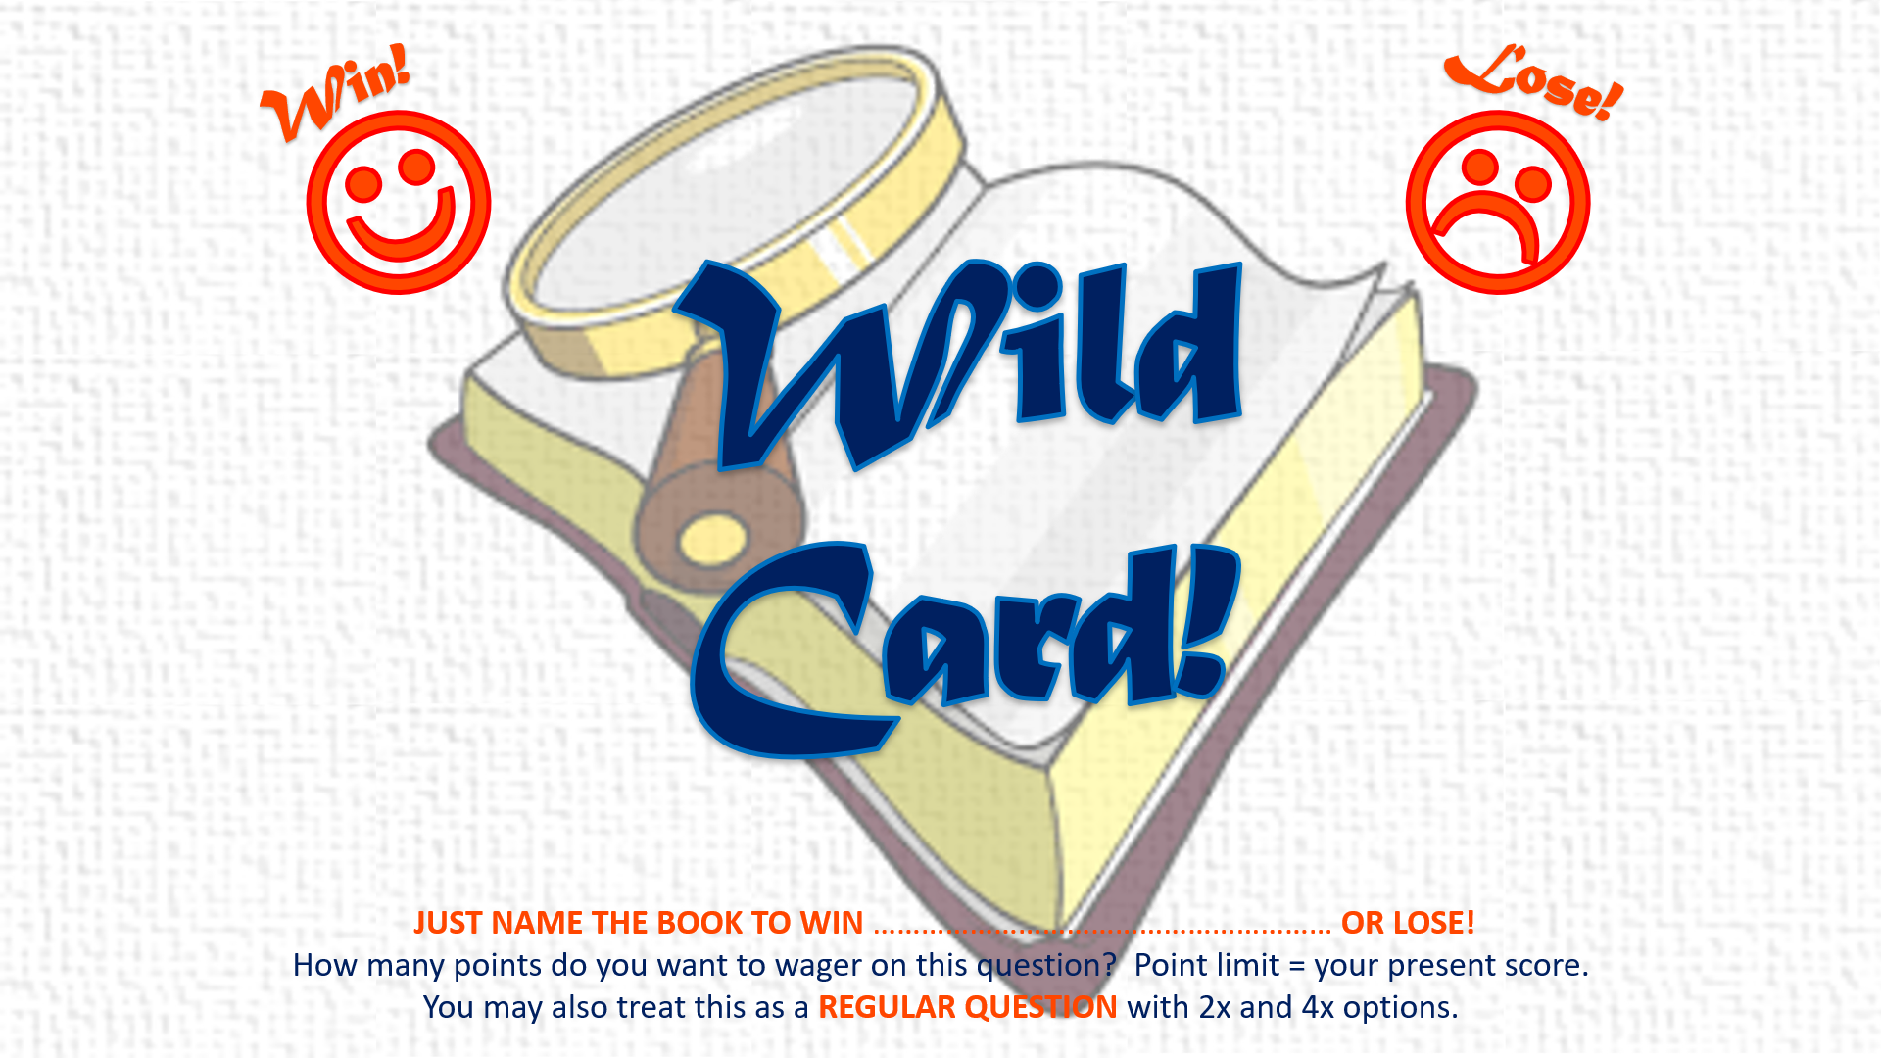
Here’s how it works
(1) Player chooses a Category (Law & History, etc.) and a Point Value (10, 20, etc.). Tap this choice on the Menu Board.
(2) Read the Bible Passage that comes up. Player tries to determine the Book that the Passage is found in. (Chapter and Verse are optional for extra points or none at all! See Scoring Rules on the next screen.) Set a time limit. After Player answers, tap the screen.
(3) The correct answer comes up. Complete Scoring Rules are on the next screen.
(4) A few random questions are Wild Card questions. Player can set the Point Value for these questions as described in the Scoring Rules (next screen).
Tap the screen to continue

Slide 4
Scoring Rules
REGULAR QUESTIONS:
☺ Read the passage and name the Book = 1x score (E.g., a 10-point question gets 10 points) ☺
☺ Optional: name the Book and Chapter = 2x score (E.g., a 10-point question gets 20 points) ☺
☺ Optional: name the Book, Chapter, and Verse = 4x score (E.g., a 10-point question gets 40 points) ☺
(If there is more than one Verse in the passage, name at least one of the Verses for a 4x score)
☹ Miss any part (Book, Chapter, or Verse) = 0 score! ☹
WILD CARD QUESTIONS:
When these occur, Player decides the Point Value of the question beforehand, up to the Player’s present score
(E.g., Player has 115 points. Player can wager up to 115 points before seeing the question)
☺ Win = Just name the Book. Add the wagered points to Player’s score! ☺
☹ Lose = Miss the Book name. Deduct the wagered points from Player’s score! ☹
OR
Player can decide beforehand to treat this as a REGULAR QUESTION with 2x and 4x options as above
ANSWERS MAY BE CHALLENGED!
All Challenges are to be scored as REGULAR QUESTIONS with 2x and 4x options as above
Tap the screen to go to the Menu Board and start playing

Slide 5
Bible Wise – The Way of Life
Law & History
10
20
30
40
50
Wisdom
10
20
30
40
50
Prophets
10
20
30
40
50
Gospels & Acts
10
20
30
40
50
Letters & Revelation
10
20
30
40
50

Slide 6
Law & History
As for me
and my house,
we will serve the LORD.

Slide 7
Law & History
As for me
and my house,
we will serve the LORD.
Joshua 24:15

Slide 8
Law & History
You shall love the LORD your God
with all your heart,
with all your soul,
and with all your strength.

Slide 9
Law & History
You shall love the LORD your God
with all your heart,
with all your soul,
and with all your strength.
Deuteronomy 6:5

Slide 10
Win!
Lose!
☺
☹
Wild
Card!
JUST NAME THE BOOK TO WIN ………………………………………………… OR LOSE!
How many points do you want to wager on this question? Point limit = your present score.
You may also treat this as a REGULAR QUESTION with 2x and 4x options.

Slide 11
Law & History
You shall not take vengeance,
nor bear any grudge against
the children of your people,
but you shall love your neighbor as yourself:
I am the LORD.

Slide 12
Law & History
You shall not take vengeance,
nor bear any grudge against
the children of your people,
but you shall love your neighbor as yourself:
I am the LORD.
Leviticus 19:18

Slide 13
Law & History
You shall not take the name
of the LORD your God in vain,
for the LORD will not hold him guiltless
who takes his name in vain.

Slide 14
Law & History
You shall not take the name
of the LORD your God in vain,
for the LORD will not hold him guiltless
who takes his name in vain.
Exodus 20:7 & Deuteronomy 5:11

Slide 15
Law & History
Has the LORD as great delight
in burnt offerings and sacrifices,
as in obeying the voice of the LORD?
Behold, to obey is better than sacrifice,
and to heed than the fat of rams.

Slide 16
Law & History
Has the LORD as great delight
in burnt offerings and sacrifices,
as in obeying the voice of the LORD?
Behold, to obey is better than sacrifice,
and to heed than the fat of rams.
1 Samuel 15:22

Slide 17
Wisdom
Let the words of my mouth
and the meditation of my heart
be acceptable in your sight,
O LORD, my strength and my redeemer.

Slide 18
Wisdom
Let the words of my mouth
and the meditation of my heart
be acceptable in your sight,
O LORD, my strength and my redeemer.
Psalm 19:14

Slide 19
Wisdom
So teach us
to number our days,
that we may gain a heart of wisdom.

Slide 20
Wisdom
So teach us
to number our days,
that we may gain a heart of wisdom.
Psalm 90:12

Slide 21
Wisdom
Let us hear the conclusion
of the whole matter:
fear God and keep his commandments,
for this is man’s all.

Slide 22
Wisdom
Let us hear the conclusion
of the whole matter:
fear God and keep his commandments,
for this is man’s all.
Ecclesiastes 12:13

Slide 23
Wisdom
A soft answer
turns away wrath,
but a harsh word
stirs up anger.

Slide 24
Wisdom
A soft answer
turns away wrath,
but a harsh word
stirs up anger.
Proverbs 15:1

Slide 25
Wisdom
If your enemy is hungry,
give him bread to eat;
and if he is thirsty,
give him water to drink.

Slide 26
Wisdom
If your enemy is hungry,
give him bread to eat;
and if he is thirsty,
give him water to drink.
Proverbs 25:21

Slide 27
Prophets
Seek the LORD
while he may be found,
call upon him while he is near.

Slide 28
Prophets
Seek the LORD
while he may be found,
call upon him while he is near.
Isaiah 55:6

Slide 29
Prophets
He has shown you, O man, what is good;
and what does the LORD require of you
but to do justly,
to love mercy,
and to walk humbly with your God?

Slide 30
Prophets
He has shown you, O man, what is good;
and what does the LORD require of you
but to do justly,
to love mercy,
and to walk humbly with your God?
Micah 6:8

Slide 31
Prophets
Then those who feared the LORD
spoke to one another,
and the LORD listened and heard them;
so a book of remembrance was written before him
for those who fear the LORD
and who meditate on His name.

Slide 32
Prophets
Then those who feared the LORD
spoke to one another,
and the LORD listened and heard them;
so a book of remembrance was written before him
for those who fear the LORD
and who meditate on His name.
Malachi 3:16

Slide 33
Prophets
For I desire mercy and not sacrifice,
and the knowledge of God
more than burnt offerings.

Slide 34
Prophets
For I desire mercy and not sacrifice,
and the knowledge of God
more than burnt offerings.
Hosea 6:6

Slide 35
Prophets
Sow for yourselves righteousness;
reap in mercy;
break up your fallow ground,
for it is time to seek the LORD,
till he comes and rains righteousness on you.

Slide 36
Prophets
Sow for yourselves righteousness;
reap in mercy;
break up your fallow ground,
for it is time to seek the LORD,
till he comes and rains righteousness on you.
Hosea 10:12

Slide 37
Gospels & Acts
They continued steadfastly
in the apostles’ doctrine and fellowship,
in the breaking of bread,
and in prayers.

Slide 38
Gospels & Acts
They continued steadfastly
in the apostles’ doctrine and fellowship,
in the breaking of bread,
and in prayers.
Acts 2:42

Slide 39
Gospels & Acts
Let your light so shine before men,
that they may see your good works
and glorify your Father in heaven.

Slide 40
Gospels & Acts
Let your light so shine before men,
that they may see your good works
and glorify your Father in heaven.
Matthew 5:16

Slide 41
Win!
Lose!
☺
☹
Wild
Card!
JUST NAME THE BOOK TO WIN ………………………………………………… OR LOSE!
How many points do you want to wager on this question? Point limit = your present score.
You may also treat this as a REGULAR QUESTION with 2x and 4x options.

Slide 42
Gospels & Acts
But you, when you pray, go into your room,
and when you have shut your door,
pray to your Father who is in the secret place;
and your Father who sees in secret
will reward you openly.

Slide 43
Gospels & Acts
But you, when you pray, go into your room,
and when you have shut your door,
pray to your Father who is in the secret place;
and your Father who sees in secret
will reward you openly.
Matthew 6:6

Slide 44
Gospels & Acts
Remember the words of the Lord Jesus,
that He said,
“It is more blessed to give
than to receive.”

Slide 45
Gospels & Acts
Remember the words of the Lord Jesus,
that He said,
“It is more blessed to give
than to receive.”
Acts 20:35

Slide 46
Gospels & Acts
Give, and it will be given to you:
good measure, pressed down, shaken together,
and running over will be put into your bosom.
For with the same measure that you use,
it will be measured back to you.

Slide 47
Gospels & Acts
Give, and it will be given to you:
good measure, pressed down, shaken together,
and running over will be put into your bosom.
For with the same measure that you use,
it will be measured back to you.
Luke 6:38

Slide 48
Letters & Revelation
And do not be conformed to this world,
but be transformed by the renewing of your mind,
that you may prove
what is that good and acceptable and perfect
will of God.

Slide 49
Letters & Revelation
And do not be conformed to this world,
but be transformed by the renewing of your mind,
that you may prove
what is that good and acceptable and perfect
will of God.
Romans 12:2

Slide 50
Letters & Revelation
And let us consider one another
in order to stir up love
and good works.

Slide 51
Letters & Revelation
And let us consider one another
in order to stir up love
and good works.
Hebrews 10:24

Slide 52
Letters & Revelation
And let us not grow weary
while doing good,
for in due season we shall reap
if we do not lose heart.

Slide 53
Letters & Revelation
And let us not grow weary
while doing good,
for in due season we shall reap
if we do not lose heart.
Galatians 6:9

Slide 54
Letters & Revelation
And be kind to one another,
tenderhearted,
forgiving one another,
just as God in Christ forgave you.

Slide 55
Letters & Revelation
And be kind to one another,
tenderhearted,
forgiving one another,
just as God in Christ forgave you.
Ephesians 4:32

Slide 56
Win!
Lose!
☺
☹
Wild
Card!
JUST NAME THE BOOK TO WIN ………………………………………………… OR LOSE!
How many points do you want to wager on this question? Point limit = your present score.
You may also treat this as a REGULAR QUESTION with 2x and 4x options.

Slide 57
Letters & Revelation
Therefore gird up the loins of your mind,
be sober,
and rest your hope fully upon the grace
that is to be brought to you
at the revelation of Jesus Christ.

Slide 58
Letters & Revelation
Therefore gird up the loins of your mind,
be sober,
and rest your hope fully upon the grace
that is to be brought to you
at the revelation of Jesus Christ.
1 Peter 1:13

