Slide 1
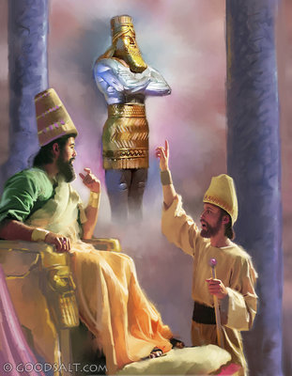
Daniel 2
YOU
&
Tap the screen to begin
GOODSALT.COM

Slide 2
Daniel 2 & YOU!
A Multiple-Choice Bible Game
This multiple-choice game is created in PowerPoint. A tap (screen-tap or mouse-click) is all that is needed to play. No PowerPoint skills are required.
To play, tap a number on the Menu Board (next screen). Read the Daniel 2 passage that comes up. What word or words are needed to complete the passage? Tap again to get three answer choices. Continue to follow the on-screen instructions. Earn points for correct answers. (Sorry, no Bibles for this one!)
Image credits are as follows:
Kids reading the Bible clipart is from clipart-library.com/clipart/1169048.htm.
Images on screens 1, 86, and 186 are from goodsalt.com.
Nebuchadnezzar’s Image on screens 97-104 is a readily available Google Image.
Maps on screens 295, 305, 315, and 325 are from Lion Publishing.
Image on screen 345 is from 4kingdoms.com.
Image on screen 373 is from unfoldingword.org/sweet-publishing, artist: Jim Padgett.
Tap the screen to go to the Menu Board

Slide 3
Daniel 2 & YOU!

Slide 4
Daniel 2 & YOU!
Tap a Question
1
2
3
4
5
6
7
8
9
10
11
12
13
14
15
16
17
18
19
20
21
22
23
24
25
26
27
28
29
30
31
32
33
34
35
36
37
38
39
40

Slide 5
Daniel 2 & YOU!

Slide 6
Daniel 2 & YOU!
Daniel 2:1
“_____ had dreams; his spirit was troubled,
and his sleep left him.”
Tap the screen to get answer choices

Slide 7
Daniel 2 & YOU!
Daniel 2:1
“_____ had dreams; his spirit was troubled,
and his sleep left him.”
Tap your answer
ARIOCH
DANIEL
NEBUCHADNEZZAR

Slide 8
Daniel 2 & YOU!
Daniel 2:1
“_____ had dreams; his spirit was troubled,
and his sleep left him.”
YAY!
2 points
Tap the screen to continue
NEBUCHADNEZZAR

Slide 9
Daniel 2 & YOU!
Daniel 2:1
No…
Tap and try again
“_____ had dreams; his spirit was troubled,
and his sleep left him.”
ARIOCH
DANIEL
NEBUCHADNEZZAR

Slide 10
Daniel 2 & YOU!
Daniel 2:1
“_____ had dreams; his spirit was troubled,
and his sleep left him.”
Tap your answer
ARIOCH
DANIEL
NEBUCHADNEZZAR

Slide 11
Daniel 2 & YOU!
Daniel 2:1
“_____ had dreams; his spirit was troubled,
and his sleep left him.”
Got it!
1 point
Tap the screen to continue
NEBUCHADNEZZAR

Slide 12
Daniel 2 & YOU!
Daniel 2:1
The answer is …
“_____ had dreams; his spirit was troubled,
and his sleep left him.”
NEBUCHADNEZZAR
Tap the screen to continue
ARIOCH
DANIEL
NEBUCHADNEZZAR

Slide 13
Daniel 2 & YOU!
Daniel 2:1
“NEBUCHADNEZZAR had dreams; his spirit was troubled,
and his sleep left him.”
Tap the screen to return to the Menu Board
ARIOCH
DANIEL
NEBUCHADNEZZAR

Slide 14
Daniel 2 & YOU!

Slide 15
Daniel 2 & YOU!
Daniel 2:4
The Chaldeans said to the king, “O king, live forever! Tell your servants the _____
and we will show the interpretation.”
Tap the screen to get answer choices

Slide 16
Daniel 2 & YOU!
Daniel 2:4
The Chaldeans said to the king, “O king, live forever! Tell your servants the _____
and we will show the interpretation.”
Tap your answer
DREAM
VISION
SECRET

Slide 17
Daniel 2 & YOU!
Daniel 2:4
The Chaldeans said to the king, “O king, live forever! Tell your servants the _____
and we will show the interpretation.”
RIGHT!
2 points
Tap the screen to continue
DREAM

Slide 18
Daniel 2 & YOU!
Daniel 2:4
Errrrr!
Tap and try again
The Chaldeans said to the king, “O king, live forever! Tell your servants the _____
and we will show the interpretation.”
DREAM
VISION
SECRET

Slide 19
Daniel 2 & YOU!
Daniel 2:4
The Chaldeans said to the king, “O king, live forever! Tell your servants the _____
and we will show the interpretation.”
Tap your answer
DREAM
VISION
SECRET

Slide 20
Daniel 2 & YOU!
Daniel 2:4
The Chaldeans said to the king, “O king, live forever! Tell your servants the _____
and we will show the interpretation.”
Okay!
1 point
Tap the screen to continue
DREAM

Slide 21
Daniel 2 & YOU!
Daniel 2:4
The answer is …
The Chaldeans said to the king, “O king, live forever! Tell your servants the _____
and we will show the interpretation.”
DREAM
Tap the screen to continue
DREAM
VISION
SECRET

Slide 22
Daniel 2 & YOU!
Daniel 2:4
The Chaldeans said to the king, “O king, live forever! Tell your servants the DREAM
and we will show the interpretation.”
Tap the screen to return to the Menu Board
DREAM
VISION
SECRET

Slide 23
Daniel 2 & YOU!

Slide 24
Daniel 2 & YOU!
Daniel 2:5
The king answered and said to the Chaldeans,
“Make known to me the dream and its _____”
Tap the screen to get answer choices

Slide 25
Daniel 2 & YOU!
Daniel 2:5
The king answered and said to the Chaldeans,
“Make known to me the dream and its _____”
Tap your answer
CAUSE
IMPORTANCE
INTERPRETATION

Slide 26
Daniel 2 & YOU!
Daniel 2:5
The king answered and said to the Chaldeans,
“Make known to me the dream and its _____”
NICE GOING!
2 points
Tap the screen to continue
INTERPRETATION

Slide 27
Daniel 2 & YOU!
Daniel 2:5
Not today!
Tap and try again
The king answered and said to the Chaldeans,
“Make known to me the dream and its _____”
CAUSE
IMPORTANCE
INTERPRETATION

Slide 28
Daniel 2 & YOU!
Daniel 2:5
The king answered and said to the Chaldeans,
“Make known to me the dream and its _____”
Tap your answer
CAUSE
IMPORTANCE
INTERPRETATION

Slide 29
Daniel 2 & YOU!
Daniel 2:5
The king answered and said to the Chaldeans,
“Make known to me the dream and its _____”
Got it now!
1 point
Tap the screen to continue
INTERPRETATION

Slide 30
Daniel 2 & YOU!
Daniel 2:5
The answer is …
The king answered and said to the Chaldeans,
“Make known to me the dream and its _____”
INTERPRETATION
Tap the screen to continue
Tap or click your answer
CAUSE
IMPORTANCE
INTERPRETATION

Slide 31
Daniel 2 & YOU!
Daniel 2:5
The king answered and said to the Chaldeans,
“Make known to me the dream and its INTERPRETATION”
Tap the screen to return to the Menu Board
CAUSE
IMPORTANCE
INTERPRETATION

Slide 32
Daniel 2 & YOU!

Slide 33
Daniel 2 & YOU!
Daniel 2:10-11
The Chaldeans answered the king, “The thing that the king asks is difficult, and no one can show it to the king except the ______, whose dwelling is not with flesh.”
Tap the screen to get answer choices

Slide 34
Daniel 2 & YOU!
Daniel 2:10-11
The Chaldeans answered the king, “The thing that the king asks is difficult, and no one can show it to the king except the ______, whose dwelling is not with flesh.”
Tap your answer
CREATURES
GODS
IMMORTALS

Slide 35
Daniel 2 & YOU!
Daniel 2:10-11
The Chaldeans answered the king, “The thing that the king asks is difficult, and no one can show it to the king except the ______, whose dwelling is not with flesh.”
2 points
WAY TO GO!
Tap the screen to continue
GODS

Slide 36
Daniel 2 & YOU!
Daniel 2:10-11
Hmmm!
Tap and try again
The Chaldeans answered the king, “The thing that the king asks is difficult, and no one can show it to the king except the ______, whose dwelling is not with flesh.”
CREATURES
GODS
IMMORTALS

Slide 37
Daniel 2 & YOU!
Daniel 2:10-11
The Chaldeans answered the king, “The thing that the king asks is difficult, and no one can show it to the king except the ______, whose dwelling is not with flesh.”
Tap your answer
CREATURES
GODS
IMMORTALS

Slide 38
Daniel 2 & YOU!
Daniel 2:10-11
The Chaldeans answered the king, “The thing that the king asks is difficult, and no one can show it to the king except the ______, whose dwelling is not with flesh.”
On it now!
1 point
Tap the screen to continue
GODS

Slide 39
Daniel 2 & YOU!
Daniel 2:10-11
The answer is …
The Chaldeans answered the king, “The thing that the king asks is difficult, and no one can show it to the king except the ______, whose dwelling is not with flesh.”
GODS
Tap the screen to continue
CREATURES
GODS
IMMORTALS

Slide 40
Daniel 2 & YOU!
Daniel 2:10-11
The Chaldeans answered the king, “The thing that the king asks is difficult, and no one can show it to the king except the GODS, whose dwelling is not with flesh.”
Tap the screen to return to the Menu Board
CREATURES
GODS
IMMORTALS

Slide 41
Daniel 2 & YOU!

Slide 42
Daniel 2 & YOU!
Daniel 2:12-13
King Nebuchadnezzar was angry,
and the _____ went out
that the wise men were to be killed.
Tap the screen to get answer choices

Slide 43
Daniel 2 & YOU!
Daniel 2:12-13
King Nebuchadnezzar was angry,
and the _____ went out
that the wise men were to be killed.
Tap your answer
DECREE
NEWS
RUMOR

Slide 44
Daniel 2 & YOU!
Daniel 2:12-13
King Nebuchadnezzar was angry,
and the _____ went out
that the wise men were to be killed.
WELL DONE!
2 points
Tap the screen to continue
DECREE

Slide 45
Daniel 2 & YOU!
Daniel 2:12-13
Oops!
Tap and try again
King Nebuchadnezzar was angry,
and the _____ went out
that the wise men were to be killed.
DECREE
NEWS
RUMOR

Slide 46
Daniel 2 & YOU!
Daniel 2:12-13
King Nebuchadnezzar was angry,
and the _____ went out
that the wise men were to be killed.
Tap your answer
DECREE
NEWS
RUMOR

Slide 47
Daniel 2 & YOU!
Daniel 2:12-13
King Nebuchadnezzar was angry,
and the _____ went out
that the wise men were to be killed.
That’s it!
1 point
Tap the screen to continue
DECREE

Slide 48
Daniel 2 & YOU!
Daniel 2:12-13
The answer is …
King Nebuchadnezzar was angry,
and the _____ went out
that the wise men were to be killed.
DECREE
Tap the screen to continue
DECREE
NEWS
RUMOR

Slide 49
Daniel 2 & YOU!
Daniel 2:12-13
King Nebuchadnezzar was angry,
and the DECREE went out
that the wise men were to be killed.
Tap the screen to return to the Menu Board
DECREE
NEWS
RUMOR

Slide 50
Daniel 2 & YOU!

Slide 51
Daniel 2 & YOU!
Daniel 2:16
“_____ went in and requested the king
to appoint him a time,
that he might show the interpretation to the king.”
Tap the screen to get answer choices

Slide 52
Daniel 2 & YOU!
Daniel 2:16
“_____ went in and requested the king
to appoint him a time,
that he might show the interpretation to the king.”
Tap your answer
ARIOCH
DANIEL
SHADRACH

Slide 53
Daniel 2 & YOU!
Daniel 2:16
“_____ went in and requested the king
to appoint him a time,
that he might show the interpretation to the king.”
2 points
YESSS!
Tap the screen to continue
DANIEL

Slide 54
Daniel 2 & YOU!
Daniel 2:16
Sorry!
Tap and try again
“_____ went in and requested the king
to appoint him a time,
that he might show the interpretation to the king.”
ARIOCH
DANIEL
SHADRACH

Slide 55
Daniel 2 & YOU!
Daniel 2:16
“_____ went in and requested the king
to appoint him a time,
that he might show the interpretation to the king.”
Tap your answer
ARIOCH
DANIEL
SHADRACH

Slide 56
Daniel 2 & YOU!
Daniel 2:16
“_____ went in and requested the king
to appoint him a time,
that he might show the interpretation to the king.”
1 point
Yes!
Tap the screen to continue
DANIEL

Slide 57
Daniel 2 & YOU!
Daniel 2:16
The answer is …
“_____ went in and requested the king
to appoint him a time,
that he might show the interpretation to the king.”
DANIEL
Tap the screen to continue
ARIOCH
DANIEL
SHADRACH

Slide 58
Daniel 2 & YOU!
Daniel 2:16
“DANIEL went in and requested the king
to appoint him a time,
that he might show the interpretation to the king.”
Tap the screen to return to the Menu Board
ARIOCH
DANIEL
SHADRACH

Slide 59
Daniel 2 & YOU!

Slide 60
Daniel 2 & YOU!
Daniel 2:16
When Daniel asked the king to let him explain the dream, he was acting on ______.
Tap the screen to get answer choices

Slide 61
Daniel 2 & YOU!
Daniel 2:16
When Daniel asked the king to let him explain the dream, he was acting on ______.
Tap your answer
FEAR
FAITH IN GOD
SELF-CONFIDENCE

Slide 62
Daniel 2 & YOU!
Daniel 2:16
When Daniel asked the king to let him explain the dream, he was acting on ______.
2 points
EXACTLY!
Tap the screen to continue
FAITH IN GOD

Slide 63
Daniel 2 & YOU!
Daniel 2:16
Uhhh!
Tap and try again
When Daniel asked the king to let him explain the dream, he was acting on ______.
FEAR
FAITH IN GOD
SELF-CONFIDENCE

Slide 64
Daniel 2 & YOU!
Daniel 2:16
When Daniel asked the king to let him explain the dream, he was acting on ______.
Tap your answer
FEAR
FAITH IN GOD
SELF-CONFIDENCE

Slide 65
Daniel 2 & YOU!
Daniel 2:16
When Daniel asked the king to let him explain the dream, he was acting on ______.
1 point
Alright!
Tap the screen to continue
FAITH IN GOD

Slide 66
Daniel 2 & YOU!
Daniel 2:16
The answer is …
When Daniel asked the king to let him explain the dream, he was acting on ______.
FAITH IN GOD
Tap the screen to continue
FEAR
FAITH IN GOD
SELF-CONFIDENCE

Slide 67
Daniel 2 & YOU!
Daniel 2:16
When Daniel asked the king to let him explain the dream, he was acting on FAITH IN GOD.
Tap the screen to return to the Menu Board
FEAR
FAITH IN GOD
SELF-CONFIDENCE

Slide 68
Daniel 2 & YOU!

Slide 69
Daniel 2 & YOU!
Daniel 2:17-18
After telling the king that he would explain the dream to him, Daniel ______.
Tap the screen to get answer choices

Slide 70
Daniel 2 & YOU!
Daniel 2:17-18
After telling the king that he would explain the dream to him, Daniel ______.
Tap your answer
FASTED
PRAYED
WAITED

Slide 71
Daniel 2 & YOU!
Daniel 2:17-18
After telling the king that he would explain the dream to him, Daniel ______.
GOOD JOB!
2 points
Tap the screen to continue
PRAYED

Slide 72
Daniel 2 & YOU!
Daniel 2:17-18
Uh Uh!
Tap and try again
After telling the king that he would explain the dream to him, Daniel ______.
FASTED
PRAYED
WAITED

Slide 73
Daniel 2 & YOU!
Daniel 2:17-18
After telling the king that he would explain the dream to him, Daniel ______.
Tap your answer
FASTED
PRAYED
WAITED

Slide 74
Daniel 2 & YOU!
Daniel 2:17-18
After telling the king that he would explain the dream to him, Daniel ______.
1 point
Yay!
Tap the screen to continue
PRAYED

Slide 75
Daniel 2 & YOU!
Daniel 2:17-18
The answer is …
After telling the king that he would explain the dream to him, Daniel ______.
PRAYED
Tap the screen to continue
FASTED
PRAYED
WAITED

Slide 76
Daniel 2 & YOU!
Daniel 2:17-18
After telling the king that he would explain the dream to him, Daniel PRAYED.
Tap the screen to return to the Menu Board
FASTED
PRAYED
WAITED

Slide 77
Daniel 2 & YOU!

Slide 78
Daniel 2 & YOU!
Daniel 2:17-18
When Daniel prayed about the king’s dream,
he ______.
Tap the screen to get answer choices

Slide 79
Daniel 2 & YOU!
Daniel 2:17-18
When Daniel prayed about the king’s dream,
he ______.
Tap your answer
ASKED HIS FRIENDS TO PRAY WITH HIM
PRAYED ALONE
TOLD NO ONE

Slide 80
Daniel 2 & YOU!
Daniel 2:17-18
When Daniel prayed about the king’s dream,
he ______.
2 points
THAT’S IT!
Tap the screen to continue
ASKED HIS FRIENDS TO PRAY WITH HIM

Slide 81
Daniel 2 & YOU!
Daniel 2:17-18
Not so…
Tap and try again
When Daniel prayed about the king’s dream,
he ______.
ASKED HIS FRIENDS TO PRAY WITH HIM
PRAYED ALONE
TOLD NO ONE

Slide 82
Daniel 2 & YOU!
Daniel 2:17-18
When Daniel prayed about the king’s dream,
he ______.
Tap your answer
ASKED HIS FRIENDS TO PRAY WITH HIM
PRAYED ALONE
TOLD NO ONE

Slide 83
Daniel 2 & YOU!
Daniel 2:17-18
When Daniel prayed about the king’s dream,
he ______.
1 point
Good!
Tap the screen to continue
ASKED HIS FRIENDS TO PRAY WITH HIM

Slide 84
Daniel 2 & YOU!
Daniel 2:17-18
The answer is …
When Daniel prayed about the king’s dream,
he ______.
ASKED HIS FRIENDS TO PRAY WITH HIM
Tap the screen to continue
ASKED HIS FRIENDS TO PRAY WITH HIM
PRAYED ALONE
TOLD NO ONE

Slide 85
Daniel 2 & YOU!
Daniel 2:17-18
When Daniel prayed about the king’s dream,
he ASKED HIS FRIENDS TO PRAY WITH HIM.
Tap to continue
ASKED HIS FRIENDS TO PRAY WITH HIM
PRAYED ALONE
TOLD NO ONE

Slide 86
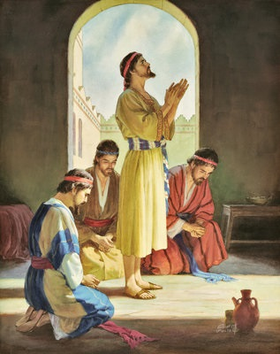
Then Daniel went to his house and made the matter known to Hananiah, Mishael, and Azariah, his companions, and told them to seek mercy from the God of heaven concerning this mystery, so that Daniel and his companions might not be destroyed with the rest of the wise men of Babylon. Then the mystery was revealed to Daniel in a vision of the night.
GOODSALT.COM
Tap the screen to return to the Menu Board

Slide 87
Daniel 2 & YOU!

Slide 88
Daniel 2 & YOU!
Daniel 2:17-18
Daniel told his friends to seek _____
from the God of heaven concerning the mystery.
Tap the screen to get answer choices

Slide 89
Daniel 2 & YOU!
Daniel 2:17-18
Daniel told his friends to seek _____
from the God of heaven concerning the mystery.
Tap your answer
MERCY
POWER
PROTECTION

Slide 90
Daniel 2 & YOU!
Daniel 2:17-18
Daniel told his friends to seek _____
from the God of heaven concerning the mystery.
2 points
PERFECT!
Tap the screen to continue
MERCY

Slide 91
Daniel 2 & YOU!
Daniel 2:17-18
No…
Tap and try again
Daniel told his friends to seek _____
from the God of heaven concerning the mystery.
MERCY
POWER
PROTECTION

Slide 92
Daniel 2 & YOU!
Daniel 2:17-18
Daniel told his friends to seek _____
from the God of heaven concerning the mystery.
Tap your answer
MERCY
POWER
PROTECTION

Slide 93
Daniel 2 & YOU!
Daniel 2:17-18
Daniel told his friends to seek _____
from the God of heaven concerning the mystery.
1 point
Nice!
Tap the screen to continue
MERCY

Slide 94
Daniel 2 & YOU!
Daniel 2:17-18
The answer is …
Daniel told his friends to seek _____
from the God of heaven concerning the mystery.
MERCY
Tap the screen to continue
MERCY
POWER
PROTECTION

Slide 95
Daniel 2 & YOU!
Daniel 2:17-18
Daniel told his friends to seek MERCY
from the God of heaven concerning the mystery.
Tap the screen to return to the Menu Board
MERCY
POWER
PROTECTION

Slide 96
Daniel 2 & YOU!

Slide 97
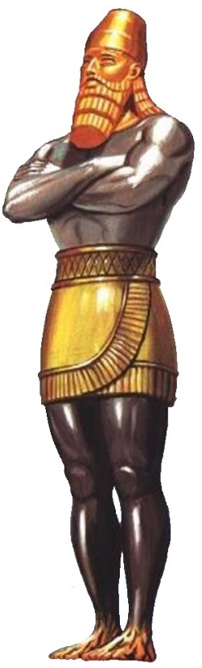
Daniel 2 & YOU!
Daniel 2:17-18
The mystery was revealed to Daniel
in a _____ of the night.
Tap the screen to get answer choices

Slide 98
Daniel 2 & YOU!
Daniel 2:17-18
The mystery was revealed to Daniel
in a _____ of the night.
Tap your answer
VIGIL
VISION
VOICE

Slide 99
Daniel 2 & YOU!
Daniel 2:17-18
The mystery was revealed to Daniel
in a _____ of the night.
2 points
NICE JOB!
Tap the screen to continue
VISION

Slide 100
Daniel 2 & YOU!
Daniel 2:17-18
Errrrr!
Tap and try again
The mystery was revealed to Daniel
in a _____ of the night.
VIGIL
VISION
VOICE

Slide 101
Daniel 2 & YOU!
Daniel 2:17-18
The mystery was revealed to Daniel
in a _____ of the night.
Tap your answer
VIGIL
VISION
VOICE

Slide 102
Daniel 2 & YOU!
Daniel 2:17-18
The mystery was revealed to Daniel
in a _____ of the night.
1 point
Right!
Tap the screen to continue
VISION

Slide 103
Daniel 2 & YOU!
Daniel 2:17-18
The answer is …
The mystery was revealed to Daniel
in a _____ of the night.
VISION
Tap the screen to continue
VIGIL
VISION
VOICE

Slide 104
Daniel 2 & YOU!
Daniel 2:17-18
The mystery was revealed to Daniel
in a VISION of the night.
Tap the screen to return to the Menu Board
VIGIL
VISION
VOICE

Slide 105
Daniel 2 & YOU!

Slide 106
Daniel 2 & YOU!
Daniel 2:19-20
When the mystery was revealed to him,
Daniel answered and said: “_____ be the name of God forever and ever, to whom belong wisdom and might.”
Tap the screen to get answer choices

Slide 107
Daniel 2 & YOU!
Daniel 2:19-20
When the mystery was revealed to him,
Daniel answered and said: “_____ be the name of God forever and ever, to whom belong wisdom and might.”
Tap your answer
BLESSED
FAMOUS
AMAZING

Slide 108
Daniel 2 & YOU!
Daniel 2:19-20
When the mystery was revealed to him,
Daniel answered and said: “_____ be the name of God forever and ever, to whom belong wisdom and might.”
2 points
EXCELLENT!
Tap the screen to continue
BLESSED

Slide 109
Daniel 2 & YOU!
Daniel 2:19-20
True, but …
Tap and try again
When the mystery was revealed to him,
Daniel answered and said: “_____ be the name of God forever and ever, to whom belong wisdom and might.”
BLESSED
FAMOUS
AMAZING

Slide 110
Daniel 2 & YOU!
Daniel 2:19-20
When the mystery was revealed to him,
Daniel answered and said: “_____ be the name of God forever and ever, to whom belong wisdom and might.”
Tap your answer
BLESSED
FAMOUS
AMAZING

Slide 111
Daniel 2 & YOU!
Daniel 2:19-20
When the mystery was revealed to him,
Daniel answered and said: “_____ be the name of God forever and ever, to whom belong wisdom and might.”
1 point
Got it!
Tap the screen to continue
BLESSED

Slide 112
Daniel 2 & YOU!
Daniel 2:19-20
The answer is …
When the mystery was revealed to him,
Daniel answered and said: “_____ be the name of God forever and ever, to whom belong wisdom and might.”
BLESSED
Tap the screen to continue
BLESSED
FAMOUS
AMAZING

Slide 113
Daniel 2 & YOU!
Daniel 2:19-20
When the mystery was revealed to him,
Daniel answered and said: “BLESSED be the name of God forever and ever, to whom belong wisdom and might.”
Tap the screen to return to the Menu Board
BLESSED
FAMOUS
AMAZING

Slide 114
Daniel 2 & YOU!

Slide 115
Daniel 2 & YOU!
Daniel 2:20-22
“Blessed be the name of God forever and ever.
He ______ times and seasons.”
Tap the screen to get answer choices

Slide 116
Daniel 2 & YOU!
Daniel 2:20-22
“Blessed be the name of God forever and ever.
He ______ times and seasons.”
Tap your answer
CHANGES
IGNORES
UNDERSTANDS

Slide 117
Daniel 2 & YOU!
Daniel 2:20-22
“Blessed be the name of God forever and ever.
He ______ times and seasons.”
YES INDEED!
2 points
Tap the screen to continue
CHANGES

Slide 118
Daniel 2 & YOU!
Daniel 2:20-22
Hmmm!
Tap and try again
“Blessed be the name of God forever and ever.
He ______ times and seasons.”
CHANGES
IGNORES
UNDERSTANDS

Slide 119
Daniel 2 & YOU!
Daniel 2:20-22
“Blessed be the name of God forever and ever.
He ______ times and seasons.”
Tap your answer
CHANGES
IGNORES
UNDERSTANDS

Slide 120
Daniel 2 & YOU!
Daniel 2:20-22
“Blessed be the name of God forever and ever.
He ______ times and seasons.”
1 point
Okay!
Tap the screen to continue
CHANGES

Slide 121
Daniel 2 & YOU!
Daniel 2:20-22
The answer is …
“Blessed be the name of God forever and ever.
He ______ times and seasons.”
CHANGES
Tap the screen to continue
CHANGES
IGNORES
UNDERSTANDS

Slide 122
Daniel 2 & YOU!
Daniel 2:20-22
“Blessed be the name of God forever and ever.
He CHANGES times and seasons.”
Tap the screen to return to the Menu Board
CHANGES
IGNORES
UNDERSTANDS

Slide 123
Daniel 2 & YOU!

Slide 124
Daniel 2 & YOU!
Daniel 2:20-22
“Blessed be the name of God forever and ever.
He removes ______ and sets up ______.”
Tap the screen to get answer choices

Slide 125
Daniel 2 & YOU!
Daniel 2:20-22
“Blessed be the name of God forever and ever.
He removes ______ and sets up ______.”
Tap your answer
IMAGES
KINGS
WISE MEN

Slide 126
Daniel 2 & YOU!
Daniel 2:20-22
“Blessed be the name of God forever and ever.
He removes ______ and sets up ______.”
2 points
GRRREAT!
Tap the screen to continue
KINGS

Slide 127
Daniel 2 & YOU!
Daniel 2:20-22
Oops!
Tap and try again
“Blessed be the name of God forever and ever.
He removes ______ and sets up ______.”
IMAGES
KINGS
WISE MEN

Slide 128
Daniel 2 & YOU!
Daniel 2:20-22
“Blessed be the name of God forever and ever.
He removes ______ and sets up ______.”
Tap your answer
IMAGES
KINGS
WISE MEN

Slide 129
Daniel 2 & YOU!
Daniel 2:20-22
“Blessed be the name of God forever and ever.
He removes ______ and sets up ______.”
On it now!
1 point
Tap the screen to continue
KINGS

Slide 130
Daniel 2 & YOU!
Daniel 2:20-22
The answer is …
“Blessed be the name of God forever and ever.
He removes ______ and sets up ______.”
KINGS
Tap the screen to continue
IMAGES
KINGS
WISE MEN

Slide 131
Daniel 2 & YOU!
Daniel 2:20-22
“Blessed be the name of God forever and ever.
He removes KINGS and sets up KINGS.”
Tap the screen to return to the Menu Board
IMAGES
KINGS
WISE MEN

Slide 132
Daniel 2 & YOU!

Slide 133
Daniel 2 & YOU!
Daniel 2:20-22
“Blessed be the name of God forever and ever.
He gives _______ to the wise,
and knowledge to those who have understanding.”
Tap the screen to get answer choices

Slide 134
Daniel 2 & YOU!
Daniel 2:20-22
“Blessed be the name of God forever and ever.
He gives _______ to the wise,
and knowledge to those who have understanding.”
Tap your answer
HONOR
POWER
WISDOM

Slide 135
Daniel 2 & YOU!
Daniel 2:20-22
“Blessed be the name of God forever and ever.
He gives _______ to the wise,
and knowledge to those who have understanding.”
WISE CHOICE!
2 points
Tap the screen to continue
WISDOM

Slide 136
Daniel 2 & YOU!
Daniel 2:20-22
Sorry!
Tap and try again
“Blessed be the name of God forever and ever.
He gives _______ to the wise,
and knowledge to those who have understanding.”
HONOR
POWER
WISDOM

Slide 137
Daniel 2 & YOU!
Daniel 2:20-22
“Blessed be the name of God forever and ever.
He gives _______ to the wise,
and knowledge to those who have understanding.”
Tap your answer
HONOR
POWER
WISDOM

Slide 138
Daniel 2 & YOU!
Daniel 2:20-22
“Blessed be the name of God forever and ever.
He gives _______ to the wise,
and knowledge to those who have understanding.”
Got it now!
1 point
Tap the screen to continue
WISDOM

Slide 139
Daniel 2 & YOU!
Daniel 2:20-22
The answer is …
“Blessed be the name of God forever and ever.
He gives _______ to the wise,
and knowledge to those who have understanding.”
WISDOM
Tap the screen to continue
HONOR
POWER
WISDOM

Slide 140
Daniel 2 & YOU!
Daniel 2:20-22
“Blessed be the name of God forever and ever.
He gives WISDOM to the wise,
and knowledge to those who have understanding.”
Tap the screen to return to the Menu Board
HONOR
POWER
WISDOM

Slide 141
Daniel 2 & YOU!

Slide 142
Daniel 2 & YOU!
Daniel 2:20-22
“Blessed be the name of God forever and ever.
He reveals ______ things.”
Tap the screen to get answer choices

Slide 143
Daniel 2 & YOU!
Daniel 2:20-22
“Blessed be the name of God forever and ever.
He reveals ______ things.”
Tap your answer
DEEP AND HIDDEN
HIGH AND MIGHTY
STRANGE AND WONDERFUL

Slide 144
Daniel 2 & YOU!
Daniel 2:20-22
“Blessed be the name of God forever and ever.
He reveals ______ things.”
GREAT INSIGHT!
2 points
Tap the screen to continue
DEEP AND HIDDEN

Slide 145
Daniel 2 & YOU!
Daniel 2:20-22
Not quite!
Tap and try again
“Blessed be the name of God forever and ever.
He reveals ______ things.”
DEEP AND HIDDEN
HIGH AND MIGHTY
STRANGE AND WONDERFUL

Slide 146
Daniel 2 & YOU!
Daniel 2:20-22
“Blessed be the name of God forever and ever.
He reveals ______ things.”
Tap your answer
DEEP AND HIDDEN
HIGH AND MIGHTY
STRANGE AND WONDERFUL

Slide 147
Daniel 2 & YOU!
Daniel 2:20-22
“Blessed be the name of God forever and ever.
He reveals ______ things.”
That’s it!
1 point
Tap the screen to continue
DEEP AND HIDDEN

Slide 148
Daniel 2 & YOU!
Daniel 2:20-22
The answer is …
“Blessed be the name of God forever and ever.
He reveals ______ things.”
DEEP AND HIDDEN
Tap the screen to continue
DEEP AND HIDDEN
HIGH AND MIGHTY
STRANGE AND WONDERFUL

Slide 149
Daniel 2 & YOU!
Daniel 2:20-22
“Blessed be the name of God forever and ever.
He reveals DEEP AND HIDDEN things.”
Tap the screen to return to the Menu Board
DEEP AND HIDDEN
HIGH AND MIGHTY
STRANGE AND WONDERFUL

Slide 150
Daniel 2 & YOU!

Slide 151
Daniel 2 & YOU!
Daniel 2:20-22
“Blessed be the name of God forever and ever.
He knows what is in the darkness,
and ______ dwells with him.”
Tap the screen to get answer choices

Slide 152
Daniel 2 & YOU!
Daniel 2:20-22
“Blessed be the name of God forever and ever.
He knows what is in the darkness,
and ______ dwells with him.”
Tap your answer
LIFE
LIGHT
LOVE

Slide 153
Daniel 2 & YOU!
Daniel 2:20-22
“Blessed be the name of God forever and ever.
He knows what is in the darkness,
and ______ dwells with him.”
SPLEN…
DID!
2 points
Tap the screen to continue
LIGHT

Slide 154
Daniel 2 & YOU!
Daniel 2:20-22
Yes, but …
Tap and try again
“Blessed be the name of God forever and ever.
He knows what is in the darkness,
and ______ dwells with him.”
LIFE
LIGHT
LOVE

Slide 155
Daniel 2 & YOU!
Daniel 2:20-22
“Blessed be the name of God forever and ever.
He knows what is in the darkness,
and ______ dwells with him.”
Tap your answer
LIFE
LIGHT
LOVE

Slide 156
Daniel 2 & YOU!
Daniel 2:20-22
“Blessed be the name of God forever and ever.
He knows what is in the darkness,
and ______ dwells with him.”
1 point
Yes!
Tap the screen to continue
LIGHT

Slide 157
Daniel 2 & YOU!
Daniel 2:20-22
The answer is …
“Blessed be the name of God forever and ever.
He knows what is in the darkness,
and ______ dwells with him.”
LIGHT
Tap the screen to continue
LIFE
LIGHT
LOVE

Slide 158
Daniel 2 & YOU!
Daniel 2:20-22
“Blessed be the name of God forever and ever.
He knows what is in the darkness,
and LIGHT dwells with him.”
Tap the screen to return to the Menu Board
LIFE
LIGHT
LOVE

Slide 159
Daniel 2 & YOU!

Slide 160
Daniel 2 & YOU!
Daniel 2:23
Daniel gave thanks and ______ to God
for making the king’s dream known.
Tap the screen to get answer choices

Slide 161
Daniel 2 & YOU!
Daniel 2:23
Daniel gave thanks and ______ to God
for making the king’s dream known.
Tap your answer
MADE A VOW
OFFERINGS
PRAISE

Slide 162
Daniel 2 & YOU!
Daniel 2:23
Daniel gave thanks and ______ to God
for making the king’s dream known.
2 points
GLORIOUS!
Tap the screen to continue
PRAISE

Slide 163
Daniel 2 & YOU!
Daniel 2:23
Uh Uh!
Tap and try again
Daniel gave thanks and ______ to God
for making the king’s dream known.
MADE A VOW
OFFERINGS
PRAISE

Slide 164
Daniel 2 & YOU!
Daniel 2:23
Daniel gave thanks and ______ to God
for making the king’s dream known.
Tap your answer
MADE A VOW
OFFERINGS
PRAISE

Slide 165
Daniel 2 & YOU!
Daniel 2:23
Daniel gave thanks and ______ to God
for making the king’s dream known.
1 point
Alright!
Tap the screen to continue
PRAISE

Slide 166
Daniel 2 & YOU!
Daniel 2:23
The answer is …
Daniel gave thanks and ______ to God
for making the king’s dream known.
PRAISE
Tap the screen to continue
MADE A VOW
OFFERINGS
PRAISE

Slide 167
Daniel 2 & YOU!
Daniel 2:23
Daniel gave thanks and PRAISE to God
for making the king’s dream known.
Tap the screen to return to the Menu Board
MADE A VOW
OFFERINGS
PRAISE

Slide 168
Daniel 2 & YOU!

Slide 169
Daniel 2 & YOU!
Daniel 2:27-28
Daniel answered the king and said, “There is a God in heaven who reveals mysteries, and he has made known to King Nebuchadnezzar what will be in ______.”
Tap the screen to get answer choices

Slide 170
Daniel 2 & YOU!
Daniel 2:27-28
Daniel answered the king and said, “There is a God in heaven who reveals mysteries, and he has made known to King Nebuchadnezzar what will be in ______.”
Tap your answer
BABYLON
HIS DAYS
THE LATTER DAYS

Slide 171
Daniel 2 & YOU!
Daniel 2:27-28
Daniel answered the king and said, “There is a God in heaven who reveals mysteries, and he has made known to King Nebuchadnezzar what will be in ______.”
YOU’VE GOT IT!
2 points
Tap the screen to continue
THE LATTER DAYS

Slide 172
Daniel 2 & YOU!
Daniel 2:27-28
Much more!
Tap and try again
Daniel answered the king and said, “There is a God in heaven who reveals mysteries, and he has made known to King Nebuchadnezzar what will be in ______.”
BABYLON
HIS DAYS
THE LATTER DAYS

Slide 173
Daniel 2 & YOU!
Daniel 2:27-28
Daniel answered the king and said, “There is a God in heaven who reveals mysteries, and he has made known to King Nebuchadnezzar what will be in ______.”
Tap your answer
BABYLON
HIS DAYS
THE LATTER DAYS

Slide 174
Daniel 2 & YOU!
Daniel 2:27-28
Daniel answered the king and said, “There is a God in heaven who reveals mysteries, and he has made known to King Nebuchadnezzar what will be in ______.”
1 point
Yay!
Tap the screen to continue
THE LATTER DAYS

Slide 175
Daniel 2 & YOU!
Daniel 2:27-28
The answer is …
Daniel answered the king and said, “There is a God in heaven who reveals mysteries, and he has made known to King Nebuchadnezzar what will be in ______.”
THE LATTER DAYS
Tap the screen to continue
BABYLON
HIS DAYS
THE LATTER DAYS

Slide 176
Daniel 2 & YOU!
Daniel 2:27-28
Daniel answered the king and said, “There is a God in heaven who reveals mysteries, and he has made known to King Nebuchadnezzar what will be in THE LATTER DAYS.”
Tap the screen to return to the Menu Board
BABYLON
HIS DAYS
THE LATTER DAYS

Slide 177
Daniel 2 & YOU!

Slide 178
Daniel 2 & YOU!
Daniel 2:31-33
Daniel told King Nebuchadnezzar,
“You saw a great ______.”
Tap the screen to get answer choices

Slide 179
Daniel 2 & YOU!
Daniel 2:31-33
Daniel told King Nebuchadnezzar,
“You saw a great ______.”
Tap your answer
IMAGE
MONUMENT
STONE

Slide 180
Daniel 2 & YOU!
Daniel 2:31-33
Daniel told King Nebuchadnezzar,
“You saw a great ______.”
2 points
BRILLIANT!
Tap the screen to continue
IMAGE

Slide 181
Daniel 2 & YOU!
Daniel 2:31-33
No…
Tap and try again
Daniel told King Nebuchadnezzar,
“You saw a great ______.”
IMAGE
MONUMENT
STONE

Slide 182
Daniel 2 & YOU!
Daniel 2:31-33
Daniel told King Nebuchadnezzar,
“You saw a great ______.”
Tap your answer
IMAGE
MONUMENT
STONE

Slide 183
Daniel 2 & YOU!
Daniel 2:31-33
Daniel told King Nebuchadnezzar,
“You saw a great ______.”
1 point
Good!
Tap the screen to continue
IMAGE

Slide 184
Daniel 2 & YOU!
Daniel 2:31-33
The answer is …
Daniel told King Nebuchadnezzar,
“You saw a great ______.”
IMAGE
Tap the screen to continue
IMAGE
MONUMENT
STONE

Slide 185
Daniel 2 & YOU!
Daniel 2:31-33
Daniel told King Nebuchadnezzar,
“You saw a great IMAGE.”
Tap to continue
IMAGE
MONUMENT
STONE

Slide 186
Tap the screen to return
to the Menu Board
GOODSALT.COM

Slide 187
Daniel 2 & YOU!

Slide 188
Daniel 2 & YOU!
Daniel 2:31-33
In Nebuchadnezzar’s dream, the head
of the image was of ______.
Tap the screen to get answer choices

Slide 189
Daniel 2 & YOU!
Daniel 2:31-33
In Nebuchadnezzar’s dream, the head
of the image was of ______.
Tap your answer
BRONZE
FINE GOLD
IRON

Slide 190
Daniel 2 & YOU!
Daniel 2:31-33
In Nebuchadnezzar’s dream, the head
of the image was of ______.
FIRST CLASS!
2 points
Tap the screen to continue
FINE GOLD

Slide 191
Daniel 2 & YOU!
Daniel 2:31-33
Errrrr!
Tap and try again
In Nebuchadnezzar’s dream, the head
of the image was of ______.
BRONZE
FINE GOLD
IRON

Slide 192
Daniel 2 & YOU!
Daniel 2:31-33
In Nebuchadnezzar’s dream, the head
of the image was of ______.
Tap your answer
BRONZE
FINE GOLD
IRON

Slide 193
Daniel 2 & YOU!
Daniel 2:31-33
In Nebuchadnezzar’s dream, the head
of the image was of ______.
1 point
Nice!
Tap the screen to continue
FINE GOLD

Slide 194
Daniel 2 & YOU!
Daniel 2:31-33
The answer is …
In Nebuchadnezzar’s dream, the head
of the image was of ______.
FINE GOLD
Tap the screen to continue
BRONZE
FINE GOLD
IRON

Slide 195
Daniel 2 & YOU!
Daniel 2:31-33
In Nebuchadnezzar’s dream, the head
of the image was of FINE GOLD.
Tap the screen to return to the Menu Board
BRONZE
FINE GOLD
IRON

Slide 196
Daniel 2 & YOU!

Slide 197
Daniel 2 & YOU!
Daniel 2:31-33
In Nebuchadnezzar’s dream, the chest and arms
of the image were of ______.
Tap the screen to get answer choices

Slide 198
Daniel 2 & YOU!
Daniel 2:31-33
In Nebuchadnezzar’s dream, the chest and arms
of the image were of ______.
Tap your answer
CLAY
BRONZE
SILVER

Slide 199
Daniel 2 & YOU!
Daniel 2:31-33
In Nebuchadnezzar’s dream, the chest and arms
of the image were of ______.
2 points
RADIANT!
Tap the screen to continue
SILVER

Slide 200
Daniel 2 & YOU!
Daniel 2:31-33
Nope!
Tap and try again
In Nebuchadnezzar’s dream, the chest and arms
of the image were of ______.
CLAY
BRONZE
SILVER

Slide 201
Daniel 2 & YOU!
Daniel 2:31-33
In Nebuchadnezzar’s dream, the chest and arms
of the image were of ______.
Tap your answer
CLAY
BRONZE
SILVER

Slide 202
Daniel 2 & YOU!
Daniel 2:31-33
In Nebuchadnezzar’s dream, the chest and arms
of the image were of ______.
1 point
Right!
Tap the screen to continue
SILVER

Slide 203
Daniel 2 & YOU!
Daniel 2:31-33
The answer is …
In Nebuchadnezzar’s dream, the chest and arms
of the image were of ______.
SILVER
Tap the screen to continue
CLAY
BRONZE
SILVER

Slide 204
Daniel 2 & YOU!
Daniel 2:31-33
In Nebuchadnezzar’s dream, the chest and arms
of the image were of SILVER.
Tap the screen to return to the Menu Board
CLAY
BRONZE
SILVER

Slide 205
Daniel 2 & YOU!

Slide 206
Daniel 2 & YOU!
Daniel 2:31-33
In Nebuchadnezzar’s dream, the middle and thighs
of the image were of ______.
Tap the screen to get answer choices

Slide 207
Daniel 2 & YOU!
Daniel 2:31-33
In Nebuchadnezzar’s dream, the middle and thighs
of the image were of ______.
Tap your answer
BRONZE
IRON
SILVER

Slide 208
Daniel 2 & YOU!
Daniel 2:31-33
In Nebuchadnezzar’s dream, the middle and thighs
of the image were of ______.
ON A ROLL!
2 points
Tap the screen to continue
BRONZE

Slide 209
Daniel 2 & YOU!
Daniel 2:31-33
Hmmm!
Tap and try again
In Nebuchadnezzar’s dream, the middle and thighs
of the image were of ______.
BRONZE
IRON
SILVER

Slide 210
Daniel 2 & YOU!
Daniel 2:31-33
In Nebuchadnezzar’s dream, the middle and thighs
of the image were of ______.
Tap your answer
BRONZE
IRON
SILVER

Slide 211
Daniel 2 & YOU!
Daniel 2:31-33
In Nebuchadnezzar’s dream, the middle and thighs
of the image were of ______.
1 point
Got it!
Tap the screen to continue
BRONZE

Slide 212
Daniel 2 & YOU!
Daniel 2:31-33
The answer is …
In Nebuchadnezzar’s dream, the middle and thighs
of the image were of ______.
BRONZE
Tap the screen to continue
BRONZE
IRON
SILVER

Slide 213
Daniel 2 & YOU!
Daniel 2:31-33
In Nebuchadnezzar’s dream, the middle and thighs
of the image were of BRONZE.
Tap the screen to return to the Menu Board
BRONZE
IRON
SILVER

Slide 214
Daniel 2 & YOU!

Slide 215
Daniel 2 & YOU!
Daniel 2:31-33
In Nebuchadnezzar’s dream, the legs
of the image were of ______.
Tap the screen to get answer choices

Slide 216
Daniel 2 & YOU!
Daniel 2:31-33
In Nebuchadnezzar’s dream, the legs
of the image were of ______.
Tap your answer
IRON
CLAY
SILVER

Slide 217
Daniel 2 & YOU!
Daniel 2:31-33
In Nebuchadnezzar’s dream, the legs
of the image were of ______.
YOU’RE ON!
2 points
Tap the screen to continue
IRON

Slide 218
Daniel 2 & YOU!
Daniel 2:31-33
Oops!
Tap and try again
In Nebuchadnezzar’s dream, the legs
of the image were of ______.
IRON
CLAY
SILVER

Slide 219
Daniel 2 & YOU!
Daniel 2:31-33
In Nebuchadnezzar’s dream, the legs
of the image were of ______.
Tap your answer
IRON
CLAY
SILVER

Slide 220
Daniel 2 & YOU!
Daniel 2:31-33
In Nebuchadnezzar’s dream, the legs
of the image were of ______.
1 point
Okay!
Tap the screen to continue
IRON

Slide 221
Daniel 2 & YOU!
Daniel 2:31-33
The answer is …
In Nebuchadnezzar’s dream, the legs
of the image were of ______.
IRON
Tap the screen to continue
IRON
CLAY
SILVER

Slide 222
Daniel 2 & YOU!
Daniel 2:31-33
In Nebuchadnezzar’s dream, the legs
of the image were of IRON.
Tap the screen to return to the Menu Board
IRON
CLAY
SILVER

Slide 223
Daniel 2 & YOU!

Slide 224
Daniel 2 & YOU!
Daniel 2:31-33
In Nebuchadnezzar’s dream, the feet of the image were partly of iron and partly of ______.
Tap the screen to get answer choices

Slide 225
Daniel 2 & YOU!
Daniel 2:31-33
In Nebuchadnezzar’s dream, the feet of the image were partly of iron and partly of ______.
Tap your answer
BRONZE
CLAY
FINE GOLD

Slide 226
Daniel 2 & YOU!
Daniel 2:31-33
In Nebuchadnezzar’s dream, the feet of the image were partly of iron and partly of ______.
NOT A DOUBT!
2 points
Tap the screen to continue
CLAY

Slide 227
Daniel 2 & YOU!
Daniel 2:31-33
Sorry!
Tap and try again
In Nebuchadnezzar’s dream, the feet of the image were partly of iron and partly of ______.
BRONZE
CLAY
FINE GOLD

Slide 228
Daniel 2 & YOU!
Daniel 2:31-33
In Nebuchadnezzar’s dream, the feet of the image were partly of iron and partly of ______.
Tap your answer
BRONZE
CLAY
FINE GOLD

Slide 229
Daniel 2 & YOU!
Daniel 2:31-33
In Nebuchadnezzar’s dream, the feet of the image were partly of iron and partly of ______.
On it now!
1 point
Tap the screen to continue
CLAY

Slide 230
Daniel 2 & YOU!
Daniel 2:31-33
The answer is …
In Nebuchadnezzar’s dream, the feet of the image were partly of iron and partly of ______.
CLAY
Tap the screen to continue
BRONZE
CLAY
FINE GOLD

Slide 231
Daniel 2 & YOU!
Daniel 2:31-33
In Nebuchadnezzar’s dream, the feet of the image were partly of iron and partly of CLAY.
Tap the screen to return to the Menu Board
BRONZE
CLAY
FINE GOLD

Slide 232
Daniel 2 & YOU!

Slide 233
Daniel 2 & YOU!
Daniel 2:34
In Nebuchadnezzar’s dream, the feet of the image were struck by a ______.
Tap the screen to get answer choices

Slide 234
Daniel 2 & YOU!
Daniel 2:34
In Nebuchadnezzar’s dream, the feet of the image were struck by a ______.
Tap your answer
HAMMER
HUMAN HAND
STONE

Slide 235
Daniel 2 & YOU!
Daniel 2:34
In Nebuchadnezzar’s dream, the feet of the image were struck by a ______.
2 points
SOLID!
Tap the screen to continue
STONE

Slide 236
Daniel 2 & YOU!
Daniel 2:34
Really?
Tap and try again
In Nebuchadnezzar’s dream, the feet of the image were struck by a ______.
HAMMER
HUMAN HAND
STONE

Slide 237
Daniel 2 & YOU!
Daniel 2:34
In Nebuchadnezzar’s dream, the feet of the image were struck by a ______.
Tap your answer
HAMMER
HUMAN HAND
STONE

Slide 238
Daniel 2 & YOU!
Daniel 2:34
In Nebuchadnezzar’s dream, the feet of the image were struck by a ______.
Got it now!
1 point
Tap the screen to continue
STONE

Slide 239
Daniel 2 & YOU!
Daniel 2:34
The answer is …
In Nebuchadnezzar’s dream, the feet of the image were struck by a ______.
STONE
Tap the screen to continue
HAMMER
HUMAN HAND
STONE

Slide 240
Daniel 2 & YOU!
Daniel 2:34
In Nebuchadnezzar’s dream, the feet of the image were struck by a STONE.
Tap the screen to return to the Menu Board
HAMMER
HUMAN HAND
STONE

Slide 241
Daniel 2 & YOU!

Slide 242
Daniel 2 & YOU!
Daniel 2:35
In Nebuchadnezzar’s dream, the image is broken to pieces and carried away, and ______.
Tap the screen to get answer choices

Slide 243
Daniel 2 & YOU!
Daniel 2:35
In Nebuchadnezzar’s dream, the image is broken to pieces and carried away, and ______.
Tap your answer
A NEW IMAGE FORMS
THE DREAM ENDS
NOT A TRACE IS FOUND

Slide 244
Daniel 2 & YOU!
Daniel 2:35
In Nebuchadnezzar’s dream, the image is broken to pieces and carried away, and ______.
2 points
ALRIGHT!
Tap the screen to continue
NOT A TRACE IS FOUND

Slide 245
Daniel 2 & YOU!
Daniel 2:35
Uhhh!
Tap and try again
In Nebuchadnezzar’s dream, the image is broken to pieces and carried away, and ______.
A NEW IMAGE FORMS
THE DREAM ENDS
NOT A TRACE IS FOUND

Slide 246
Daniel 2 & YOU!
Daniel 2:35
In Nebuchadnezzar’s dream, the image is broken to pieces and carried away, and ______.
Tap your answer
A NEW IMAGE FORMS
THE DREAM ENDS
NOT A TRACE IS FOUND

Slide 247
Daniel 2 & YOU!
Daniel 2:35
In Nebuchadnezzar’s dream, the image is broken to pieces and carried away, and ______.
That’s
it!
1 point
Tap the screen to continue
NOT A TRACE IS FOUND

Slide 248
Daniel 2 & YOU!
Daniel 2:35
The answer is …
In Nebuchadnezzar’s dream, the image is broken to pieces and carried away, and ______.
NOT A TRACE IS FOUND
Tap the screen to continue
A NEW IMAGE FORMS
THE DREAM ENDS
NOT A TRACE IS FOUND

Slide 249
Daniel 2 & YOU!
Daniel 2:35
In Nebuchadnezzar’s dream, the image is broken to pieces and carried away, and NOT A TRACE IS FOUND.
Tap the screen to return to the Menu Board
A NEW IMAGE FORMS
THE DREAM ENDS
NOT A TRACE IS FOUND

Slide 250
Daniel 2 & YOU!

Slide 251
Daniel 2 & YOU!
Daniel 2:35
In Nebuchadnezzar’s dream, the stone that strikes the image on its feet becomes ______.
Tap the screen to get answer choices

Slide 252
Daniel 2 & YOU!
Daniel 2:35
In Nebuchadnezzar’s dream, the stone that strikes the image on its feet becomes ______.
Tap your answer
A GREAT MOUNTAIN
A NEW IMAGE
A STUMBLING STONE

Slide 253
Daniel 2 & YOU!
Daniel 2:35
In Nebuchadnezzar’s dream, the stone that strikes the image on its feet becomes ______.
GREAT
JOB!
2 points
Tap the screen to continue
A GREAT MOUNTAIN

Slide 254
Daniel 2 & YOU!
Daniel 2:35
Uh uh!
Tap and try again
In Nebuchadnezzar’s dream, the stone that strikes the image on its feet becomes ______.
A GREAT MOUNTAIN
A NEW IMAGE
A STUMBLING STONE

Slide 255
Daniel 2 & YOU!
Daniel 2:35
In Nebuchadnezzar’s dream, the stone that strikes the image on its feet becomes ______.
Tap your answer
A GREAT MOUNTAIN
A NEW IMAGE
A STUMBLING STONE

Slide 256
Daniel 2 & YOU!
Daniel 2:35
In Nebuchadnezzar’s dream, the stone that strikes the image on its feet becomes ______.
1 point
Yes!
Tap the screen to continue
A GREAT MOUNTAIN

Slide 257
Daniel 2 & YOU!
Daniel 2:35
The answer is …
In Nebuchadnezzar’s dream, the stone that strikes the image on its feet becomes ______.
A GREAT MOUNTAIN
Tap the screen to continue
A GREAT MOUNTAIN
A NEW IMAGE
A STUMBLING STONE

Slide 258
Daniel 2 & YOU!
Daniel 2:35
In Nebuchadnezzar’s dream, the stone that strikes the image on its feet becomes A GREAT MOUNTAIN.
Tap the screen to return to the Menu Board
A GREAT MOUNTAIN
A NEW IMAGE
A STUMBLING STONE

Slide 259
Daniel 2 & YOU!

Slide 260
Daniel 2 & YOU!
Daniel 2:35
In Nebuchadnezzar’s dream, the stone that becomes a great mountain fills ______.
Tap the screen to get answer choices

Slide 261
Daniel 2 & YOU!
Daniel 2:35
In Nebuchadnezzar’s dream, the stone that becomes a great mountain fills ______.
Tap your answer
BABYLON
THE COUNTRYSIDE
THE WHOLE EARTH

Slide 262
Daniel 2 & YOU!
Daniel 2:35
In Nebuchadnezzar’s dream, the stone that becomes a great mountain fills ______.
OUT STANDING!
2 points
Tap the screen to continue
THE WHOLE EARTH

Slide 263
Daniel 2 & YOU!
Daniel 2:35
Are you sure?
Tap and try again
In Nebuchadnezzar’s dream, the stone that becomes a great mountain fills ______.
BABYLON
THE COUNTRYSIDE
THE WHOLE EARTH

Slide 264
Daniel 2 & YOU!
Daniel 2:35
In Nebuchadnezzar’s dream, the stone that becomes a great mountain fills ______.
Tap your answer
BABYLON
THE COUNTRYSIDE
THE WHOLE EARTH

Slide 265
Daniel 2 & YOU!
Daniel 2:35
In Nebuchadnezzar’s dream, the stone that becomes a great mountain fills ______.
1 point
Alright!
Tap the screen to continue
THE WHOLE EARTH

Slide 266
Daniel 2 & YOU!
Daniel 2:35
The answer is …
In Nebuchadnezzar’s dream, the stone that becomes a great mountain fills ______.
THE WHOLE EARTH
Tap the screen to continue
BABYLON
THE COUNTRYSIDE
THE WHOLE EARTH

Slide 267
Daniel 2 & YOU!
Daniel 2:35
In Nebuchadnezzar’s dream, the stone that becomes a great mountain fills THE WHOLE EARTH.
Tap the screen to return to the Menu Board
BABYLON
THE COUNTRYSIDE
THE WHOLE EARTH

Slide 268
Daniel 2 & YOU!

Slide 269
Daniel 2 & YOU!
Daniel 2:37-40
In Nebuchadnezzar’s dream, the upper four parts of the image represent ______.
Tap the screen to get answer choices

Slide 270
Daniel 2 & YOU!
Daniel 2:37-40
In Nebuchadnezzar’s dream, the upper four parts of the image represent ______.
Tap your answer
FOUR CORNERS OF THE EARTH
FOUR KINGS
FOUR WORLD EMPIRES

Slide 271
Daniel 2 & YOU!
Daniel 2:37-40
In Nebuchadnezzar’s dream, the upper four parts of the image represent ______.
YES INDEED!
2 points
Tap the screen to continue
FOUR WORLD EMPIRES

Slide 272
Daniel 2 & YOU!
Daniel 2:37-40
Not quite!
Tap and try again
In Nebuchadnezzar’s dream, the upper four parts of the image represent ______.
FOUR CORNERS OF THE EARTH
FOUR KINGS
FOUR WORLD EMPIRES

Slide 273
Daniel 2 & YOU!
Daniel 2:37-40
In Nebuchadnezzar’s dream, the upper four parts of the image represent ______.
Tap your answer
FOUR CORNERS OF THE EARTH
FOUR KINGS
FOUR WORLD EMPIRES

Slide 274
Daniel 2 & YOU!
Daniel 2:37-40
In Nebuchadnezzar’s dream, the upper four parts of the image represent ______.
1 point
Yay!
Tap the screen to continue
FOUR WORLD EMPIRES

Slide 275
Daniel 2 & YOU!
Daniel 2:37-40
The answer is …
In Nebuchadnezzar’s dream, the upper four parts of the image represent ______.
FOUR WORLD EMPIRES
Tap the screen to continue
FOUR CORNERS OF THE EARTH
FOUR KINGS
FOUR WORLD EMPIRES

Slide 276
Daniel 2 & YOU!
Daniel 2:37-40
In Nebuchadnezzar’s dream, the upper four parts of the image represent FOUR WORLD EMPIRES.
Tap the screen to return to the Menu Board
FOUR CORNERS OF THE EARTH
FOUR KINGS
FOUR WORLD EMPIRES

Slide 277
Daniel 2 & YOU!

Slide 278
Daniel 2 & YOU!
Daniel 2:44
In Nebuchadnezzar’s dream, the whole image represents the ______.
Tap the screen to get answer choices

Slide 279
Daniel 2 & YOU!
Daniel 2:44
In Nebuchadnezzar’s dream, the whole image represents the ______.
Tap your answer
KINGDOM OF BABYLON
KINGDOM OF GOD
KINGDOMS OF MEN

Slide 280
Daniel 2 & YOU!
Daniel 2:44
In Nebuchadnezzar’s dream, the whole image represents the ______.
ABSO…
LUTELY!
2 points
Tap the screen to continue
KINGDOMS OF MEN

Slide 281
Daniel 2 & YOU!
Daniel 2:44
Errrrr!
Tap and try again
In Nebuchadnezzar’s dream, the whole image represents the ______.
KINGDOM OF BABYLON
KINGDOM OF GOD
KINGDOMS OF MEN

Slide 282
Daniel 2 & YOU!
Daniel 2:44
In Nebuchadnezzar’s dream, the whole image represents the ______.
Tap your answer
KINGDOM OF BABYLON
KINGDOM OF GOD
KINGDOMS OF MEN

Slide 283
Daniel 2 & YOU!
Daniel 2:44
In Nebuchadnezzar’s dream, the whole image represents the ______.
1 point
Good!
Tap the screen to continue
KINGDOMS OF MEN

Slide 284
Daniel 2 & YOU!
Daniel 2:44
The answer is …
In Nebuchadnezzar’s dream, the whole image represents the ______.
KINGDOMS OF MEN
Tap the screen to continue
KINGDOM OF BABYLON
KINGDOM OF GOD
KINGDOMS OF MEN

Slide 285
Daniel 2 & YOU!
Daniel 2:44
In Nebuchadnezzar’s dream, the whole image represents the KINGDOMS OF MEN.
Tap the screen to return to the Menu Board
KINGDOM OF BABYLON
KINGDOM OF GOD
KINGDOMS OF MEN

Slide 286
Daniel 2 & YOU!

Slide 287
Daniel 2 & YOU!
Daniel 2:37-38
In Nebuchadnezzar’s dream, the head of gold represents ______.
Tap the screen to get answer choices

Slide 288
Daniel 2 & YOU!
Daniel 2:37-38
In Nebuchadnezzar’s dream, the head of gold represents ______.
Tap your answer
BABYLON
MEDO-PERSIA
ROME

Slide 289
Daniel 2 & YOU!
Daniel 2:37-38
In Nebuchadnezzar’s dream, the head of gold represents ______.
2 points
TERRIFIC!
Tap the screen to continue
BABYLON

Slide 290
Daniel 2 & YOU!
Daniel 2:37-38
oooo!
Tap and try again
In Nebuchadnezzar’s dream, the head of gold represents ______.
BABYLON
MEDO-PERSIA
ROME

Slide 291
Daniel 2 & YOU!
Daniel 2:37-38
In Nebuchadnezzar’s dream, the head of gold represents ______.
Tap your answer
BABYLON
MEDO-PERSIA
ROME

Slide 292
Daniel 2 & YOU!
Daniel 2:37-38
In Nebuchadnezzar’s dream, the head of gold represents ______.
1 point
Nice!
Tap the screen to continue
BABYLON

Slide 293
Daniel 2 & YOU!
Daniel 2:37-38
The answer is …
In Nebuchadnezzar’s dream, the head of gold represents ______.
BABYLON
Tap the screen to continue
BABYLON
MEDO-PERSIA
ROME

Slide 294
Daniel 2 & YOU!
Daniel 2:37-38
In Nebuchadnezzar’s dream, the head of gold represents BABYLON.
Tap the screen to continue
BABYLON
MEDO-PERSIA
ROME

Slide 295
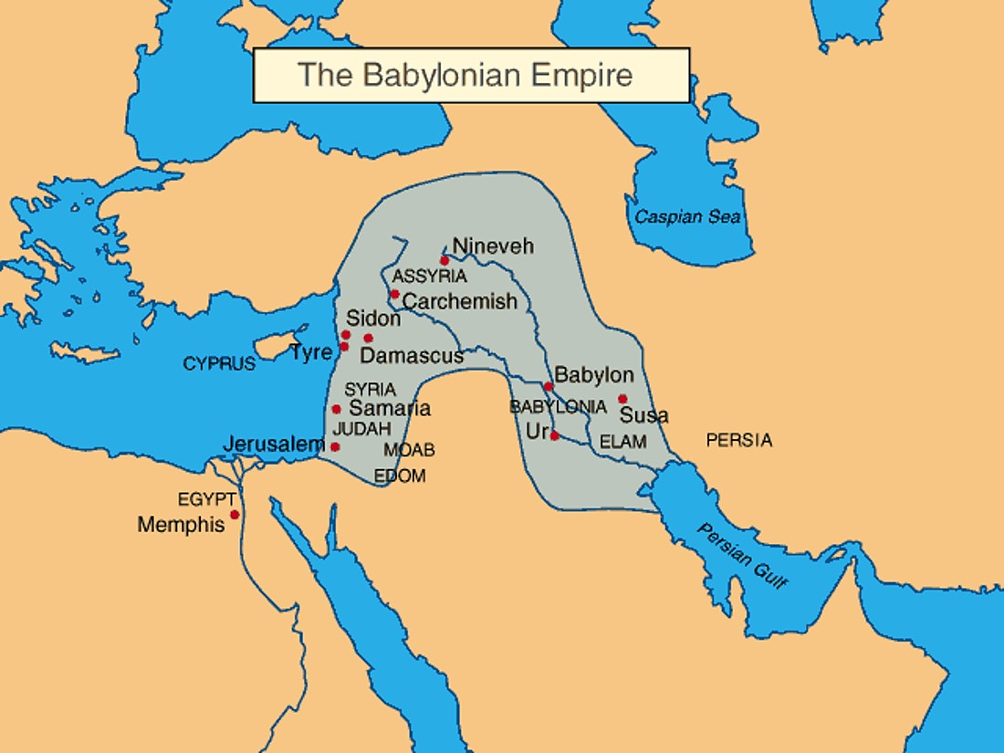
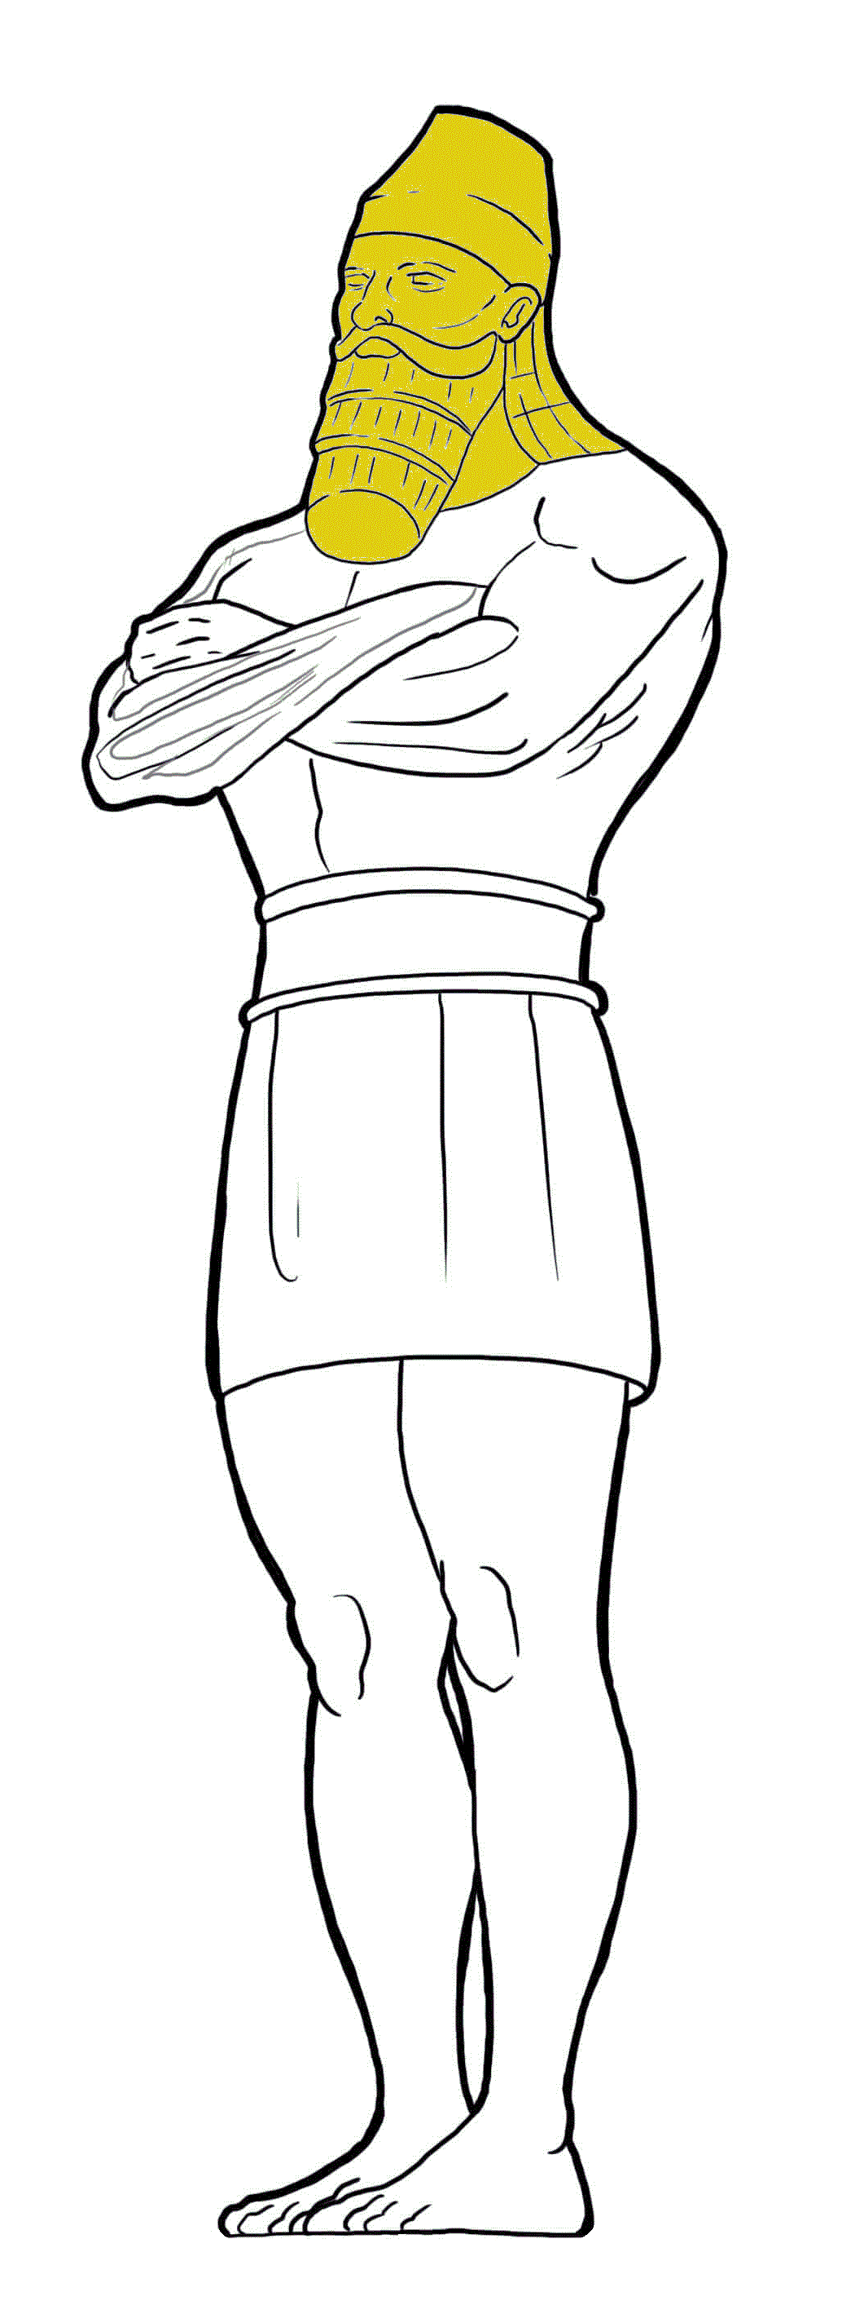
The Babylonian Empire
c. 605-538 B.C.
Head
of Fine Gold
Lion Publishing
Tap the screen to return to the Menu Board

Slide 296
Daniel 2 & YOU!

Slide 297
Daniel 2 & YOU!
Daniel 2:39
In Nebuchadnezzar’s dream, the chest and arms of silver represent ______.
Tap the screen to get answer choices

Slide 298
Daniel 2 & YOU!
Daniel 2:39
In Nebuchadnezzar’s dream, the chest and arms of silver represent ______.
Tap your answer
GREECE
MEDO-PERSIA
MODERN NATIONS

Slide 299
Daniel 2 & YOU!
Daniel 2:39
In Nebuchadnezzar’s dream, the chest and arms of silver represent ______.
PERRR… CEPTIVE!
2 points
Tap the screen to continue
MEDO-PERSIA

Slide 300
Daniel 2 & YOU!
Daniel 2:39
Hmmm!
Tap and try again
In Nebuchadnezzar’s dream, the chest and arms of silver represent ______.
GREECE
MEDO-PERSIA
MODERN NATIONS

Slide 301
Daniel 2 & YOU!
Daniel 2:39
In Nebuchadnezzar’s dream, the chest and arms of silver represent ______.
Tap your answer
GREECE
MEDO-PERSIA
MODERN NATIONS

Slide 302
Daniel 2 & YOU!
Daniel 2:39
In Nebuchadnezzar’s dream, the chest and arms of silver represent ______.
1 point
Got it!
Tap the screen to continue
MEDO-PERSIA

Slide 303
Daniel 2 & YOU!
Daniel 2:39
The answer is …
In Nebuchadnezzar’s dream, the chest and arms of silver represent ______.
MEDO-PERSIA
Tap the screen to continue
GREECE
MEDO-PERSIA
MODERN NATIONS

Slide 304
Daniel 2 & YOU!
Daniel 2:39
In Nebuchadnezzar’s dream, the chest and arms of silver represent MEDO-PERSIA.
Tap the screen to continue
GREECE
MEDO-PERSIA
MODERN NATIONS

Slide 305
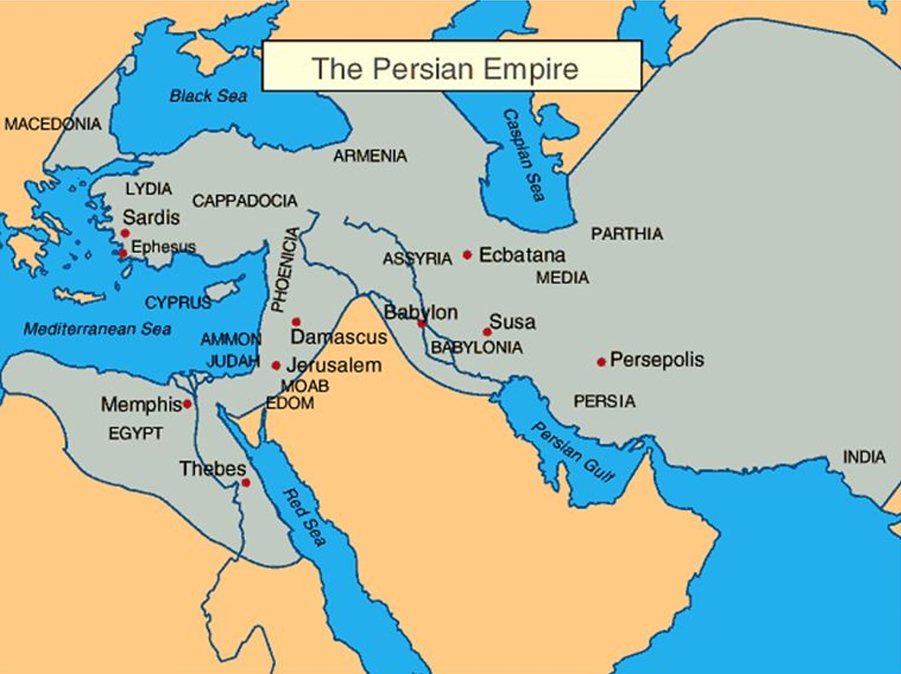
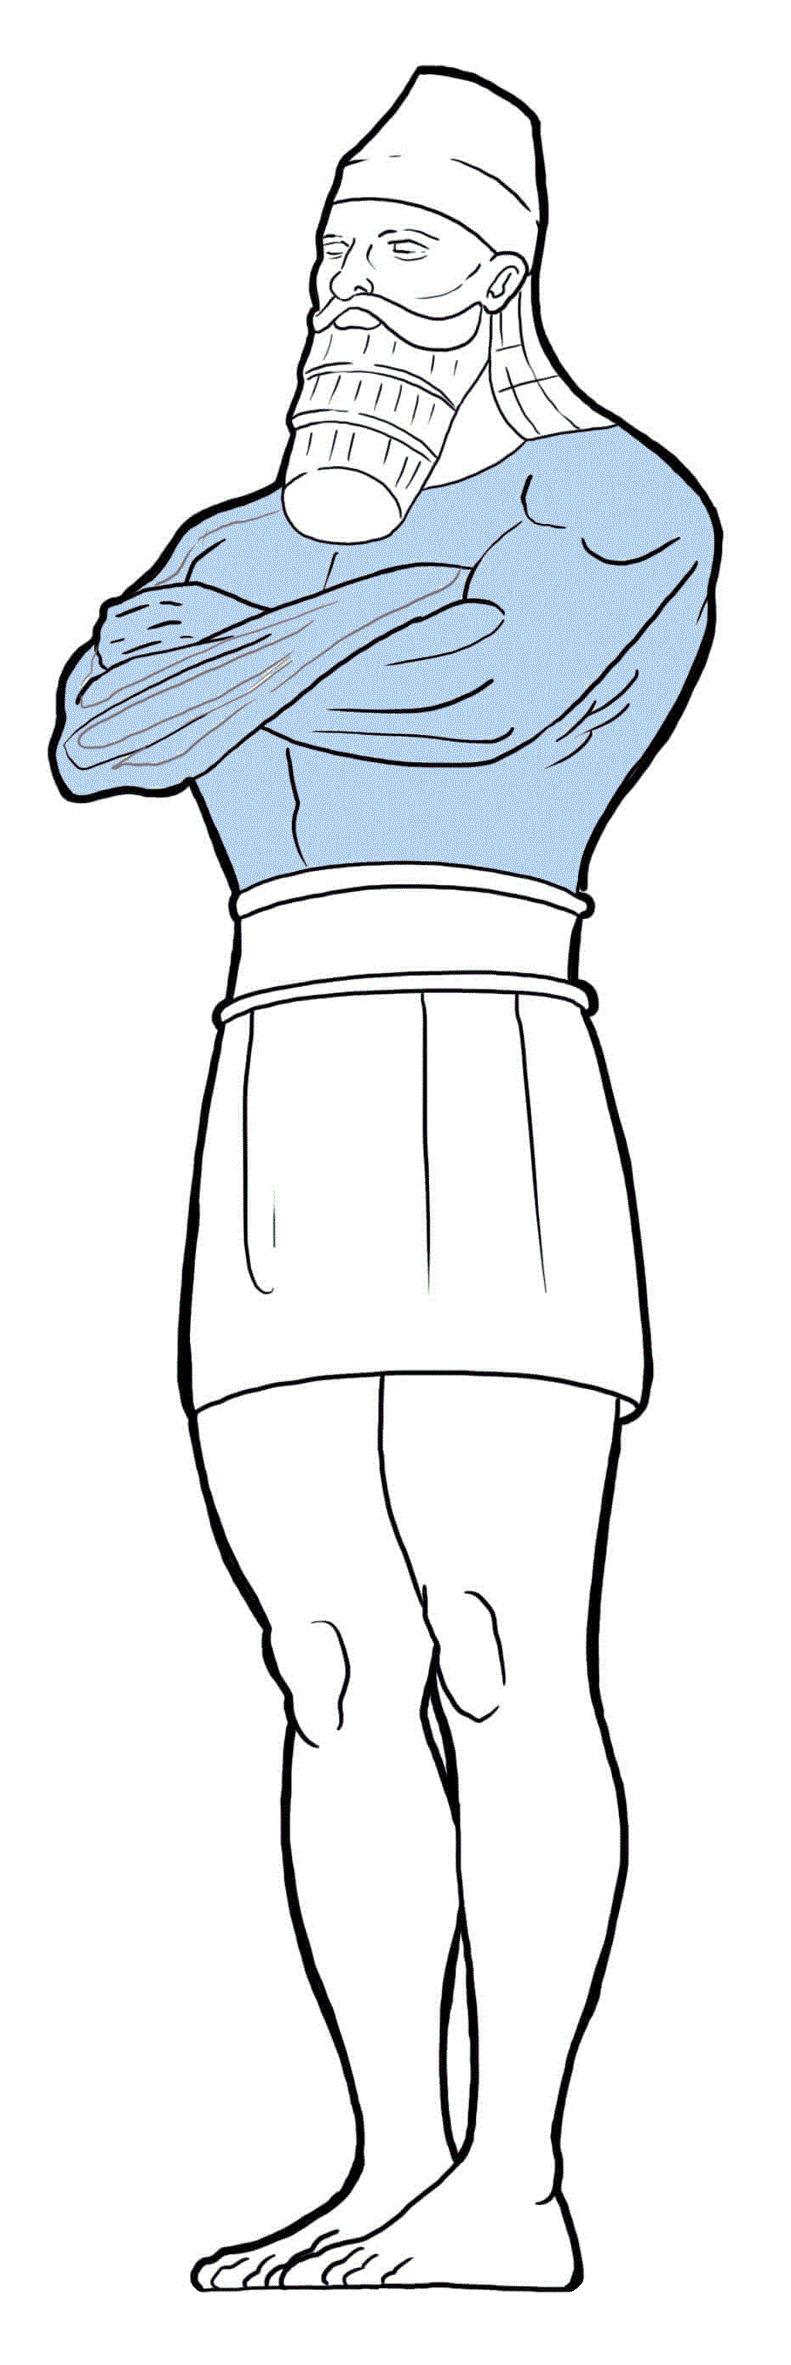
The Persian Empire
c. 538-330 B.C.
Chest & Arms
of Silver
Lion Publishing
Tap the screen to return to the Menu Board

Slide 306
Daniel 2 & YOU!

Slide 307
Daniel 2 & YOU!
Daniel 2:39
In Nebuchadnezzar’s dream, the middle and thighs of bronze represent ______.
Tap the screen to get answer choices

Slide 308
Daniel 2 & YOU!
Daniel 2:39
In Nebuchadnezzar’s dream, the middle and thighs of bronze represent ______.
Tap your answer
GREECE
MODERN NATIONS
ROME

Slide 309
Daniel 2 & YOU!
Daniel 2:39
In Nebuchadnezzar’s dream, the middle and thighs of bronze represent ______.
2 points
CORRECT!
Tap the screen to continue
GREECE

Slide 310
Daniel 2 & YOU!
Daniel 2:39
Oops!
Tap and try again
In Nebuchadnezzar’s dream, the middle and thighs of bronze represent ______.
GREECE
MODERN NATIONS
ROME

Slide 311
Daniel 2 & YOU!
Daniel 2:39
In Nebuchadnezzar’s dream, the middle and thighs of bronze represent ______.
Tap your answer
GREECE
MODERN NATIONS
ROME

Slide 312
Daniel 2 & YOU!
Daniel 2:39
In Nebuchadnezzar’s dream, the middle and thighs of bronze represent ______.
1 point
Okay!
Tap the screen to continue
GREECE

Slide 313
Daniel 2 & YOU!
Daniel 2:39
The answer is …
In Nebuchadnezzar’s dream, the middle and thighs of bronze represent ______.
GREECE
Tap the screen to continue
GREECE
MODERN NATIONS
ROME

Slide 314
Daniel 2 & YOU!
Daniel 2:39
In Nebuchadnezzar’s dream, the middle and thighs of bronze represent GREECE.
Tap the screen to continue
GREECE
MODERN NATIONS
ROME

Slide 315
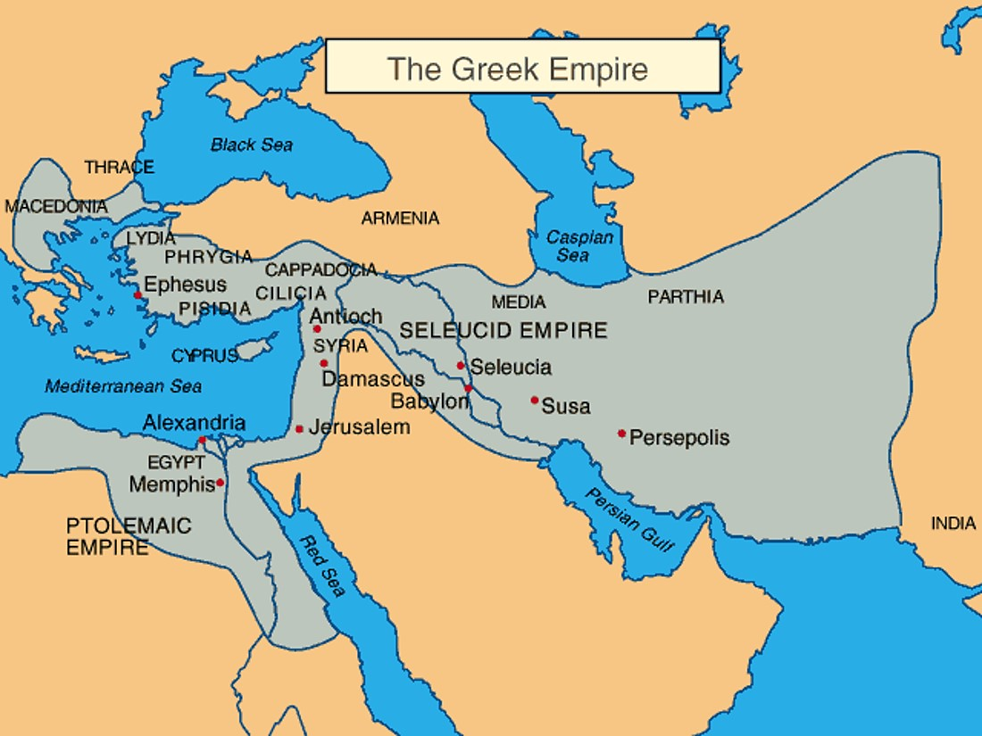
The Greek Empire
c. 330-147 B.C.
Middle & Thighs of Bronze
Lion Publishing
Tap the screen to return to the Menu Board

Slide 316
Daniel 2 & YOU!

Slide 317
Daniel 2 & YOU!
Daniel 2:40
In Nebuchadnezzar’s dream, the legs of iron
represent ______.
Tap the screen to get answer choices

Slide 318
Daniel 2 & YOU!
Daniel 2:40
In Nebuchadnezzar’s dream, the legs of iron
represent ______.
Tap your answer
BABYLON
MEDO-PERSIA
ROME

Slide 319
Daniel 2 & YOU!
Daniel 2:40
In Nebuchadnezzar’s dream, the legs of iron
represent ______.
YOU’RE RIGHT!
2 points
Tap the screen to continue
ROME

Slide 320
Daniel 2 & YOU!
Daniel 2:40
Sorry!
Tap and try again
In Nebuchadnezzar’s dream, the legs of iron
represent ______.
BABYLON
MEDO-PERSIA
ROME

Slide 321
Daniel 2 & YOU!
Daniel 2:40
In Nebuchadnezzar’s dream, the legs of iron
represent ______.
Tap your answer
BABYLON
MEDO-PERSIA
ROME

Slide 322
Daniel 2 & YOU!
Daniel 2:40
In Nebuchadnezzar’s dream, the legs of iron
represent ______.
On it now!
1 point
Tap the screen to continue
ROME

Slide 323
Daniel 2 & YOU!
Daniel 2:40
The answer is …
In Nebuchadnezzar’s dream, the legs of iron
represent ______.
ROME
Tap the screen to continue
BABYLON
MEDO-PERSIA
ROME

Slide 324
Daniel 2 & YOU!
Daniel 2:40
In Nebuchadnezzar’s dream, the legs of iron
represent ROME.
Tap the screen to continue
BABYLON
MEDO-PERSIA
ROME

Slide 325
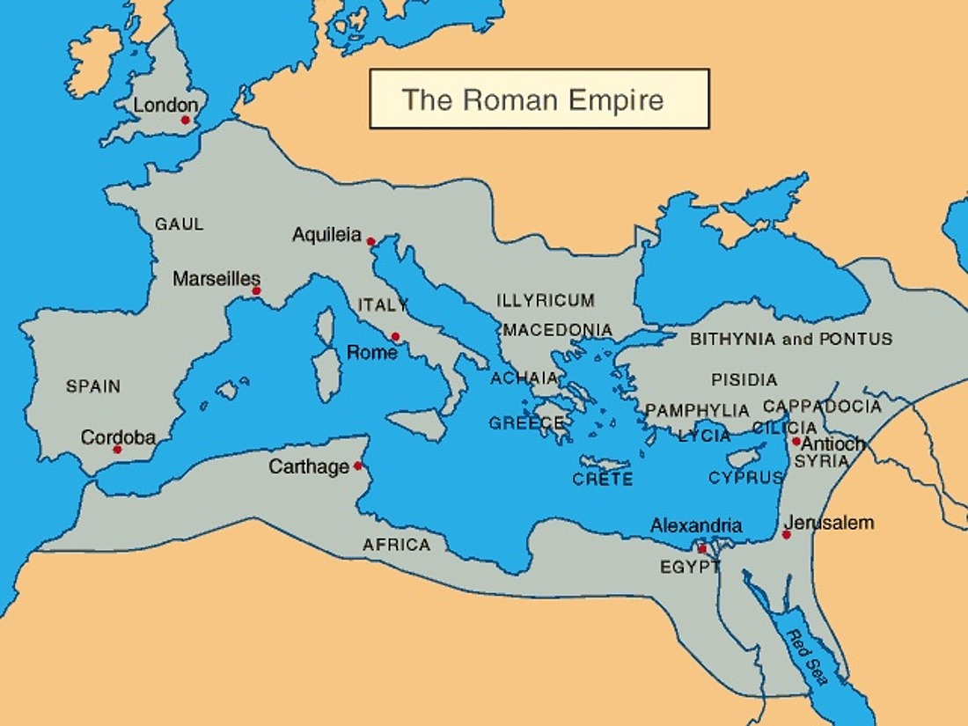
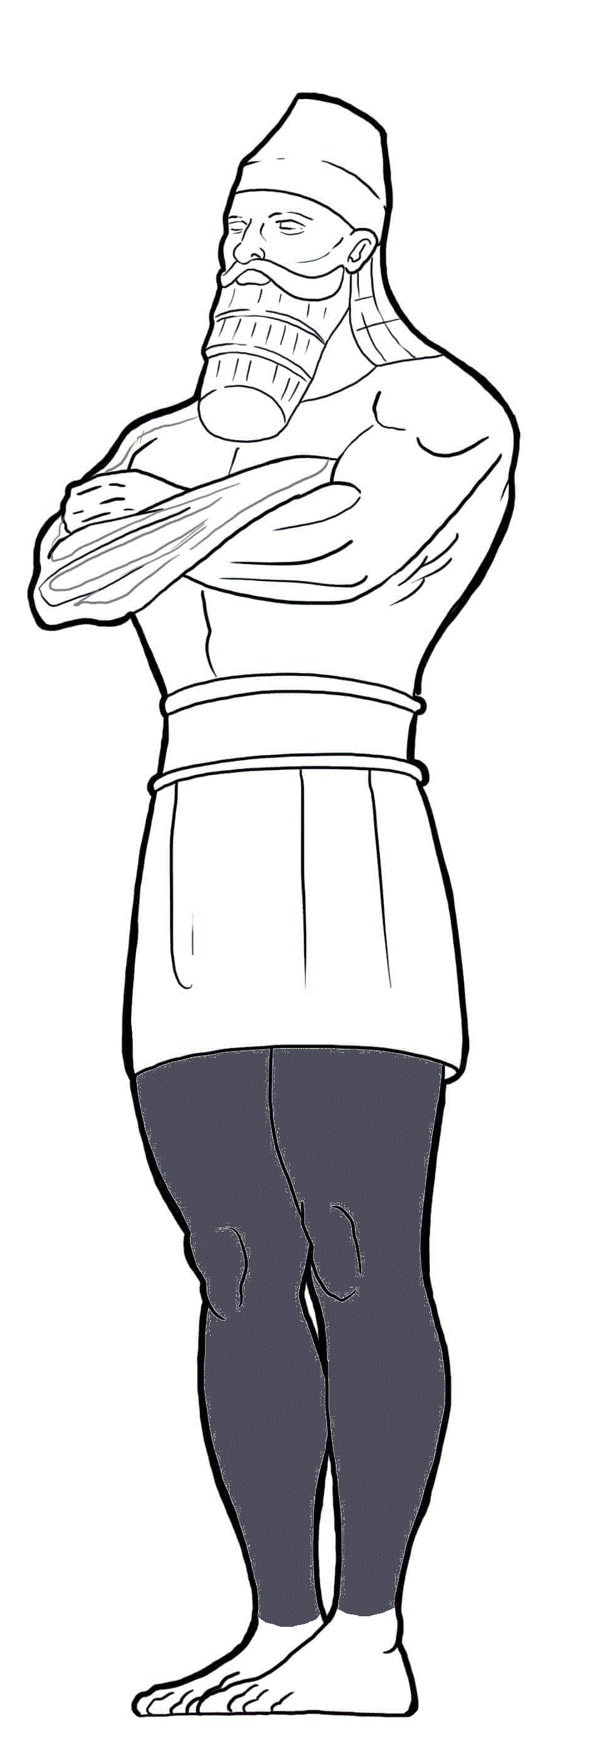
The Roman Empire
c. 147 B.C.-476 A.D.
Legs of Iron
Lion Publishing
Tap the screen to return to the Menu Board

Slide 326
Daniel 2 & YOU!

Slide 327
Daniel 2 & YOU!
Daniel 2:41-43
In Nebuchadnezzar’s dream, the feet of iron and clay represent ______.
Tap the screen to get answer choices

Slide 328
Daniel 2 & YOU!
Daniel 2:41-43
In Nebuchadnezzar’s dream, the feet of iron and clay represent ______.
Tap your answer
ROME
MODERN NATIONS
A FIFTH WORLD EMPIRE

Slide 329
Daniel 2 & YOU!
Daniel 2:41-43
In Nebuchadnezzar’s dream, the feet of iron and clay represent ______.
PURE GENIUS!
2 points
Tap the screen to continue
MODERN NATIONS

Slide 330
Daniel 2 & YOU!
Daniel 2:41-43
Ohhh!
Tap and try again
In Nebuchadnezzar’s dream, the feet of iron and clay represent ______.
ROME
MODERN NATIONS
A FIFTH WORLD EMPIRE

Slide 331
Daniel 2 & YOU!
Daniel 2:41-43
In Nebuchadnezzar’s dream, the feet of iron and clay represent ______.
Tap your answer
ROME
MODERN NATIONS
A FIFTH WORLD EMPIRE

Slide 332
Daniel 2 & YOU!
Daniel 2:41-43
In Nebuchadnezzar’s dream, the feet of iron and clay represent ______.
Got it now!
1 point
Tap the screen to continue
MODERN NATIONS

Slide 333
Daniel 2 & YOU!
Daniel 2:41-43
The answer is …
In Nebuchadnezzar’s dream, the feet of iron and clay represent ______.
MODERN NATIONS
Tap the screen to continue
ROME
MODERN NATIONS
A FIFTH WORLD EMPIRE

Slide 334
Daniel 2 & YOU!
Daniel 2:41-43
In Nebuchadnezzar’s dream, the feet of iron and clay represent MODERN NATIONS.
Tap the screen to continue
ROME
MODERN NATIONS
A FIFTH WORLD EMPIRE

Slide 335
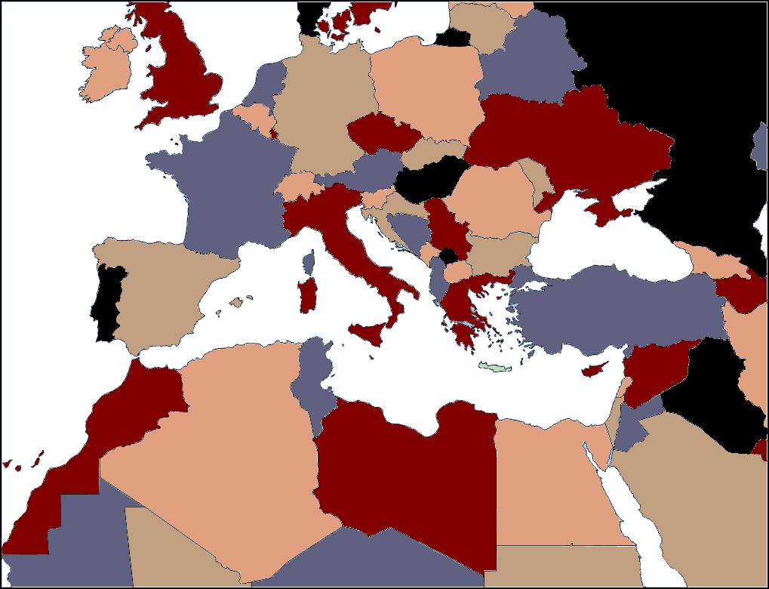
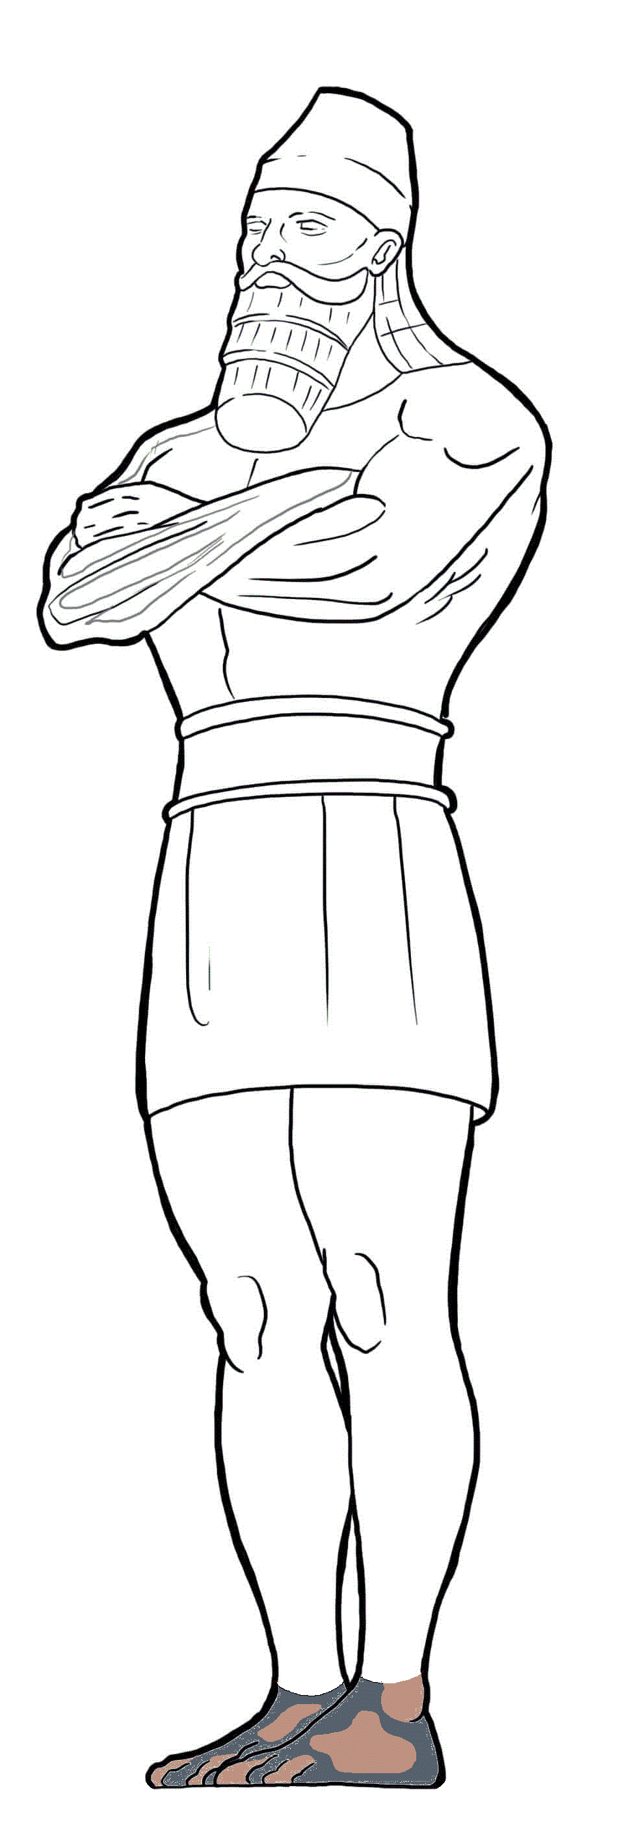
Modern Nations
“The Latter Days”
Feet
of Iron & Clay
Tap the screen to return to the Menu Board

Slide 336
Daniel 2 & YOU!

Slide 337
Daniel 2 & YOU!
Daniel 2:34-35, 44-45
In Nebuchadnezzar’s dream, the stone that strikes
the image on its feet represents God’s overthrow of ______.
Tap the screen to get answer choices

Slide 338
Daniel 2 & YOU!
Daniel 2:34-35, 44-45
In Nebuchadnezzar’s dream, the stone that strikes
the image on its feet represents God’s overthrow of ______.
Tap your answer
ROME
BABYLON
THE KINGDOMS OF MEN

Slide 339
Daniel 2 & YOU!
Daniel 2:34-35, 44-45
In Nebuchadnezzar’s dream, the stone that strikes
the image on its feet represents God’s overthrow of ______.
2 points
REMARK ABLE!
Tap the screen to continue
THE KINGDOMS OF MEN

Slide 340
Daniel 2 & YOU!
Daniel 2:34-35, 44-45
Are you sure?
Tap and try again
In Nebuchadnezzar’s dream, the stone that strikes
the image on its feet represents God’s overthrow of ______.
BABYLON
ROME
THE KINGDOMS OF MEN

Slide 341
Daniel 2 & YOU!
Daniel 2:34-35, 44-45
In Nebuchadnezzar’s dream, the stone that strikes
the image on its feet represents God’s overthrow of ______.
Tap your answer
ROME
BABYLON
THE KINGDOMS OF MEN

Slide 342
Daniel 2 & YOU!
Daniel 2:34-35, 44-45
In Nebuchadnezzar’s dream, the stone that strikes
the image on its feet represents God’s overthrow of ______.
That’s it!
1 point
Tap the screen to continue
THE KINGDOMS OF MEN

Slide 343
Daniel 2 & YOU!
Daniel 2:34-35, 44-45
The answer is …
In Nebuchadnezzar’s dream, the stone that strikes
the image on its feet represents God’s overthrow of ______.
THE KINGDOMS OF MEN
Tap the screen to continue
BABYLON
ROME
THE KINGDOMS OF MEN

Slide 344
Daniel 2 & YOU!
Daniel 2:34-35, 44-45
In Nebuchadnezzar’s dream, the stone that strikes
the image on its feet represents God’s overthrow of THE KINGDOMS OF MEN.
Tap the screen to continue
BABYLON
ROME
THE KINGDOMS OF MEN

Slide 345
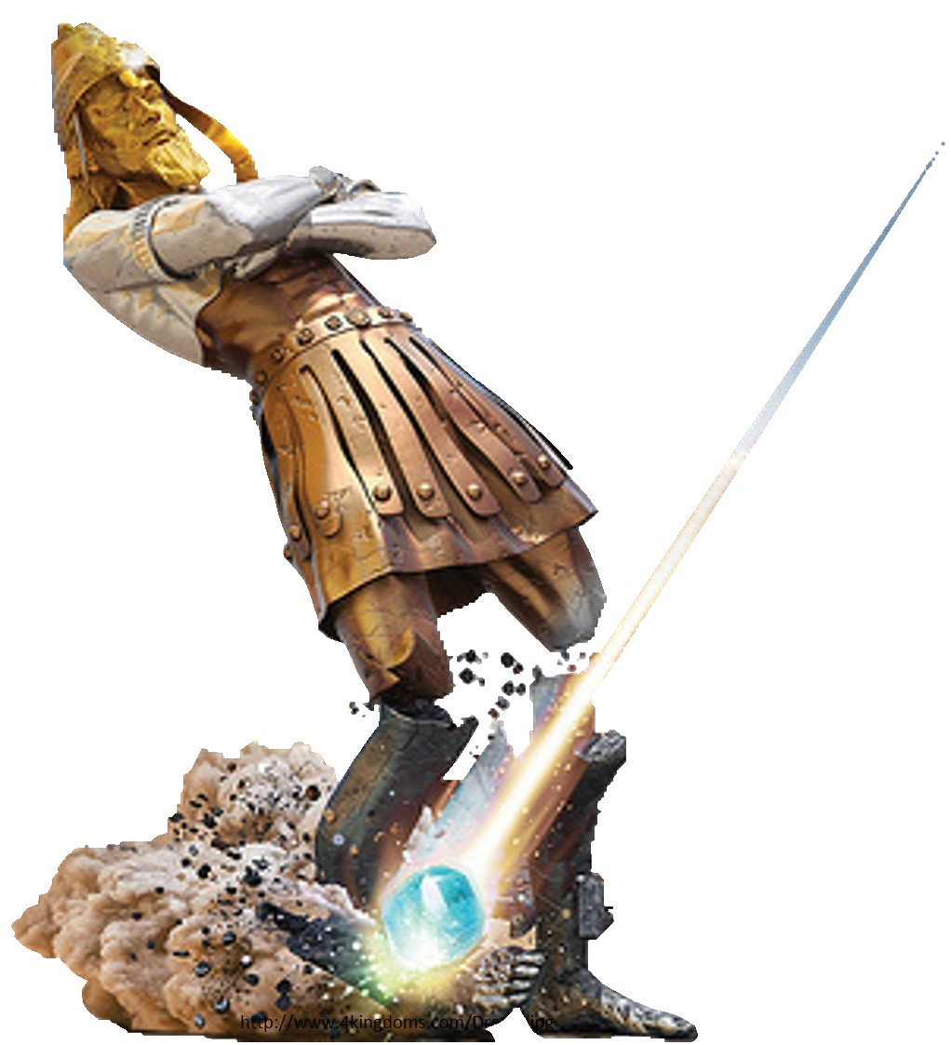
And in the days of those kings the God of heaven will set up a kingdom that shall never be destroyed, nor shall the kingdom be left to another people. It shall break in pieces all these kingdoms and bring them to an end, and it shall stand forever, just as you saw that a stone was cut from a mountain by no human hand, and that it broke in pieces the iron, the bronze, the clay, the silver, and the gold.
Tap the screen
to return to
the Menu Board

Slide 346
Daniel 2 & YOU!

Slide 347
Daniel 2 & YOU!
Daniel 2:44
In Nebuchadnezzar’s dream, the great mountain that fills the whole earth represents the ______.
Tap the screen to get answer choices

Slide 348
Daniel 2 & YOU!
Daniel 2:44
In Nebuchadnezzar’s dream, the great mountain that fills the whole earth represents the ______.
Tap your answer
KINGDOM OF BABYLON
KINGDOM OF GOD
KINGDOMS OF MEN

Slide 349
Daniel 2 & YOU!
Daniel 2:44
In Nebuchadnezzar’s dream, the great mountain that fills the whole earth represents the ______.
THAT’S PERFECT!
2 points
Tap the screen to continue
KINGDOM OF GOD

Slide 350
Daniel 2 & YOU!
Daniel 2:44
Uh Uh!
Tap and try again
In Nebuchadnezzar’s dream, the great mountain that fills the whole earth represents the ______.
KINGDOM OF BABYLON
KINGDOM OF GOD
KINGDOMS OF MEN

Slide 351
Daniel 2 & YOU!
Daniel 2:44
In Nebuchadnezzar’s dream, the great mountain that fills the whole earth represents the ______.
Tap your answer
KINGDOM OF BABYLON
KINGDOM OF GOD
KINGDOMS OF MEN

Slide 352
Daniel 2 & YOU!
Daniel 2:44
In Nebuchadnezzar’s dream, the great mountain that fills the whole earth represents the ______.
1 point
Yes!
Tap the screen to continue
KINGDOM OF GOD

Slide 353
Daniel 2 & YOU!
Daniel 2:44
The answer is …
In Nebuchadnezzar’s dream, the great mountain that fills the whole earth represents the ______.
KINGDOM OF GOD
Tap the screen to continue
KINGDOM OF BABYLON
KINGDOM OF GOD
KINGDOMS OF MEN

Slide 354
Daniel 2 & YOU!
Daniel 2:44
In Nebuchadnezzar’s dream, the great mountain that fills the whole earth represents the KINGDOM OF GOD.
Tap the screen to return to the Menu Board
KINGDOM OF BABYLON
KINGDOM OF GOD
KINGDOMS OF MEN

Slide 355
Daniel 2 & YOU!

Slide 356
Daniel 2 & YOU!
Daniel 2:45
Daniel told King Nebuchadnezzar, “The dream is certain, and its interpretation is ______.”
Tap the screen to get answer choices

Slide 357
Daniel 2 & YOU!
Daniel 2:45
Daniel told King Nebuchadnezzar, “The dream is certain, and its interpretation is ______.”
Tap your answer
LIKELY
POSSIBLE
SURE

Slide 358
Daniel 2 & YOU!
Daniel 2:45
Daniel told King Nebuchadnezzar, “The dream is certain, and its interpretation is ______.”
IT SURE IS!
2 points
Tap the screen to continue
SURE

Slide 359
Daniel 2 & YOU!
Daniel 2:45
Much more!
Tap and try again
Daniel told King Nebuchadnezzar, “The dream is certain, and its interpretation is ______.”
LIKELY
POSSIBLE
SURE

Slide 360
Daniel 2 & YOU!
Daniel 2:45
Daniel told King Nebuchadnezzar, “The dream is certain, and its interpretation is ______.”
Tap your answer
LIKELY
POSSIBLE
SURE

Slide 361
Daniel 2 & YOU!
Daniel 2:45
Daniel told King Nebuchadnezzar, “The dream is certain, and its interpretation is ______.”
1 point
Alright!
Tap the screen to continue
SURE

Slide 362
Daniel 2 & YOU!
Daniel 2:45
The answer is …
Daniel told King Nebuchadnezzar, “The dream is certain, and its interpretation is ______.”
SURE
Tap the screen to continue
LIKELY
POSSIBLE
SURE

Slide 363
Daniel 2 & YOU!
Daniel 2:45
Daniel told King Nebuchadnezzar, “The dream is certain, and its interpretation is SURE.”
Tap the screen to return to the Menu Board
LIKELY
POSSIBLE
SURE

Slide 364
Daniel 2 & YOU!

Slide 365
Daniel 2 & YOU!
Daniel 2:47
When Daniel explained the dream to Nebuchadnezzar, the king ______.
Tap the screen to get answer choices

Slide 366
Daniel 2 & YOU!
Daniel 2:47
When Daniel explained the dream to Nebuchadnezzar, the king ______.
Tap your answer
PRAISED DANIEL’S GOD
REBUKED HIS WISE MEN
PRAISED HIS GODS

Slide 367
Daniel 2 & YOU!
Daniel 2:47
When Daniel explained the dream to Nebuchadnezzar, the king ______.
SOOO…
TRUE!
2 points
Tap the screen to continue
PRAISED DANIEL’S GOD

Slide 368
Daniel 2 & YOU!
Daniel 2:47
Not this time!
Tap and try again
When Daniel explained the dream to Nebuchadnezzar, the king ______.
PRAISED DANIEL’S GOD
REBUKED HIS WISE MEN
PRAISED HIS GODS

Slide 369
Daniel 2 & YOU!
Daniel 2:47
When Daniel explained the dream to Nebuchadnezzar, the king ______.
Tap your answer
PRAISED DANIEL’S GOD
REBUKED HIS WISE MEN
PRAISED HIS GODS

Slide 370
Daniel 2 & YOU!
Daniel 2:47
When Daniel explained the dream to Nebuchadnezzar, the king ______.
1 point
Yay!
Tap the screen to continue
PRAISED DANIEL’S GOD

Slide 371
Daniel 2 & YOU!
Daniel 2:47
The answer is …
When Daniel explained the dream to Nebuchadnezzar, the king ______.
PRAISED DANIEL’S GOD
Tap the screen to continue
PRAISED DANIEL’S GOD
REBUKED HIS WISE MEN
PRAISED HIS GODS

Slide 372
Daniel 2 & YOU!
Daniel 2:47
When Daniel explained the dream to Nebuchadnezzar, the king PRAISED DANIEL’S GOD.
Tap the screen to continue
PRAISED DANIEL’S GOD
REBUKED HIS WISE MEN
PRAISED HIS GODS

Slide 373
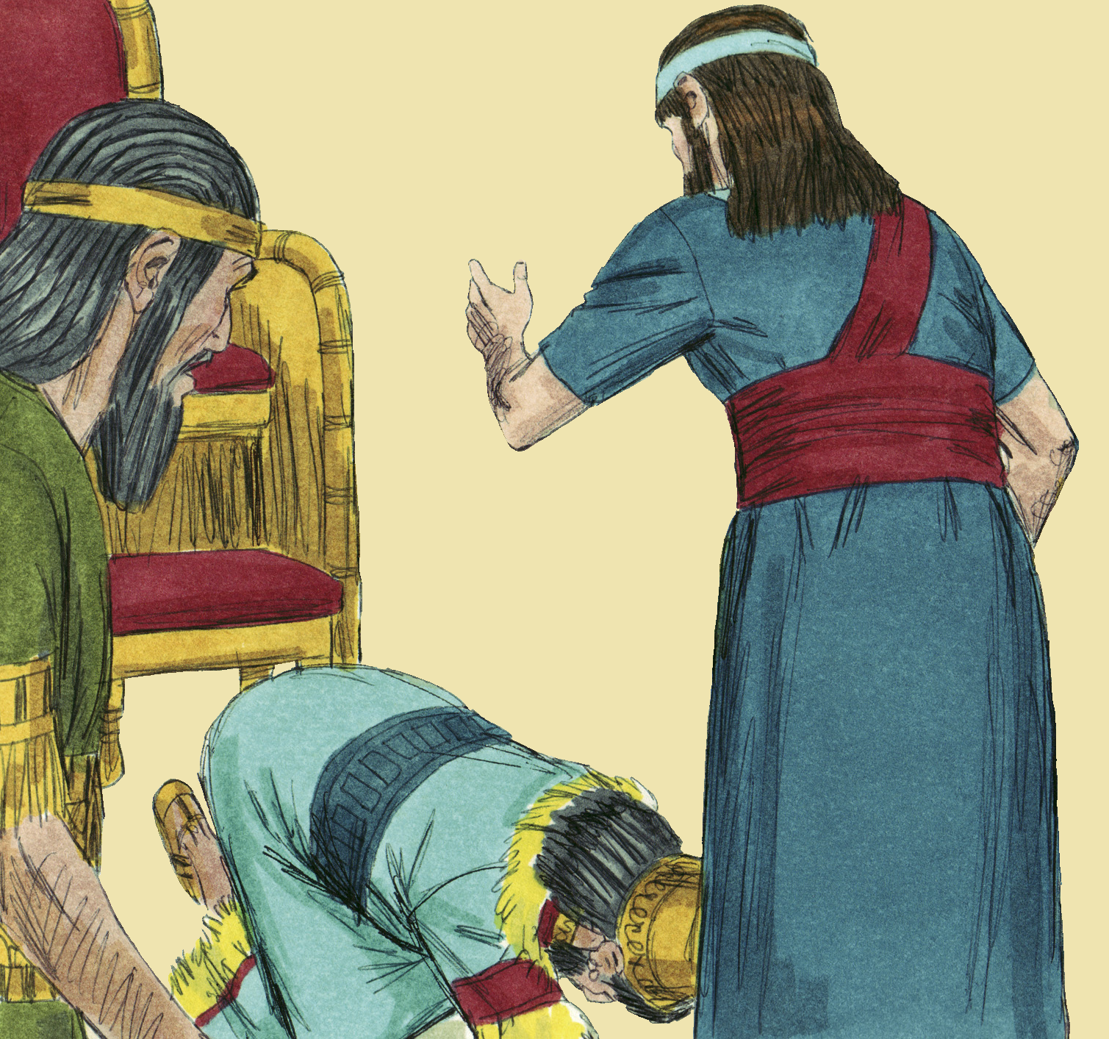
Then King Nebuchadnezzar fell upon his face and paid homage to Daniel, and commanded that an offering and incense be offered up to him. The king answered and said to Daniel, “Truly, your God is God of gods and Lord of kings, and a revealer of mysteries, for you have been able to reveal this mystery.”
Tap the screen to return to the Menu Board
www.unfoldingword.org/sweet-publishing

